Slide 1
SARI CLINICAL care Training Clinical syndromes
25 January 2020

Slide 2
Learning objectives
At the end of this lecture, you will be able to:
Describe the importance of early recognition of patients with SARI.
Recognize patients with severe pneumonia.
Recognize patients with ARDS.
Recognize patients with sepsis and septic shock.
|

Slide 3
SARI
25 January 2020
S | SEVERE
A | ACUTE
R | RESPIRATORY
I | INFECTION

Slide 4
COVID- 2019
COVID-2019 is associated with a broad clinical spectrum of disease.
Most patients appear to have mild disease: common symptoms include fever, cough, sore throat, fatigue, myalgia.
It is estimated that 15 % have severe disease, which includes severe pneumonia and sepsis; and 5% have critical illness.
Of these, some patients progress to acute respiratory failure requiring mechanical ventilation. Death has occurred in 0.3-5%) of cases, but CFR estimate still not available.

Slide 5
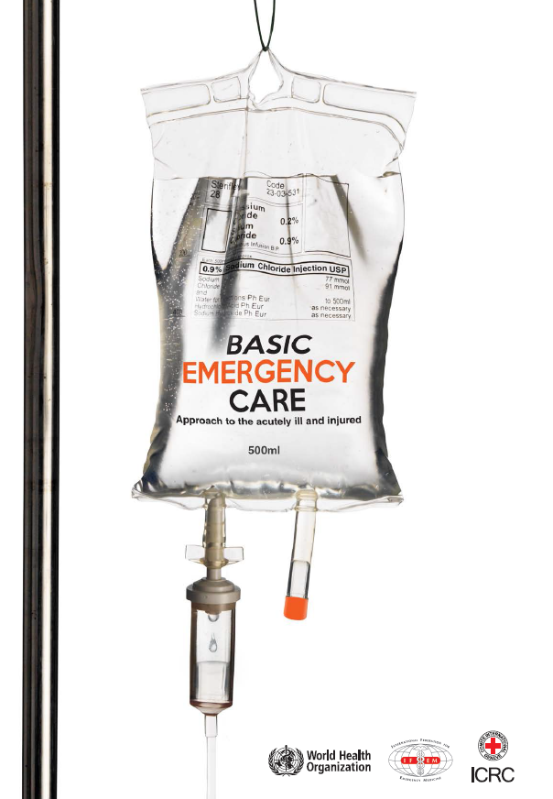
Severe presentations of COVID-19
Patients who present with severe manifestations of COVID-19 may present with:
Severe difficulty breathing
Shock (from sepsis)
Altered mental status (for example, from lack of oxygenation to the brain)
WHO/ICRC Basic Emergency Care course teaches a systematic approach to assessment and management of these time sensitive conditions in the acutely ill
Targeted toward frontline providers with limited diagnostic and therapeutic resources
https://www.who.int/publications-detail/basic-emergency-care-approach-to-the-acutely-ill-and-injured
PDF, Powerpoints: https://www.who.int/publications-detail/basic-emergency-care-approach-to-the-acutely-ill-and-injured
Apple App Store: https://apps.apple.com/us/app/basic-emergency-care/id1485810807
Google Play Store: https://play.google.com/store/apps/details?id=com.enginious.bec.ucsf&hl=en
Notes:
https://www.who.int/publications-detail/basic-emergency-care-approach-to-the-acutely-ill-and-injured
PDF, Powerpoints: https://www.who.int/publications-detail/basic-emergency-care-approach-to-the-acutely-ill-and-injured
Apple App Store: https://apps.apple.com/us/app/basic-emergency-care/id1485810807
Google Play Store: https://play.google.com/store/apps/details?id=com.enginious.bec.ucsf&hl=en

Slide 6
Severe presentations of COVID-19
Pneumonia
ARDS
Sepsis and Septic Shock

Slide 7
Uncomplicated illness | Uncomplicated upper respiratory tract viral infection, they may not have specific symptoms such as fever, cough, sore throat, nasal congestion, malaise, headache or muscle pain. These patients don´t have any signs of dehydration, sepsis or shortness of breath
Mild Pneumonia | Adolescent or adult: fever or suspected respiratory infection, plus one of: respiratory rate> 30 breaths/min, severe respiratory distress or SpO2<90% on room air. Child: with cough or difficulty in breathing, plus at least one of the following: central cyanosis or SpO2<90%, severe respiratory distress (e.g. grunting, very severe chest indrawing); signs of pneumonia with a danger sign: inability to breastfeed or drink, lethargy or unconsciousness, or convulsions. Other signs of pneumonia may be present: chest indrawing, fast breathing (in breaths/min): <2 months> 60,;2-11 months> 50;1-5 years >40. The diagnosis is clinical; chest imaging can exclude complications.
Acute Respiratory Distress Syndrome (ARDS) | Onset: new or worsening respiratory symptoms with one week on known clinical insult Chest Imaging (CXR, CT scan, Lung US): bilateral opacities, not fully explained by effusions, lobar or lung collapse or nodules. Origin of oedema: Respiratory failure not fully explained by cardiac failure or fluid overload. Need objective assessment (if available Echocardiogram) to exclude hydrostatic cause of oedema if no risk factor present Oxygenation (adults): SpO2/FiO2<315 suggests ARDS Mild: between 300-200 Moderate: 200-100 Severe: <100
Sepsis | Life-threatening organ dysfunction caused by a dysregulated host response to suspected or proven infection, with organ dysfunction*. Signs of organ dysfunction include: altered mental status, difficulty or fast breathing, low oxygen saturation, reduced urine output, fast heart failure, weak pulse, cold extremities or low blood pressure, skin mottling or laboratory evidence of coagulopathy, thrombocytopenia, acidosis, high lactate or hyperbilirubinemia.
Septic Shock | Adults: Persisting hypotension despite volume resuscitation, requiring vasopressors to maintain MAP >or=65 mmHg and serum Lactate < 2mmol/L Children: any hypotension or 2-3 of the following: altered mental state, tachycardia or bradycardia (HR< 90 bpm or >160 bpm in infants, HR <70bpm or >150 bpm in children), prolonged capillary refill (>2 sec) or warm vasodilation with bounding pulses, tachypnea, mottled skin or petechial or purpuric rash, increased lactate, oliguria, hyperthermia or hypothermia.

Slide 8
PNEUMONIA

Slide 9
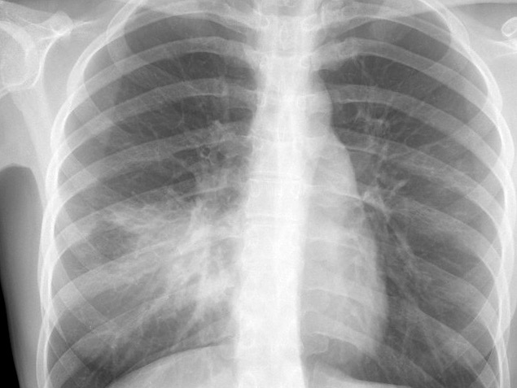
Pneumonia
Fever or suspected respiratory infection, plus one of: respiratory rate> 30 breaths/min, severe respiratory distress or SpO2<90% on room air.
Lower respiratory tract infections (pneumonia) and diarrhoea are the second leading cause of death and disability-adjusted life years lost in adults and children globally.
Global Burden of Disease Study (http://vizhub.healthdata.org/gbd-compare/)

Slide 10
Common symptoms of community acquired pneumonia (CAP)- Adults
Fever and cough
Sputum production
Haemoptysis
Difficulty breathing
Pleuritic chest pain
Chest radiograph recommended to make diagnosis.
Courtesy of Dr. Harry Shulman at http://chestatlas.com/cover.htm
|

Slide 11
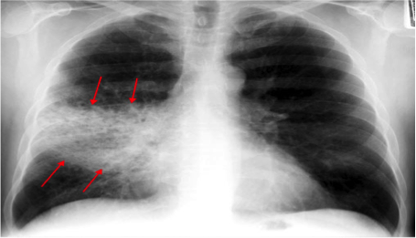
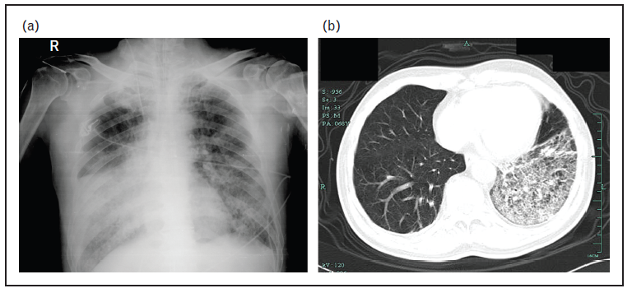
Radiological findings are non-specific
Bacterial pneumonia
H7N9

Slide 12
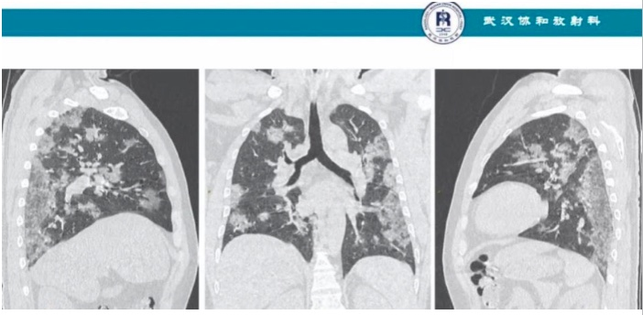
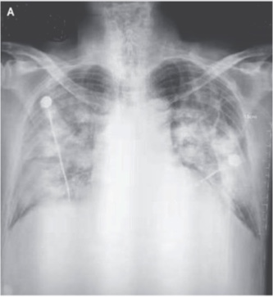
Radiological findings are non-specific
MERS
COVID 19
Za Nau et al. A Novel Coronavirus from Patients with Pneumonia in China, 2019. DOI: 10.1056/NEJMoa2001017
Courtesy Wuhan State Hospital

Slide 13
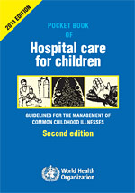
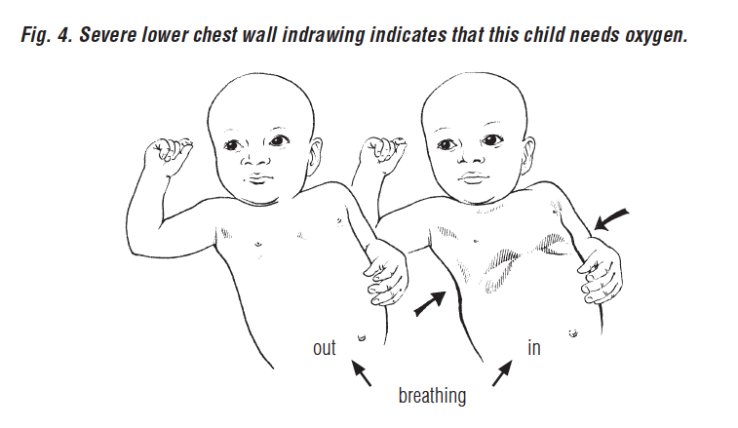
Recognize severe pneumonia
Pneumonia Children
Non-severe pneumonia
Severe pneumonia
Cough or difficulty breathing and
≥ 1 of the following:
signs of pneumonia with a general danger sign:
lethargy or unconscious
convulsions
inability to breastfeed or drink.
central cyanosis, SpO₂ < 90%
severe respiratory distress
grunting, very severe chest indrawing.
≥ 50 breaths/min in child aged 2–12 months
≥ 40 breaths/min in child aged 1–5 years
chest indrawing
|
Notes:
Signs of pneumonia: (not severe):
-Fast breathing + chest indrawing
≥ 50 BPM in child aged 2-11 months
->40 BPM, in child agedn 12 months to 5 years

Slide 14
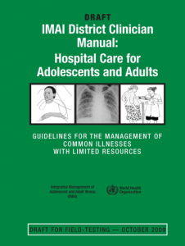
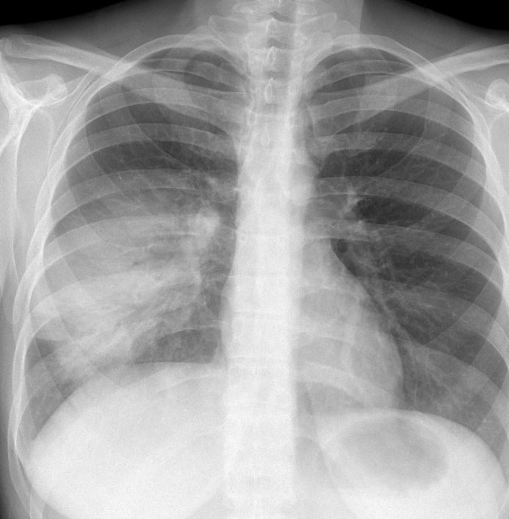
Recognize severe pneumonia
Fever and cough
RR > 30/min
SpO₂ < 90% on room air
Severe respiratory distress:
inability to speak
use of accessory muscles.
Courtesy of Dr. Harry Shulman at http://chestatlas.com/cover.htm
|

Slide 15
Pneumonia severity scores (1/2)
Severity scores can guide decision-making process regarding hospitalization and ICU admission:
must be used alongside clinical judgement
validate scoring system in your setting.
For example, the CURB-65 score includes:
Confusion
Urea > 7 mmol/L
RR ≥ 30 breaths/min
Blood pressure (SBP < 90 mmHg or DBP ≤ 60 mmHg)
Age > 65.
|
Notes:
Score 0-1 can be suitable for treatment at home. When deciding home treatment, always take into account the patient’s social circumstances and wishes.

Slide 16
Pneumonia severity scores (2/2)
Higher score is associated with higher risk of death:
score 0–1, low risk of death
may be suitable for treatment at home, always take into account the patient’s social circumstances and wishes
score 2, moderate risk of death,
consider for short stay hospitalization or close outpatient treatment
score ≥ 3, high risk of death
4–5 consider for ICU hospitalization.
|
Notes:
Score 0-1 can be suitable for treatment at home. When deciding home treatment, always take into account the patient’s social circumstances and wishes.

Slide 17
ACUTE RESPIRATORY DISTRESS SYNDROME (ards)

Slide 18
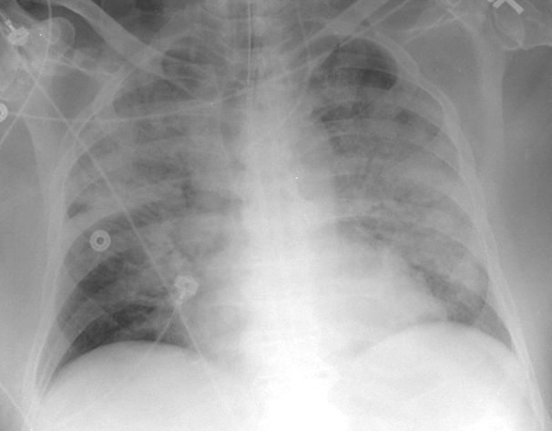
Acute respiratory distress syndrome (ARDS)
Courtesy Dr. WR Webb/UCSF
Notes:
??? Cofirm mortality data from Lung Safe study

Slide 19
ARDS
25 January 2020
A | ACUTE
R | RESPIRATORY
D | DISTRESS
S | SYNDROME

Slide 20
Acute respiratory distress syndrome (ARDS)
In adults, ARDS accounts for 10.4 % ICU admissions; 23% of patients on mechanical ventilation. Mortality ranges between 35–46% (Lung Safe, JAMA, 2016). Older age, active neoplasm, haematologic neoplasm, chronic liver failure, and more severe disease associated with higher mortality.
ARDS is less common in children, but incidence increases with age. Mortality ranges between18–35%. Concern for under-recognition may lead to underestimation of prevalence (Rota et al. Rev Bras Ter Intensiva. 2015;27(3):266–273).
Notes:
??? Cofirm mortality data from Lung Safe study

Slide 21
Recognize patients with ARDS (1/2)
Rapid progression of severe respiratory distress:
severe shortness of breath
inability to complete full sentences
tachypnoea
use of accessory muscles of respiration
cyanosis (very severe).

Slide 22
Recognize patients with ARDS (2/2)
Severe hypoxaemia requiring high-flow oxygen therapy:
SpO₂/FiO₂ ≤ 315 or SpO₂/FiO₂ ≤ 264.
Early recognition and implementation of lung protective ventilation saves lives.

Slide 23
ARDS: four clinical criteria (1/3) Berlin definition, JAMA 2012
1. Acute onset
≤1 week of known insult or new or worsening respiratory status.
2. Origin of oedema:
Respiratory failure not fully explained by cardiac failure or fluid overload.
Need objective assessment (e.g. echocardiography) to exclude hydrostatic cause of oedema if no risk factor present.

Slide 24
ARDS: four clinical criteria (2/3) Berlin definition, JAMA 2012
3. Severity of oxygenation impairment (if ABG available)
Disease severity | PaO₂/FiO₂ _{(SpO2/FiO2)} | PEEP
Mild ARDS | 200 < x ≤ 300 | ≥ 5 cm H₂O (or CPAP)
Moderate ARDS | 100 < x ≤ 200 | ≥ 5 cm H₂O
Severe ARDS | x ≤ 100 | ≥ 5 cm H₂O
*If altitude is higher than 1000 m, then correction factor should be calculated as follows: PaO₂/FiO₂ x barometric pressure/760 mmHg.

Slide 25
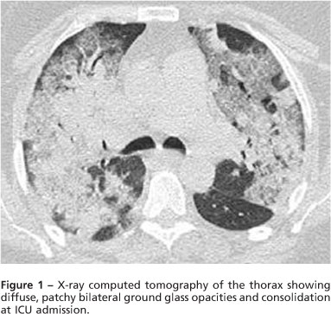
ARDS: four clinical criteria Berlin definition, JAMA 2012
4. Bilateral opacities, not fully explained by effusions, lobar/lung collapse or nodules on chest x-ray or CT.
Courtesy Dr. WR Webb/UCSF

Slide 26
ARDS in resource-limited settings
Kigali-modification of Berlin criteria clinical trial proposed Kigali modification of Berlin criteria for resource-constrained setting
Challenge | Adaptation
No arterial blood gas analyser to assess degree of hypoxaemia | SpO₂/FiO₂ ≤ 315 is ARDS
No mechanical ventilation | Remove PEEP and CPAP from definition
No chest radiograph or CT scan | Use ultrasound to document bilateral chest opacities

Slide 27
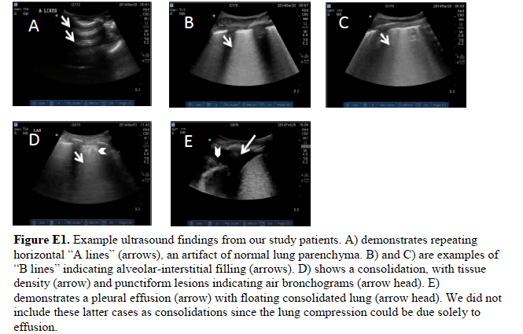
Am J Respir Crit Care Med. 2015 Sep 9
ARDS defined as B-lines and/or consolidations present without effusions on both sides.

Slide 28
ARDS in infants and children (1/2)
International consensus statement suggests alternate definition for infants and children.
Challenge | Adaptation
Arterial blood gas analysis less commonly used in children | SpO₂ is acceptable alternative to PaO₂ PaO₂/FiO₂ ≤ 300 or SpO₂ /FiO₂ ≤ 264

Slide 29
ARDS in infants and children (2/2)
Disease severity | OSI (oxygen saturation index) | Oxygen index (OI)
Mild ARDS | 5 ≤ x < 7.5 | 4 ≤ x < 8
Moderate ARDS | 7.5 ≤ x < 12.3 | 8 ≤ x < 16
Severe ARDS | ≥ 12.3 | ≥ 16
OSI = FiO₂ X (mean airway pressure X 100)/SpO₂
OI = FiO₂ X (mean airway pressure X 100)/PaO₂
Mean airway pressure = (Ti x PIP) + (Te x PEEP) ÷Tt

Slide 30
Reminder: always consider other causes of diffuse alveolar infiltrates
Acute heart failure.
Other acute pneumonias (not primary infection):
e.g. acute interstitial pneumonia, hypersensitivity pneumonitis, cryptogenic organizing pneumonia, eosinophilic pneumonia.
Diffuse alveolar haemorrhage:
e.g. associated with autoimmune diseases.
Malignancy:
e.g. bronchoalveolar cell carcinoma.
.

Slide 31
Sepsis

Slide 32
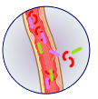
Sepsis
Sepsis and septic shock are medical emergencies. Treatment and resuscitation should begin immediately (Surviving Sepsis Campaign, 2016).
Global estimate: 49 million cases of hospital-treated sepsis leading to 11 million deaths annually
(Lancet 2020)*.
© WHO
*Kempker J, Martin S. A global accounting of sepsis
Lancet 2020:295(10219);168-170

Slide 33
Importance of early recognition of sepsis in SARI patients
Early identification of patients with SARI with sepsis and implementation of early, evidence-based therapies improves outcomes and reduces mortality.
Implementing the Surviving Sepsis Campaign (2016) saves lives:
➔antimicrobial therapy within 1 hour
➔early, targeted resuscitation for septic shock
➔early application of lung protective ventilation for ARDS
Lack of early recognition is a major obstacle!

Slide 34
25 January 2020
SEPSIS
Suspected or documented infection
And acute, life-threatening organ dysfunction
Caused by dysregulated host response to infection.

Slide 35
SEPSIS-3: consensus (JAMA, 2016)
Current definition of sepsis:
suspected or documented infection
And acute, life-threatening organ dysfunction
caused by dysregulated host response to infection.
|

Slide 36
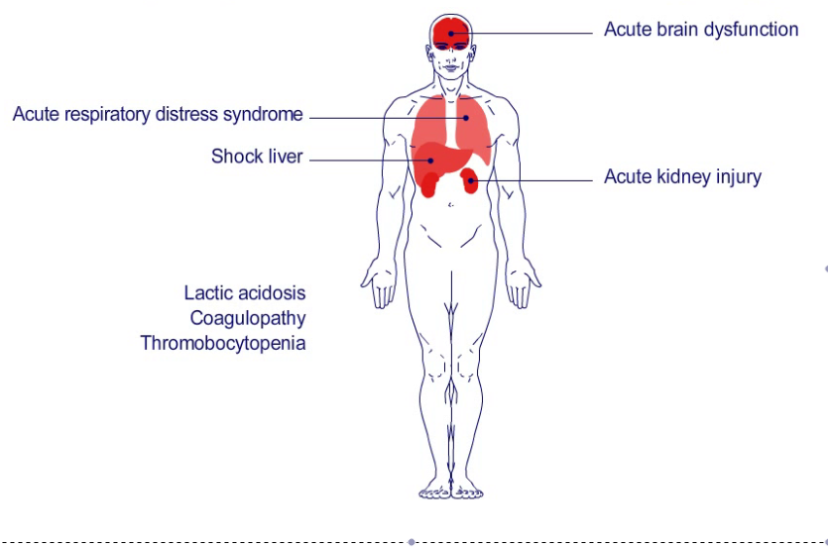
Brain
confusion, lethargy, coma
Lungs
hypoxemia, acute respiratory distress syndrome
Cardiovascular
hypotension, hypoperfusion, shock
Kidney
oliguria, elevated creatinine, acute kidney injury
Liver
transaminitis, elevated bilirubin
Gastrointestinal
ileus
Hematologic
coagulopathy, thrombocytopenia
Lactic acidosis
|

Slide 37
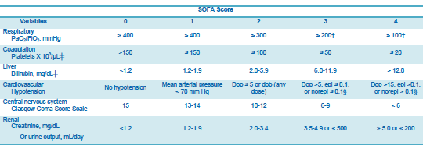
Sepsis-3 and SOFA score calculation
Sepsis = acute change of ≥ 2 points in the SOFA from baseline (if available).

Slide 38
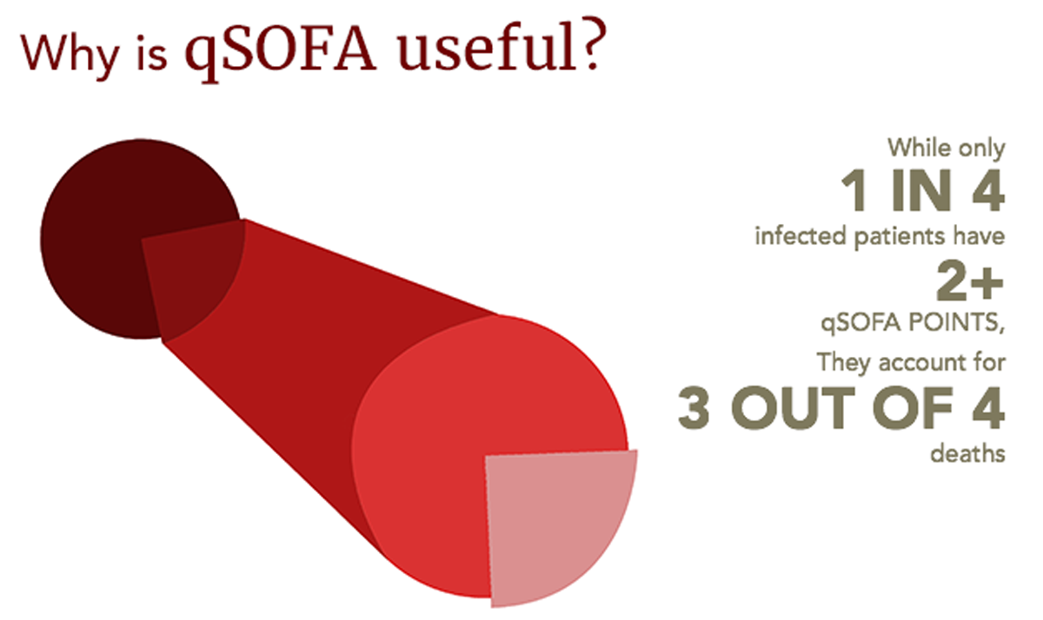
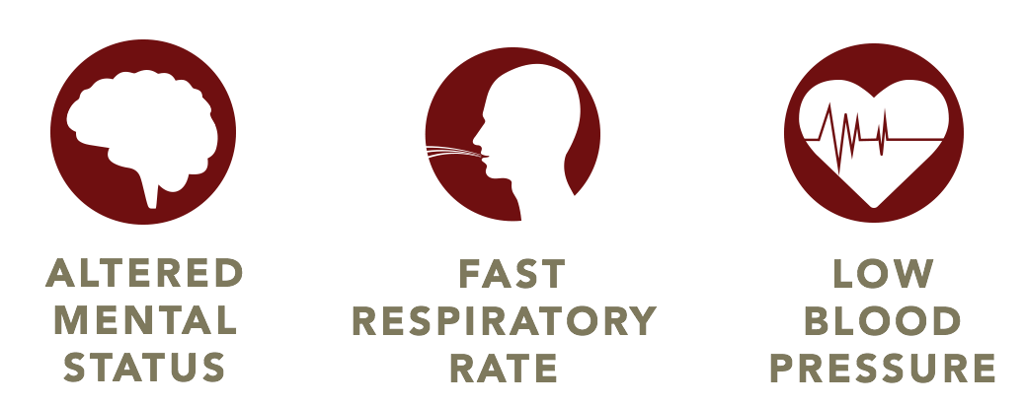
Sepsis-3 and qSOFA
www.jamasepsis.com
www.qsofa.org
In patient with suspected infection, the presence of ≥ 2 of the following associated with increase risk of death:
alteration in sensorium
RR ≥ 22 breaths/min
SBP ≤ 100 mmHg.
Notes:
Check recent data on qSOFA validation

Slide 39
SEPSIS-3: consensus (JAMA, 2016)
Current definition of septic shock (subset of sepsis):
circulatory, cellular and metabolic dysfunction associated with higher mortality
hypotension unresponsive to fluid challenge
requires vasopressors to maintain mean arterial pressure of 65 mmHg or greater
serum lactate > 2 mmol/L (when available).
|

Slide 40
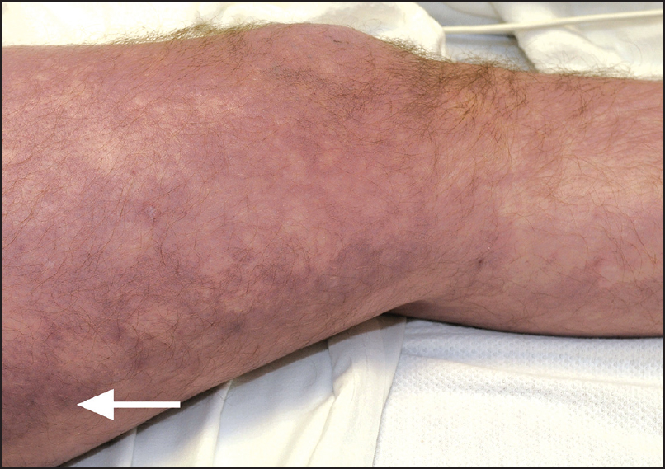
Clinical features of shock
Hypotension:
SBP < 100 mmHg or MAP < 65 mmHg, or
SBP decrease of > 40 mmHg of baseline.
Clinical signs of hypoperfusion:
altered sensorium
prolonged capillary refill
mottling of the skin
reduced urine output.
Elevate serum lactate > 2 mmol/L.
|

Slide 41
A spectrum of disease Sepsis → septic shock
Life-threatening organ dysfunction
Infection
SEPSIS
SEPTIC SHOCK
|
Notes:
RC Bone, et al. Chest 1992; 101: 1649-1655.

Slide 42
Sepsis in children
Many similarities with adults.
Children with SARI also have sepsis.
New consensus definitions more similar to adults coming in the near future.
|

Slide 43
Clinical features of shock in child
Mental status alteration:
irritability, inappropriate crying, confusion
drowsiness, poor interaction, lethargy, or unarousable.
Capillary refill abnormalities:
prolonged capillary refill
flash capillary refill.
Abnormal peripheral pulses:
weak distal pulses
widened pulse pressure (bounding pulses).
Cool or mottled extremities
Hypotension (late finding in children)
|

Slide 44
Shock definition WHO ETAT 2016
The presence of all three clinical criteria required to diagnose shock:
delayed capillary refill > 3 sec, and
cold extremities, and
weak and fast pulse.
or, frank hypotension (age-related SBP or MAP).
Age | < 1 month | 1–12 months | 1–12 years | > 12 years
SBP | < 50 | < 70 | 70 + (2 × age) | < 90
|

Slide 45
Shock definition PALS 2015 (1/2)
Fluid-unresponsive hypotension (age-related SBP or MAP)
Need for vasopressor
Delayed capillary refill
Core to peripheral temperature gap > 3 ºC.
Age | < 1 month | 1–12 months | 1–12 years | > 12 years
SBP | < 50 | < 70 | 70 + (2 × age) | < 90
|

Slide 46
Shock definition PALS 2015 (2/2)
Oliguria ( < 1 mL/kg/hr).
High lactate (uncommon finding in children and can also be seen in other causes of shock).
Not all criteria need to be present to diagnose shock when using the PALS criteria.
|

Slide 47
Sepsis and mortality
Higher mortality associated with increased severity.
Higher mortality in settings with resource limitations.
In children, recent study in PICUs suggest an 8% prevalence and mortality of 25%, similar to adults.
|

Slide 48
Reminder: always consider simultaneous cause of shock
Cardiogenic
impaired cardiac contractility (e.g. myocardial ischemia).
Haemorrhagic
massive blood loss (e.g. gastrointestinal bleed, trauma).
Hypovolaemic
severe diarrheal illness (e.g. cholera).
Neurogenic
acute spinal cord injury (e.g. trauma).
Obstructive
cardiac tamponade, massive pulmonary embolism.
Endocrine
adrenal insufficiency (e.g. disseminated TB).
If clinical examination is unclear about cause of shock, then obtain further hemodynamic assessment (i.e. cardiac ultrasound) to guide therapy.

Slide 49
Summary
Early identification of patients with SARI with sepsis allows implementation of early evidence-based therapies and saves lives.
Suspect severe pneumonia when patient has clinical pneumonia and a rapid RR, signs of respiratory distress, or low SpO₂ < 90%.
Suspect ARDS when patient has rapid progression of severe respiratory distress, severe hypoxaemia and bilateral chest opacities.
Suspect sepsis when patient has infection and life-threatening organ dysfunction.
Suspect septic shock when patient has signs of tissue hypoperfusion or shock refractory to fluid challenge.

Slide 50
Acknowledgements
Contributors
Dr Carlos Grijalva, Vanderbilt University, Nashville, USA
Dr Neill Adhikari, Sunnybrook Health Sciences Centre, Toronto, Canada
Dr Janet V Diaz, WHO Consultant, San Francisco, USA
Dr Shevin Jacob, University of Washington, Seattle, USA
Dr Niranjan Bhat, Johns Hopkins University, Baltimore, USA
Dr Timothy Uyeki, Centers for Disease Control and Prevention, Atlanta, USA
Dr Steve Webb, Royal Perth Hospital, Australia
Dr Paula Lister, Great Ormond Street Hospital, London, UK
Dr Michael Matthay, University of California San Francisco, USA
Dr Christopher Seymour, University of Pittsburgh Medical Center, USA
Dr Derek Angus, University of Pittsburgh Medical Center, USA
Dr. Niranjan "Tex" Kissoon, British Colombia Children’s Hospital and Snny Hill Health Centre for Children
Dr Stephen Playfor, Royal Manchester Children’s Hospital, UK
Dr Leo Yee Sin, Tan Tock Seng Hospital, Communicable Disease Centre, Singapore

