Slide 1
triage, early recognition and referral of patients with Severe Acute respiratory infection (SARI): COVID-19

Slide 2
Learning objectives
9 March 2020
Describe first steps of managing patients who present with acute respiratory infection (ARI)
Recognize patients with SARI that need emergent care and hospitalization (including ICU admission)
Describe first steps of managing critically ill patients with severe acute respiratory infection (SARI)
Describe triage process and tool
Describe IPC interventions at all times
Recognize patients with uncomplicated influenza-like illness (ILI) that can safely go home
Coordinate safe patient transfer

Slide 3
Principles of caring for patients with ARI
Screen and apply appropriate IPC precautions immediately
Triage and recognize the critically ill patient early
Treat with evidence-based, supportive therapies as soon as possible (later lecture)
Treat the underlying aetiology as soon as possible (later lecture)
Monitor-record-interpret-respond (later lecture)
Deliver quality care (later lecture)
If a patient is suspected to have a novel or emerging viral infection, notify health officials as soon as possible.

Slide 4
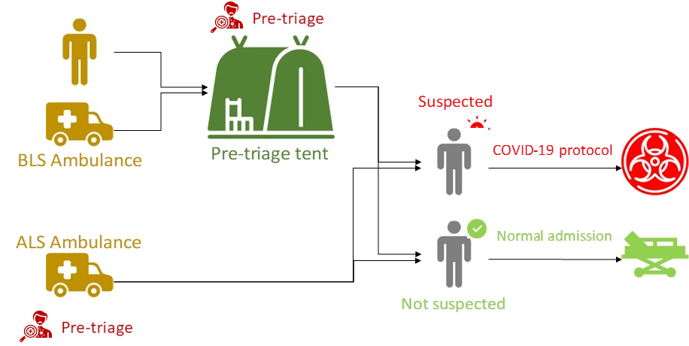
Set up your referral pathways now!

Slide 5
Pre-hospital setting
Emergency medical services with dedicated medical command centre (or dedicated line) for referral at regional that reports to national level.
Dedicated ambulance service to move suspect patients from community to designated health facility. Ensure that IPC measures are always respected during patient retrieval and transport. .
Consider expanded screening/triage services in certain areas (i.e. fever clinics)
If a patient is suspected to have a novel or emerging viral infection, notify health officials as soon as possible.
If a patient is suspected to have a novel or emerging viral infection, notify health officials as soon as possible.

Slide 6
Case definition
Step 1: Screening
Suspect case:
A patient with acute respiratory illness (fever and at least one sign/symptom of respiratory disease (e.g. cough, shortness of breath), AND with no other etiology that fully explains the clinical presentation AND a history of travel to or residence in a country/area or territory reporting local transmission (See situation report) of COVID-19 disease during the 14 days prior to symptom onset.
OR
A patient with any acute respiratory illness AND having been in contact with a confirmed or probable COVID19 case (see definition of contact) in the last 14 days prior to onset of symptoms;
OR
A patient with severe acute respiratory infection (fever and at least one sign/symptom of respiratory disease (e.g., cough, shortness breath) AND requiring hospitalization AND with no other etiology that fully explains the clinical presentation.

Slide 7
Case definition (2)
Probable case:
A suspect case for whom testing for COVID-19 is inconclusive.
* Inconclusive being the result of the test reported by the laboratory
Confirmed case:
A person with laboratory confirmation of COVID-19 infection, irrespective of clinical signs and symptoms. .

Slide 8
Facility level activities during COVID-19
Step 2: Separate suspect
If the case definition is met, the patient should immediately be given a mask and directed to a separate area (an isolation room if available). At least 1 meter distance should be kept between suspected patients and other patients.
Step 3: Triage (acuity-based)
Acuity-based triage is the standard method of sorting patients in the medical setting.
Used as the basis for identifying patients who require immediate medical intervention, patients who can safely wait, or patients who may need to be transported to a specific facility based upon their condition.
A standard, validated tool should be used to assess for severity of patients and designation to the appropriate part of the facility or the healthcare system (such as the Integrated Interagency Triage Tool).

Slide 9
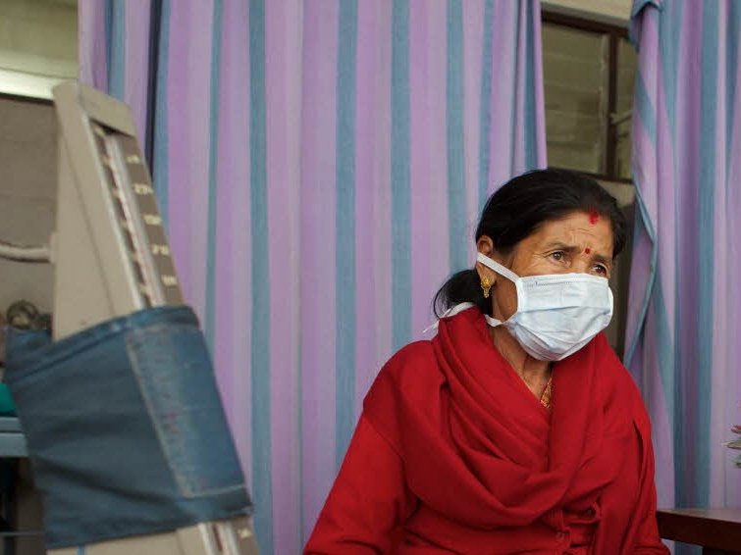
If patient is suspected to have COVID-19, then
Give the suspect patient with ARI a medical mask
Move the patient to a separate area (isolation room, if available)
Instruct the patient to practice respiratory hygiene and hand hygiene and to avoid movements within the facility
Keep at least 1 m distance between patients
© WHO /Tom Pietrasik
Aim to avoid transmission to other patients and to health care workers. But do not delay medical treatments

Slide 10
Identification of suspected case in triage area of health facilities, POE, quarantine hubs (as per case definition)
Isolation of suspected case in Isolation unit
Inform DHMT, surveillance team
Specimen collection and testing as per testing algorithm
Delivery of immediate treatment/care
Positive Test Result
Non-severe
Admission to treatment centre
to non-severe bed
Negative Test Result
Discharged home or
Referred for further care within the facility
Severe
Admission to treatment centre
to critical care bed
Ongoing treatment until final outcome
Safe dignified burial
Discharge after 2 negative PCRs
separated by 24 hours

Slide 11
When providing direct care to suspect COVID-19 patient,
Add contact to droplet precaution measures
HCW should use gown, gloves, medical mask and eye protection when before entering the room where suspected or confirmed COVID-19 patients are admitted.
HCW should use dedicated patient equipment when possible (such as single-use stethoscopes) or disinfect equipment between patients.
Add airborne precautions if there is an emergent need for non-invasive ventilation, intubation, cardiopulmonary resuscitation, or other aerosol-generating procedures
See WHO website for current IPC recommendations for nCoV infection https://www.who.int/publications-detail/infection-prevention-and-control-during-health-care-when-novel-coronavirus-(ncov)-infection-is-suspected-20200125

Slide 12
Droplet precaution
Droplet precautions prevent large droplet transmission of respiratory viruses.
Use a medical mask if working within 1 m of the patient.
Place patients in single rooms, or group together those with the same etiological diagnosis. If an etiological diagnosis is not possible, group patients with similar clinical diagnosis and based on epidemiological risk factors, with a spatial separation.
When providing care in close contact with a patient with respiratory symptoms (e.g. coughing or sneezing), use eye protection (face mask or goggles), because sprays of secretions may occur. Limit patient movement within the institution and ensure that patients wear medical masks when outside their rooms.

Slide 13
Contact precautions
Contact precautions prevent direct or indirect transmission from contact with contaminated surfaces or equipment (i.e. contact with contaminated oxygen tubing/interfaces).
Use PPE (medical mask, eye protection, gloves and gown) when entering room and
remove PPE when leaving and practice hand hygiene following PPE removal. If possible, use either disposable or dedicated equipment (e.g. stethoscopes, blood pressure cuffs, pulse oximeters and thermometers). If equipment needs to be shared among
patients, clean and disinfect between each patient use.
Ensure that health care workers refrain from touching their eyes, nose and mouth with potentially contaminated gloved or ungloved hands. Avoid contaminating environmental surfaces that are not directly related to patient care (e.g. door handles and light switches).
Avoid medically unnecessary movement of patients or transport.
Perform hand hygiene.

Slide 14
Airborne transmission
Ensure that health care workers performing aerosol-generating procedures (e.g. open suctioning of respiratory tract, intubation, bronchoscopy, cardiopulmonary resuscitation) use the appropriate PPE, including gloves, long-sleeved gowns, eye protection, and fit-tested particulate respirators (N95 or equivalent, or higher level of protection).
Whenever possible, use adequately ventilated single rooms when performing aerosol-generating procedures, meaning negative pressure rooms with a minimum of 12 air changes per hour or at least 160 L/second/patient in facilities with natural ventilation.
Avoid the presence of unnecessary individuals in the room. Care for the patient in the same type of room after mechanical ventilation commences.

Slide 15
Triage
At any facility: Health post, primary health centre, or clinic, emergency unit/area/department, accident and emergency department, casualty area
Prioritize and sort patients based on their severity of illness and need for immediate care
Use standardized triage tools to ensure reliability and valid sorting of patients
Avoid “under-triage” and “over-triage”
Identify patients who require immediate medical intervention, patients who can safely wait, or patients who may need to be transported to a specific facility based upon their condition

Slide 16
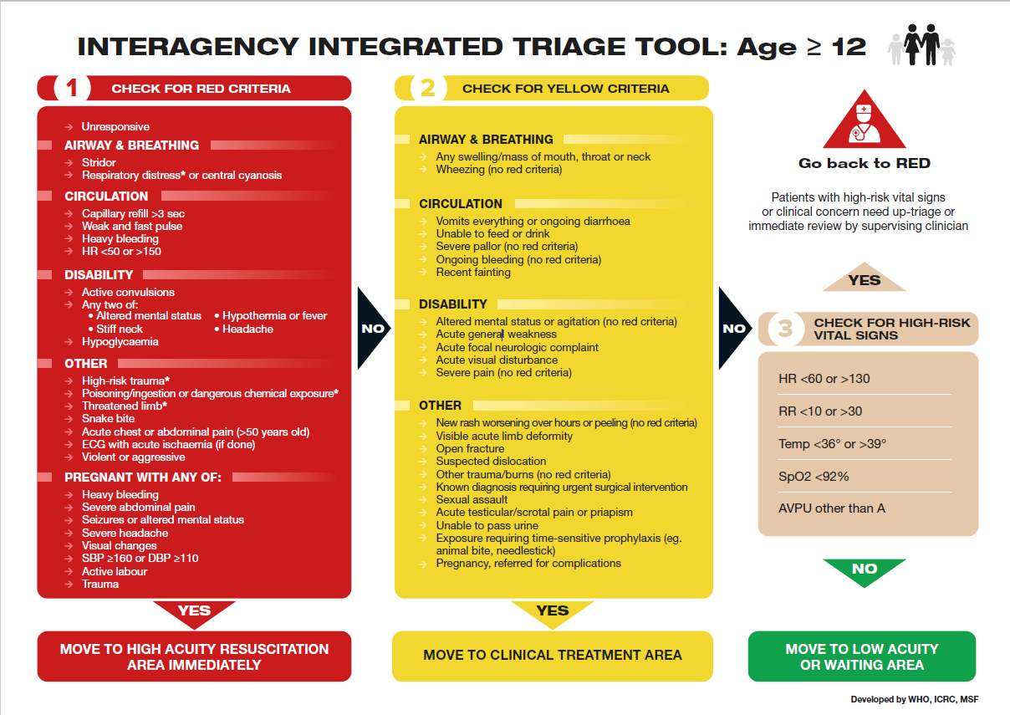
25 January 2020
Interagency
Integrated Triage Tool ≽ 12 years

Slide 17
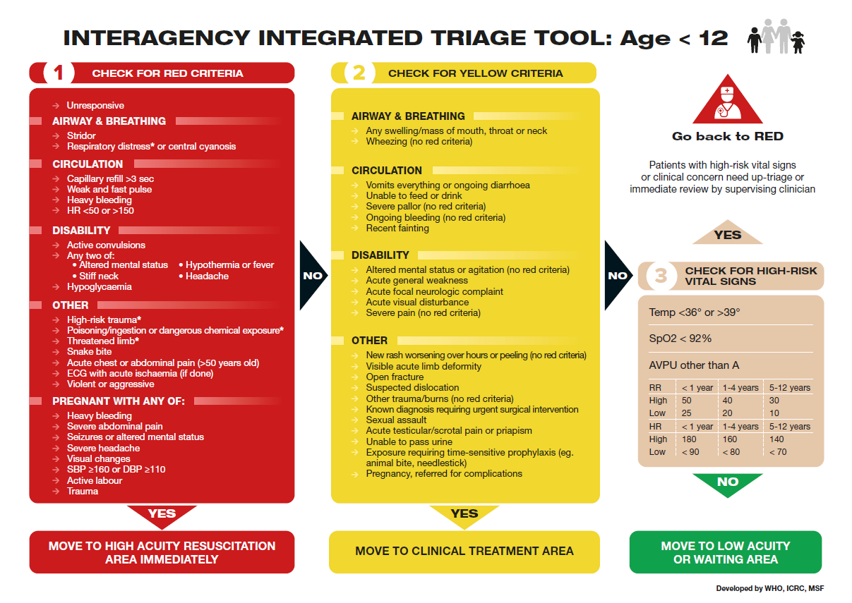
Interagency Integrated Triage Tool < 12 years
25 January 2020

Slide 18
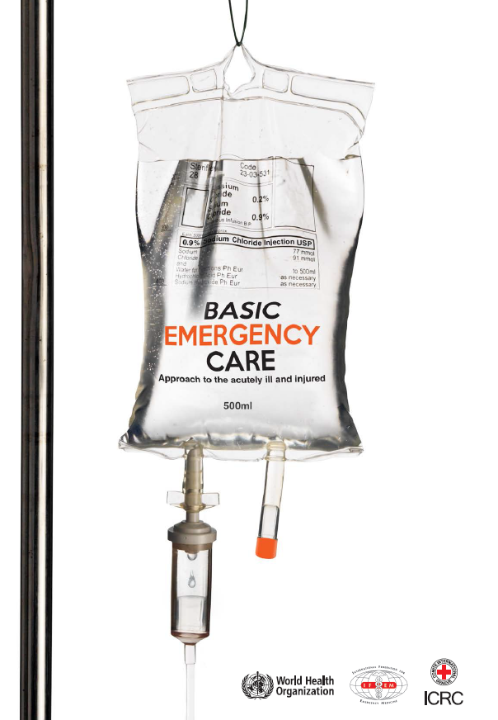
WHO Basic Emergency Care
Open-access, short course
For frontline providers with limited diagnostic and therapeutic resources
Teaches systematic assessment and management of time-sensitive conditions in the acutely ill by focusing on 3 main conditions: difficulty in breathing, shock, altered mental status
French, Spanish translations available for field use; Arabic and Russian translations available soon
PDF, Powerpoints: https://www.who.int/publications-detail/basic-emergency-care-approach-to-the-acutely-ill-and-injured
Apple App Store: https://apps.apple.com/us/app/basic-emergency-care/id1485810807
Google Play Store: https://play.google.com/store/apps/details?id=com.enginious.bec.ucsf&hl=en

Slide 19
Emergency care
Based on clinical condition and available resources:
administer oxygen +/- advanced ventilatory support
if in septic shock, insert peripheral IV and start fluid therapy (see module on clinical syndromes for more)
give appropriate antimicrobial therapies if required, before transfer
obtain appropriate laboratory testing (i.e. respiratory tract swabs, blood cultures, chest radiograph, CBC).
Do NOT delay life-saving treatments.
Early treatment reduces mortality.

Slide 20
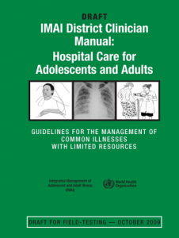
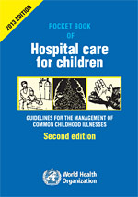
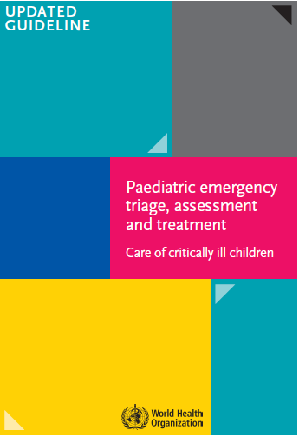
WHO hospital care handbooks
Emergency treatments for clinical use
IMAI quick check
Pocket book
IMCI emergency triage, assessment
and treatment.
.
2011
2013
2016

Slide 21
Risk factors for severe disease (COVID-19 )
9 March 2020
Comorbidities
cardiovascular disease (cardiac failure) (COVID-2019)
pulmonary disease (asthma and COPD)
metabolic disease (diabetes)
kidney disease
hepatic disease
haemoglobinopathies
chronic neurologic conditions (neuromuscular, neurocognitive and seizure disorders).
Extremes of age
infants and young children (< 2 years)
elderly (≥ 65). COVID-2019
Immunosuppressive conditions
HIV, immunosuppressive medication, malignancy.
Special situations
children receiving chronic aspirin therapy
pregnancy (up to 2 weeks’ postpartum).
High risks groups should be considered for hospitalization even with mild disease, for close monitoring to detect deterioration and treatment
Notes:
Hospitalization depends on patient factors such as social situations, ability to follow up and resources.

Slide 22
COVID-19: Mild uncomplicated illness
Symptoms are non-specific:
fever and cough within 14 days
sore throat, nasal congestion or rhinorrhea
headache, muscle pain or malaise
diarrhea or vomiting (less common).
elderly or immunosuppressed patients may present with atypical symptoms and may not have fever
NO signs of:
dehydration
shortness of breath
sepsis
These patients need to be isolated for containment, and this can be in hospital, or alternative facility or at home.
See WHO Guidance.

Slide 23
COVID-19: symptoms suggestive of severe illness
Decreased activity, dizziness, decreased urine output.
Increasing breathing difficulties, cyanosis, bloody or coloured sputum, chest pain, noisy breathing.
Confusion, lethargy, coma, weakness, seizures.
Persistent high fever and other symptoms beyond 3 days without signs of resolution.
Children may also present with poor feeding, excessive diarrhea and vomiting.
Educate community members that if they develop any of these symptoms to seek medical care.

Slide 24
COVID-19: clinical signs suggestive of severe illness
Respiratory distress:
fast breathing, shortness of breath, accessory muscle use, cyanosis, grunting, severe chest indrawing, wheezing, stridor.
Cardiovascular/circulatory instability
delayed capillary refill, weak pulse, cool extremities, reduced urine output, low blood pressure.
Neurological instability
alteration of mental status, seizures, irritability, confusion, lethargy.
Severe dehydration, stridor
sunken eyes, very low skin pinch, unable to drink, lethargy.
First responders should recognize these signs and symptoms, start available emergency care and refer the sick patient for hospitalization.

Slide 25
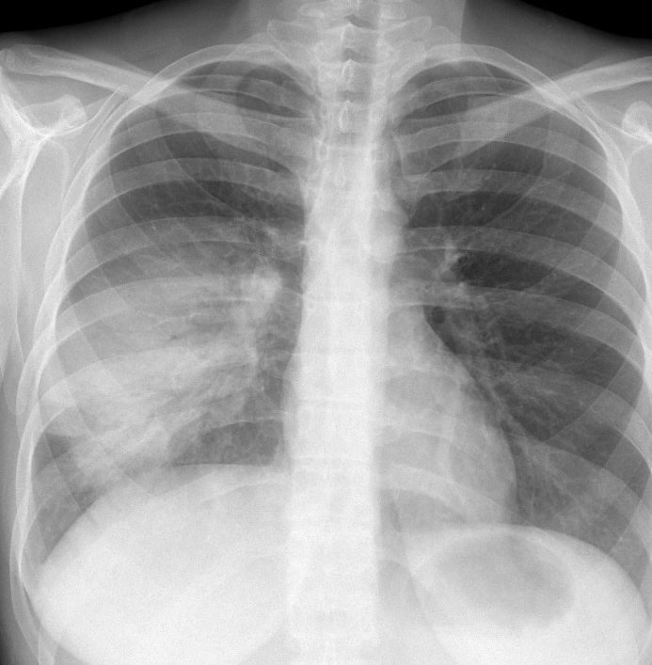
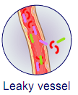
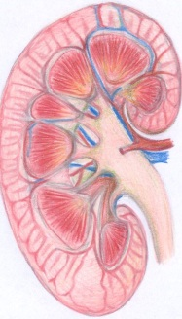
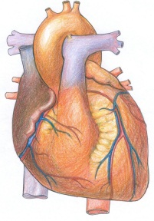
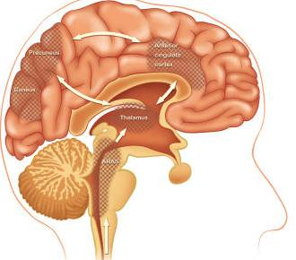
Severe illnesses associated with COVID-19
Severe pneumonia (most common)
Sepsis
Secondary bacterial co-infections
Exacerbations of chronic diseases (i.e. COPD, CHF, DM)
Severe pneumonia
Sepsis
Acute kidney injury
Myocarditis
Encephalitis
© Dr. Harry Shulman http://chestatlas.com/cover.htm ,
© Janet Fong http://www.aic.cuhk.edu.hk/web8/Anatomy%20brain%20diagrams.htm,
Sally Fong http://www.aic.cuhk.edu.hk/web8/Hi%20res/Kidney%20cross%20section.jpg,
© Kathy Mak http://www.aic.cuhk.edu.hk/web8/Heart%20diagrams.htm
© WHO

Slide 26
Assess patients with ARI (suspect COVID-2019)
Fever or history of fever (≥ 38 °C)
+
Cough
+
Epidemiologic link
Low-risk patient
Isolation: hospital, alternate facility or at home*
MILD
High-risk patient
Hospitalization for close monitoring.
Severe SARI*
Hospitalization, consider ICU if critically ill.
* Home care an be considered in settings when health system is unable to isolate patients in health care settings. Use WHO home care guidance: https://www.who.int/emergencies/diseases/novel-coronavirus-2019/technical-guidance
Notes:
* Non-severe pneumonia or low risk pneumonia could be treated at home in select patients with careful monitoring.

Slide 27
COVID-19 and severe illness
Estimate 15% with severe illness and this also depends on country
Need to be cared for in a hospital ward/unit that has oxygen therapy.
Able to be monitored frequently in case of deterioration

Slide 28
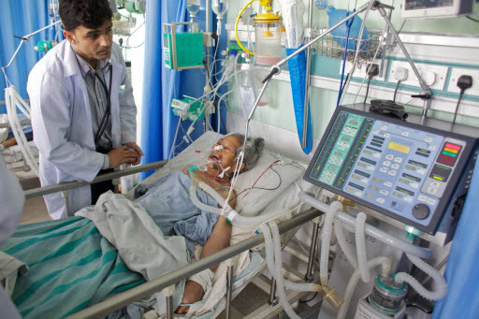
COVID-19 and critical illness
Estimate of 5% need ICUs but this depends on demographics of country
Patients with impending or ongoing acute, life-threatening organ dysfunction, respiratory failure
Provide intensive and continuous monitoring
Provide intensive therapies that cannot be delivered on the general ward (i.e. ventilation)
Depends on local resources
Do NOT delay ICU admission.
Delay is associated with higher mortality.

Slide 29
Critical
Severe
Mild

Slide 30
Safe patient transfer
Ensure IPC measures are always applied.
Ensure appropriate diagnostics and emergency treatments have been given and patient is stable and ready for transport.
Ensure all monitors and ongoing treatments are secured and can be maintained during transport.
Ensure appropriate documentation and handover of care to next responsible clinicians.
Ensure the responsible health care worker is prepared.

Slide 31
Summary
At the front door of a facility, screen, isolate and triage patients with suspected COVID-19 and apply appropriate IPC precautions to prevent spread of illness to health care workers or other patients.
Triage all patients at a validated, acuity-based standardized tool.
Recognize patients that need emergent care, start emergency interventions and arrange for hospitalization using designated targeted referral pathways.
Clinical syndromes that require hospitalization include-severe pneumonia, sepsis, severe dehydration or exacerbation of chronic disease.
Patients with SARI that are critically ill should be transferred safely and in a timely fashion to an ICU for intensive monitoring and care that cannot be delivered on the general ward.

Slide 32
Acknowledgements
Contributors
Dr Janet V Diaz, WHO consultant, San Francisco, USA
Dr T Eoin West, University of Washington, Seattle, USA
Dr Hillary Cohen, Maimonides Medical Center, New York, USA
Dr Neill Adhikari, Sunnybrook University, Toronto, Canada
Dr Paula Lister, Great Ormond Street Hospital, London, UK
Dr Abdo Khoury, Franche-Compte Medical and Trauma Hospital, Besançon, France
Dr Paul McGinn, Australia

