Slide 1


CQUIN & CHAI Virtual Learning Network Workshop on Advanced HIV Disease
AHD Package of Care: Optimal Products, Implementation Planning and Costing | July 29
Veuillez poser vos questions aux panélistes dans la boîte à questions et réponses
Please ask questions to panelists in the Q&A box
Por favor, faça perguntas aos painelistas na caixa de Q&A

Slide 2
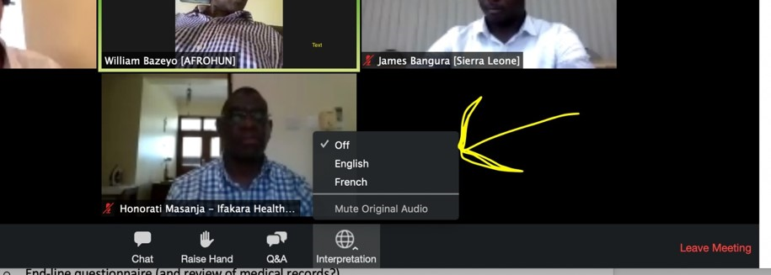
Welcome/Bienvenue/Bem-vindos
Be sure you have selected the language of your choice using the “Interpretation” menu on the bottom of your screen.
Assurez-vous d’avoir sélectionné la langue de votre choix à l’aide du menu <<Interprétation>> en bas de votre écran Zoom.
Certifique-se de ter selecionado o idioma à sua escolha usando o menu de interpretação na parte inferior do seu ecrã
The CQUIN Project Virtual Workshop on Advanced HIV Disease | July 28-29, 2020

Slide 3


Session 6b: Moderators
Richard Borain
Associate Director
Global HIV Access Program,
CHAI
Amir Shroufi
Medical Advisor
CDC Foundation
The CQUIN Project Virtual Workshop on Advanced HIV Disease | July 28-29, 2020

Slide 4
Panelists/Panélistes/Painelistas
Session 6b: AHD Package of Care: Optimal Products, Implementation Planning and Costing
Tijana Clevenger
Results Officer
UNITAID
Angela Loyse
Expert Advisor
CHAI
Tinevimbo Shiri
Sr. Research Associate
Liverpool School of Tropical Medicine
Tom Harrison
Professor of Infectious Diseases
St George’s University of London
The CQUIN Project Virtual Workshop on Advanced HIV Disease | July 28-29, 2020
Notes:
Complete

Slide 5






Implementation Considerations for AHD in Resource-Limited Settings
Dr Angela Loyse
Strategic advisor to CHAI on the Unitaid/CHAI AHD project
Chief investigator DREAMM project
Chair CryptoMAG advocacy group
29 July 2020

Slide 6
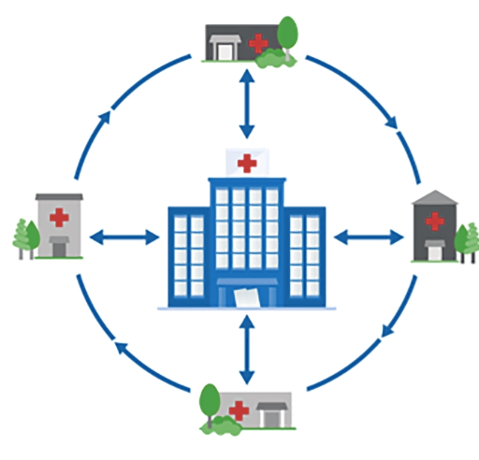
A “Hub & Spoke” model permits for access to appropriate AHD care based on the severity of illness (ambulatory, critically unwell)
A hub and spoke system:
Spoke
Involves setting up local networks based on expertise and infrastructure of health facilities identified for AHD care (e.g. Cryptococcal Meningitis care in hub/regional referral hospitals & district hospitals).
Provides reliable linkage to appropriate AHD services, including timely referral where need be e.g. Referral from spokes to Hubs of critically unwell recipients of care.
Spoke
Hub
Spoke
Streamlines and permits easier coordination and communication by implementing partners and national programs to monitor uptake of AHD services, and to ensure quality.
Spoke

Slide 7

AHD care for critically unwell patient hospitalized patients (Hub)
1
Hubs:
Definition: Hospital level facilities where comprehensive packages of AHD care can be implemented with;
  Clinical expertise in management of critically unwell AHD patients
  Appropriate storage facilities
  Laboratory capacity (timely and reliable laboratory monitoring e.g. renal function monitoring; basic microbiology including CSF culture)
Will serve as referral sites for spokes and will manage patients in need of hospitalization and regular monitoring e.g. in treatment of cryptococcal meningitis

Slide 8

Spokes - provide AHD care package for ambulatory patients
2
Spokes:
Definition: Include primary health care facilities and hospitals with;
  limited clinical expertise and diagnostic capacity (including creatinine) for AHD care.
  limited to no storage capacity (including cold chain) for AHD commodities.
The spokes will;
  Offer outpatient and routine care to stable AHD patients.
  Refer critically unwell AHD patients in need of in-patient care and patients with suspected cryptococcal meningitis to hubs within proximity.

Slide 9
HIV-related meningoencephalitis in African LMICs
Up to 1/3 of deaths from AHD are due to meningoencephalitis
Cryptococcal meningitis: leading cause of HIV-related meningoencephalitis
    15-20% HIV-related deaths/135,900 deaths annually in African LMICs
    >70% mortality @ 10 weeks in resource limited settings
    Empirical treatments often prescribed e.g. fluconazole monotherapy
Most people living with HIV (PLHIV) presenting with meningoencephalitis are ART experienced
Confirmed diagnosis of meningoencephalitis rarely made in resource limited settings.
ART: Antiretroviral therapy; LMIC: Low-and middle-income countries

Slide 10
How to DREAMM
Led and driven by local African leadership-
Key triad: Hospital director-Research/Implementation lead-MoH
DREAMM interventions:
Health system strengthening (including mapping and optimising of clinical and laboratory pathways, and increased physician-laboratory communication).
Delivery of a co-designed education program for frontline HCWs focused on mortality-reducing interventions.
Implementation of an algorithm for diagnosis (using bedside RDTs alongside standard microbiology) and treatment, according to latest WHO guidance on AHD and cryptococcal meningitis.
Infectious diseases/AHD mentorship and laboratory capacity building.

Slide 11
Pre-DREAMM
PLHIV presents to hospital with probable meningoencephalitis
Triage area
Laboratory
  Blood tests including renal function test
  Limited CSF analysis
  CSF biochemistry
  CrAg LFA
  Fungal culture
  CSF Gene Xpert
  Monitoring bloods
  TB testing etc….
  Urinary LAM
OPD/Emergency area
Ward
Blood tests
LPs ordered by Dr
Empirical therapy: Broad spectrum antibiotics + Fluconazole monotherapy
Amphotericin B (AmB)
Flucytosine (5FC)
LP: Lumbar puncture; CSF: Cerebrospinal fluid; CrAg LFA: Cryptococcal antigen lateral flow assay, LAM: Lipoarabinomannan

Slide 12
PLHIV presents to hospital with probable meningoencephalitis
Triage area
Early identification of patients
Laboratory
  Urgent blood tests including timely (<6 hours) renal function test
  Full CSF analysis (including CrAg LFA, biochemistry,
  fungal culture +
  Gene Xpert Ultra
  + TB culture)
  Monitoring bloods
  Blood cultures, syphilis + TB testing etc….
OPD/Emergency area
Bedside CrAg LFA (in blood + CSF) + Urinary LAM
Urgent baseline blood tests/renal function
LP performed*
Microbiologically guided treatment initiated (✓AmB + 5FC available)
Ward
Patient monitoring
Clinical-Thrombophlebitis, additional OIs etc..
Laboratory-Monitoring bloods etc..
2nd diagnostic LP as required

Slide 13
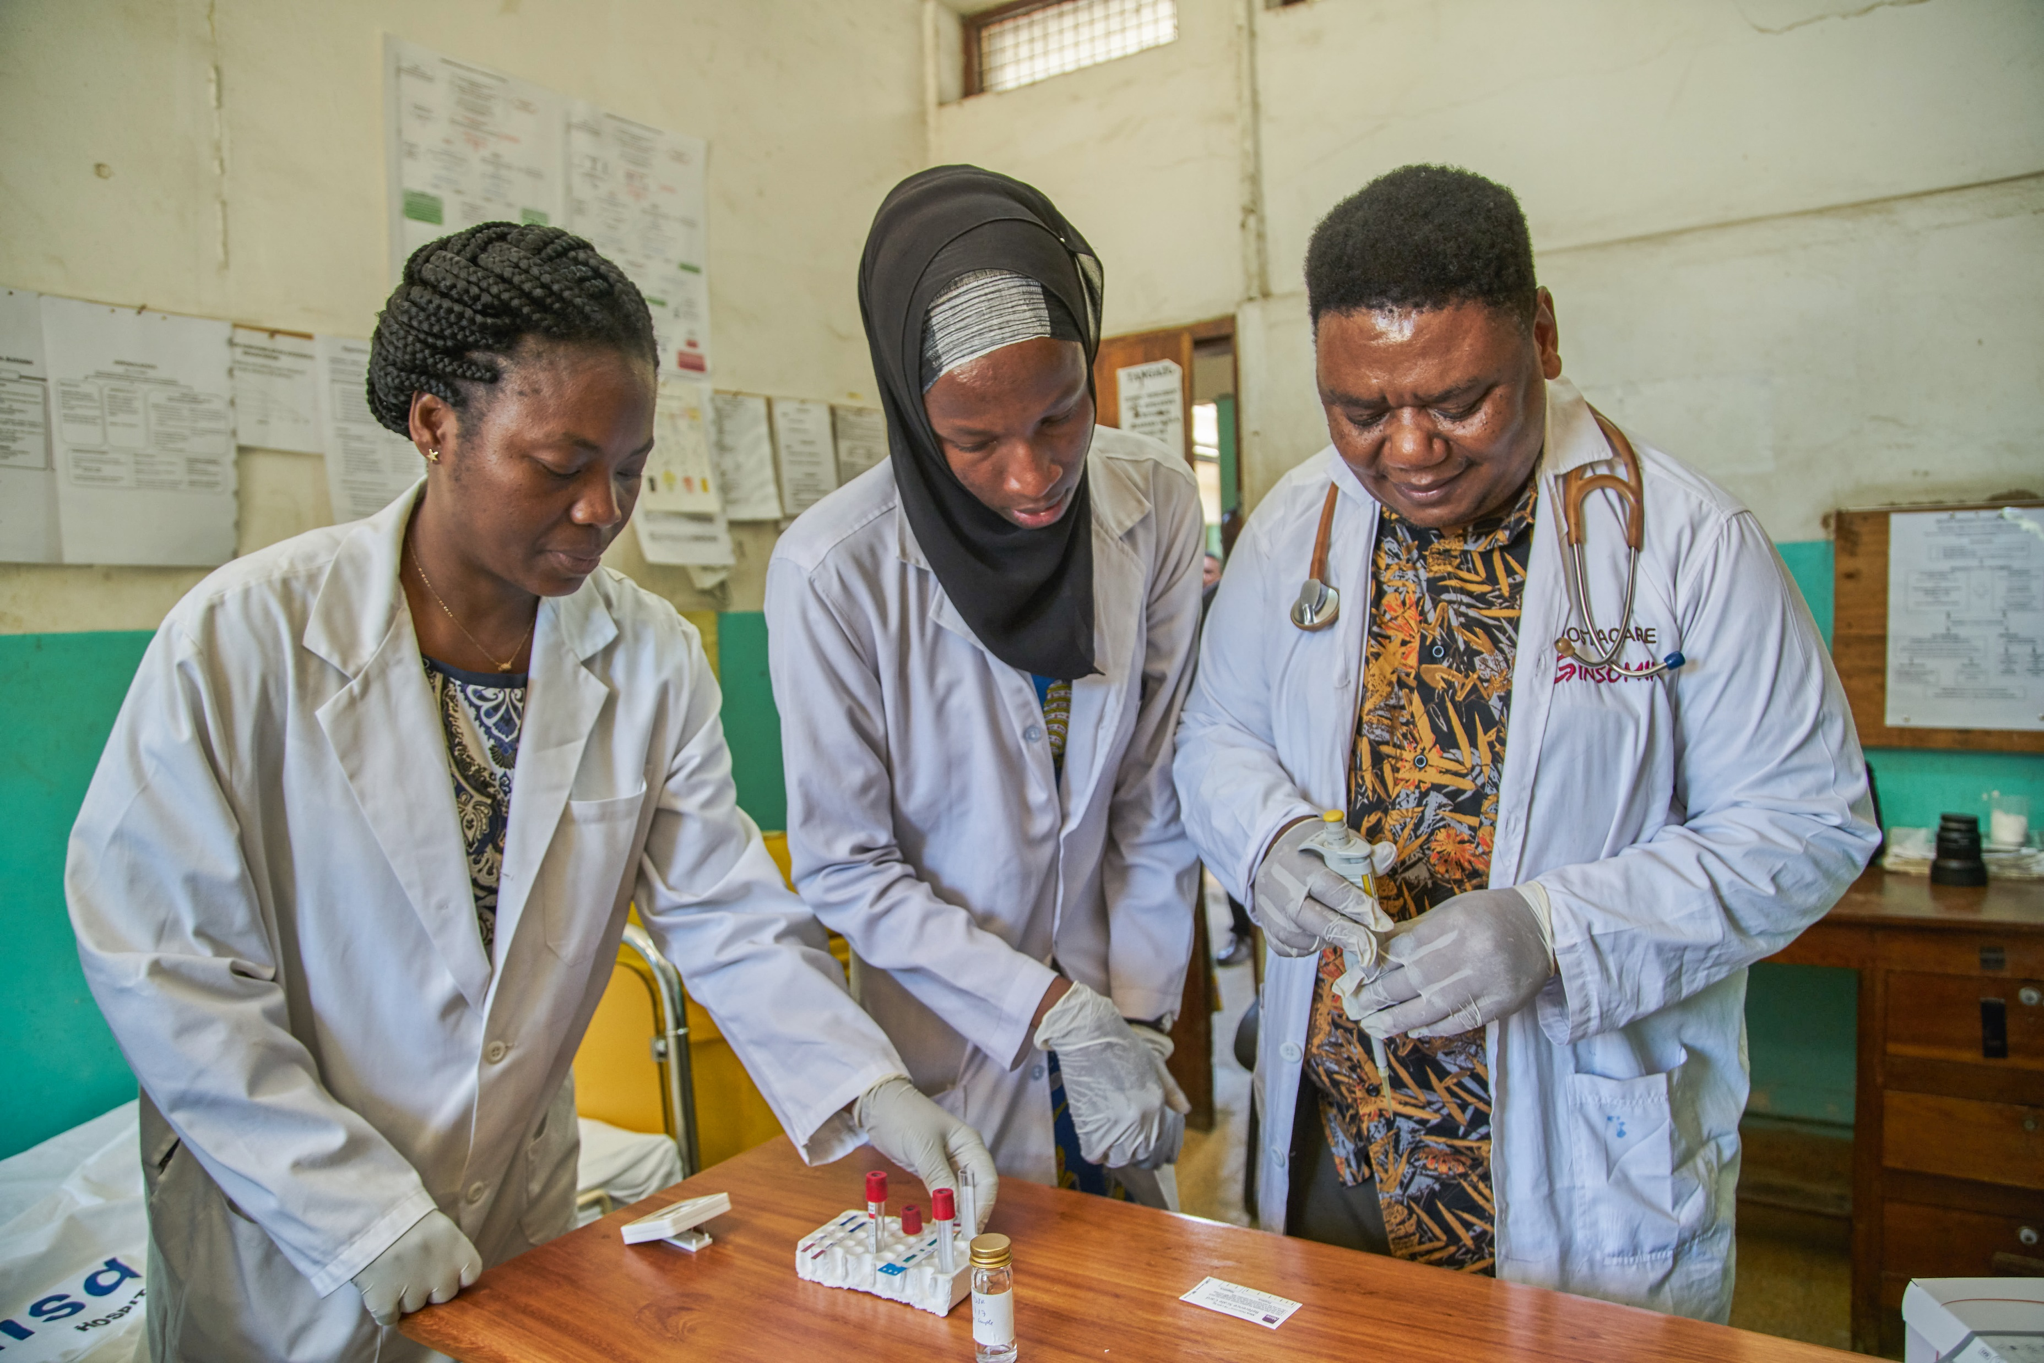
Implementation of AHD models of care.
Key lessons learnt from the DREAMM project
Rapid diagnostic tests in the Meningitis Room at Amana Hospital, Dar es Salaam, Tanzania, August 2017
(Photo courtesy of EDCTP)

Slide 14
Meningitis care tools
CLINICAL
Spinal needles
Sterile LP packs
Manometers
CrAg LFA + Urinary LAM tests
Amphotericin B + Flucytosine
Brain imaging facilities
LABORATORY
CD4 + VL tests
CrAg LFA + Urinary LAM tests
CSF White cell count (WCC) quantification
CSF biochemistry reagents + machine calibration
Additional incubator (set at 30C) + reagents for CSF fungal culture
Calibration of Gene Xpert platforms for analysis of CSF samples
Optimised patient and laboratory pathways that:
Enhance clinician-laboratory technician communication +
Include test reporting mechanisms + agreements on test turn around times

Slide 15
AHD educational resources
Global AHD toolkit:
http://www.differentiatedcare.org/Resources/Resource-Library/Global-Advanced-HIV-DiseaseToolkit
DREAMM co-designed education program between African hospital directors, researchers from Malawi, Tanzania and Cameroon tailored to frontline HCWs in collaboration with SGUL and Institut Pasteur:
https://www.sgul.ac.uk/about/our-institutes/infection-and-immunity/research-themes/working-internationally/dreamms-of-implementation

Slide 16
Acknowledgements
Drs Ikechuku Amamilo + Brian Ngwatu + CHAI AHD team
Prof Sayoki Mfinanga, Dr Cecilia Kanyama, Dr Charles Kouanfack, Dr Saulos Nyirenda, Dr Sokoine Lesikari + the DREAMM consortium
All queries: aloyse@sgul.ac.uk

Slide 17
The economics of cryptococcal meningitis packages of care
Tinevimbo Shiri
Health Economist, Liverpool School of Tropical Medicine
29 July 2020

Slide 18
Outline
Why health economics in AHD packages of care?
Evidence to support decision-making: examples
Gaps in economic evidence
Image from Flat Icon http://flaticon.com/
The CQUIN Project Virtual Workshop on Advanced HIV Disease | July 28-29, 2020

Slide 19
Why health economics?
Scarce resources
Policy question: does this intervention work?
Economic question: is it worth it?
Health economics defines what is “work” and “worth”
The CQUIN Project Virtual Workshop on Advanced HIV Disease | July 28-29, 2020
Images from Flat Icon http://flaticon.com/

Slide 20
Health services costing
Resource use measured in all patients at individual level in all arms, e.g., bed days, CM-specific treatment, general treatment, laboratory tests, etc.
Health care unit costs estimated empirically
Overhead and other hospital expenditure data were aggregated and attributed proportionally to patients in all trial arms
The CQUIN Project Virtual Workshop on Advanced HIV Disease | July 28-29, 2020

Slide 21
Example I: REMSTART
Cost component | Unit price($) | Unit of measurement | Intervention (n=1001) | Standard care (N=998)
Outpatients visits |  |  | Mean (STD) | Mean (STD)
Initial visits | 8.93 | Visit | 1.05(0.36) | 1.04(0.37)
ART eligibility assessment visit | 7.99 | Visit | 1.16(0.44) | 1.10(0.33)
Six-monthly clinic review visit | 8.92 | Visit | 0.81(0.77) | 0.79(0.81)
Routine follow-up visit | 7.62 | Visit | 3.89(2.77) | 3.56(2.81)
Home visit^{b} | 19.51 | Visit | 3.06(1.43) | 0.01(0.18)
Laboratory
CD4 count test | 20.86 | Test | 1.55(0.62) | 1.51(0.62)
Liver function (ALT) test | 1.16 | Test | 1.27(0.59) | 1.19(0.56)
Creatinine test | 0.41 | Test | 0.89(0.44) | 0.87(0.44)
Haemoglobin (Hb) test | 1.15 | Test | 1.46(0.73) | 1.35(0.68)
Syphilis (VDRL) test | 1.13 | Test | 0.03(0.18) | 0.03(0.17)
Pregnancy test | 2.50 | Test | 0.14(0.47) | 0.13(0.44)
Xpert test | 25.23 | Test | 0.96(0.61) | 0.82(0.46)
CrAg test | 5.24 | Test | 0.98(0.13) | 0.01(0.08)
CSF test | 21.55 | Test | 0.01(0.09) | 0.00(0.00)
Chest X-ray | 2.70 | X-ray | 0.05(0.21) | 0.04(0.19)
Medication
Days on antiretroviral therapy | 0.56 | Day | 260.47(137.23) | 250.27(140.70)
Days on co-trimoxazole treatment | 0.02 | Day | 263.22(136.00) | 254.82(139.76)
10-week fluconazole course^{c} | 6.35 | Course | 0.07(0.37) | 0.00(0.00)
Hospitalisation
Overnight hospital stay | 35.00 | Day | 0.18(1.17) | 0.22(1.55)
The primary economic outcome was health service care cost per life-year saved
The CQUIN Project Virtual Workshop on Advanced HIV Disease | July 28-29, 2020

Slide 22
REMSTART: Cost-effectiveness analyses
 | Life expectancy (years)ª, 95% CI | Standard care arm |  |  |  | Intervention arm |  |  |  | Incremental comparison of the intervention versus standard care
 |  | N | Mean total cost (US$) per person (95% CI) | All-cause mortality |  | N | Mean total cost (US$) per person (95% CI) | All-cause mortality |  | Incremental cost (US$) per person (95% CI) | Incremental death (%) (95% CI) | ICER (incremental cost per life years saved) (95% CI)
 |  |  |  | Events (95% CI) | Death rate (95% CI) |  |  | Events (95% CI) | Death rate (95% CI)
CD4 <200 cells /μl | 24.0 | 998 | 262 | 180 | 18.0 | 1001 | 339 | 134 | 13.4 | 77 | -4.6 | 70
 | (22.2 – 25.8) |  | (254 – 269) | (156-203) | (15.6-20.3) |  | (331-347) | (113-156) | (11.3-15.6) | (66-88) | (-7.8, -1.3) | (43, 211)
CD4<100 cells /μl | 18.7 | 707 | 262 | 144 | 20.2 | 724 | 341 | 114 | 15.7 | 79 | -4.5 | 91
 | (17.2 – 20.3) |  | (253 – 271) | (123-165) | (17.4-23.3) |  | (331-350) | (94-134) | (13.0-18.5) | (65-92) | (-8.6, -0.6) | (49, 443)
CrAg screening plus adherence support improved survival by 24%, i.e., from 18.0% to 13.4%, at an extra cost of about $80 per patient.
The CQUIN Project Virtual Workshop on Advanced HIV Disease | July 28-29, 2020

Slide 23
Example II: ACTA
Mean (standard deviation) resource use per patient by trial arm, over 10 weeks trial period.
Service use item | Service use item | 2 weeks oral FLU and 5FC | 1 week AmB+FLU | 1 week AmB+5FC | 2 weeks AmB+FLU | 2 weeks AmB+5FC
Hospitalization | Days | 17.33(15.29) | 17.14(18.04) | 17.99(15.06) | 16.09(12.27) | 19.31(18.31)
Re-hospitalization | Days | 2.02(5.23) | 2.14(6.31) | 0.88(2.72) | 1.77(5.48) | 1.38(4.10)
CM-specific treatment
Trial drug
Fluconazole (FLU) | Tablet (200 mg) | 187.96(123.83) | 147.18(130.65) | 161.50(148.25) | 170.68(125.26) | 120.37(159.31)
Flucytosine (5FC) | Tablet (500mg) | 131(56) | 0.00(0.00) | 74(23) | 0.00(0.00) | 131(59)
Amphotericin B (AmB) | Vial (50mg) | 0.00(0.00) | 6.50(2.60) | 7.35(2.12) | 12.71(5.53) | 13.07(5.94)
Other intervention
Potassium | days | 0.00(0.00) | 6.05(2.20) | 6.72(1.43) | 11.71(4.41) | 11.83(4.62)
Magnesium | days | 0.00(0.00) | 6.05(2.20) | 6.72(1.43) | 11.71(4.41) | 11.83(4.62)
Blood transfusion | Units | 0.12(0.52) | 0.23(0.66) | 0.15(0.57) | 0.31(0.73) | 0.37(0.86)
Lumber puncture | times | 3.13(1.84) | 2.62(1.07) | 3.26(1.39) | 2.93(1.59) | 2.98(1.44)
Bio-chemistry
Total Bilirubin | times | 1.69(2.95) | 1.57(2.77) | 1.74(2.99) | 1.44(2.79) | 1.63(2.94)
CRP | times | 0.06(0.31) | 0.09(0.39) | 0.04(0.21) | 0.11(0.42) | 0.10(0.41)
ALT | times | 3.48(2.09) | 3.04(1.73) | 3.69(2.00) | 3.66(2.32) | 3.40(1.99)
Magnesium (Mg) | times | 0.19(0.73) | 0.20(0.75) | 0.20(0.67) | 0.16(0.66) | 0.22(0.81)
Potassium (K) | times | 7.00(3.15) | 6.23(3.21) | 7.22(2.35) | 7.07(3.12) | 6.83(3.21)
Sodium (Na) | times | 7.02(3.09) | 6.25(3.21) | 7.27(2.41) | 7.12(3.14) | 6.90(3.23)
Urea | times | 6.99(3.12) | 6.22(3.14) | 7.19(2.44) | 7.04(3.07) | 6.79(3.12)
Creatinine | times | 7.15(3.17) | 6.32(3.32) | 7.39(2.45) | 7.18(3.12) | 6.98(3.29)
Proteinuria | times | 7.64(3.48) | 6.82(3.80) | 7.82(2.71) | 7.87(3.63) | 7.47(3.65)
Full Blood Count | times | 4.62(2.39) | 4.26(2.62) | 4.68(1.96) | 4.69(2.41) | 4.63(2.60)
CD4 Count | times | 0.97(0.37) | 1.01(0.37) | 0.93(0.29) | 0.97(0.45) | 0.98(0.30)
Microbiology *
CSF - negative | times | 0.64(0.88) | 0.77(0.99) | 1.27(1.04) | 0.75(0.84) | 1.34(1.21)
CSF - positive | times | 2.44(1.88) | 1.83(1.14) | 1.95(1.39) | 2.17(1.63) | 1.56(1.02)
The CQUIN Project Virtual Workshop on Advanced HIV Disease | July 28-29, 2020

Slide 24
ACTA: Cost-effectiveness analyses
 | Total cost per patient and death rate (%) per arm |  | Incremental comparison of 1 week of AmB+5FC versus 2 weeks of FLU+5FC
ACTA treatment arms | Mean total costs | Deaths (%) | Incremental costs per patient | Incremental death rate (%) | Incremental costs per life year saved
2 week Oral FLU+5FC | 1442 (1336 -1565) | 35(28-41) | Reference | Reference | Reference
1 week AmB+FLU | 1763 (1567 -1979) | 49(39-58) | - | - | -
1 week AmB+5FC | 1861 (1724 -2033) | 24(16-31) | 419 (236, 619) | 11 (0.6, 21) | 208 (91, 1210)
2 weeks AmB+FLU | 2125 (1946 -2313) | 41(32-49) | - | - | -
2 week AmB + 5FC | 2285 (2070 -2525) | 38(29-46) | - | - | -
Reduction in cost per patient and change in deaths in 4 arms relative to that in the gold standard of 2 weeks AmB+5FC
The CQUIN Project Virtual Workshop on Advanced HIV Disease | July 28-29, 2020

Slide 25
Example III: Oral 5FC+FLU
Total costs per patient and death rate (%) |  |  | Incremental comparison of 2 weeks of oral FLU + 5FC versus oral FLU monotherapy
Treatment | Total costs ($) | Deaths (%) | Incremental costs/patient ($) | Incremental death (%) | ICER/life year saved
FLU alone | 628(557-709) | 54(43-64) | reference | reference
FLU + 5FC | 847(776-929) | 35(29-42) | 219(110-329) | 19(6-30) | 65(28-208)
The CQUIN Project Virtual Workshop on Advanced HIV Disease | July 28-29, 2020

Slide 26
Gaps in economic evidence
Costs to patients, families and society in general, including health care financing
Long term consequences unknown
Implementation
Quality of life
The CQUIN Project Virtual Workshop on Advanced HIV Disease | July 28-29, 2020

Slide 27
Cryptococcal Meningitis Treatment: What’s on the horizon?
Tom Harrison
Professor of Infectious Diseases, St Georges University of London
29th July 2020

Slide 28
Current recommendations
Symptomatic meningitis: WHO (2018), SA HIV Clinicians Soc. (2019)
Preferred: A short course (1 week) induction with AmB + 5FC
Alternative: 2 weeks fluconazole 1200 mg/d + 5FC
both followed by fluconazole consolidation and maintenance and ART at 4-6 wks
Early infection - Asymptomatic CrAg-positive cases identified during screening:
Recommend LP; if LP declined (majority of cases), or CSF CrAg negative: fluconazole 1200 mg/d 2 weeks, followed by fluconazole consolidation/maintenance and ART at 2 wks
AmB = amphotericin B deoxycholate; 5FC = flucytosine. ART antiretroviral treatment, CrAg = cryptococcal antigen, CSF = cerebrospinal fluid.
The CQUIN Project Virtual Workshop on Advanced HIV Disease | July 28-29, 2020

Slide 29
Current recommendations
Both based RCT mortality benefit data:
Symptomatic meningitis - ACTA
Molloy et al. NEJM 2018 378:1004
long term follow-up data CID 2020;70:521 ➔
Screening – REMSTART
Mfinanga, et al. Lancet 2015 385:2173-82
⬅
Approx half mortality benefit due screening

Slide 30
The future? Optimising use of Liposomal Amphotericin B: The AMBITION-CM trial
Liposomal amphotericin (L-AmB, Ambisome) – in prior trials, no more effective but less toxic (renal impairment, anaemia) than conventional amphotericin B deoxycholate; even longer half life; excellent brain levels
Even better suited than conventional AmB to short course high dose induction treatment (as used in ACTA) – aimed at loading brain compartment
IF one / few doses effective, could be cost effective due shorter admission, less monitoring; and feasible to implement
Phase II RCT
Single 10 mg/kg/d dose:
Safe, safer than Deoxy AmB
As rapid clearance as daily
dosing for 2 weeks
Jarvis et al Clin Infect Dis.
2019 Jan 18;68:393

Slide 31


The AMBITION-CM trial: Phase-III study – clinical endpoint non-inferiority trial
Liposomal-AmB 10 mg/kg day 1 (single dose) plus 5FC plus fluconazole (for initial 2 weeks) vs
Amphotericin B deoxycholate 1.0 mg/kg/d 7 days plus 5FC (“control arm” new WHO standard – from ACTA)
All patients fluconazole 800 mg/d to 10 weeks, 200 mg/d thereafter. ART initiated 4-6 weeks
Endpoints: Primary: All-cause mortality within 10 weeks
Secondary: Early Fungicidal Activity (EFA); 2-week mortality; tolerability and adverse events; cost-effectiveness
>650 of target of 850 participants already enrolled
Results expected early 2021

Slide 32
Wide access to Flucytosine, and Modified-Release Flucytosine
Access to 5FC is increasing and costs of 5FC are coming down:
UNITAID AHD programme (launched Jan 2019)
South African access programme, 5FC in routine use from May 2019:
  24% in-hospital mortality first 335 patients, with 1 week AmB+5FC regimen, compared with 35% from long term surveillance data in South Africa. Govender N et al ICASA Dec2019
Major (Mylan) and multiple manufacturers committed
Funding secured for development of easier to use modified release formulation that could be given twice rather than 4 x daily (EDCTP – DNDi and partners)
In fact, progress since release of ACTA results showing that 5FC is an essential part of best treatment has been rapid
The CQUIN Project Virtual Workshop on Advanced HIV Disease | July 28-29, 2020

Slide 33
The future? More effective antifungal treatment for those testing CrAg-positive during screening
  Those testing CrAg positive have continued high mortality, despite fluconazole
  And a significant proportion 30-40% CrAg positives have subclinical CM (defined by +ve CSF CrAg) if they agree to LP
  A high CrAg titre predicts subclinical CM; and a high titre and subclinical CM are both associated with higher mortality
  We need to study more effective antifungal therapy for those who are CrAg+ve, in the context of a bundle of diagnostics and ART adherence support for all
The CQUIN Project Virtual Workshop on Advanced HIV Disease | July 28-29, 2020

Slide 34
More effective antifungal treatment for those testing CrAg-positive: EFFECT and ACACIA trials
EFFECT trial – funded MRC WT DFID Global Health Trials
  From ACTA we know Fluconazole plus flucytosine (2 wks) is safe and effective and could be sustainable, cost-effective oral option for CrAg +ve, that may preclude need for LP and i/v Rx
  South Africa, Tanzania, pragmatic trial, within screening programmes
  600 asymptomatic CrAg positive randomised to:
  Fluconazole vs Fluconazole + flucytosine (first 2 wks)
  All participants: ART adherence support, TB diagnostics
ACACIA trial - Single Dose iv Liposomal Amphotericin for Asymptomatic Cryptococcal Antigenemia (ACACIA)
Uganda, enrolling 2019 - 2023
The CQUIN Project Virtual Workshop on Advanced HIV Disease | July 28-29, 2020

Slide 35
Stratified management for those testing CrAg-positive according to CrAg titre
Semi-quantitative tests are in development:
IMMY CrAgSQ (negative, 1+ to 4+)
Jarvis et al J. Clin. Microbiol. Online 27 May 2020 ➔
But may not be as easy to use in routine care as standard
CrAg LFA - Depends relative intensity different test bands
Biosynex Crypto PS (negative, 1+, 2+)
Simple to use But sensitivity and specificity sub-optimal
compared IMMY LFA. Tenforde et al, unpublished
Nevertheless prospect is that more aggressive antifungal treatment
could be directed at those with higher blood titre, at greatest risk of
poor outcome.
EFFECT and ACACIA can be analyzed by titre in retrospect
in order to guide management pathways
The CQUIN Project Virtual Workshop on Advanced HIV Disease | July 28-29, 2020

