Slide 1
Sierra Leone Update
Mr. Francis K. Tamba
DSD Focal Person
Ministry of Health and Sanitation
National HIV and AIDS Control Programme
December 2020

Slide 2
Outline
Where are we now?
CQUIN Dashboard Results
DART Model Mix
How did we get here?
Update on CQUIN Action Plan
Program adaptations made in response to COVID19
Successes and Challenges
2021 goals and targets
The CQUIN Project 4th Annual Meeting | December 7-10, 2020

Slide 3
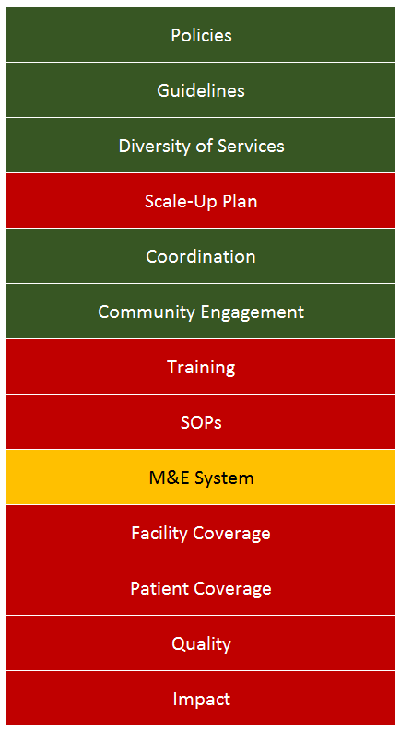
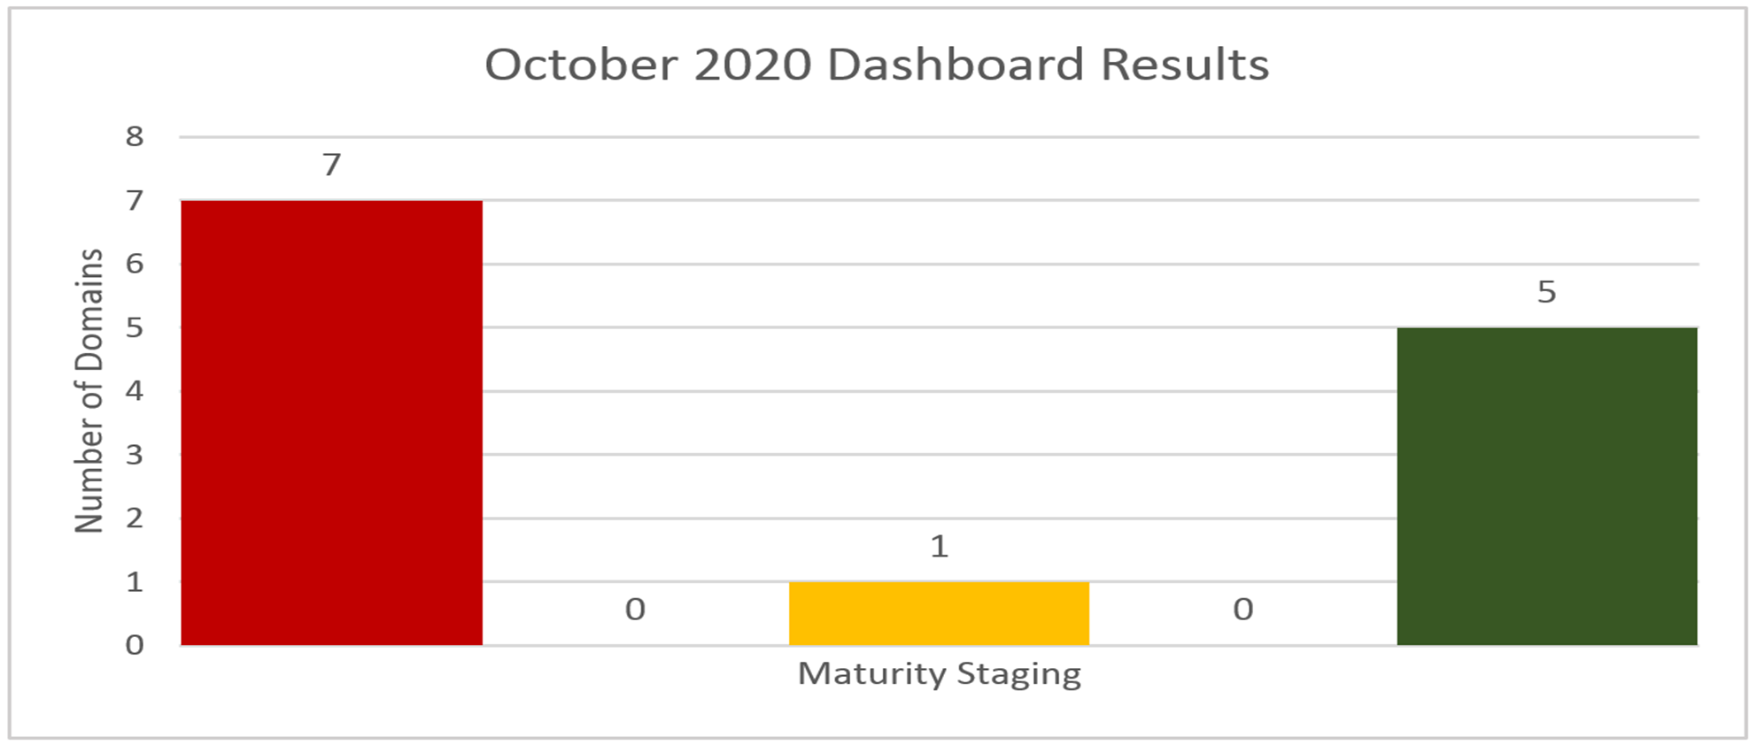
CQUIN Dashboard Results
2020

Slide 4
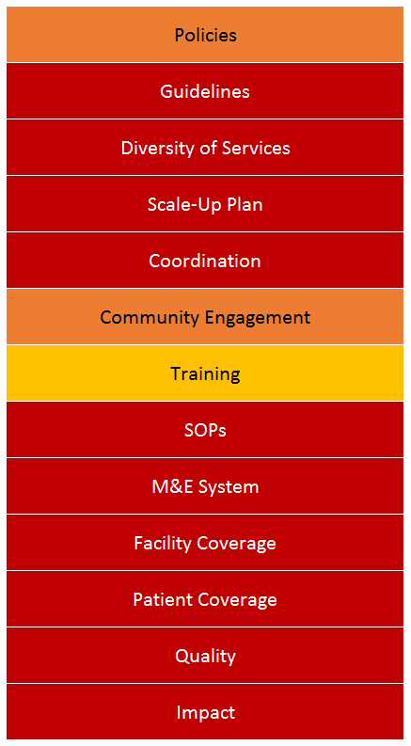
Change in Dashboard Domains since 2019
2019
2020
Notes:
Please be ready to explain how you were able to move from red to dark greens for some

Slide 5
Update on CQUIN Action Plan from 11/2019 (1/2)
Activities that have been successfully completed include:
Formation of DSD Technical Working Group
Inclusion of DSD in the Consolidated HIV Guidelines 2020
Inclusion of a basic DSD orientation module for HCW in the national comprehensive HIV training
Participated in CQUIN M&E for DSD Orientation
DSD indicator tracking - Inclusion of one indicator (3MMD) in the M&E reporting tool
The CQUIN Project 4th Annual Meeting | December 7-10, 2020

Slide 6
Update on CQUIN Action Plan from 11/2019 (2/2)
Activities underway are:
Implementation of 3MMD (fast tracked due to COVID-19 with modified eligibility criteria)
Complete and validate DSD operational guide
Training on DSD Guidelines (HCWs, community owned resource persons)
Development of DSD tracking indicators
The CQUIN Project 4th Annual Meeting | December 7-10, 2020

Slide 7
Key Policy and Practice Adaptations made in Response to COVID19
Policy Adaptations
Review of DSD policy to provide 3MMD for all categories of RoC
Development of:
COVID-19 Guidance on Comprehensive HIV Service Delivery
COVID 19 and HIV/TB management protocol
Inclusion of HIV testing and management in National COVID-19 Case Management Guidelines
The CQUIN Project 4th Annual Meeting | December 7-10, 2020

Slide 8
Key policy and practice adaptations made in response to COVID19
Practice Adaptation
Integration of Comprehensive HIV Service Delivery into COVID-19 case management
Inclusion of HIV testing in National COVID-19 case management
Improving ART Access
Multi-month scripting of ART (3Months for all RoC)
Activation of point of contacts for ART refills
ART home delivery
Participation in NACOVERC case management pillar - integrated emergency response
COVID-19 Infection prevention control
Integrated COVID-19 IPC measures into HIV counselling services
Screening for COVID-19 (Fever clinics)
Provision of IPC supplies for HIV clinics
The CQUIN Project 4th Annual Meeting | December 7-10, 2020

Slide 9
M&E Adaptations made in Response to COVID19 to Enhance Data Reporting
Developed ad hoc registers to capture DSD interventions
The CQUIN Project 4th Annual Meeting | December 7-10, 2020

Slide 10
Successes 1/2
DSD implementation during COVID-19
Multi-sectoral collaboration for DSD implementation
Formation of 87 community ART groups (Bo-9, Kenema-9, Makeni-6, WU-48, WR-15) in collaboration with NETHIPS
Development of tools ( job aides, postal, SOPs, check list etc.) to rollout and monitor
Training of HCWs at COVID-19 Treatment Centers and Community Care Centers(CCC) on HIV testing and management
Minimized drug stock out despite emergency roll-out of DSD
The CQUIN Project 4th Annual Meeting | December 7-10, 2020

Slide 11
Successes 2/2
Inclusion of HIV testing as an essential component of COVID-19 case management
HIV response integrated in the national COVID-19 response
Development and rollout of comprehensive HIV/TB COVID-19 service delivery and management protocols
Continued provision of HIV services during COVID19 lockdown
New and old RoCs benefited from multi month ART scripting (3MMD)
Activation of point of contacts for ART refills
The CQUIN Project 4th Annual Meeting | December 7-10, 2020

Slide 12
Challenges (other than COVID-19)
Human resources for health and logistics for community ART
No funding for community ART programming
No national level integrated active patient retention program (use of CHW)
Current DSD implementation not targeting RoCs with advance HIV disease
Mechanisms for reporting during COVID-19 period were not streamlined
Ad-hoc tools were not equitably distributed
No electronic reporting platform for data collection
Intermittent stock out of HIV commodities and IPC materials
The CQUIN Project 4th Annual Meeting | December 7-10, 2020

Slide 13
2021 Goals and Targets
By CQUIN’s 5th annual meeting (end-2021):
30% of people on ART would be in less-intensive DSD models
Strengthen roll out of 3MMD
Integrate TPT into less-intensive models
Integrate NCDs services into less-intensive models
Strengthen M&E system to improve data availability for decision making

Slide 14
Acknowledgements
NAS
NACP (MoHS)
NETHIPS
UNAIDS
ICAP
SOLTHIS
KSLP
AHF
PIH
WHO
UNICEF
The CQUIN Project 4th Annual Meeting | December 7-10, 2020

