Slide 1
Reducing Stigma Toward Key Populations in Eswatini
Bheki Sithole
FHI 360, EpiC/Eswatini
30 August 2021

Slide 2
Presentation Outline
Background Information
KP structural experiences in Eswatini
EpiC’s approach to addressing stigma in Eswatini
Results from stakeholders’ engagement related to addressing stigma in Eswatini
Trend in experiences of structural barriers: results from the HIV Integrated Bio-Behavioral Surveillance Study (IBBSS)
Lessons learned from Implementation
Next steps

Slide 3
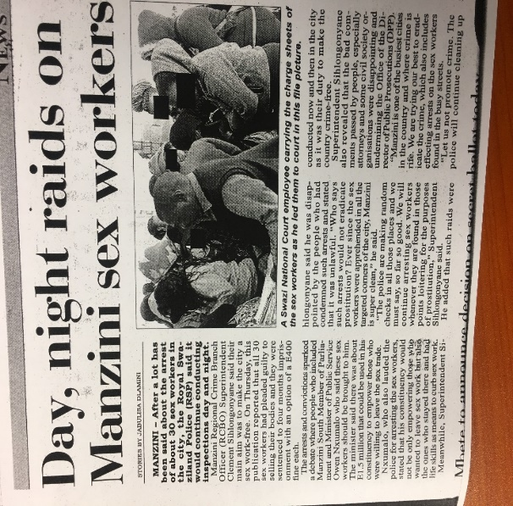
Background Information
KPs experience both legal and social challenges:
Punitive laws criminalizing sex work and same-sex behaviours: Crimes Act 1889 (and SODV), common law, and sodomy act
Stigma, discrimination, and violence from families, society, places of service provision
Arbitrary arrest due to perceived “loitering” in the streets often results in secondary violations (police violence and rape). – IBBSS, 2012.
Experiences of stigma and violence affect uptake of HIV and health services, including testing and treatment.
HIV prevalence is high among KPs: 70.3% for FSWs and 17.7% for MSM.

Slide 4
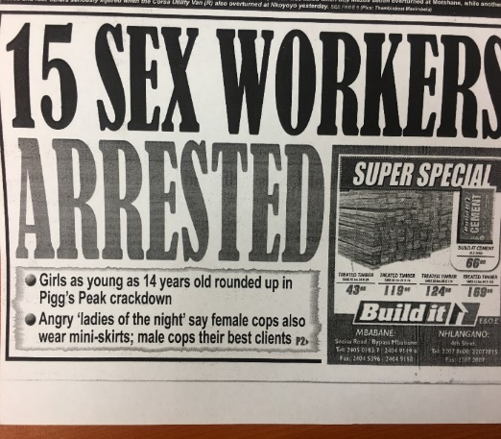
Structural Barriers that Affect KPs (qualitative): IBBSS, 2012
Experienced and perceived stigma in health care settings can lead to lack of care-seeking.
Perceived stigma from families/partners can lead to nondisclosure of HIV status. Implications:
Challenges with ART adherence, hiding medications, lack of social support for treatment
KPs face challenges of living with dual stigma: sexuality or sexual practices and living with HIV.
Stigma causes depression and self-stigma or shame.
Some MSM said feelings of self-stigma led MSM to drink alcohol to “forget,” which could lead to sexual risks.
Clandestine nature of MSM relationships may lead to more, and more casual, partnerships.
Often when FSW are incarcerated by police, they do not have access to HIV treatment.

Slide 5
EpiC’s Approach
EpiC took a public health approach to address stigma and discrimination with power holders:
Research data from IBBSS are used for sensitizations and training of police and health care workers.
A collaborative approach for stigma reduction: EpiC works with MOH, implementing partners, KP representatives.
A multisectoral national technical working was created in 2012 under the MOH, and it meets quarterly.
Comprised of MOH, UN agencies, civil society including KP-led organisations, police and other security agencies, and funders.

Slide 6
Results from Engagement with Stakeholders
KP stakeholder forums to plan and implement activities
KP technical working group
Multisectoral violence response forum
Community engagement
EpiC supports forums where KP networks meet to discuss issues affecting them and to plan advocacy.
Police training and sensitization from executive level to police-station level. Included south-to-south mentoring and development of a human rights training manual.
Stigma reduction in health facilities through pre-service and in-service trainings and mentoring for facilities to become "centers of excellence."
Engaging human-rights lawyers and the Human Rights Commission

Slide 7
Results of Engagement with Stakeholders
Collaboration with UN agencies
UNDP has supported a legal environmental assessment.
WHO support: training HCWs and development of a training manual for HCWs.
UNFPA supported HCWs trainings using new manual.
Collaboration with law enforcement and public health (LEPH)
FHI 360 supports local police to participate and have a representation in LEPH.

Slide 8
Sample of Results Shift: IBBSS FSWs, 2012 & 2021
 | 2012 (percentage) | 2021 (percentage)
As a result of selling sex in the past 12 months:
Felt afraid to seek health care | 44 | 25
Been refused police protection | 49 | 21
Been blackmailed | 35 | 24
Verbal and physical harassment | 61 | 37
Been beaten up as a sex worker | 39 | 18
Ever been raped | 44 | 32

Slide 9
Sample of Results Shift: IBBSS MSM, 2012 & 2021
 | 2012 (percentage) | 2021 (percentage)
As a result of sexual behavior in the past 12 months:
Felt afraid to seek health care | 55 | 31
Been refused police protection | 31 | 2
Verbal and physical harassment | 44 | 13
Been beaten up due to sexuality | 15 | 9
Ever been raped | 7 | 8

Slide 10
Quotes from Stakeholders
“When we were first approached about working with KPs, I never thought it would be something I will do and my religion would have never allowed me, but learning from other police in the LEPH conference opened my eyes, sex workers have rights.” - Senior Deputy Commissioner
“These sensitizations are eye-openers. We never learned about these things from our tertiary training.” - Clinic Nurse
“To the KPs, we are sorry, we did not know we were hurting you, we did not understand, I will no more allow any discrimination in this facility.” - Hospital Matron
“I went to Raleigh Fitkin Memorial Hospital as a transgender person. I received a friendly reception and the nurse understood my needs as well as my gender issues even before explaining, because she is sensitized. I was impressed.” - Transwoman
“In Malkerns police station, we are not afraid to go and report any issue as sex workers. The station commander encourages us to do that and contact him directly when meeting any challenge.” - One sex worker from Marlkerns town where the commander and police were trained on KPs.

Slide 11
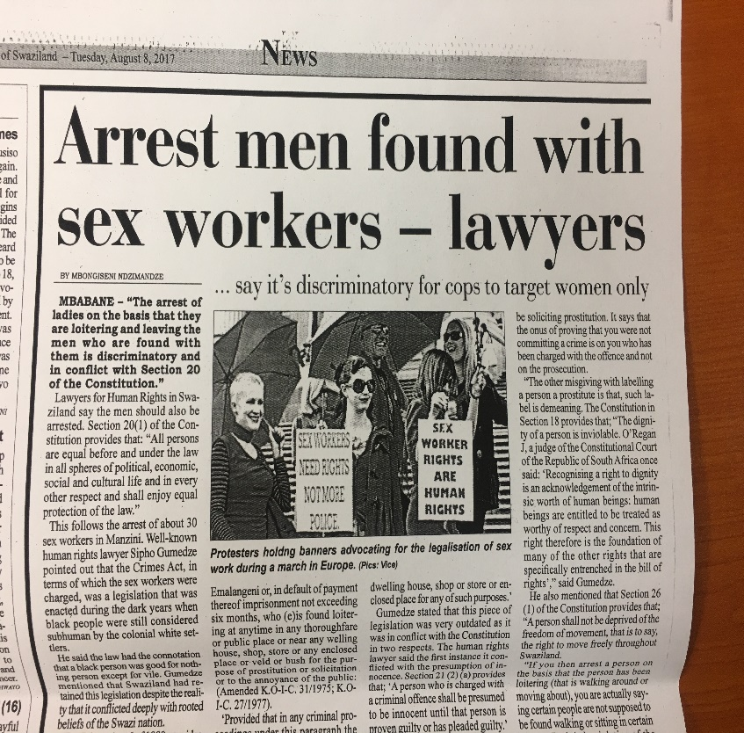
Lessons Learned
Multisectoral stakeholder engagement can be successful in addressing stigma toward KPs in different institutions.
Constant engagement of service providers, at all levels, is key.
Community empowerment is important: vulnerable populations should know their rights.
Pre-service training for both police and HCWs is key for early behavior change and sustainability.

Slide 12
Next Steps
Sustain and expand stigma reduction efforts:
More focus on pre-service trainings for service providers.
Implement activities for health care facilities beyond initial sensitizations, for example, mentoring for competent service providers.
Develop centers of excellence for selected “tier one” facilities.
Strengthen collaborations with allies institutions and stakeholders, including police, MOH, KP organizations, etc. for their contribution beyond EpiC.
Collect and use data for improvements.

Slide 13
Acknowledgments

