Slide 1
Differentiated Service Delivery for People in Prison
Tuesday, October 5, 2021
Please type your name, organization and email address in the chat box
Veuillez saisir votre nom, votre organisation et votre adresse électronique dans la boîte de discussion

Slide 2
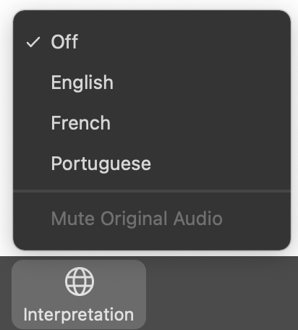
Welcome/Bienvenue/Bem-vindos
Be sure you have selected the language of your choice using the “Interpretation” menu on the bottom of your screen.
Assurez-vous d’avoir sélectionné la langue de votre choix à l’aide du menu <<Interprétation>> en bas de votre écran Zoom.
Certifique-se de ter selecionado o idioma à sua escolha usando o menu de interpretação na parte inferior do seu ecrã

Slide 3

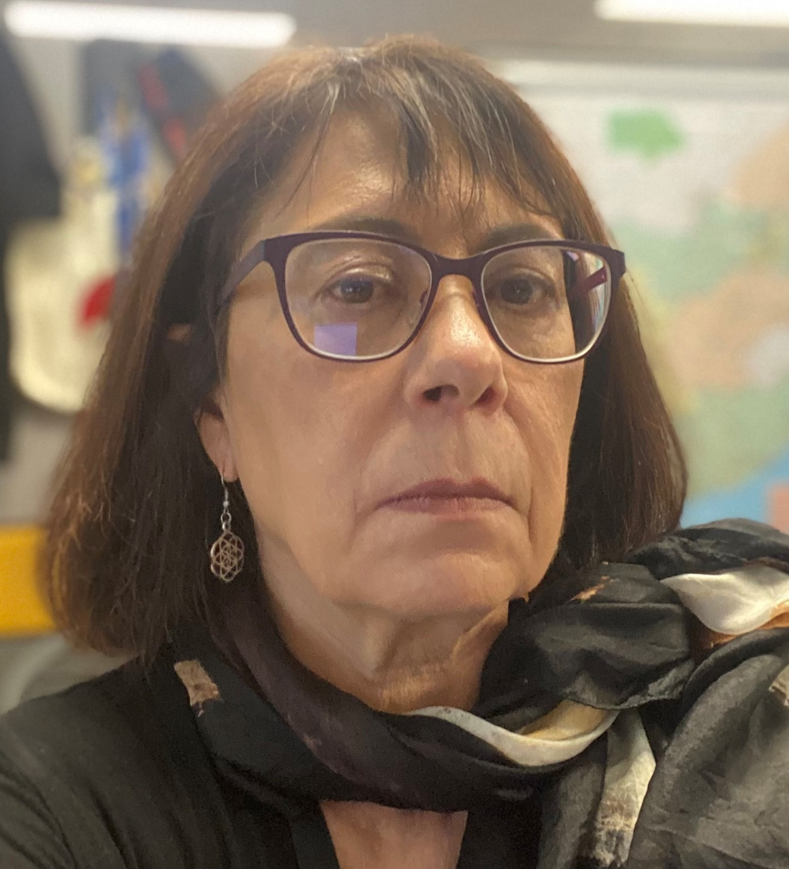
Moderators
Cassia Wells
Senior Technical Advisor, ICAP at Columbia University
Key Populations Lead, CQUIN Learning Network
Helen Savva
Public Health Specialist and Key Populations Lead
CDC, South Africa

Slide 4
Agenda
Moderators: Cassia Wells, ICAP at Columbia University & Helen Saava, CDC South Africa
Case studies: Differentiated HIV services for people in prison
Thais Ferriera, ICAP in Mozambique
Linah Kampilimba Mwango, CIHEB, Zambia
Panel discussion and Q&A

Slide 5


Panelists
Thaís Ferreira
HIV Prevention Director
ICAP Mozambique
Linah Kampilimba Mwango
Deputy Chief of Party
CIHEB, Zambia

Slide 6
HIV Testing and Linkage to PrEP and Treatment
for Inmates in Zambia
Linah Kampilimba Mwango-RN, Bsc-Nrs, MPH
Deputy Chief of Party-Ciheb-Zambia
5th October, 2021

Slide 7
Presentation Outline
Zambia Correctional Services Site
Background
Activities Conducted
Lessons Learnt
Results
Challenges/Recommendations

Slide 8
Background
Approximately 21,078 incarcerated persons across 87 correctional facilities with occupancy of over 300%.
Incarcerated persons represent a critical key population often at risk of HIV infection during incarceration
Inmates have limited access to HIV prevention options
HIV prevalence among incarcerated people in Zambia is estimated to be 14.3%, slightly higher than the national HIV prevalence (11.1%).
In collaboration with Zambia Correctional Services (ZCS) and Ministry of Health, Ciheb Zambia sub-granted by UMB provides HIV prevention, testing, and linkage services

Slide 9
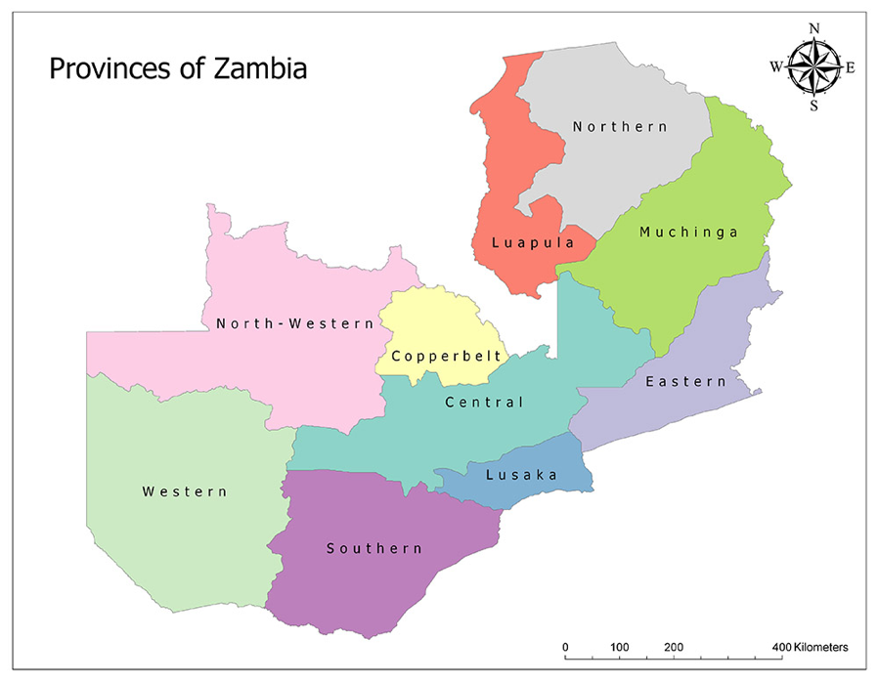




Supported Correctional Services Facilities
 | Prison Name | District | Population
1 | Monze Correctional Facility | Monze | 385
2 | Mazabuka Correctional Facility | Mazabuka | 350
3 | Choma Correctional Facility | Choma | 420
4 | Kalomo Correctional Facility | Kalomo | 180
5 | Livingstone Correctional Facility | Livingstone | 630
6 | Senanga Correctional Facility | Senenga | 250
7 | Kalabo Correctional Facility | Kalabo | 130
8 | Mongu Correctional Facility | Mongu | 550
9 | Kaoma Correctional Facility | Kaoma | 210
10 | Namuseche Correctional Facility | Chipata | 1150
11 | Petauke Correctional Facility | Petauke | 300
12 | Lusaka Central Correctional Facility | Lusaka | 1200
13 | Kamwala Remand Correctional Facility | Lusaka | 350
14 | Mwembeshi Open Air | Chilanga | 350
15 | Mwembeshi Maximum | Chilanga | 750
16 | Lundazi Correctional Facility | Lundazi | 350
ZCS Facilities Supported
Total incarcerated at supported sites 7,555 @June 21
Transitioned to PHO in FY 22

Slide 10
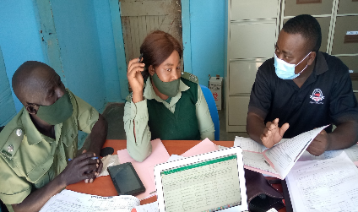
Activities Conducted
Training and mentorship of ZCS staff in HIV prevention and treatment
Training of inmates as peer educators in HIV prevention, testing and linkage to treatment
Support strengthening and establishment of Prison Health Committees
Conducting health education messages on prevention, testing and linkage to services
Trained officers in COVID-19 infection prevention, vaccine management (Risk communication & community engagement, adverse events, cold chain)
Provide COVID IPC supplies and equipment

Slide 11
PrEP Implementation in the ZCS Facilities
1
Group Education on PrEP
INMATE PrEP PROCESS
2
HIV Risk Screening
Not at Substantial HIV Risk
Substantial HIV Risk
3
HIV Testing
Test HIV Positive
Linked to ART
Test HIV Negative
4
Assessed for PrEP Eligibility
Not eligible for PrEP
PrEP Eligible
5
Offered PrEP
Not willing to take PrEP
Follow-up Counselling
Initiated on PrEP
Outcomes

Slide 12
KP_PREV-Inmates
Oct 2020 - June 2021 (16 facilities)

Slide 13
PrEP_New and PrEP_CURR: Inmates
Oct 20-Jun21 (16 facilities)

Slide 14
Prevention, Testing & Linkage: Inmates, Oct 20-Jun21 (16 facilities)

Slide 15
Monthly Trends-KP_HTS-TST, HTS_POS, Linkage Oct 20-Jun 21 (N=16)

Slide 16
KP Viral Load
Notes:
Low VL coverage could be attributed to prisoner discharge or transfer before VL collection and documentation.

Slide 17
Lessons Learnt
Collaboration with ZCS and MOH improves HIV service delivery for inmates
Training and mentoring the ZCS health care workers improves service delivery and enhances program ownership
Using a DSD peer-to-peer model helps improve KP reach
VL campaigns improved the coverage

Slide 18
Challenges and Recommendations
# | Challenges | Recommendations
1 | Inmate transfers without referral letters | Coordination meetings with Provincial Health Coordinators, Correctional Facility Health Coordinators and Warders
2 | Inmates change names upon entry in CF, affecting continuity of HIV care | Education on correct details for continued managed
3 | Some inmates not willing disclose their home addresses for fears of being investigated further- affecting index testing | Continued education and counselling

Slide 19
Acknowledgements
Zambia Correctional Services
Ministry of Health Zambia
Centers for Disease Control and Prevention-Zambia
University of Maryland Baltimore
Ciheb-Zambia
Inmates

Slide 20


Slide 21
HIV prevention, care, and treatment for people in prison in Mozambique
Thaís Ferreira
HIV Prevention Director, ICAP Mozambique
October 5th, 2021

Slide 22
HIV in Mozambique
2.1M adults and children living with HIV
Adult HIV prevalence 11.5% (UNAIDS 2020)
HIV prevalence among people in prison = 24% (UNAIDS 2015)
Nearly 20,000 inmates as of July 2021

Slide 23

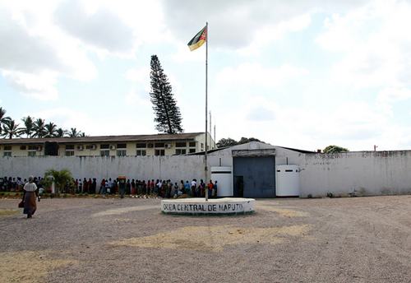
HIV Services for People in Prison
Incarcerated populations are most at-risk for HIV
  Power imbalance between prisoners and guards, and among prisoners, particularly younger prisoners
  Limited access to HIV and TB prevention and treatment interventions
  Increased risk of engaging in high-risk behaviors, such as injecting drugs
Access to treatment for HIV positive people in prison is also challenging
  Challenges with staff training, space, access to laboratory and clinical services
Central Prison, Maputo Province

Slide 24
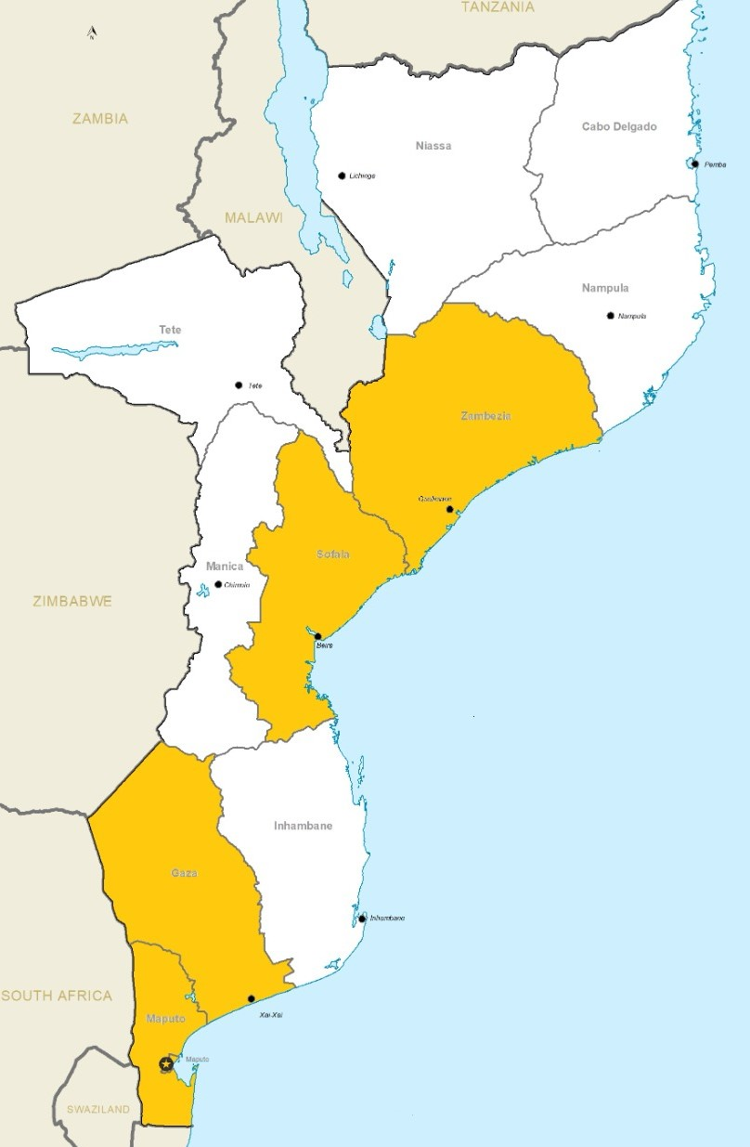
ICAP-supported HIV prevention, care and treatment services in prisons during COP20
VMMC Prison supported sites
C&T prison supported sites
* transitioned to MOH and other partner for COP21

Slide 25
Step 1 – Stakeholder Engagement
Coordination across multiple levels of government:
Central level
  Advocacy with MOH and Mozambican National Directorate for Penitentiary Services (SERNAP)
Provincial / District levels
  Provincial Health Directorate (DPS)
  Provincial Directorate for Penitentiary Services
  Provincial Health Focal Point for Penitentiaries

Slide 26
Step 2 Process
Assessment
Following coordination, field staff conduct site visits to assess conditions – space, privacy, demand, human resources available and trained
Logistics
Review and elaborate needs assessment
Conduct minor improvements, as needed
Implementation
Selection of appropriate model: mobile units, fixed sites, temporary sites
Data flow, training of staff and teams
Implementation of service delivery package
Allocate materials, consumables and equipment
Training of staff

Slide 27
VMMC support to prisons

Slide 28
Program Background
The Mozambique Ministry of Health (MOH) launched the National Voluntary Medical Male Circumcision (VMMC) Program in November 2009, in collaboration with PEPFAR, identifying VMMC as an evidence-based HIV prevention method
As of 2015, national VMMC coverage amongst men 15-49 years = 63%¹
ICAP at Columbia University (ICAP) has supported MOH to implement VMMC in Zambezia province since 2012
Cumulative # of males circumcised with ICAP support: 397,468 (2012 – July 2021)
1 IMASIDA 2015
Notes:
Expanding to cover all CDC VMMC portfolio.

Slide 29
Voluntarism and Informed Consent
Adult males opting for VMMC have the right to receive full information on the benefits and risks of the procedure.
Only adult male clients may give their informed consent
  For individuals between 15 and 17yr old, consent is required from the caregiver
The informed consent process should be conducted in a language that is understood by the VMMC client
ICAP provides clear guidance to prison leadership regarding voluntarism and informed consent

Slide 30
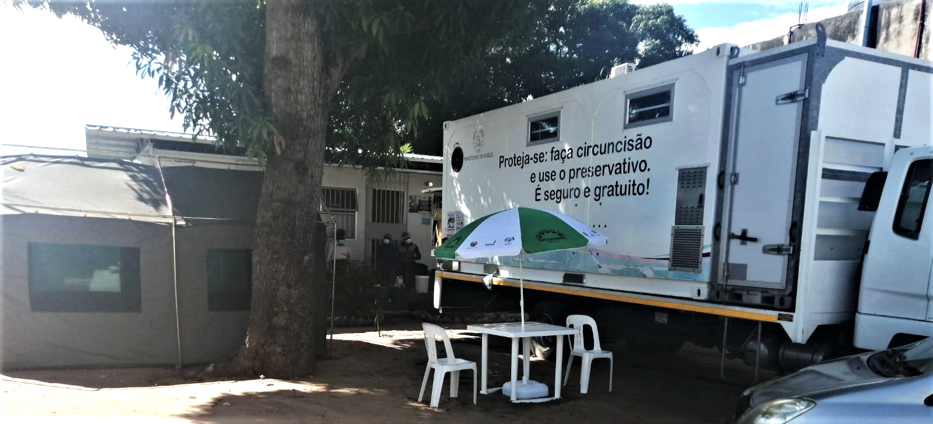
VMMC Model 1: Mobile Units
2 bed capacity
  currently only using 1 due to COVID
Logistics:
  Fuel for generator, if electricity is not available within the prison
  Materials, consumables, job aids, M&E forms, emergency supplies, sterilization and waste management at the closest fixed site
Staffing:
  2 VMMC providers
  2 VMMC assistants
  1 data assistant
  1 lay counselor
  1 driver
Mobile Clinic at Gaza penitentiary

Slide 31
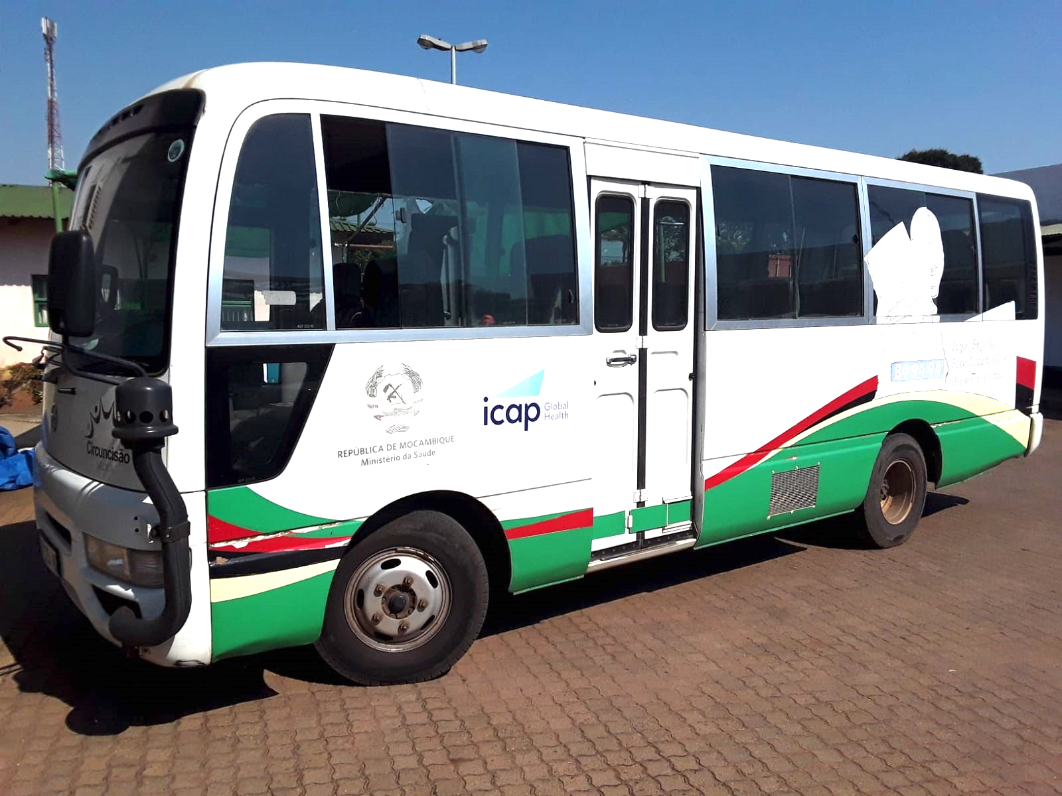
VMMC Model 2: Fixed Sites
Initial screening is conducted in a tent at the prison
Eligible clients are transported to the closest fixed site
  2-3 beds per site (currently only using 1 due to COVID)
Logistics:
  Minibus for transport
  Materials, consumables, job aids, M&E forms, emergency supplies, sterilization and waste management at the fixed site
Staffing:
  2 VMMC providers
  2 VMMC assistants
  1 data assistant
  1 lay counselor
  1 driver

Slide 32
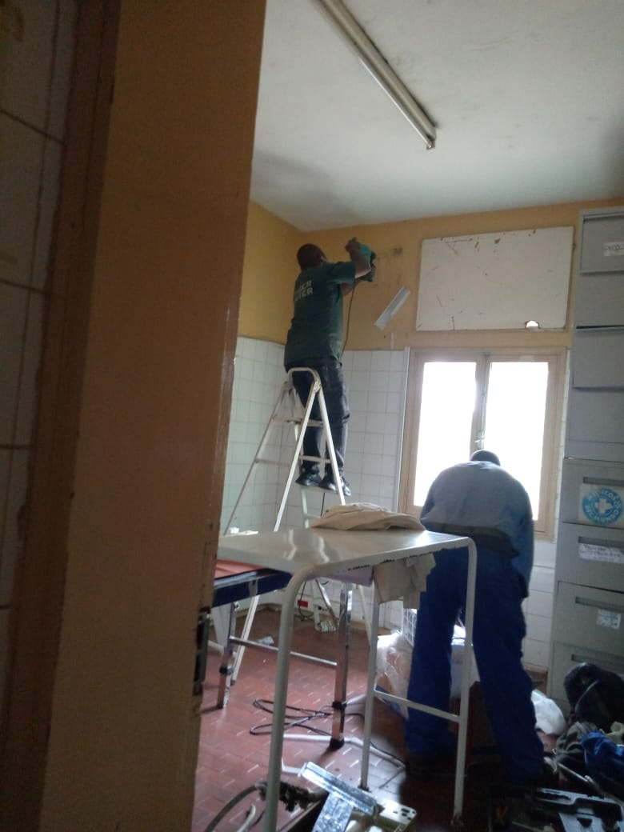
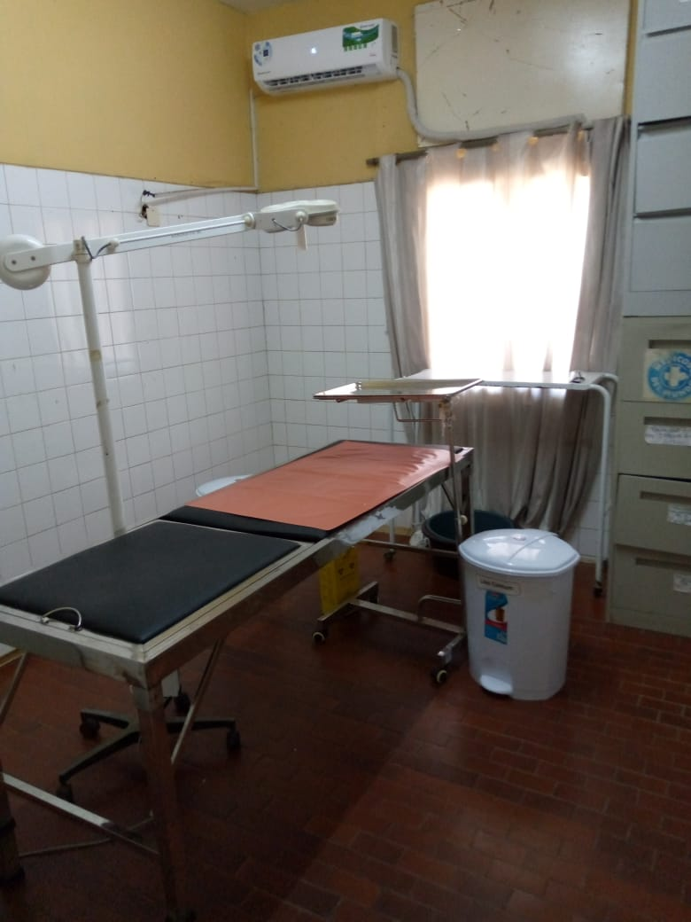
VMMC Model 3: Temporary Sites
1 bed capacity
Logistics:
  Minor improvements including air conditioning, curtains, additional tents if necessary
  Generator and fuel, if not available
  Materials, consumables, job aids, M&E forms, emergency supplies, sterilization and waste management at the closest fixed site
Staffing:
  2 VMMC providers
  2 VMMC assistants
  1 data assistant
  1 lay counselor
after
before
Machava Penitentiary in Maputo

Slide 33
Results: HIV Testing at VMMC services for prisoners
October 2020 – September 2021
Overall yield for prisoners = 22.8% (377/1,650),
This is much higher than HIV+ rates in VMMC fixed and mobile sites for the general population, where overall yield across provinces during the same period was 1.6% (344/22,132)
Notes:
According to MOH MZ is implementing HIV testing Algorithm. KP such as prisons are elegible if they aceept to be tested.

Slide 34
HIV prevention, testing, care and treatment support in prisons in Nampula province

Slide 35
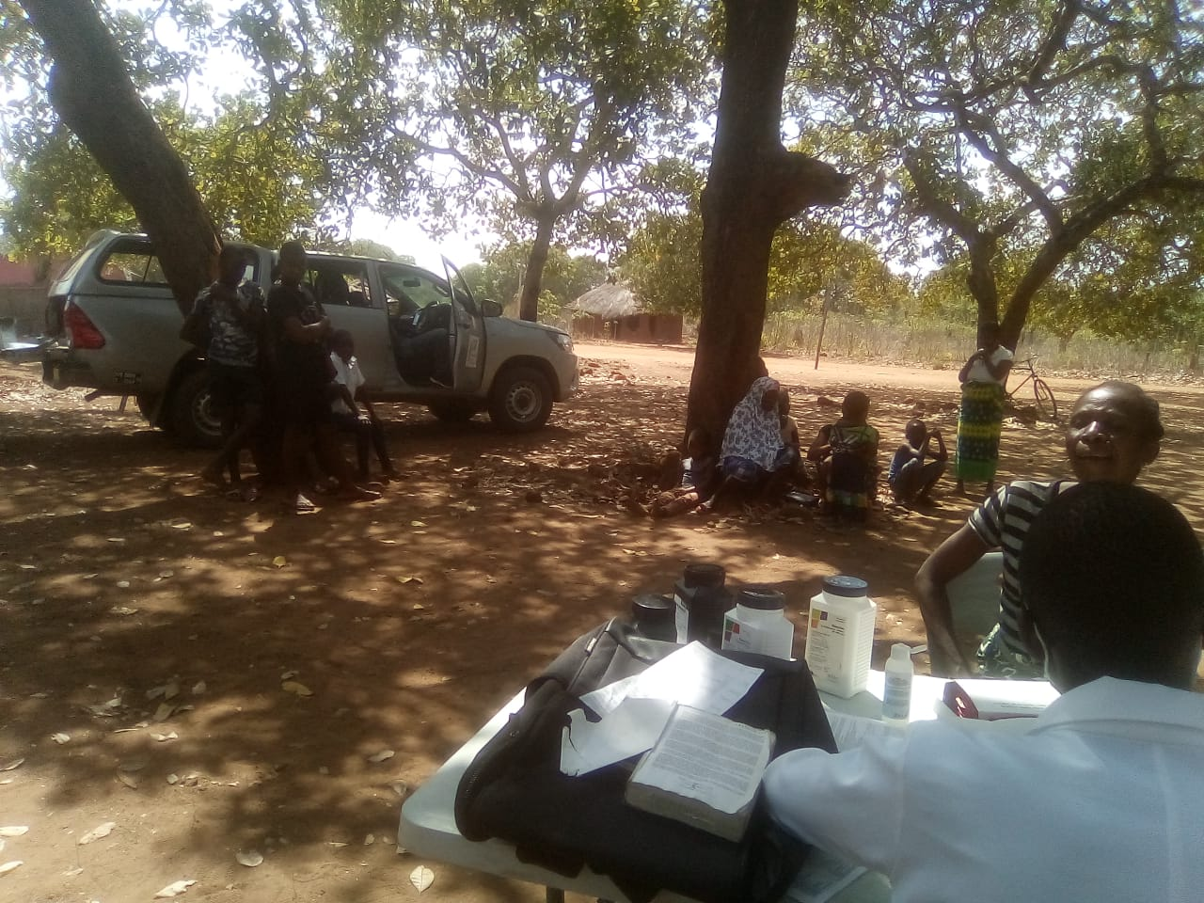
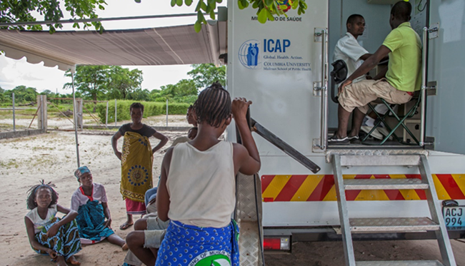
Models of prison support in Nampula province
  Model 1 - Integration of services using existing prison space and staff
    Identification of a room to provide services
    Minor renovations and allocation of medical, office and M&E/support material
    Identification of prison staff to train and provide clinical services
    Three supported prisons using this model
  Model 2 - Service provision through MOH mobile brigades model
    Nine supported prisons using this model
    Identification of NHS staff (one clinical officer and one lay counselor) and support with transportation fees
      At women’s prison, one additional MCH nurse to provide MCH services
    ICAP car with tents, foldable tables and chairs, medical material, M&E and support tools
  Both Models
    Frequency of services depends upon the number of inmates
    Data from prison is reported through a referral HF
    Receive routine technical assistance by ICAP provincial and HF staff
Notes:
PrEP recently initiated in July according to MOH revised guidelines

Slide 36
Package of services provided at prisons in Nampula province
  Provide training and TA on prevention and C&T services:
    Services include:
      COVID-19 and HIV screening and testing
      STI and TB screening and treatment initiation
      PrEP and ART initiation and continuation
      Psychosocial Social Support
      Sample collection (EID, VL and TB)
      Maternal and child health services (ANC, FP, CCR, CACUM) within the female prison
    Logistics support
      Transport and sample collection
      Transport HCW from HF to prisons on a monthly basis
      Allocate M&E tools and job aids
      Provide materials, consumables, including PPE/handwashing stations
Notes:
PrEP recently initiated in July according to MOH revised guidelines

Slide 37
Results: Testing yield at prisons in Nampula province
October 2020 to August 2021
Notes:
Gráfico com Cascata de HTS_TST, HTS_POS yeild Outubro 2020 a Agosto 2021 (dados agregado) em reclusos

Slide 38
Results: Increasing number of prisoners on ART
October 2020 to August 2021
Notes:
Gráfico com a Evolução do TX Curr de Outubro 2020 a Agosto 2021 (dados agregado) em reclusos

Slide 39
Lessons Learned
Close coordination with provincial penitentiary directorates is essential for successful implementation
  Implementation within prisons requires flexibility; service delivery should be contextualized according to the needs of the penitentiary
Utilizing different service delivery models, including temporary sites, mobile units and mobile brigade is important to increase demand for VMMC and access to C&T services among prisoners
Services within prisons presents high HTS yield and link an underserved population (i.e., KP/men) to essential HIV prevention and care and treatment interventions
Notes:
This was particularly important during the COVID-19 pandemic, when demand for VMMC services was low, maximizing the use of human resources for target achievement

Slide 40


Thank You
With support from the U.S. President's Emergency Plan for AIDS Relief, through the Centers for Disease Control and Prevention.

Slide 41
Q&A and Discussion
Cassia Wells
Senior Technical Advisor, ICAP at Columbia University
Key Populations Lead, CQUIN Learning Network
Thaís Ferreira
HIV Prevention Director
ICAP Mozambique
Linah Kampilimba Mwango
Deputy Chief of Party
CIHEB, Zambia
Helen Savva
Public Health Specialist and Key Populations Lead
CDC, South Africa

Slide 42
Next steps & useful links
Slides and recordings from today’s session will be posted on the CQUIN website: https://cquin.icap.columbia.edu/
The next CQUIN webinar will be in November

