Slide 1
Uganda HIV-FP Integration;
Dr. Arthur Ahimbisibwe
(MBChB, MPH)
Team Lead Adult HIV care and treatment
MOH/ACP-Uganda

Slide 2
Outline
Overview of current DSD models of care
FP methods in Uganda
Family Planning methods in DSD models
Unmet need for FP in Uganda
FP uptake/Integration- EC region
Challenges and Actions
Opportunities
Conclusion

Slide 3
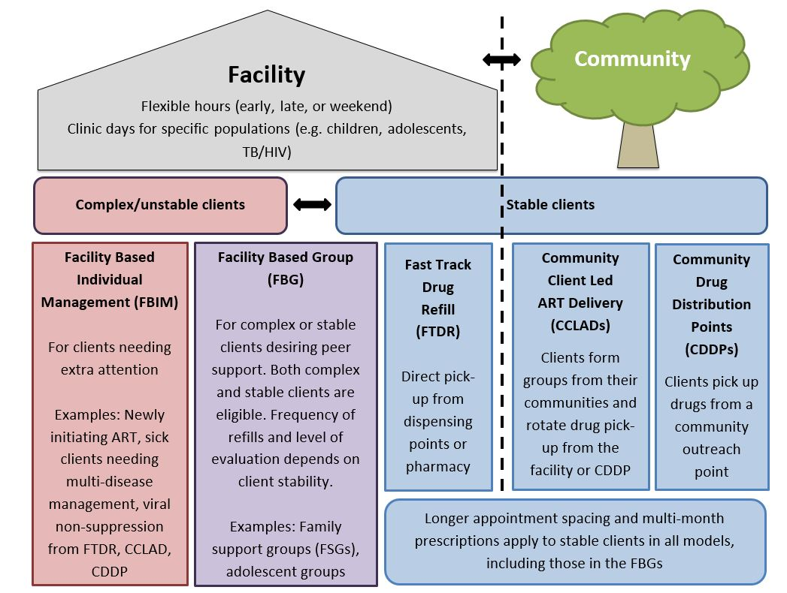
DSD Models of Care for PLHIV in Uganda

Slide 4
Family Planning methods available in Uganda
Fertility awareness.
Hormonal contraception
Depo Provera injection.
Emergency contraception
Contraception pills
Physical Barrier methods
condoms.
Long-acting reversible contraception
the implant
Intra uterine device (IUD)
Permanent Methods
vasectomy
tubal ligation.

Slide 5
Family Planning methods in DSD models
Facility Models
Assessment done,
Condoms and awareness available at HIV clinic
Referral and guided linkage to MCH department for other methods
Community Models
CDDP= except long term, all other methods available for patients in an integrated approach
CCLAD= Condoms, contraceptive pills, awareness available,
others need to access them at HF

Slide 6
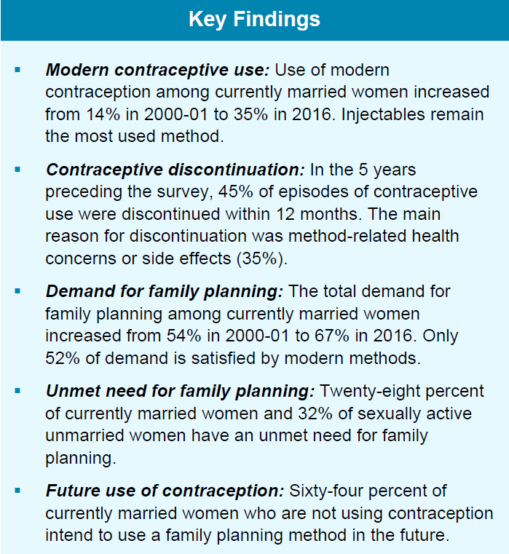
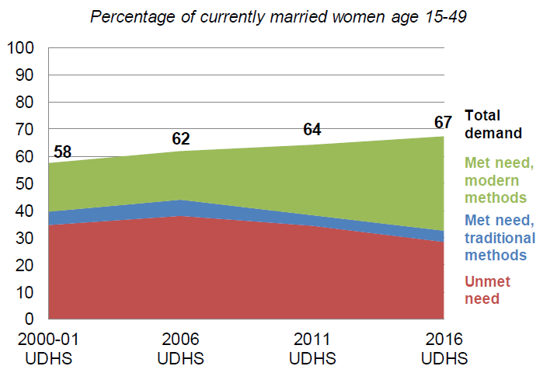
General Unmet need for FP in Uganda
Data Source – Uganda Demographic and Health Survey 2016

Slide 7
FP uptake ; East Central region(Oct 20 – Dec 2)
The proportion of new users who took-up LARC increased from 21.9% in FY20 to 27.1%. Similarly %age of new users 10-19 years increased from 18.2% in FY20 to 21.1%; surge, improved IPs coordination; media sensitization; support to VHTs for campaigns.
District | Total FP Users | Total new users | % Total new users | % LARCS New users | % permanent users | % Short term New Users | % Other new users | % New Users 10-19 Years | Facility Adolescenpregnancy rate (10 -19 years)
Bugiri | 15,385 | 7,928 | 51.5% | 27.9% | 0.6% | 65.7% | 5.8% | 22.7% | 7.9%
Bugweri | 7,211 | 3,840 | 53.3% | 20.2% | 0.2% | 73.1% | 6.5% | 22.2% | 7.4%
Busia | 17,293 | 10,949 | 63.3% | 35.0% | 0.1% | 52.8% | 12.1% | 18.3% | 7.8%
Buyende | 11,455 | 6,375 | 55.7% | 20.2% | 0.6% | 70.2% | 9.1% | 24.3% | 7.5%
Iganga | 25,036 | 12,485 | 49.9% | 16.0% | 0.3% | 80.4% | 3.4% | 23.1% | 8.4%
Jinja | 18,296 | 11,392 | 62.3% | 30.8% | 0.1% | 60.7% | 8.4% | 16.1% | 7.5%
Kaliro | 4,848 | 3,194 | 65.9% | 36.9% | 2.0% | 60.3% | 0.8% | 19.8% | 7.3%
Kamuli | 23,449 | 14,090 | 60.1% | 26.1% | 0.1% | 71.8% | 2.0% | 21.2% | 8.9%
Luuka | 7,215 | 4,475 | 62.0% | 34.3% | 0.4% | 49.9% | 15.4% | 20.5% | 7.2%
Mayuge | 13,879 | 6,773 | 48.8% | 26.3% | 0.2% | 60.9% | 12.6% | 25.4% | 7.5%
Namayingo | 4,491 | 2,562 | 57.0% | 31.5% | 0.3% | 66.3% | 1.9% | 20.7% | 8.9%
Namutumba | 5,502 | 3,111 | 56.5% | 34.0% | 1.0% | 60.8% | 4.2% | 23.5% | 6.7%
EC region | 154,060 | 87,174 | 56.6% | 27.1% | 0.4% | 65.6% | 6.9% | 21.1% | 7.8%
.
Notes:
Iganga and Kamuli districts had the highest numbers of FP users; Majority of family planning users took-up Injectables, condoms and implants. Adolescent Pregnancy rates were highest (>8%) in Iganga, Kamuli and Namayingo districts

Slide 8
EC region; New HIV+ FP users increased by 262 (47%) from 562 in Oct-Dec 2018 to 824 in July- Sept 2019. Similarly revisits of HIV+ FP users increased from 711 in Oct-Dec 18 to 1,210 in July-Sept 2019.
47% increase among New HIV+ FP users was attributed to., robust and improvements in data capture in the HIV clinics, targeted peer led mobilization; sensitization; improved coordination with FP IPs in the region and training of peers/ expert clients to provide some FP services.

Slide 9
.
Challenges
Action for course correction
Measuring quality of integrated service provision
Data capture and reporting on Integration of FP services within the HIV clinic.
Inadequate HR to provide comprehensive FP services at HIV clinic- avoid depart referral
Knowledge gap among HCWs and VHTs/peers on provision of FP.
Stock-outs of FP commodities
Discussions focused on quality provision of FP services in an integrated manner in HIV clinics
Strengthening capacity of HCWs and peers to provide FP services, mentorship, coaching.
Improve data and reporting for FP services in HIV clinic
Targeted Youth/Adolescent peer-led mobilization.
Regional collaborative engagements to learn from each other on the best integration modality.
Strengthening management of FP supplies and commodities at health facilities.- SCO

Slide 10
Opportunities
Review of HIV guidelines on going-
strong inclusion of FP integration in HIV management within the HIV clinic.
HMIS data tools review process is ongoing
Inclusion of structured tracking of FP indicators within the HIV clinic setting.
Available Infrastructure/ resources; Space; Commodit

Slide 11
CONCLUSION
Integration of FP services in HIV care and management is possible at DSD level
Both in DSD- Health facility and Community Models
Key components in the pre-liminary stages
Trained HCWs and Peers in FP provision
Availability of FP commodities
Structured data capture and reporting tools
Infrastructure- space
Peer led mobilization approach

