Slide 1
Session 10 c. Integrating Tuberculosis Preventive Treatment into DSD models: Developing Quality Standards
Greet Vandebriel
Technical Director, ICAP Burundi
Regional Clinical Advisor
29 April 2022

Slide 2
Outline
Rationale for integrating TPT in DART models
CQUIN TPT shark tank projects Zimbabwe: feasibility of integration of TPT into Fast Track models
Objectives of the session

Slide 3
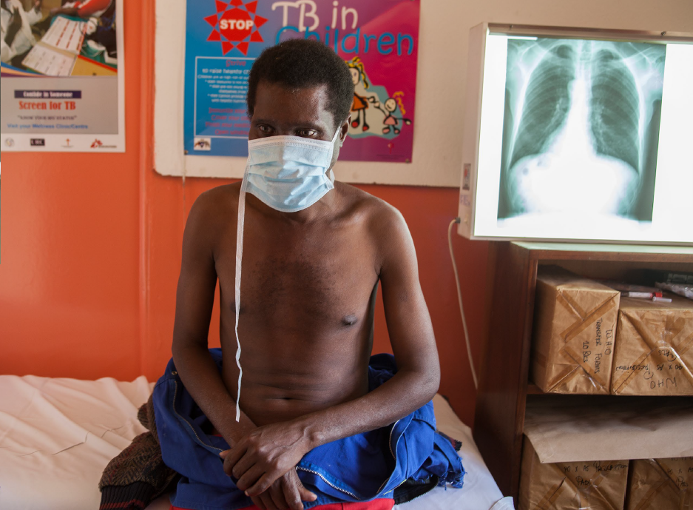
Tuberculosis Remains a Leading Cause of Death
TB remains the second leading cause of death from an infectious disease
  >1.5 million TB deaths in 2020
Leading cause of death among PLHIV
  In 2020, about 215 000 people died of HIV-associated TB: ~30% AIDS-related deaths in 2021
TB is largely curable and preventable
WHO Global Tuberculosis Report 2021

Slide 4
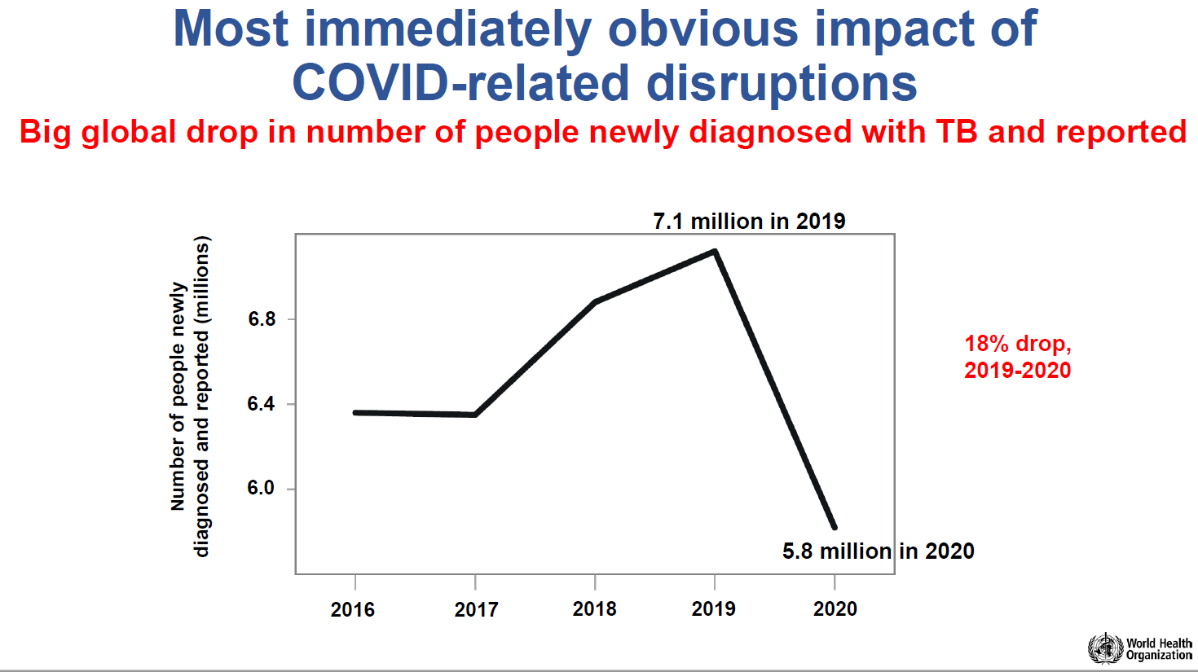
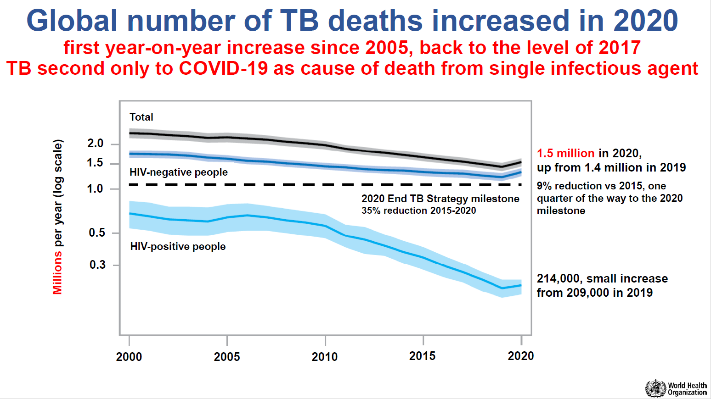
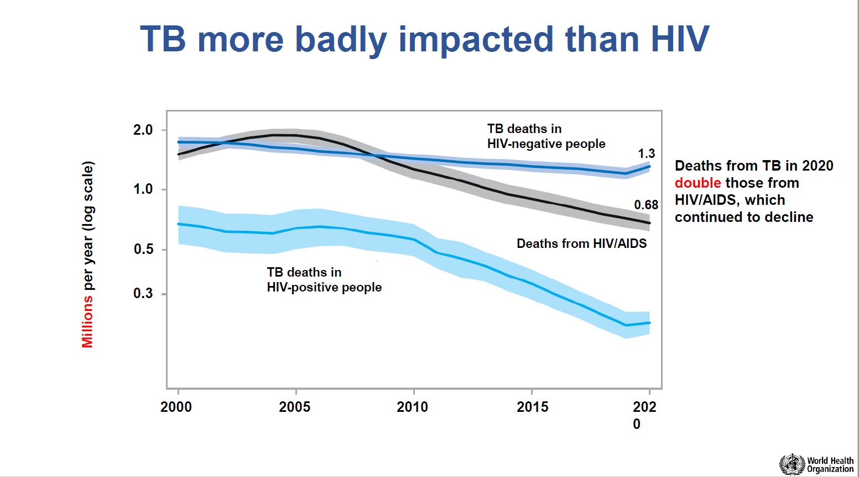
Impact of COVID on TB Diagnosis and Mortality
WHO Global Tuberculosis Report 2021

Slide 5
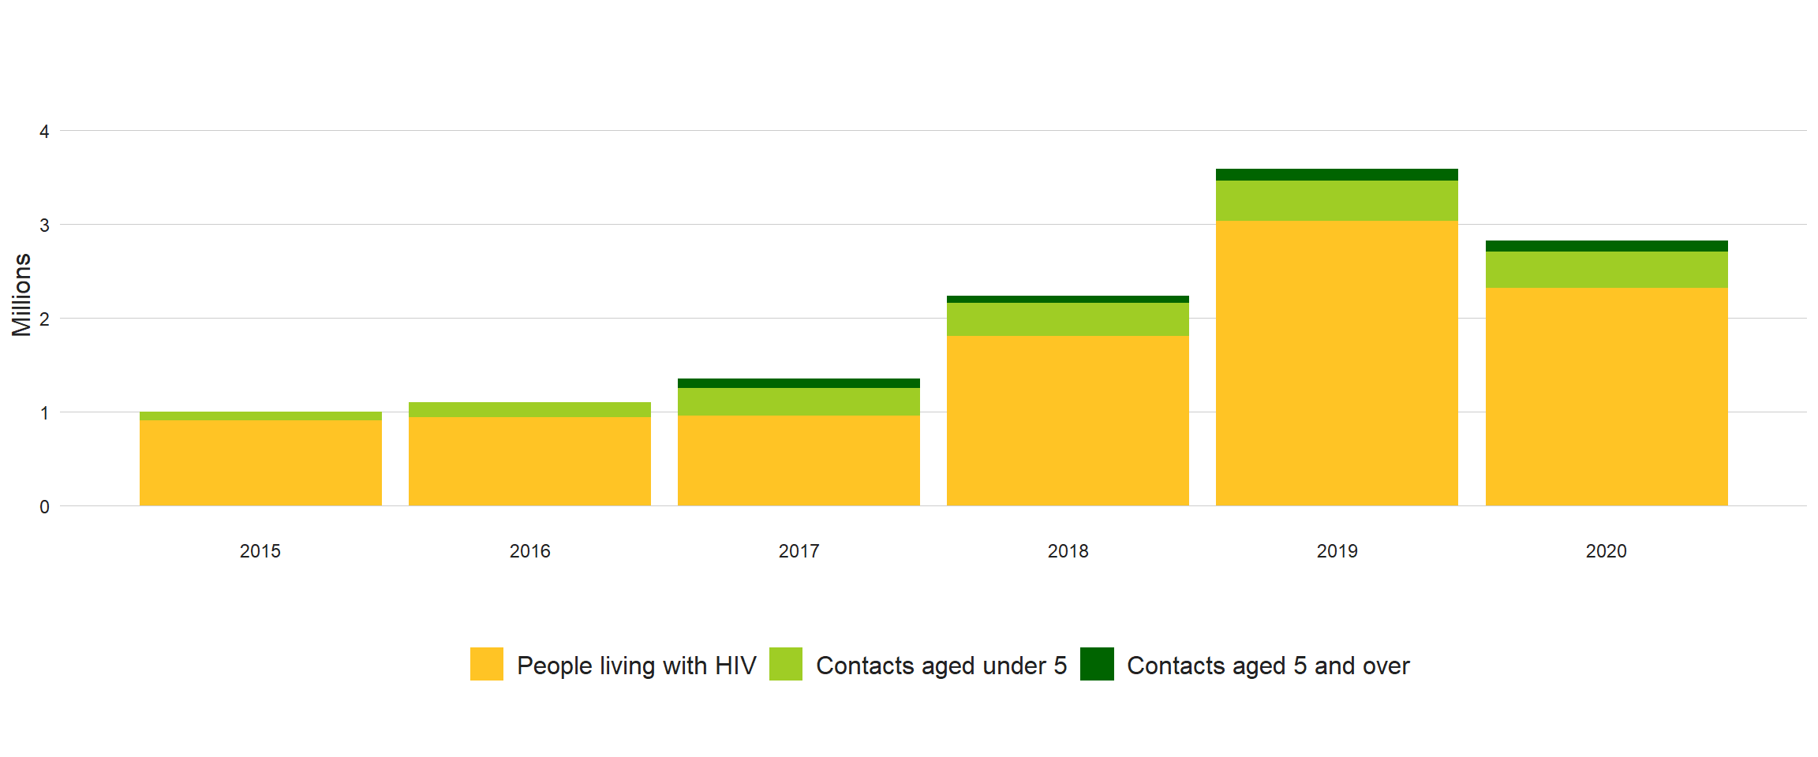
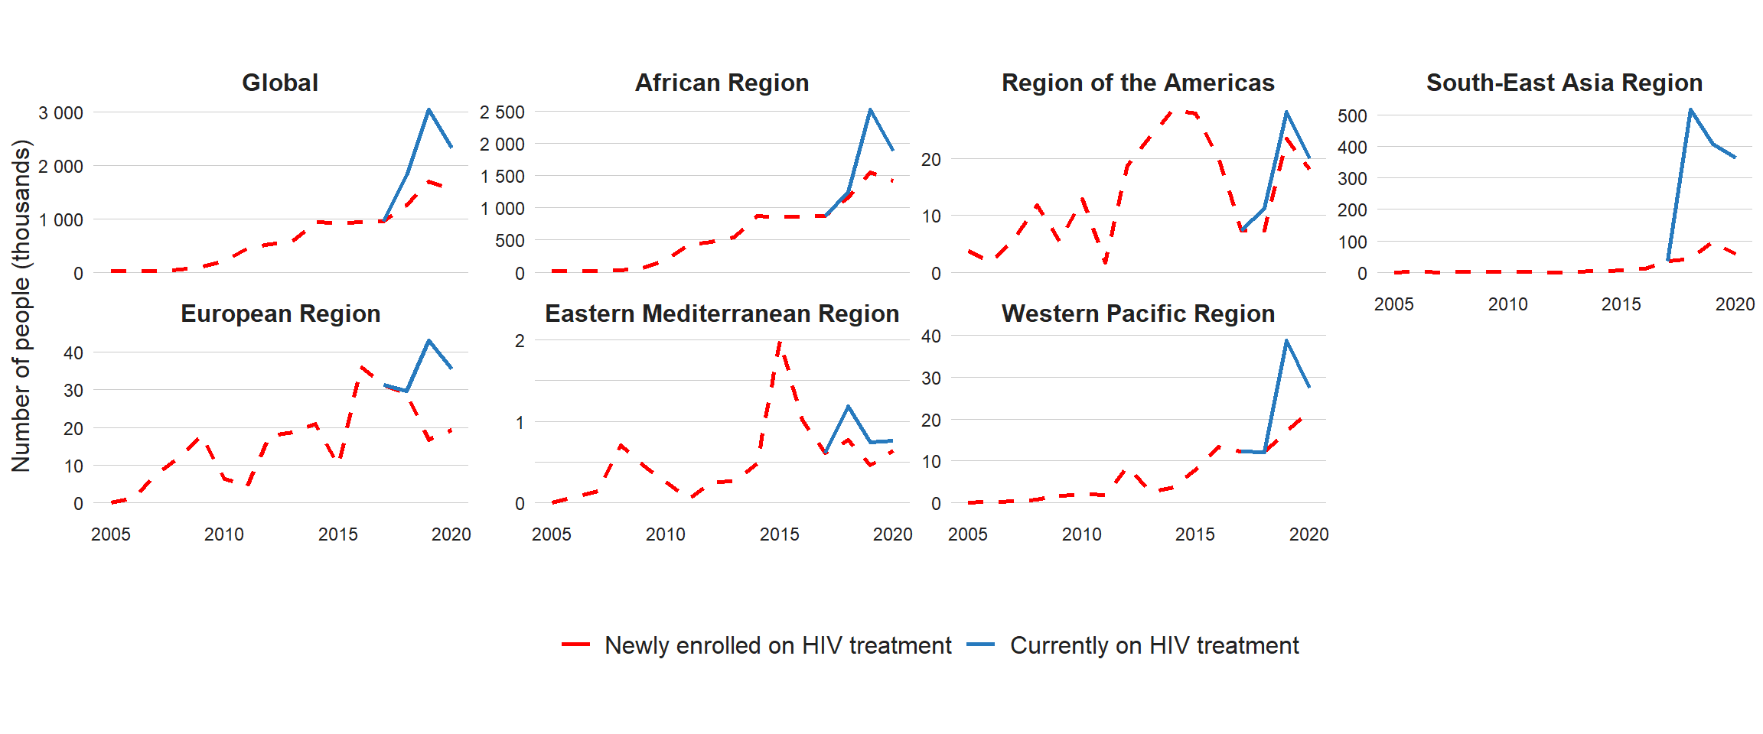
TB Preventive Therapy
Preventing TB infection and stopping progression from infection to disease are critical to reduce TB incidence
One of the main health care interventions to achieve this reduction is TB Preventive Treatment (TPT), recommended for PLHIV, household contacts of people with TB and other risk groups
3.0 million PLHIV received TPT in 2019, falling to 2.3 million in 2020, a reduction of 23% compared with 2019
30% of 37.7 million people estimated to be living with HIV in 2020 have received TPT
  Coverage varies widely among countries
  Target: 90% by 2025
Global number of people provided with TPT, 2015–2020
Provision of TPT to PLHIVª, 2005–2020
a For the period 2005–2016, countries were requested to report data for people newly enrolled in HIV care (dashed lines). Subsequently, countries have been encouraged to report data for people currently on antiretroviral treatment (solid lines).

Slide 6
Expanding Coverage and Quality of TPT
Substantial intensification and expansion of efforts will be required to reach the targets for provision of TPT
This will require:
  More TB screening at household level
  Strengthening the follow-up to TB screening at both household level and among PLHIV
  Increased access to shorter (1–3 months) rifamycin-based regimens.
Urgent action, given the serious disruptions to essential TB services caused by the COVID-19 pandemic since 2020

Slide 7
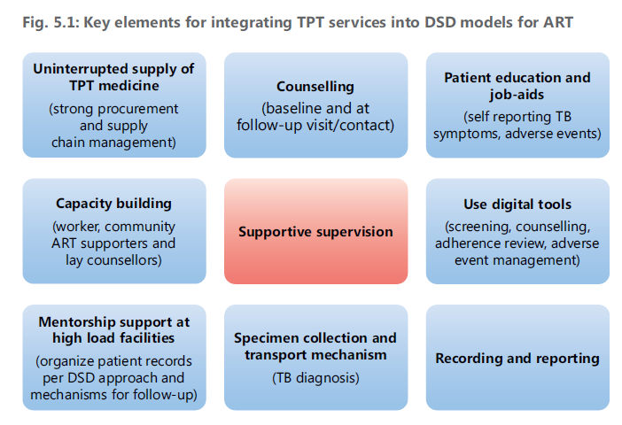
Integrating TPT into DSD Models for ART
Taking DSD models to scale while ensuring high quality services
Intensified TB case finding and TPT should be integrated within these models.
Establishing DSD should not become a reason for delaying or denying benefits of TPT to PLHIV.
  Patient visits should be scheduled such that they can pick up ART and TPT drugs at the same time.
  Adherence and adverse events monitoring should be shifted/shared to peers for those in community DSD models.
WHO operational handbook on tuberculosis. Module 1: prevention - tuberculosis preventive treatment. Geneva: World Health Organization; 2020. Licence: CC BY-NC-SA 3.0 IGO

Slide 8
Proposed TPT Standards of Care
Everyone at high risk of developing tuberculosis (TB) should be systematically identified and provided access to a full course of TPT to improve individual health and reduce ongoing TB transmission.
  Recipients of Care (ROC) are at elevated risk of progression from TB infection to disease and should be screened for TB symptoms at every opportunity or when in contact with a health worker. TB screening should be incorporated into differentiated HIV service delivery models for all ROC.
  ROC who are presumed to have TB should receive prompt diagnostic testing for TB with rapid molecular tests, and TB treatment if found positive (referral from DART model to facility for diagnostic follow up)
  ROC without TB symptoms should be evaluated for eligibility for TPT:
  All ROC who are identified as eligible for TPT while enrolled in a DART model should be offered TPT including standardized client education, adherence monitoring and support, and adverse events monitoring, with standardized endpoints. Careful attention should be paid to integration of TPT within DART models, including harmonization of TPT and ART dispensing and health facility visits

Slide 9
CQUIN’s Capability Maturity Model Dashboard to Guide Annual Self-assessments
TB/HIV | National HIV treatment guidelines do not define a minimum package* of TPT services | National HIV treatment guidelines define a minimum package* for TPT But TPT is not integrated within differentiated treatment (DART) models | The national HIV treatment guidelines define a minimum package for TPT and the country monitors progress towards national TPT coverage among clients enrolled in DART semi-annually But TPT coverage among clients enrolled in DART is < 50% | The national HIV treatment guidelines define a minimum package for TPT and the country monitors progress towards national TPT coverage among clients enrolled in DART semi-annually and TPT coverage among clients enrolled in DART is 50-75% | The national HIV treatment guidelines define a minimum package for TPT and the country monitors progress towards national TPT coverage among clients enrolled in DART semi-annually and TPT coverage among clients enrolled in DART is greater than 75%

Slide 10
Zimbabwe 3HP Fast Track Study: Brief Overview
Goal:
To improve TB preventive treatment (TPT) coverage amongst PLHIV in less-intensive differentiated treatment models, ICAP partnered with MoHCC, HRSA, CDC, and ZNNP+ to assess integration of TPT into Fast Track (FT) models.
Objective:
To explore the feasibility and acceptability of integrating 3HP into the FT model without additional HF visits by:
  Piloting 3HP for adults enrolled in FT at an urban hospital
  Assessing 3HP initiation and completion rates
  Surveying patients re: experience with this approach to 3HP, including adherence, tolerability, side effects, perceived quality of counseling and care, convenience, acceptability
  Surveying healthcare providers (HCP) re: their experience providing 3HP and their assessment of feasibility and acceptability
Participants:
50 Patients: 3HP-eligible adults ≥ 18 years, in Fast Track for at least 3 months
11 HCP: 4 nurses, 4 primary counselors, 3 linkage facilitators/health officers working at study site for ≥ 6 months

Slide 11
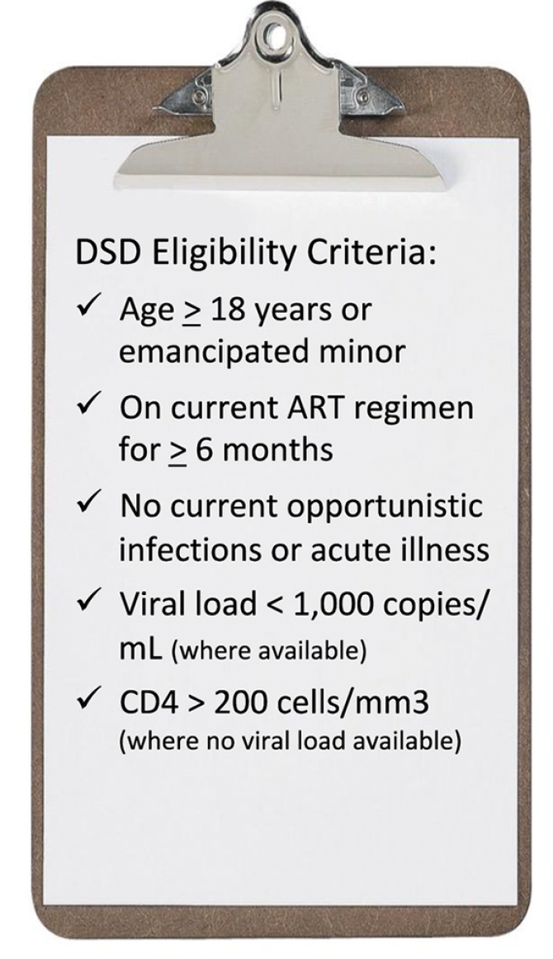
Zimbabwe’s Fast Track Model
Facility-based individual model for adults established on ART (“stable patients”)
  Patients come to HF quarterly to collect medication from pharmacy/dispensing point
  Annual clinical examination + labs
Approximately 14% of people on ART in Zimbabwe are enrolled in FT
The pilot was designed to align TPT with the routine FT visit and dispensing schedule
  Recruited PLHIV attending routine FT visit
  Utilized mobile phone follow up and counseling instead of additional visits

Slide 12
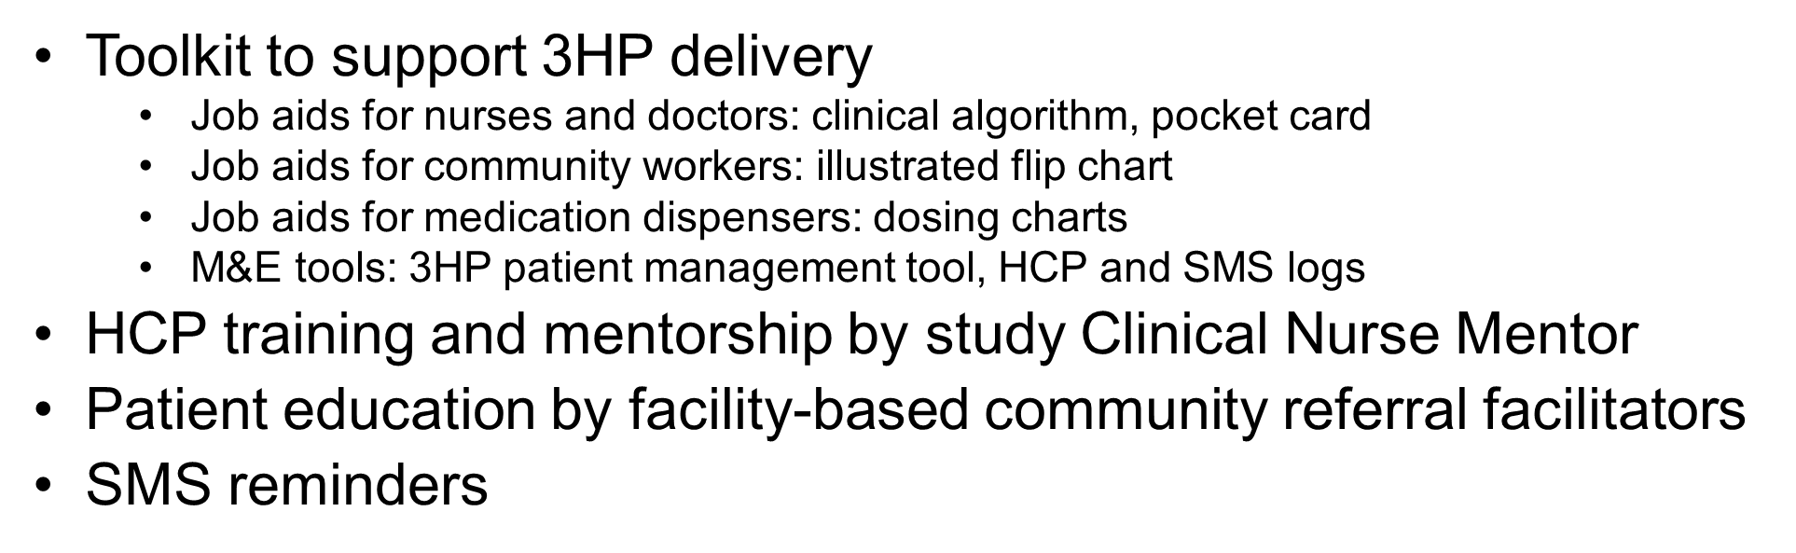
Timeline
Participants, N=50
Healthcare Providers, N=11
Enrollment
Baseline visit
3HP & vit B6 dispensed
Phone
check-in
Phone
check-in*
Phone
check-in*
Endline visit
week 1
week 2
week 3
week 4
week 5
week 6
week 7
week 8
week 9
week 10
week 11
week 12
Patient survey
Patient IDI
Chart abstraction
Patient follow-up tracking tool
Patient follow-up tracking tool
Patient follow-up tracking tool
Patient survey
Patient IDI
Patient medication tracker abstraction
HCP IDI
Site assessments conducted monthly
from April to September, N=6
*Home visits were allowed, but were not needed

Slide 13
Baseline Views on TB, TPT and 3HP through Fast Track
Knowledge of TB
  Most participants had little to moderate understanding of TB
  Knowledge was mostly regarding TB symptoms; less knowledge regarding diagnosis and treatment
  Participants were aware of risk of TB
Knowledge of TPT
  Most participants had never heard of TPT
  The few who had taken TPT in the past did not remember much about the treatment
3HP through Fast Track
  Despite limited understanding and knowledge of TB and TPT, most participants think 3HP through FT is a good idea and a convenient/helpful method of TPT delivery
  Participants were confident in their ability to adhere to 3HP with support of HCPs
  Concerns about drug interactions, ability to remember once weekly dosing, pill burden on 3HP days
  Need support in order to adhere, including nutritional support, adherence support, informational support

Slide 14
Pilot Completion and Adherence
Participant Pilot Completion
  49 (98%) participants completed 3HP
    44 participants completed within 12 weeks
  1 (2%) participant stopped 3HP due to jaundice
  All 50 participants completed all 3 remote check ins (via phone call) as intended
Patient ART & 3HP Adherence
  Participants reported high ART adherence at baseline and exit
    74% reported ‘very good’ or ‘excellent’ adherence within last 30 days (baseline survey)
    86% reported ‘very good’ or ‘excellent’ adherence within last 30 days (exit survey)
  3HP adherence was good as well
    86% reported ‘very good’ or ‘excellent’ adherence within last 30 days (exit survey)

Slide 15
Views on 3HP through Fast Track

Slide 16
Views on 3HP through Fast Track cont.
Strongly disagree (n=1); participant who had to stop participating due to jaundice

Slide 17
Session Objectives
Learn about current TPT guidelines and implementation practices in CQUIN network countries
Discuss facilitators and common barriers for aligning ART and TPT drug dispensing through differentiated treatment models
Initiate discussion about the TPT package of care and related quality standards of care for integrating TPT in DSD

