Slide 1
Delivering High-Quality Advanced HIV Disease (AHD) Services
[Presenter name]
[Presenter Title and Affiliation]
[date] August 2021
Maureen Syowai and Peter Ehrenkranz
29 April 2022

Slide 2


Co-moderators
Peter Ehrenkranz
Deputy Director, HIV Testing and Treatment
Bill & Melinda Gates Foundation, USA
Maureen Syowai
Regional Technical Specialist
ICAP at Columbia University, Kenya

Slide 3
Objectives
To understand the health systems approach to AHD using the CQUIN AHD Capability Maturity Model
To understand the global and country-level gaps and challenges in AHD service delivery and AHD quality standards
To begin to draft AHD quality standards

Slide 4



Session Agenda
Welcome and Introductions: Peter Ehrenkranz
Framing Remarks: Maureen Syowai
AHD Jamboard Session: Maureen Syowai & Peter Ehrenkranz
  Review and discuss anonymous views from the audience on gaps and challenges in AHD service delivery
Panel Discussion - perspectives on quality AHD services: Peter Ehrenkranz & Maureen Syowai
  Lindiwe M. Simelane, National Coordinator Eswatini AIDS Support Organization
  Linah Kampilimba Mwango, CIHEB Zambia
  Paul Nyasulu, MOH Malawi
Discussion on AHD quality standards: Peter Ehrenkranz & Maureen Syowai
Closing remarks: Maureen Syowai
Interactive!

Slide 5



Session Agenda
Welcome and Introductions: Peter Ehrenkranz
Framing Remarks: Maureen Syowai
AHD Jamboard Session: Maureen Syowai & Peter Ehrenkranz
  Review and discuss anonymous views from the audience on gaps and challenges in AHD service delivery
Panel Discussion - perspectives on quality AHD services: Peter Ehrenkranz & Maureen Syowai
  Lindiwe M. Simelane, National Coordinator Eswatini AIDS Support Organization
  Linah Kampilimba Mwango, CIHEB Zambia
  Paul Nyasulu, MOH Malawi
Discussion on AHD quality standards: Peter Ehrenkranz & Maureen Syowai
Closing remarks: Maureen Syowai
Interactive!

Slide 6
Outline
Epidemiology of AHD
A Health System Approach to AHD
The CQUIN AHD Journey
The CQUIN AHD Capability Maturity Model
Findings from the CQUIN AHD Capability Maturity Model
  Overall Findings 2021 / 2022
  Quality Domain Findings

Slide 7
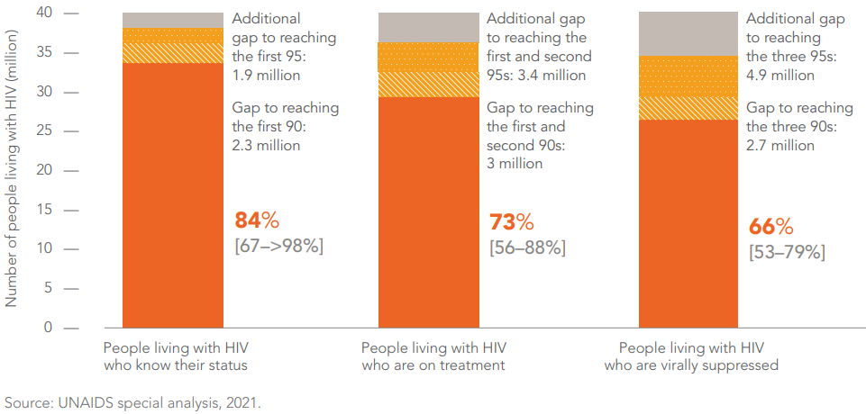
Epidemiology of AHD
At the end of 2020 an estimated 27.5 million [26.5 million–27.7 million] PLHIV globally were on ARV medicines
There has been increasing access to ART over the years particularly following the test and treat guidance
HIV TESTING AND TREATMENT CASCADE, GLOBAL, 2020
Notes:
At the end of 2020,
84% [67–>98%] of people living with HIV knew their HIV status,
87% [67–>98%] of people living with HIV who knew their HIV status were accessing antiretroviral therapy, and
90% [70–>98%] of people on treatment were virally suppressed.

Slide 8
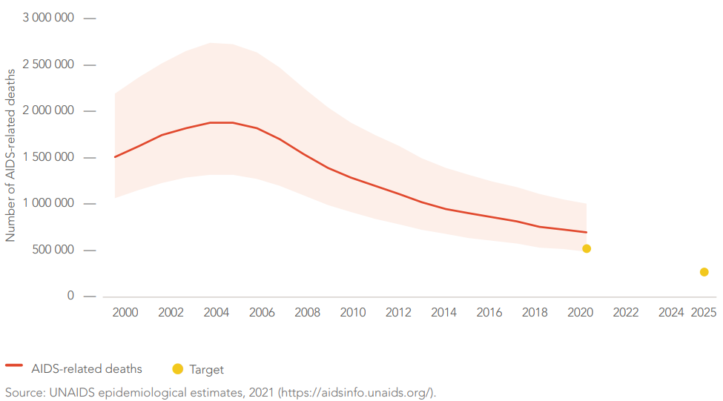
Epidemiology of AHD
AIDS-RELATED DEATHS, GLOBAL, 2000–2020, AND 2020 AND 2025 TARGETS
There has been a decline in HIV-associated mortality over the years as access to ART has increased, nonetheless there is evident plateauing of this decline
An estimated 680 000 [480 000–1 000 000] deaths from AIDS-related causes occurred in 2020

Slide 9
Epidemiology of AHD
AHD is seen in about a third of PLHIV presenting to care¹ with a wide range from 14.5% in Uganda to 29.8% in Cameroon²
PLHIV with AHD have a high risk of OIs
High risk of mortality and morbidity - Worse with CD4 <50 cell/mm³
It is estimated that >50% mortality is associated with AHD
¹Carmona S, Bor J, Nattey C, Maughan-Brown B, Maskew M, Fox MP, et al. Persistent high burden of advanced HIV disease among patients seeking care in South Africa’s National HIV Program: data from a Nationwide Laboratory Cohort. Clin Infect Dis. 2018;66(2):S111–7.
²Lamp K, McGovern S, Fong Y, Atem CD, Nfetam JBE, Nzuobontane D, et al. (2020) Proportions of CD4 test results indicating advanced HIV disease remain consistently high at primary health care facilities across four high HIV burden countries. PLoS ONE 15(1): e0226987. https://doi. org/10.1371/journal.pone.0226987

Slide 10
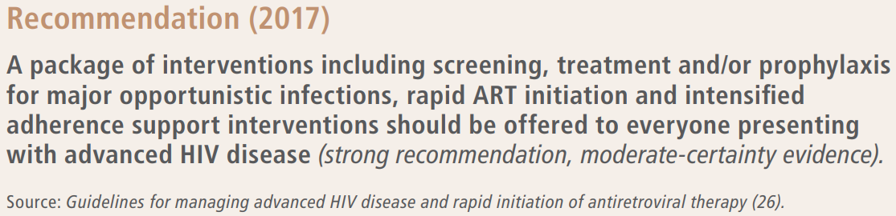
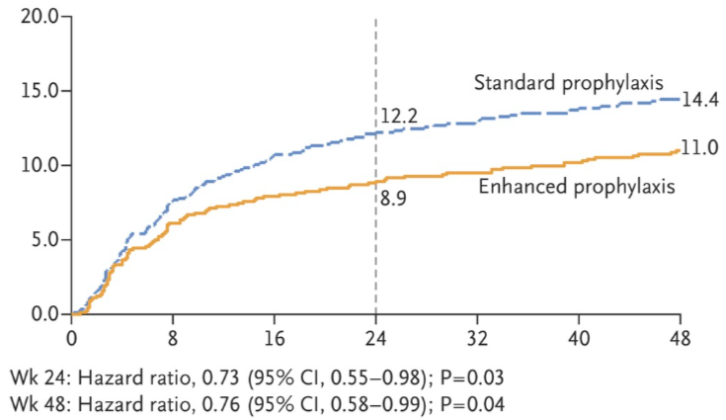
WHO AHD Package of Care
REALITY Trial
Enhanced antimicrobial prophylaxis combined with ART resulted in reduced rates of death at both 24 weeks (27% (from 12.2% to 8.9%)) and 48 weeks (24% lower rate (from 14.4% to 11%)) with most of the deaths occurring within the first three weeks
Recommendation based on two randomized controlled trials: REMSTART and REALITY
REMSTART Trial
Mortality was 28% lower in the clinic (Std care plus CrAg screening & pre-emptive treatment) plus community support group than in standard care group
Notes:
REALITY
Enhanced prophylaxis consisted of a single dose (400 mg) of albendazole, 5 days of azithromycin (500 mg once daily), 12 weeks of fluconazole (100 mg once daily), and 12 weeks of a fixed-dose combination of trimethoprim–sulfamethoxazole (160 mg of trimethoprim and 800 mg of sulfamethoxazole), isoniazid (300 mg), and pyridoxine (25 mg) as a scored once-daily tablet (total, three tablets per day for 1 to 5 days, then two pills per day for 12 weeks).
REMSTART
Enhanced clinic-based care with serum cryptococcal antigen screening and pre-emptive antifungal treatment for those who tested cryptococcal antigen–positive and additional community support (comprising a weekly home or community visit by trained and paid lay workers who delivered ART, provided adherence support and monitored participants for signs and symptoms of drug toxicity or new symptoms).
Hakim J, Musiime V, Szubert AJ, et al; REALITY Trial Team. Enhanced prophylaxis plus antiretroviral therapy for dvanced HIV infection in Africa. N Engl J Med 2017; 377:233–45.
Mfinanga S, Chanda D, Kivuyo SL, et al; REMSTART trial team. Cryptococcal meningitis screening and community-based early adherence support in people with advanced HIV infection starting antiretroviral therapy in Tanzania and Zambia: an open-label, randomised controlled trial. Lancet 2015; 385:2173–82.

Slide 11
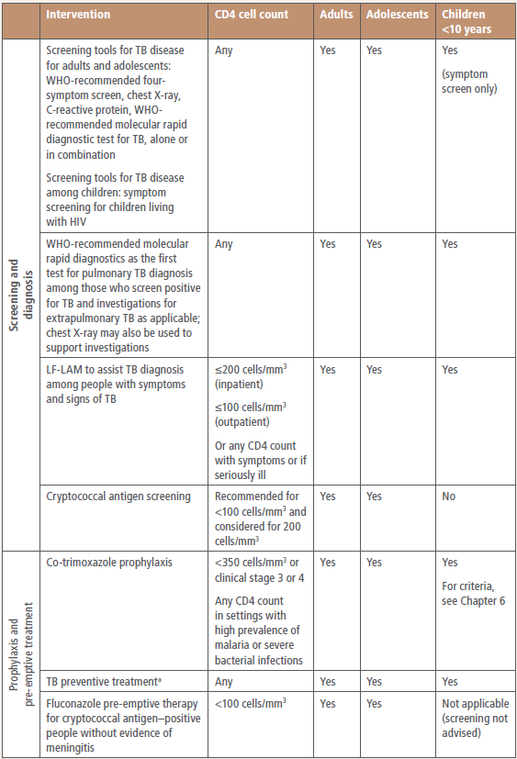
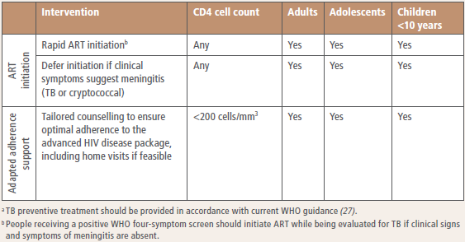
WHO AHD Package of Care
Countries adapt the WHO AHD package of care to the national policy and guideline documents
This adapted AHD minimum POC forms the basis of AHD implementation in-country
Components of the package of care for people with advanced HIV disease
Screening and Diagnosis
Prophylaxis and pre-emptive treatment
ART initiation
Adapted adherence support

Slide 12


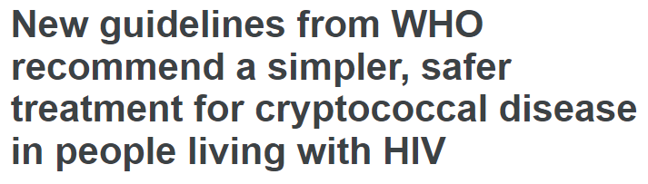
WHO Guidance on CM Treatment
Rapid Advice
20 April 2022
New guidelines developed by WHO strongly recommend a single high dose of liposomal amphotericin B as part of the preferred induction regimen for the treatment of cryptococcal meningitis in people living with HIV.

Slide 13











A Health System Approach to AHD
AHD Service Delivery
Global Guidance
National Policy and Guidelines
AHD Service Delivery Networks
Implementation Considerations
Enables countries to carefully move from adapting global guidance to national guidance to implementation with the ultimate impact of averting unnecessary HIV associated mortality due to AHD

Slide 14






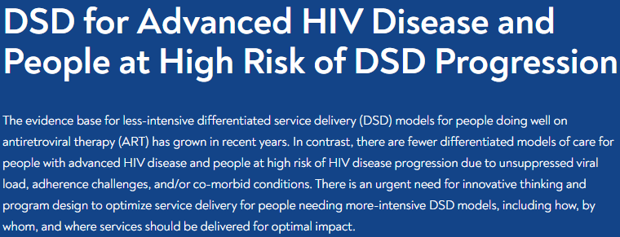
The CQUIN AHD Journey
2021
Onward and upward!
Revised AHD Dashboard & developed the AHD SOPs
Piloted the AHD Dashboard & SOPs
Held AHD Webinar: Updates from the CQUIN Network
Finalized French and English versions of the AHD package
2020
Time to Act
Virtual AHD Workshop Co-hosted with CHAI & UNITAID
Initial development and piloting of the CQUIN AHD Dashboard
2018-2019
A Call to Action
Differentiated Care for Adults at High Risk of HIV Disease Progression: A Call to Action
Screening Tool to Identify and Support P@HR
2017
Inception
All-network meeting on DSD for people with advanced HIV disease and people at high risk of HIV disease progression (P@HR)

Slide 15
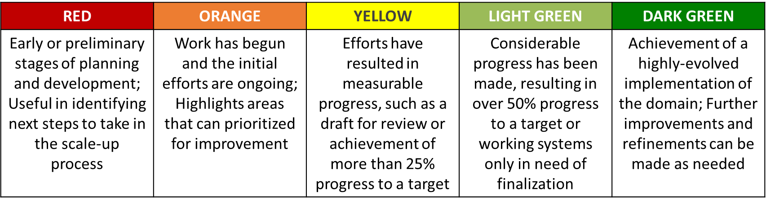
The CQUIN AHD Capability Maturity Model
The CMM is a structured collection of domains that describe the characteristics of effective / optimized AHD processes
There are five stages of maturity to the CQUIN CMM:
The AHD capability maturity model was developed to aid CQUIN member countries adapt the response to their AHD program implementation to a HSS approach

Slide 16
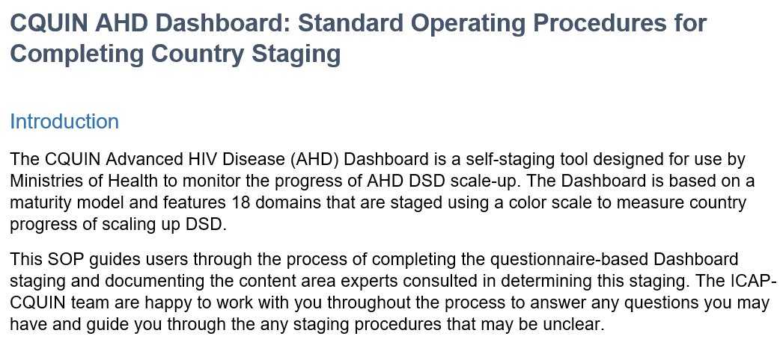
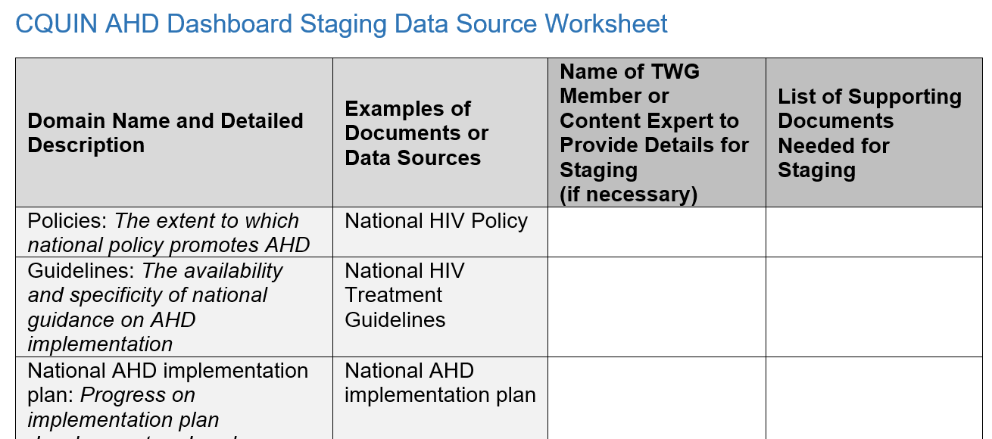
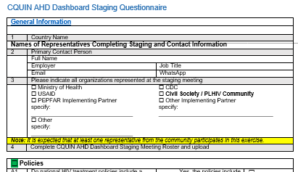
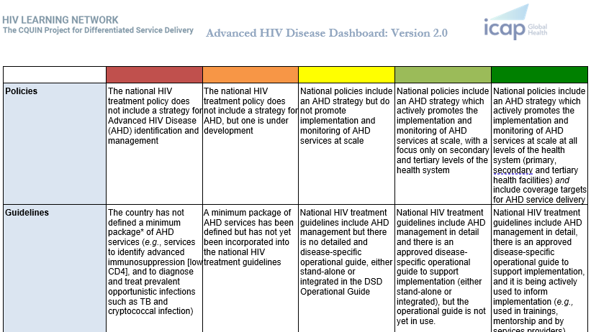
CQUIN AHD Dashboard and AHD Dashboard SOPs
Developed collaboratively in 2020/2021 by a 10-person team drawn from six countries with a wealth of experience on DSD implementation in SSA. Complete AHD Dashboard Pilot Package:
CQUIN AHD Dashboard Staging SOP
Outlines the procedures and processes of completing the AHD dashboard exercise and submitting the report to CQUIN
CQUIN AHD Dashboard Staging
Data Source Worksheet
Maps out the data source used and TWG members to be engaged in completing the AHD dashboard
CQUIN AHD Dashboard
Staging Questionnaire
Comprises of a set of guiding questions for each domain to allow for an objective review of the AHD domain under review
CQUIN AHD Dashboard Version 2.0
A self staging capability maturity model with 18 domains representing necessary components for implementing AHD services at scale with 5 stages of maturity represented by a color scale – from red (initial stage) to dark green (mature stage)
16
Notes:
Subsequent slides detail the AHD dashboard – Dark Green Domain
As a reminder, completion of each domain is guided by the AHD staging questionnaire

Slide 17
The AHD Domains
 | AHD Domains | Dark Green Domain Description
1 | Policies | National policies include an AHD strategy which actively promotes the implementation and monitoring of AHD services at scale at all levels of the health system (primary, secondary and tertiary health facilities) and include coverage targets for AHD service delivery
2 | Guidelines | National HIV treatment guidelines include AHD management in detail, there is an approved disease-specific operational guide to support implementation, and it is being actively used to inform implementation (e.g., used in trainings, mentorship and by services providers).
3 | National AHD Implementation Plan | A national AHD scale-up plan has been developed, is being implemented nationwide, and key milestones are being regularly monitored
4 | Standard Operating Protocols (SOPs) | National AHD SOPs have been developed for all the diseases in the minimum AHD package AND all of them are in use
5 | Coordination | There is a National DSD Focal Person or someone in similar coordination role at the national level whose role includes spearheading AHD activities
6 | Engagement of Recipients of Care | PLHIV are meaningfully engaged in implementation and evaluation of AHD, as well as oversight of AHD policy (e.g., through inclusion in DSD task force or other group)
7 | Training | There is a national in-service AHD training curriculum or module(s) in place and systematic trainings based on the scale up plan have been completed for all health facilities
Notes:
There are currently 18 AHD Domains, with some uniqueness including:
The diagnostic capability domain is divided into two (Identifying AHD & Identifying OI)
The patient coverage domain is divided into four (Testing for AHD, OI screening, OI prophylaxis, & OI management)
There is an added domain on supply chain management for AHD commodities
The AHD domains are aligned with the WHO HSS building blocks calling for a paradigm shift from a clinical to a HSS approach to AHD implementation

Slide 18
The AHD Domains
 | AHD Domains | Dark Green Domain Description
8 | Diagnostic Capability 1 (Identifying AHD) | PLHIV are routinely assessed for AHD using CD4 testing or alternative (e.g., universal CrAg and/or TB LAM screening) in > 75% of health facilities
9 | Diagnostic Capability 2 (Identifying OI) | Access to all three of the “minimum package” diagnostic tests are available at > 75% of all health facilities (on site or by referral) AND has a national sample & patient referral system to ensure access to AHD diagnostics by lower-level HF
10 | Facility Coverage | Over 75% of health facilities providing ART have the minimum AHD service package available (on site or by referral)
11 | Patient Coverage 1 (Testing for AHD) | > 75% of eligible PLHIV are routinely assessed for AHD using CD4 testing or alternative (e.g., universal CrAg and/or TB LAM screening)
12 | Patient Coverage 2 (OI Screening) | Over 75% of patients with advanced immunosuppression receive the screening services for TB and CM as per the national AHD package (e.g., TB LAM, CrAg)
13 | Patient Coverage 3 (OI Prophylaxis) | More than 75% of eligible patients receive the OI prevention services in the national AHD package (e.g., TPT, CTX, cryptococcal prophylaxis)
14 | Patient Coverage 4 (OI Management) | More than 75% of eligible patients receive the OI management services in the national AHD package (e.g., treatment of TB, cryptococcus and other OIs)

Slide 19
The AHD Domains
 | AHD Domains | Dark Green Domain Description
15 | Supply Chain Management for AHD Commodities | An integrated AHD related commodities forecasting, quantification and procurement implemented for all relevant opportunistic infections with effective procurement plan, warehousing and distribution and consumption in place and no stock-outs reported in the past 3 months.
16 | M&E System | All of the necessary AHD-related data elements are being systematically collected, reported, analyzed and reviewed regularly and are integrated into national M&E tools and the national HMIS for HIV/ART services.
17 | Quality of AHD Services | Repeated evaluations of AHD service quality have found that the program meets established national quality standards
18 | Impact of AHD Services | Repeated evaluations of implementation of the national AHD package of care have been conducted, with evidence indicating ongoing impact in both process and outcome indicators

Slide 20









Process of Implementing the AHD Dashboard
AHD Stakeholders
Resources & Data Collection
AHD Staging
AHD Action Plan
MOH to identify and co-opt key AHD stakeholders
Collectively review the AHD questionnaire & compile findings
Develop & monitor a national AHD action plan
Collate the national AHD resources and data
AHD Toolkit
AHD TWG
AHD Dashboard submission
Review the CQUIN AHD Dashboard and SOPs
Convene the AHD TWG
Submit the AHD documents
Annual staging using the AHD capability maturity model is recommended with frequent monitoring of the AHD action plan

Slide 21
Summary of AHD Dashboard Findings
AHD Dashboard findings by country show variability in maturity of country health systems in supporting the implementation of the AHD package of care with many countries being in the early stages of AHD program implementation
Notes:
The AHD dashboard findings enables ministries of health and their stakeholders to develop clear and concise action plans targeting the scale-up of AHD services
CQUIN encourages member countries to review their AHD dashboards and make deliberate and decisive plans aimed to improve AHD services in their countries.
In addition, to think through the resources that will be needed to actualize their action plans in support of AHD services.
The AHD dashboard also assists the CQUIN leadership to identify countries with best practices as well as areas of shared challenges to facilitate co-creation of solutions and support country to country learning exchange.

Slide 22
Summary of AHD Dashboard Findings
Looking at the summary of AHD staging by Maturity of Domains, countries are in the initial stages of AHD implementation shown by the domains in dark green and green being predominantly on the left and the domains in red, orange and yellow colors predominantly on the right
Notes:
Maturation in domains such as policies, guidelines, and coordination are key enablers in AHD implementation
Presence of a national AHD implementation plan, SOPs, RoC engagement, training are likely facilitators to AHD implementation

Slide 23
AHD Quality Findings
50% of countries self staged as Red
  Quality standards for AHD services have not been defined and are not currently in development
30% Orange
  National quality standards for AHD services are in development or have been defined, but no evaluations of quality using national standards have been completed
20% Yellow
  At least one evaluation of AHD service quality has been conducted using the national quality standards, but the results do not indicate that standards have been met
Evident gap to be addressed in defining and evaluating national AHD quality standards and indicators

Slide 24
Q&A

Slide 25
Session Agenda
Welcome and Introductions: Peter Ehrenkranz
Framing Remarks: Maureen Syowai
AHD Jamboard Session: Maureen Syowai & Peter Ehrenkranz
  Review and discuss anonymous views from the audience on gaps and challenges in AHD service delivery
Panel Discussion - perspectives on quality AHD services: Peter Ehrenkranz & Maureen Syowai
  Lindiwe M. Simelane, National Coordinator Eswatini AIDS Support Organization
  Linah Kampilimba Mwango, CIHEB Zambia
  Paul Nyasulu, MOH Malawi
Discussion on AHD quality standards: Peter Ehrenkranz & Maureen Syowai
Closing remarks: Maureen Syowai
Interactive!

Slide 26
AHD Jamboard Session
Interactive!
Aim:
Gather anonymous views from the audience on gaps and challenges in AHD service delivery and AHD quality standards
SO… feel free to let us know what your thoughts are!
Using your phone or computer, go to xxx [Insert Jamboard link]

Slide 27
AHD Jamboard Session
What global-level challenges have you encountered / anticipate in supporting AHD services?
Jamboard link: [To be inserted]

Slide 28
AHD Jamboard Session
What country-level (national, sub-national and facility level) challenges do you encounter / anticipate in establishing functional AHD hub and spoke networks?
Jamboard link: [To be inserted]

Slide 29
AHD Jamboard Session
Given the new recommendation on using single high dose of liposomal amphotericin B, what challenges / implementation considerations do you anticipate your country will face in adapting to this guidance?
Jamboard link: [To be inserted]

Slide 30
AHD Jamboard Session
In your view, what support to countries should global agencies prioritize in addressing gaps in AHD ? E.g., WHO, UNITAID, UNAIDS, PEPFAR, GF, BMGF
Jamboard link: [To be inserted]

Slide 31
Session Agenda
Welcome and Introductions: Peter Ehrenkranz
Framing Remarks: Maureen Syowai
AHD Jamboard Session: Maureen Syowai & Peter Ehrenkranz
  Review and discuss anonymous views from the audience on gaps and challenges in AHD service delivery
Panel Discussion - perspectives on quality AHD services: Peter Ehrenkranz & Maureen Syowai
  Lindiwe M. Simelane, National Coordinator Eswatini AIDS Support Organization
  Linah Kampilimba Mwango, CIHEB Zambia
  Paul Nyasulu, MOH Malawi
Discussion on AHD quality standards: Peter Ehrenkranz & Maureen Syowai
Closing remarks: Maureen Syowai
Interactive!

Slide 32



Panel Discussion
Perspectives on quality AHD services
Linah Kampilimba Mwango
Deputy Chief of Party (D-COP) at CIHEB Zambia in the Community HIV prevention, Community led monitoring and COVID 19 Vaccination program.
Paul Nyasulu
HIV Care & Treatment Program Officer
Ministry of Health, Malawi
Lindiwe M. Simelane
National Coordinator, Eswatini AIDS Support Organization

Slide 33
Session Agenda
Welcome and Introductions: Peter Ehrenkranz
Framing Remarks: Maureen Syowai
AHD Jamboard Session: Maureen Syowai & Peter Ehrenkranz
  Review and discuss anonymous views from the audience on gaps and challenges in AHD service delivery
Panel Discussion - perspectives on quality AHD services: Peter Ehrenkranz & Maureen Syowai
  Lindiwe M. Simelane, National Coordinator Eswatini AIDS Support Organization
  Linah Kampilimba Mwango, CIHEB Zambia
  Paul Nyasulu, MOH Malawi
Discussion on AHD quality standards: Peter Ehrenkranz & Maureen Syowai
Closing remarks: Maureen Syowai
Interactive!

Slide 34
AHD Quality Standards
As highlighted during the framing remarks, majority of CQUIN member countries that have used AHD capability maturity model reported that they have not yet defined quality standards for AHD services, and these are not currently in development
During this next session we will jointly review a recently developed draft of quality standards for AHD services, as part of an initial process to begin crafting a generic set of AHD quality standards and indicators that CQUIN member countries can begin to adapt and use in-country
As such this will form a first of a series of discussions towards finalizing AHD quality standards and indicators

Slide 35
AHD Quality Standards
Key Output:
Recommendations to the draft AHD quality standards for further development

Slide 36
Thank you!

