Slide 1
Session 10e: How to assess client satisfaction and use the information to improve programs – methods, experiences, and lessons learned

Slide 2
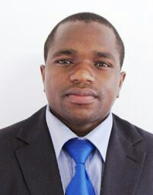
Session Moderator
Tatenda Makoni, MSc, LLB
Executive director of the Zimbabwe National Network of People Living with HIV (ZNNP+)
Notes:
Tatenda Makoni is the executive director for ZNNP+.
He has over a decade of experience implementing health, HIV, protection and rights-based interventions in Zimbabwe, Zambia, Malawi, Eswatini, and Nigeria. He holds a Master of Science Degree in International Relations, a Master of Science Degree in Strategic Management, a bachelor’s degree in Political Science and a Bachelor of Laws Degree (LLB). Mr. Makoni is a member of the Law Society of Zimbabwe and sits on the Institutional Review Board of the Biomedical Research and Training Institute (BRTI-IRB) and as well as on the ARASA Board of Trustees.

Slide 3
Agenda
Introductions
Brief framing remarks
Panel discussion and Q&A

Slide 4
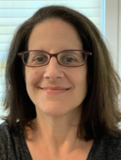
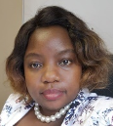
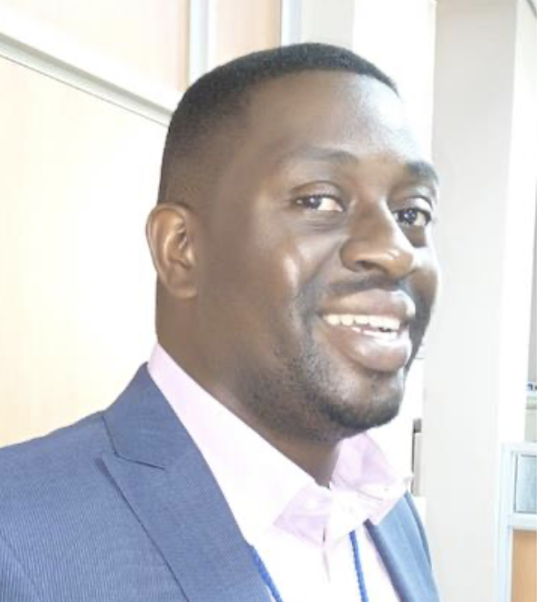
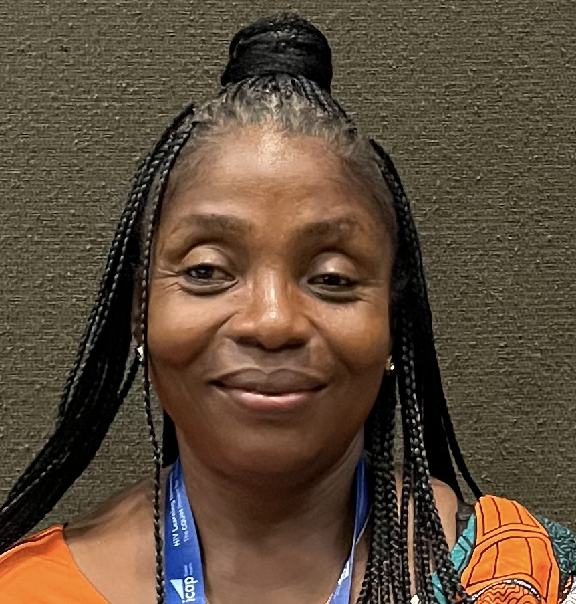
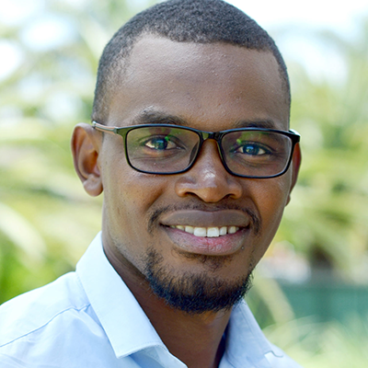
Panelist and Panel Moderators
Miriam Rabkin
ICAP Columbia
Rudo Kuwengwa
ICAP Zimbabwe
Kombatende Sikombe
CIDRZ Zambia
Mary G.H. Jackson
MOH Liberia
Baker Bakashaba
TASO Uganda

Slide 6
Assessing Client Satisfaction: Key Questions
What do we mean by “satisfaction”?
Which clients should we ask?
How should we ask them? What methods and tools should we use?
Who should ask them?
How should we use the data to improve programs?

Slide 7
What do we mean by “satisfaction”?
“Fulfillment of a need or want”
“The pleasure that you feel when you do something or get something that you wanted or needed to do or get”
“The pleasant feeling that you get when you receive something you wanted or when you have done something you wanted to do”
“Fulfilment of one's wishes, expectations, or needs, or the pleasure derived from this.”
“A happy or pleased feeling because of something that you did or something that happened to you.”

Slide 8
The American Customer Satisfaction Index
Satisfaction
Notes:
https://www.theacsi.org/company/the-science-of-customer-satisfaction/

Slide 9
Typical Domains for Healthcare Client Satisfaction
Communication
Provider empathy
Coordination
Cost
AMBIT:
Provider attitude
Trust in the providers
Time spent with the provider
Clinic administrative processes
Information received regarding HIV/ART
Technical skills
Interpersonal skills
Convenience
MOH Uganda:
Accessibility/convenience: place, time of day, day of the week
Environment: cleanliness, easy to find where to go, privacy
Efficiency: waiting time, contact time, cost during visit
Comprehensiveness: health education, counseling, number of visits
Humaneness: friendly, confidentiality, respect, listen, given enough time, involved
Notes:
The Better info study from Zambia too showed that patients were willing to wait​ up to 19 hours and cover up to 45 km for “kind” health care workers

Slide 10
Which clients should we ask?
Sampling strategy:
People retained in care?
People who are late or interrupt engagement?
People lost to follow up?
People who never linked to the HF?

Slide 11
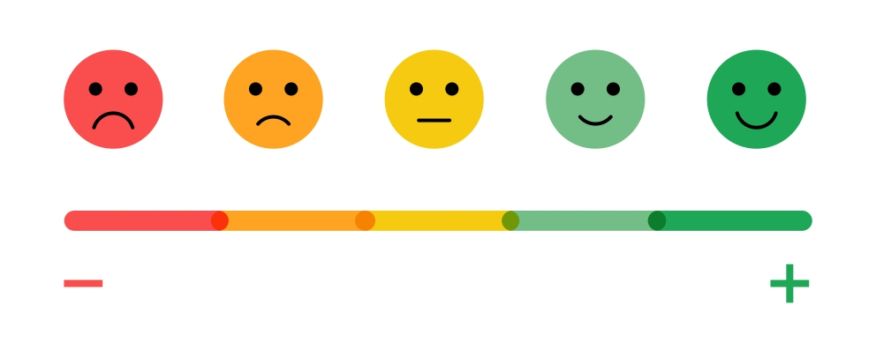
Methods and Tools
Exit interview
Exit SMS survey
Suggestion box
Client relations officer
Phone survey
Focus group discussion
Trained expert clients
Illustrative variables:
Qualitative vs. quantitative
Short vs. long
Frequent vs. infrequent
“Real time” vs. deferred data
Research vs. program

Slide 12
Who should ask?
Facility staff
Health system staff external to the facility
Community (community-led monitoring)
All of the above

Slide 13
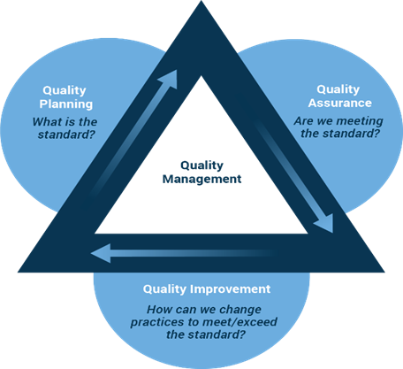
How can we use data to improve programs?

Slide 14
Panelists
Baker Bakashaba
TASO Uganda
Mary G.H. Jackson
MOH Liberia
Tatenda Makoni
ZNNP+ Zimbabwe
Kombatende Sikombe
CIDRZ Zambia

