Slide 1
Community Engagement Tracking Tool
ITPC & Community Advocacy Network

Slide 2
Community engagement
“…a structured, supported, meaningful and accountable process that ensures that people living with HIV have a SEAT and a VOICE in decision-making, planning, implementation, monitoring and evaluation, in order to achieve access to quality HIV care for all.”

Slide 3
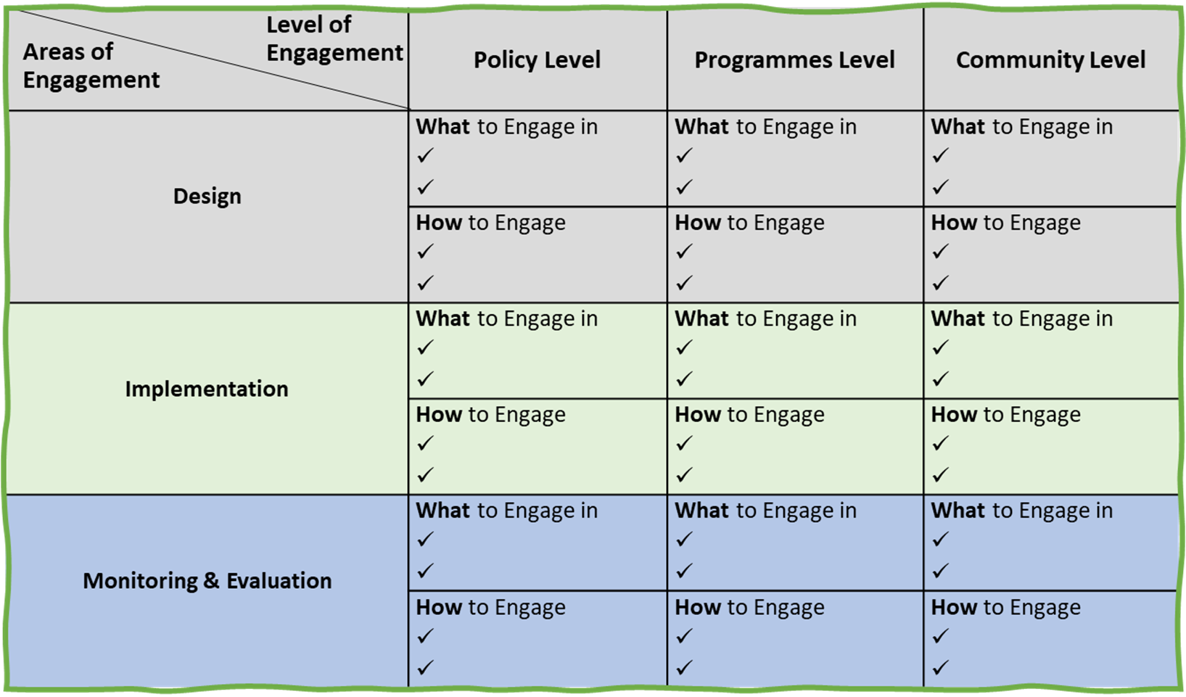
Community Engagement Framework

Slide 4
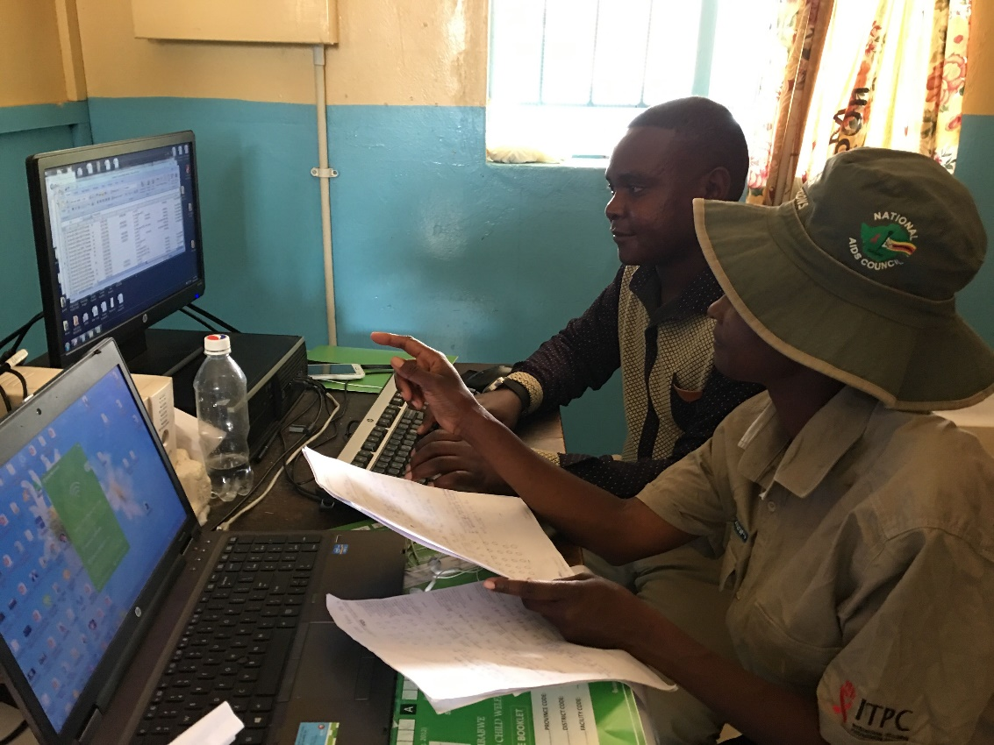
For communities, by communities
The community engagement tracking tool was developed by the ROC community of practice of ICAP CQUIN network, now the Community Advocacy Network (CAN)
The data collection is to be carried out by members of the CAN in their respective countries
This comes as a supplement to the ICAP CQUIN dashboard, completed by ministries, program implementers and communities

Slide 5
 | POLICY LEVEL (6) | PROGRAMMES LEVEL (7) | COMMUNITY LEVEL (6)
DESIGN | % of TWG on DSD where RoC participated % of policy validation exercises where RoC participated % of online DSD platforms that include RoC, policy makers, program implementers and health providers | % of meetings focused on DSD program design where RoC participated % of DSD planning meetings where RoC provided recommendations on prioritization of DSD models | # of community-level platforms established aimed at gathering RoC views on DSD models % of thematic working groups where RoC participated
IMPLEMENTATION | # of communication materials produced by RoC to educate communities about policies, results of evaluations/assessments | % of DSD HF trainings that include RoC as planners and facilitators % of DSD supportive supervision visits that include RoC leaders | % of DSD sensitization/demand creation activities led by or actively involving RoC % of HF with DSD where RoC work as service providers # of trainings organized for peer educators and RoC
MONITORING & EVALUATION | % of M&E meetings that include RoC % of impact assessment exercises where RoC participated | % of DSD M&E tools development meetings where RoC participated % of DSD M&E activities where RoC participated % of self assessments where RoC participated and led on community engagement domain | % of DSD facilities where community score cards and/or client satisfaction surveys are implemented

Slide 6
SCORING LEVELS & DEFINITIONS
COLOUR SCORE
COMMUNITY ENGAGEMENT SCORING DESCRIPTIONS (DSD Dashboard 3.0) | Representatives from the community of people living with HIV (PLHIV) and civil society organizations (CSO) are not involved in any activities related to DSD and there are currently no plans to engage these groups* * use this color score if activity not developed / planned and therefore no CE or plans to engage communities | PLHIV and CSO are not currently engaged in DSD activities, but engagement is planned or meetings and discussions are ongoing | PLHIV and CSO are meaningfully engaged in DSD implementation | PLHIV and CSO are meaningfully engaged in implementation and evaluation of DSDM | PLHIV and CSO are meaningfully engaged in implementation and evaluation of DSD, as well as oversight of DSD policy (e.g., through inclusion in DSD task force or other group)
% DEFINITION | If % is between 0-20% | If % is between 21-40% | If % is between 41-60% | If % is between 61-80% | If % is between 81-100%
SCORE POINTS | 0 | 1 | 2 | 3 | 4

Slide 7
HOW TO ENGAGE | INDICATOR | INDICATOR DESCRIPTION | NUMERATOR | DENOMINATOR | % RESULT | CONFIRMED DATA SOURCES / EVIDENCE | EXAMPLES OF DATA SOURCES / EVIDENCE
 |  |  | # of TWG mtgs on DSD w/RoC participation | # of TWG mtgs organized by MOH where DSD discussed
PL.D1. Consult with RoC leadership to facilitate information-sharing re: DSD models described in DSD policy documents PL.D2. Include RoC/community members in policy and guidelines formulation task teams and TWGs | % of TWG on DSD where RoC participated | To determine the %, take # of TWG meetings where RoC participated divided by the # of TWG organized by the government where DSD was discussed |  |  | #DIV/0! |  | National program listserv for TWG meeting invitations National DSD TWG meeting reports National policy frameworks/guidelines documents with list of contibutors/participants
Snapshot of the tracking tool

Slide 8
Tool pilot results
# | INDICATOR | COUNTRY A | COUNTRY B
PL.D1i. | % of TWG on DSD where RoC participated
PL.D2i. | % of policy validation exercises where RoC participated
PL.D3i. | % of online DSD platforms that include RoC, policy makers, program implementers and health providers
PL.I1i. | # of communication materials produced by RoC to educate communities about policies, results of evaluations/assessments
PL.ME1i. | % of M&E meetings that include RoC
PL.ME2i. | % of impact assessment exercises where RoC participated
PR.D1i. | % of meetings focused on DSD program design where RoC participated
PRL.D2i. | % of DSD planning meetings where RoC provided recommendations on prioritization of DSD models
PRL.I1i. | % of DSD HF trainings that include RoC as planners and facilitators
PRL.I2i. | % of DSD supportive supervision visits that include RoC leaders
PRL.ME1i. | % of DSD M&E tools development meetings where RoC participated
PRL.ME2i. | % of DSD M&E activities where RoC participated
PRL.ME3i. | % of self assessments where RoC participated and led on community engagement domain
CL.D1i. | # of community-level platforms established aimed at gathering RoC views on DSD models
CL.D2i. | % of thematic working groups where RoC participated
CL.I1i. | % of DSD sensitization/demand creation activities led by or actively involving RoC
CL.I2i. | % of HF with DSD where RoC work as service providers
CL.I3i. | # of trainings organized for peer educators and RoC
CL.ME1i. | % of DSD facilities where community score cards and/or client satisfaction surveys are implemented

