Slide 1
GBV PROTOCOL

Slide 2
Methodology of Post GBV Care service
MAPPING OF PARTNERS !!!
Identification of GBV Cases.
LIVES
Referral to gender focal/champion for initiation of other Post GBV services (for documentation and referral for post GBV services).
Support follow-up of PEP administration and HTS
Ensure proper documentation of cases and services provided.
Notes:
On suspicious or report of Sexual assault/rape, Physical and Emotional violence, the following should be done:
Questions should be asked to ascertain if individual is a GBV survivor using the GBV screening form (based on the score – a score =/<2 should be regarded as a GBV case).
After the GBV form has been filled (and individual has been identified as a survivor), individual should be referred to the gender champion for documentation and referral for post GBV care/services.
Follow-up of services provided (PEP, HTS and other referred services).
Scope of work would require the following:
Abide ethics of confidentiality and anti-stigma/discrimination (all staff).
Identification of GBV cases (based on reported or suspected cases that is presented to clinician, nurse, adherence counselor).
Use of screening form to ascertain eligibility for post GBV care (by clinician, nurse, adherence counselor).
Referral to gender champion for post GBV care.
Proper documentation of cases and services provided.
(Bi-weekly report of cases and services provided).

Slide 3
Pathway for Care for GBV/IPV
Violence suspected but not acknowledged/disclosed
Violence identified or disclosed*
Refer for other health care as needed
AND
Refer to available community support services
*Some survivors may need emergency care for injury. Follow standard emergency procedures.
Tell her about services
Offer information on effect of violence on health and children
Offer follow-up visit
Specific mental health conditions?
YES
First-line Support
Listen
Inquire
Validate
Enhance safety
Support
Care for the conditions that brought her there
Treat or, if possible, refer for specific treatment
WHO, 2014
Notes:
WHO Pathway for Care for Violence by Intimate Partner Job Aid
Source: World Health Organization. (‎2014)‎. Health care for women subjected to intimate partner violence or sexual violence: a clinical handbook. World Health Organization. http://www.who.int/iris/handle/10665/136101
If violence is disclosed or suspected, the client must be offered first-line support (LIVES).
Again, countries should develop their own processes and job aids for responding to IPV that are tailored to their specific context.

Slide 5
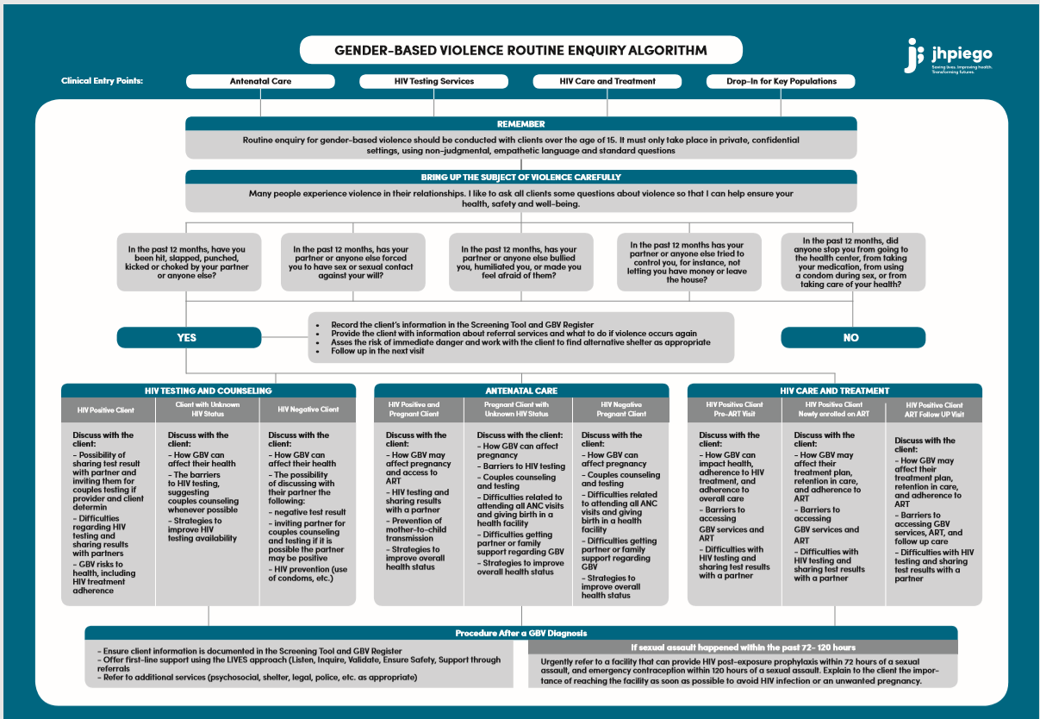

Slide 6
Minimum Requirements for Asking about Violence
The minimum requirements that must be in place for sites to conduct clinical and routine enquiry are:
Providers offer first-line support (LIVES)
A
protocol/SOP for
conducting routine
enquiry
A standard set of questions where providers can document responses
Providers are trained on how to ask about IPV or sexual violence
Providers only ask about IPV or sexual violence in a private setting, confidentiality ensured
A process for offering referrals or linkages to other services is in place
8

Slide 7
First-line Support: LIVES
L I
First-line support is the immediate care given to a GBV survivor upon first contact with the health or criminal justice system.
isten
Listen closely with empathy, not judging.
Assess and respond to the survivor’s needs and concerns – emotional, physical, social, and practical.
nquire about needs and concerns
alidate
V E S
Show that you believe and understand the survivor.
Discuss how to protect the survivor from
further harm.
nsure safety
Help the survivor connect to services, social support.
upport
9

Slide 8
Post-violence Clinical Care Minimum Package
All survivors of physical, emotional, and sexual violence should be offered:
Additionally, survivors of sexual violence should also be offered:
Treatment of injuries
PEP (within 72 hours)
Rapid HIV testing
Emergency contraception
(within 120 hours)
STI testing/screening and treatment
ALL services in the minimum package MUST be in place for sites to report on GEND_GBV.
Counseling (first-line support)
Referrals to other services as necessary
Note: The minimum package must be available, but a client does not need to receive all services
in the minimum package to be counted under GEND_GBV.
11

Slide 9
Index Testing
Index client
Passive PNS
Assisted PNS
Trained provider encourages index client to disclose to sexual partner
Trained provider helps consenting index client to notify sexual partner
Dual Referral
Contract Referral
Provider Referral
Index client agrees to enter into
a contract with the provider to disclose their HIV status
Trained provide accompanies
Index client to disclose HIV status
to the contact
Trained provider confidentially
contacts the partners of the index client

Slide 10
How it is done
Step 1: Introduce the concept of Partner Notification to the Index Client during the pretest counseling.
“I will be asking you about your partners so that we can offer them an HIV test but I will not mention your name”
Step 2: List sexual partners in last 12 months.
“Allow me to list the names and phone numbers of your partners so that we can contact them”
Step 3: Ask if the index client has experienced intimate partner violence from any of the partners.
Have you ever been hit, slapped, kicked or physically hurt by any of your partners?
Step 4: Determine the preferred approach of partner notification for each partners.
“There are two ways we can do this. Either you could notify your partners with or without my help or I could contact them on your behalf. Please note that I will not mention your name.
Step 5: (Example of provider referral approach): PNS counselor contacts the partners and informs them of the need for an HIV test.
We have learned that you may have been exposed to HIV and think that you should have an HIV test. We would like you to come for an HIV test or we could visit you at home?
Step 6: Record outcome in the PNS register.
Notes:
PNS is introduced during the pre test counseling.

