Slide 1
Differentiated Service Delivery for HIV treatment Online course demo

Slide 2
Add promo video URL

Slide 3
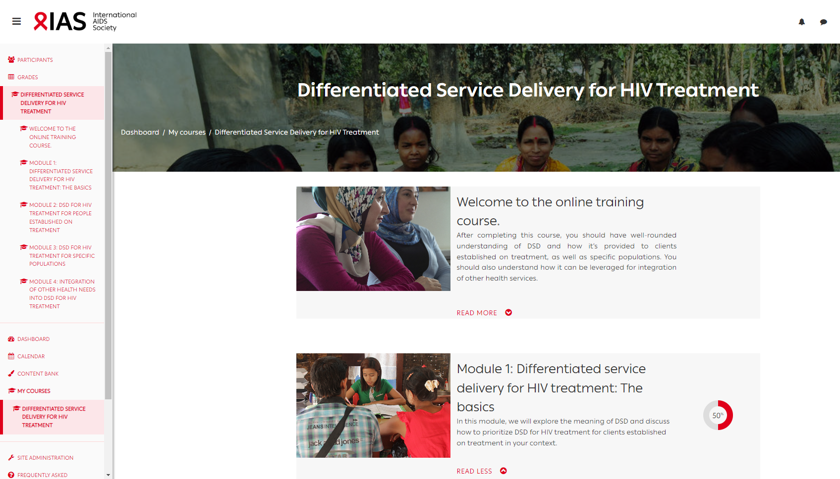
Background
Created for key stakeholders involved in the HIV response on the concept of DSD, its theoretical components and origins, practice examples and applicability to other health areas.
The course was launched in December 2021

Slide 4
Aims
Gain/refresh a basic understanding of key concepts of DSD, its evolution, how it can be applied across the HIV care cascade
Gain advanced DSD knowledge (based on evidence from implementation science studies on DSD)
Exchange with peers and experts on context-specific DSD issues

Slide 5
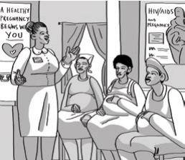
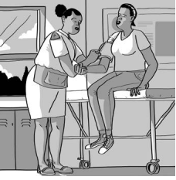
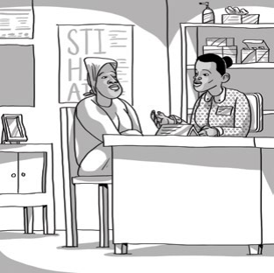
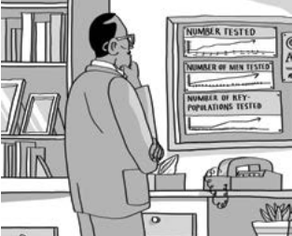
Target audience

Slide 6
Course overview (1)
Four modules
To successfully progress through this course, you need to complete the pre-assessment, course content, and the post-assessment of each module
Self-paced so you can do the modules in the order you like
Completion certificate awarded after completing all 4 modules

Slide 7
Course overview (2)

Slide 8
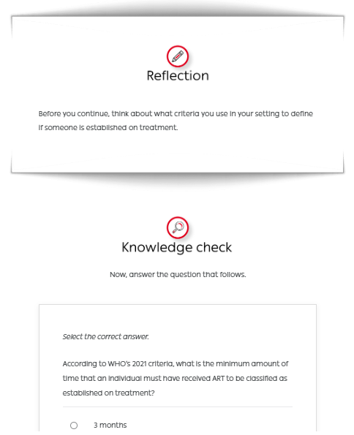
Course overview (3)
The course is hosted on the Moodle platform and is open-access (free) and requires registration
It includes interactive text and graphics, application case study and scenario-based activities and activities and quizzes
It also includes animated videos on key content areas

Slide 9
Explainer videos on key content areas
Make each video title a hyperlink to the videos
Healthcare worker-managed groups
Out-of-facility individual model
Common adaptations for specific populations
Client-managed groups
Facility-based individual model

Slide 10
User feedback
I started [the] DSD course because is a strategy that is implemented newly in my country, and to also learn more about this strategy
I was enrolled on the Differentiated service delivery course and I successfully did module one and passed it. I am happy to inform you that it was beneficial and transformed my practice
The online course has been helpful to my work, as am currently working in a NGO focusing on HIV.
I am following 129 community client Led delivery groups of about 600 patients in the community, you always except gaps. The [course] will help me to improve on service delivery

Slide 11
Enroll today - https://ias-courses.org/

Slide 12
And help spread the word

