Slide 1
Frequently Asked Questions on Blood-Based HIVST Products
Updated: May 2022

Slide 2
FAQs
What blood-based products are available for public sector procurement?
How are blood-based HIVST products designed?
Are these blood-based HIVST products easy to use?
Are the tests accurate in the hands of end-users?
Do clients find blood-based HIVST products acceptable?
Do clients prefer blood-based HIVST products?
Do blood-based HIVST products need to be disposed of differently than oral-fluid products?

Slide 3
What blood-based products are available for public sector procurement? There are currently 4 WHO PQ’d blood-based HIVST products and 1 product with Global Fund ERPD
Product Name | Manufacturer | Specimen | Sensitivity* | Specificity | Time to Result | Shelf-Life | Regulatory Status | Price
INSTI | bioLytical Laboratories | Whole Blood | 99.5% | 99.8% | 1 min | 15 months | WHO PQ - 2018 | $3–12
Mylan HIV Self Test | Mylan N.V./ Atomo Diagnostics Pty Ltd | Whole Blood | 99.8% | 99.8% | 15 min | 18 months | WHO PQ - 2019 | $1.99 EXW for public sector procurement in 135 countries
SureCheck HIV Self Test | Chembio Diagnostic Systems, Inc. | Whole Blood | 99.4% | 100.0% | 15 min | 24 months | WHO PQ - 2019 | $2.99
CheckNow HIVST | Abbott | Whole Blood | 99.5% | 98.5% | 15 min | 18 months | WHO PQ - 2022 | $1.50
Exacto Test HIV† | Biosynex | Whole Blood | 99.9% | 99.9% | 10 min | 24 months | ERPD - 2020 | Expected ~$2.00
WHO Prequalified products
Global Fund ERPD, under review for WHO PQ
*Clinical sensitivity. To be WHO prequalified, all HIV RDTs – regardless of type – have to have a sensitivity greater than 99% and a specificity greater than 98%.
†Biosynex’s Exacto test was categorized by the Expert Review Panel Diagnostics (ERPD) as Category 2 in January 2020, which allows for procurement with Global Fund and/or Unitaid resources. The sensitivity and specificity of the product are reported by the supplier.
Notes:
Sources:
https://extranet.who.int/pqweb/sites/default/files/PQDx_0481-032-00_CheckNOW-HIV-SELF-TEST_v1.0.pdf
https://extranet.who.int/pqweb/sites/default/files/PQDx_0002-002-00_INSTI_HIV_Self-Test_v3.pdf
https://extranet.who.int/pqweb/sites/default/files/191003_amended_pqpr_0320_090_00_mylan_hiv_self_test_v2.pdf
https://extranet.who.int/pqweb/sites/default/files/191129_pqdx_0054_006_01_sure_check_hiv_self_test.pdf

Slide 4
FAQs
What blood-based products are available for public sector procurement?
How are blood-based HIVST products designed?
Are these blood-based HIVST products easy to use?
Are the tests accurate in the hands of end-users?
Do clients find blood-based HIVST products acceptable?
Do clients prefer blood-based HIVST products?
Do blood-based HIVST products need to be disposed of differently than oral-fluid products?

Slide 5
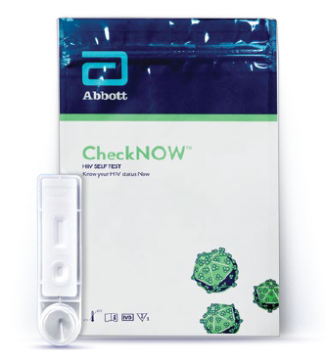
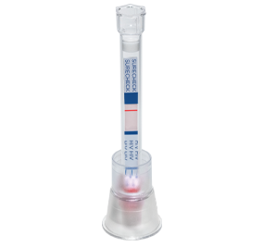
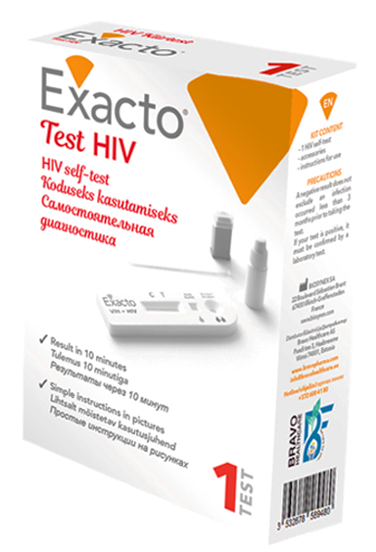
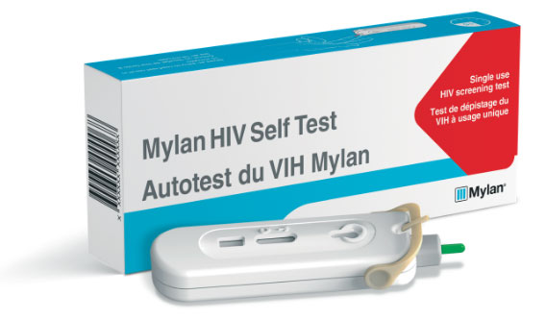
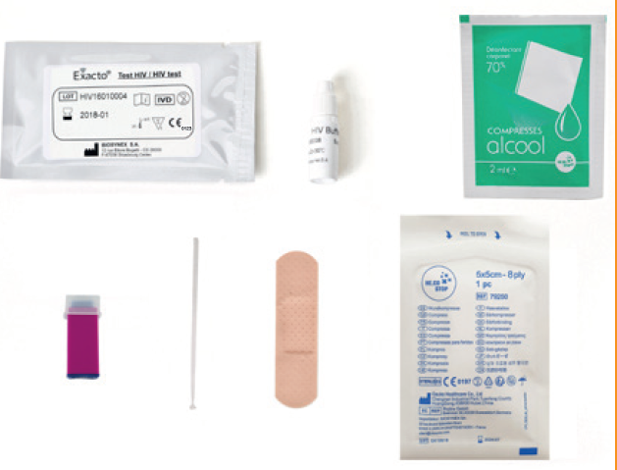
How are blood-based HIVST products designed? Blood-base HIVST products are designed slightly differently, but all are packaged with a safety lancet, specimen collection device, and buffer(s)
Most WHO Prequalified blood-based HIVST products have some unique design features, but newer products like CheckNOW and pipeline HIVSTs have simpler RDT designs
INSTI (biolytical) – WHO PQ
Sure Check (Chembio) – WHO PQ
CheckNOW (Abbott) – WHO PQ
Exacto (Biosynex) – GF ERPD
Mylan HIVST (Atomo) – WHO PQ

Slide 6
FAQs
What blood-based products are available for public sector procurement?
How are blood-based HIVST products designed?
Are these blood-based HIVST products easy to use?
Are the tests accurate in the hands of end-users?
Do clients find blood-based HIVST products acceptable?
Do clients prefer blood-based HIVST products?
Do blood-based HIVST products need to be disposed of differently than oral-fluid products?

Slide 7
Are these blood-based HIVST products easy to use? Yes, the available blood-based HIVST products all scored high in usability evaluations conducted in LMICs
The following studies assessed the usability of available HIVST products.:
In the usability studies, untrained participants were handed a kit and asked to perform the test in front of a silent observer who assessed their ability to perform the steps of the test.
In some cases, participants were tested themselves, while other studies provided participants with a contrived result to interpret.
Product | Study Location | Dates | n | Usability Score
INSTI | South Africa | June 2016-June 2018 | 200 | 97.6%
Atomo | South Africa | June 2016-June 2018 | 200 | 97.4%
SureCheck | South Africa | June 2016-June 2018 | 200 | 93.7%
CheckNow | South Africa | N/A | 900 | >96% (average)
Exacto | DRC | June-July 2016 | 300 | 91.6% (correctly preformed test)
Exacto | CAR | 2019 | 528 | 91.2%
OraQuick | CAR | 2019 |  | 95.1%
OraQuick | South Africa | June 2016-June 2018 | 200 | 93.3%
Blood-based with WHO PQ
Blood-based with GF ERPD
Oral Fluid WHO PQ
Notes:
Sources:
Majam M, Mazzola L, Rhagnath N, Lalla-Edward ST, Mahomed R, et al. (2020) Usability assessment of seven HIV self-test devices conducted with lay-users in Johannesburg, South Africa. PLOS ONE. 2020.
Abbott preliminary data
Grésenguet G, de Dieu Longo, J, Tonen-Wolyeet S, et al., Acceptability and Usability Evaluation of Finger-Stick Whole Blood HIV Self-Test as An HIV Screening Tool Adapted to The General Public in The Central African Republic. The Open AIDS Journal. 2017.
Tonen-Wolyec S, Sarassoro A, Muwonga Masidi J, et al. Field evaluation of capillary blood and oral-fluid HIV self-tests in the Democratic Republic of the Congo. PLoS One. 2020.

Slide 8
FAQs
What blood-based products are available for public sector procurement?
How are blood-based HIVST products designed?
Are these blood-based HIVST products easy to use?
Are the tests accurate in the hands of end-users?
Do clients find blood-based HIVST products acceptable?
Do clients prefer blood-based HIVST products?
Do blood-based HIVST products need to be disposed of differently than oral-fluid products?

Slide 9
Are the tests accurate in the hands of end-users? Yes, blood-based HIVST products conducted by end users have a sensitivity between 95-100%, which is on par with, or slightly higher than, the sensitivity of OraQuick
Study # | Location | N | Population Group | Test | Sensitivity | Specificity
1 | South Africa, DRC, Vietnam | 1,943 | N/A | CheckNow | 95.2% | 99.7%
2 | DRC | 528 | General population (18-49) | Exacto | 100% | 98.9%
 |  |  |  | OraQuick | 99.2% | 98.1%
3 | South Africa | 900 | Urban population (aged ≥18 years) | SureCheck | 96.8% | 100.0%
 |  | 900 |  | INSTI | 99.0% | 100.0%
 |  | 900 |  | OraQuick | 99.3% | 99.4%
4 | Malawi | 245 | General population (aged ≥16 years) attending HTS | INSTI | 100.0% | 99.6%
 |  | 416 |  | OraQuick | 95.2% | 99.7%
5 | Kenya | 467 | Rural population (adults) | INSTI | 98.99% | 98.51%
6 | Zambia | 2,570 | General population (aged ≥15 years) | OraQuick | 94.2% | 99.7%
7 | Malawi | 1,649 | Urban population (aged ≥16 years) | OraQuick | 93.6% | 99.9%
Blood-based products
Oral fluid product
Notes:
Sources:
1. Abbott, CheckNow product brochure
2. https://pubmed.ncbi.nlm.nih.gov/33017442/
3. https://journals.plos.org/plosone/article?id=10.1371/journal.pone.0227198#sec017
4. https://www.who.int/hiv/pub/posters/uptake-performance-blood-vs-oral-fluid-hiv-self-testing-malawi.pdf
5. https://journals.plos.org/plosone/article?id=10.1371/journal.pone.02024916. https://www.who.int/hiv/pub/posters/OraQuick-clinical-performance-study.pdf?ua=1
7. https://journals.plos.org/plosmedicine/article?id=10.1371/journal.pmed.1001873#sec009

Slide 10
FAQs
What blood-based products are available for public sector procurement?
How are blood-based HIVST products designed?
Are these blood-based HIVST products easy to use?
Are the tests accurate in the hands of end-users?
Do clients find blood-based HIVST products acceptable?
Do clients prefer blood-based HIVST products?
Do blood-based HIVST products need to be disposed of differently than oral-fluid products?

Slide 11
Do clients find blood-based HIVST products acceptable? Yes, studies have found blood-based HIVST products to be highly acceptable among target users
Acceptability among KPS
Acceptability among men
Acceptability among adolescents and young people
In study among MSM and transgender individuals in El Salvador and Guatemala, 92.5% of participants who used the INSTI blood-based HIVST felt comfortable using it.¹
In an online survey of MSM in Brazil, 91.2% said that they would use a finger-prick HIVST.²
In South Africa, 93% of men who tested with the Mylan/Atomo blood-based HIVST said that they would prefer to use the test again.³
97% of men who tested with either the Mylan/Atomo HIVST or OraQuick HIVST found the test “easy” or “very easy” to use and overwhelmingly preferred self-testing over testing at a health facility.^{3, 4}
In South Africa, the mean acceptability of the Mylan/Atomo blood-based HIVST among participants age 16-25 was 4.18 out of 5 (median 4.3).⁵
In a door-to-door survey of adolescents in the DRC, 95.1% of adolescents accepted peer-based distribution of the Exacto HIVST product.⁶
Some studies have found that a subset of clients (~1-5%) do not like blood-based HIVSTs because they do not like to prick themselves. This reinforces the need to offer multiple HIVST products to cater to all clients.
Notes:
Sources:
Letona P, Wheeler J, Lungo S. Acceptability and preference of a blood-based and oral-fluid HIV self-test in Guatemala and El Salvador, IAS 2020
Lippman SA, Périssé AR, Veloso VG, et al. Acceptability of self-conducted home-based HIV testing among men who have sex with men in Brazil: data from an on-line survey. Cad Saude Publica. 2014
Smith P, Wallace M, Bekker LG. Adolescents' experience of a rapid HIV self-testing device in youth-friendly clinic settings in Cape Town South Africa: a cross-sectional community based usability study. J Int AIDS Soc. 2016
Shapiro A, Van Heerden A, et al. An implementation study of oral and blood-based HIV self-testing and linkage to care among men in rural and peri-urban KwaZulu-Natal, South Africa, J Int AIDS Soc. 2020
Wyatt A, Pisarski Et, Shaprio A, et al. ‘First To Know My Status’: Acceptability of HIV Self-testing Among South African Men, CROI, 2020.
Tonen-Wolyec S, Batina-Agasa S, et a. Acceptability, feasibility, and individual preferences of blood-based HIV self-testing in a population-based sample of adolescents in Kisangani, Democratic Republic of the Congo. PLoS One. 2019

Slide 12
FAQs
What blood-based products are available for public sector procurement?
How are blood-based HIVST products designed?
Are these blood-based HIVST products easy to use?
Are the tests accurate in the hands of end-users?
Do clients find blood-based HIVST products acceptable?
Do clients prefer blood-based HIVST products?
Do blood-based HIVST products need to be disposed of differently than oral-fluid products?

Slide 13
Do clients prefer blood-based HIVST products? Client preference is mixed. Some clients prefer blood-based products, based on perceptions of higher accuracy, while others prefer oral-fluid products due to the lack of a need for a finger prick.
Studies that found preference for finger-blood (FB) products:
Studies that found preference for oral-fluid (OF) products:
87.5%
FB (INSTI)
52%
FB Product
KPs, El Salvador + Guatemala¹
n = 41
Young People, RSA²
n = 440
61%
OF(OraQuick)
12.5%
OF (OraQuick)
48%
OF Product
GP, Malawi⁵
n = 680
39%
FB (INSTI)
55%
FB (Atomo)
80%
OF Product
58%
FB (Atomo)
MSM, RSA
n = 127
Men, RSA⁴
n = 4,496
Young People, RSA⁶
n = 40
25%
OF (OraQuick)
20%
FB Product
32%
OF (OraQuick)
32%
Chose both
Studies that found preference for having both types available:
GP 18-49, DRC⁷
n = 524
KEY TAKEAWAYS:
Different population groups have different preferences.
Offering multiple options to clients would be preferred.
The most common reason for choosing an OF test was that the client did not have to prick themselves.
There was a common concern that OF tests were not accurate.
63%
Both
28%
OF (OraQuick)
7%
FB (Exacto)
Notes:
Sources:
Letona P, Wheeler J, Lungo S. Acceptability and preference of a blood-based and oral-fluid HIV self-test in Guatemala and El Salvador, IAS 2020
Shamu S, Khupakonke S, Farirai T, et al. HIV self-testing acceptability, feasibility and motivations among young people in South Africa: A demonstration community-based study, IAS 2019
Lippman SA, Lane T, Rabede O, et al. High Acceptability and Increased HIV-Testing Frequency After Introduction of HIV Self-Testing and Network Distribution Among South African MSM. J Acquir Immune Defic Syndr. 2018
Shapiro A, Van Heerden A, et al. An implementation study of oral and blood-based HIV self-testing and linkage to care among men in rural and peri-urban KwaZulu-Natal, South Africa, J Int AIDS Soc. 2020
Kumwendea M, Indravudh P, Johnson C, et al., Uptake and performance of blood-based self-testing versus oral fluid-based self-testing in Blantyre district, Malawi, IAS 2019
Ritchwood T, Selin A, Pettifor A, et al., HIV self-testing: South African young adults’ recommendations for ease of use, test kit contents, accessibility, and supportive resources, BMC Public Health, 2019.
Tonen-Wolyec S, Sarassoro A, Muwonga Masidi J, et al. Field evaluation of capillary blood and oral-fluid HIV self-tests in the Democratic Republic of the Congo. PLoS One. 2020.

Slide 14
FAQs
What blood-based products are available for public sector procurement?
How are blood-based HIVST products designed?
Are these blood-based HIVST products easy to use?
Are the tests accurate in the hands of end-users?
Do clients find blood-based HIVST products acceptable?
Do clients prefer blood-based HIVST products?
Do blood-based HIVST products need to be disposed of differently than oral-fluid products?

Slide 15
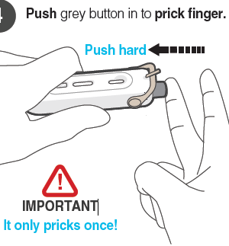
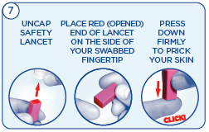
Do blood-based HIVST products need to be disposed of differently than oral-fluid products? No, all WHO prequalified HIVST products can be disposed of with normal waste.
Blood-based HIVST products do not require special waste management procedures. Once used, these products can be disposed of with normal waste.
All blood-based WHO prequalified HIVST products use a single use, retractable safety lancet.
Some products include a box or bag to facilitate disposal, some of which are sealable.
INSTI – safety lancet
Mylan/Atomo – lancet retracts back into the device
INSTI
CheckNOW
SureCheck – safety lancet

