Slide 1
HIV Self-Testing Product Overview
Updated: March 2023

Slide 2
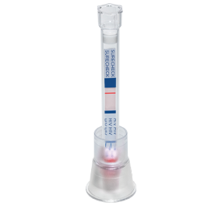
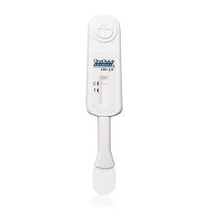
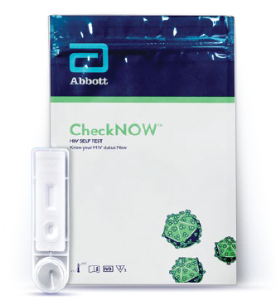
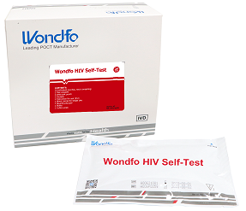
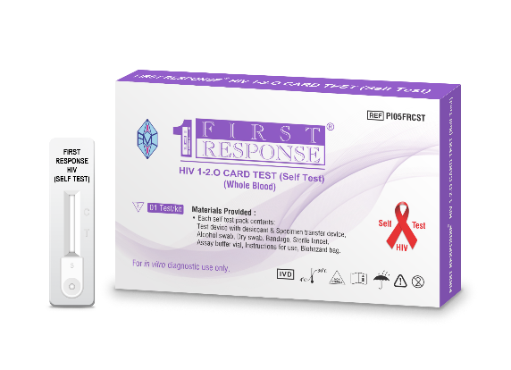
WHO PQ of Abbott’s CheckNOW HIVST and Wondfo’s HIVST marks a shift towards lower priced and simpler HIVST designs. Two additional HIVSTs are expected to enter the market <$2 in next 12-18mo
In PQ Pipeline
Current WHO Prequalified Products
Blood-based
Oral Fluid
Oral Fluid
SureCheck (Chembio)
$3.00
INSTI (bioLytical)
$3.00
OraQuick (OraSure) $2.00
Asante Oral HIVST (Sedia)
<$2 (estimated) Est PQ: Q2 2023
Mylan (Viatris/Atomo)
$1.99
CheckNOW (Abbott)
$1.50
Wondfo HIVST
$1.00
First Response HIVST (Premier)
<$2 (estimated)
Est PQ: Q4 2023
Blood-based

Slide 3
Overview of HIVST Products with WHO Prequalification
Product Name, Supplier | Specimen | Generation | Clinical Performance* |  | Untrained User Performance |  | Time to Result | Shelf-Life | Regulatory Status | Price (EXW)
Product Name | Specimen | Generation | Sens | Spec | Sens | Spec | Time to Result | Shelf-Life |  | Price (EXW)
OraQuick OraSure | Oral Fluid | 2nd Gen | 99.1% | 100% | 92% | 99.9% | 20 min | 30 months | WHO PQ - 2017 | $2.00
SURE CHECK HIVST Chembio | Blood | 2nd Gen | 99.4% | 100% | 97% | 100% | 15 min | 24 months | WHO PQ - 2019 | $2.99
INSTI bioLytical | Blood | 3rd Gen | 99.5% | 99.8% | 100% | 99.8% | 1 min | 15 months | WHO PQ - 2018 | $3
Mylan HIVST Viatris/Atomo | Blood | 3rd Gen | 99.8% | 99.8% | 94.3% | 95.2% | 15 min | 18 months | WHO PQ - 2019 | $1.99
CheckNOW HIVST Abbott | Blood | 3rd Gen | 99.5% | 98.5% | 95.1% | 99.6% | 15 min | 18 months± | WHO PQ - 2022 | $1.50
Wondfo HIVST Wondfo Biotech | Blood | 3rd Gen | 100% | 100% | 95.8% | 99.6% | 15 min | 24 months | WHO PQ - 2022 | $1.00
*To be WHO prequalified, all HIV RDTs – regardless of type – must have a sensitivity greater than 99% and a specificity greater than 98%.
±At launch - 24 months targeted. Ongoing studies to support 24 months

Slide 4
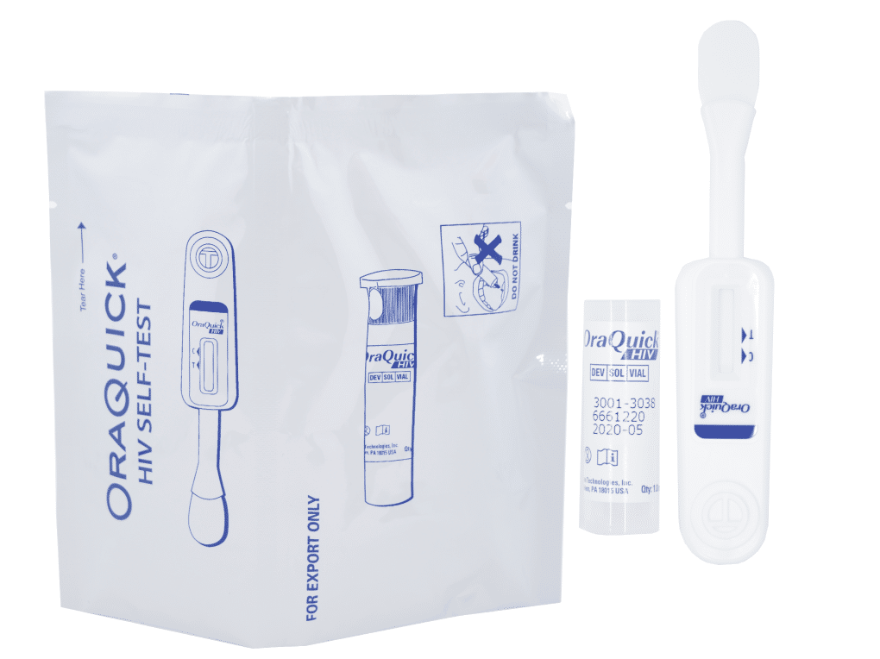
OraQuick (OraSure) – Product and Registration Details
Product Description: OraQuick® HIV Self-Test is a single-use, qualitative immunoassay to detect antibodies to HIV-1 and HIV-2 in oral fluid. The OraQuick HIV Self-Test is manufactured by OraSure and is an adaptation of their professional use product (OraQuick HIV 1/2 Rapid Antibody Test).
Test Procedure: The device is placed into the mouth and swabbed across the outer gum line. The device is then placed into a tube containing a premeasured amount of solution. A colored line forms in the ‘T’ (test) area of the result window if HIV antibodies are detected. If no HIV antibodies are detected, no line forms there. If the test is performed correctly, a line forms in the ‘C’ area of the result window.
Included in Test Kit:
Single use test device
Developer solution vial containing
WHO PQ’d: July 2017
Test stand
Disposal bag

Slide 5
OraQuick (OraSure) – Test Procedure

Slide 6
Sure Check HIV Self Test (Chembio Diagnostic Systems, Inc.) – Product and Registration Details
Product Description: The SURE CHECK HIV Self-Test is a single-use collection and testing device for the rapid, visual detection of HIV-1 and HIV-2 antibodies. The test integrates the capillary device and buffer solution, eliminating the need for separate collection devices and buffer solution bottles required by other HIVST products. It is manufactured by Chembio Diagnostic Systems, Inc. and is an adaptation of their professional use product (SURE CHECK HIV 1/2 Assay).
Test Procedure: The test is performed by mixing one drop of blood with a liquid solution contained in the buffer cap. As the test runs, the mixture can be seen flowing up the strip. When test is complete, two lines will be visible if antibodies to HIV are detected (CONTROL and TEST lines). Only the CONTROL line appears if no antibodies detected.
Included in Test Kit:
Test stand
Alcohol swab
Sterile gauze pad
Bandage
WHO PQ’d: November 2019
SURE CHECK HIV Self-Test
Sterile safety lancet

Slide 7
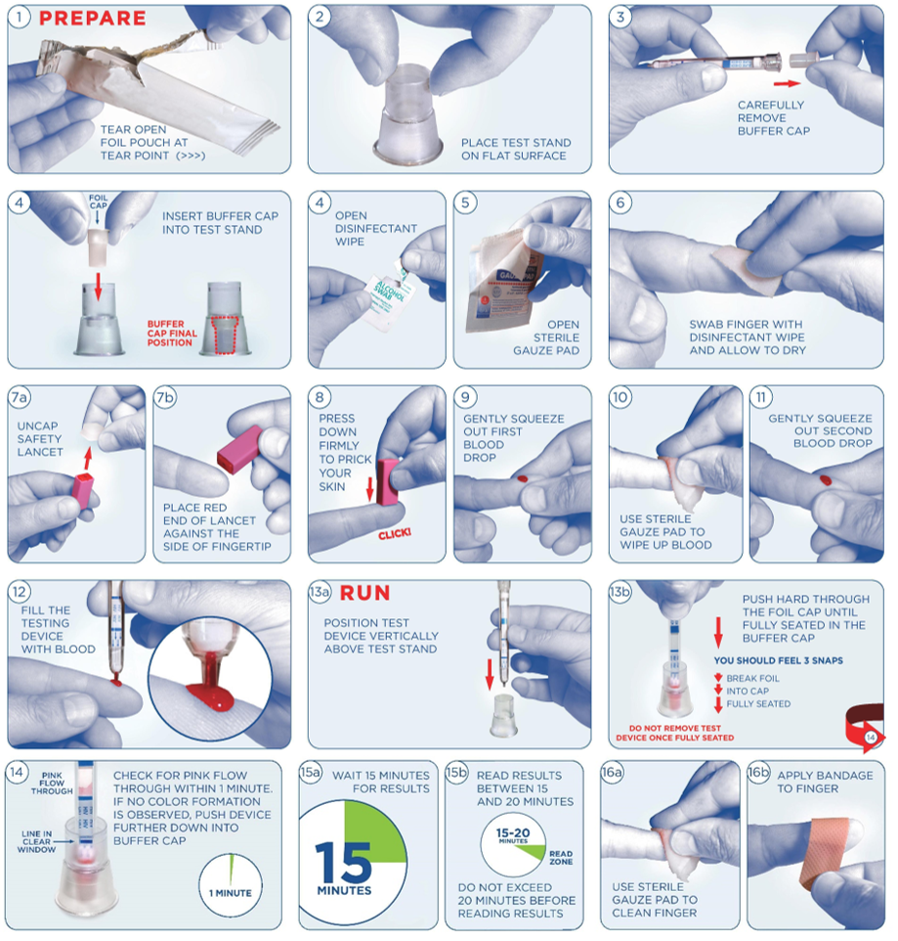
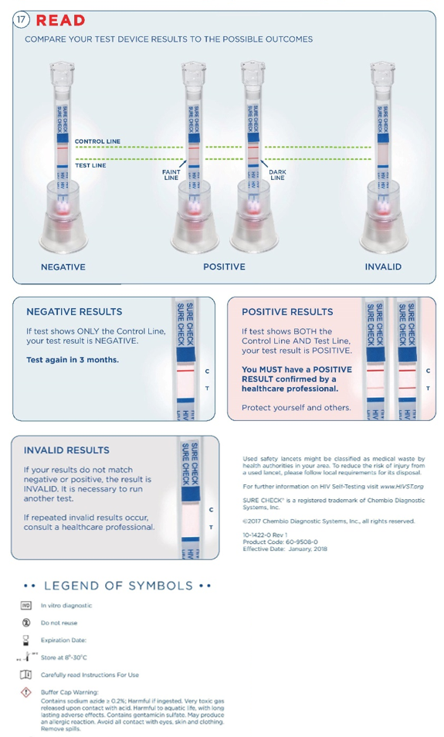
Sure Check HIV Self Test (Chembio Diagnostic Systems, Inc.) – Test Procedure

Slide 8
INSTI HIV Self Test (bioLytical Laboratories) – Product and Registration Details
Product Description: The INSTI HIV Self Test is a qualitative immunoassay that uses blood to detect HIV-1 and HIV-2 antibodies. The INSTI HIV Self Test is manufactured by bioLyitcal Laboratories and is an adaptation of their professional use product (INSTI HIV-1/HIV-2 Antibody Test).
Test Procedure: The test produces a result in the form of either one dot (control dot) or two dots (control and test dots). The control dot is a built in control feature that appears if the test has been performed correctly. A test dot will only be visible if the sample contains antibodies to HIV.
Included in Test Kit:
Blotted Membrane Unit
Sample diluent bottle (Bottle 1)
Colour developer bottle (Bottle 2)
Clarifying solution bottle (Bottle 3)
WHO PQ’d: November 2018
Sterile single-use lancet
Adhesive bandage
Alcohol swab

Slide 9
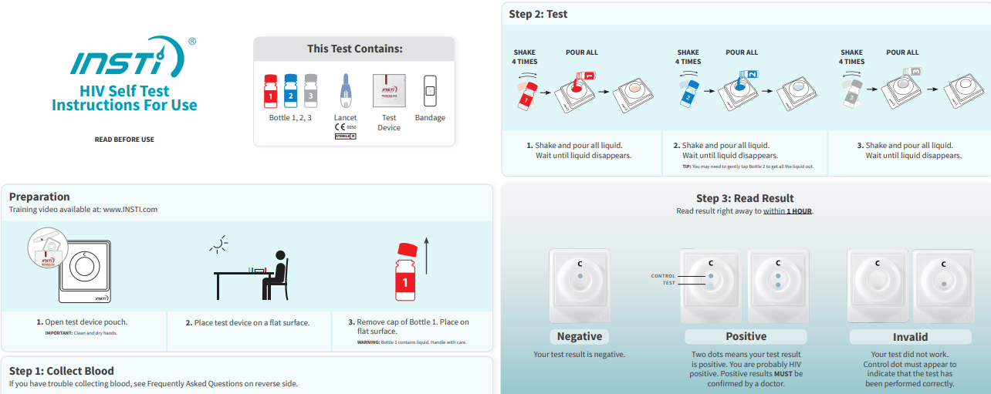
INSTI HIV Self Test (bioLytical Laboratories) – Test Procedure

Slide 10
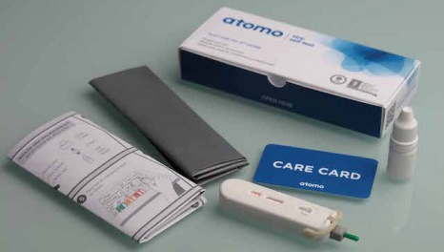
Mylan (Atomo Diagnostics Pty Ltd) – Product and Registration Details
Product Description: The Mylan HIV Self Test is comprised of a paper test strip inside a plastic cartridge. The Mylan HIV Self Test is manufactured and sold in partnership with the global pharmaceutical company Mylan N.V. and medical device manufacturer Atomo Diagnostics.
Test Procedure: The test is performed by placing a small drop of blood on the test strip and then applying drops of test fluid (diluent). When the test is completed, two lines can appear on the paper strip. A visible Control Line indicates that the diluent was added and migrated successfully, and that the test reagents are functioning correctly. The Test Line will only become visible if the applied sample contains antibodies to HIV.
Included in the Test Kit:
Mylan HIV Self Test
Bottle of Test Fluid (Diluent)
Alcohol wipe
Disposal bag
WHO PQ’d: July 2019

Slide 11
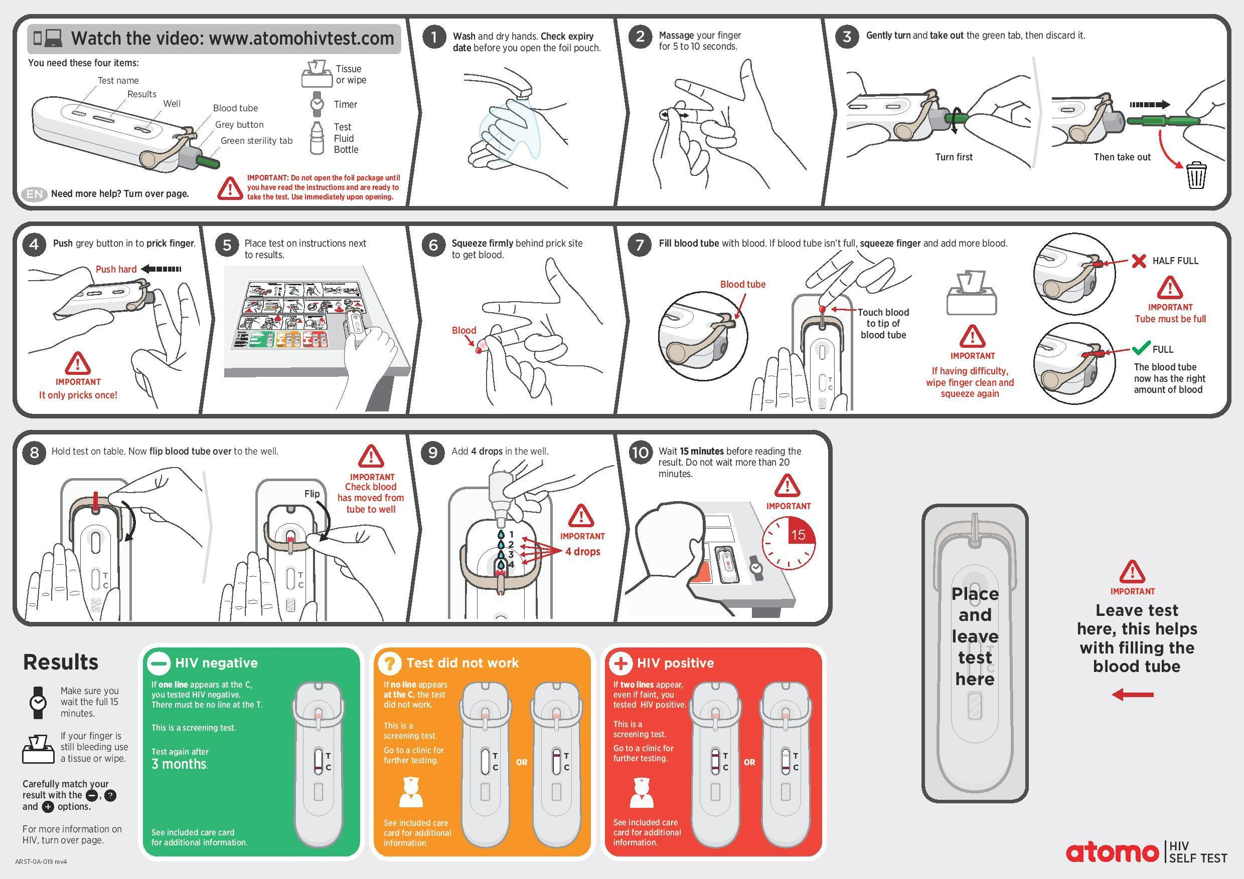
Mylan (Atomo Diagnostics Pty Ltd) – Test Procedure

Slide 12
CheckNOW (Abbott) – Product Details
Product Description: CheckNOW is a qualitative, membrane-based immunoassay for the detection of antibodies to HIV 1 and HIV 2 in whole blood. During testing, the whole blood reacts with HIV antigen coated particles in the test strip. The mixture then migrates upward on the membrane chromatographically by capillary action and reacts with recombinant HIV antigen on the membrane in the test line region.
Test Procedure: The test is performed by pricking a finger and placing two drops of blood into the collection basin, then transferring the sample to a sample well, and adding one drop of buffer. Two lines that may appear after 15-20 minutes. The first is the control line “C” confirms that the specimen migrated correctly. Test line “T” will only become visible if the applied sample contains antibodies to HIV.
Included in Test Kit:
Test device
Buffer
Alcohol pads
Lancet
WHO PQ’d: April 2022
Specimen Dropper
Plaster
IFU

Slide 13
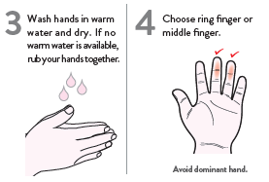
CheckNOW (Abbott) – Test Procedure
Phase 1: Preparation
Phase 2: Collect Blood
Phase 3: Test
Phase 3: Read Result

Slide 14
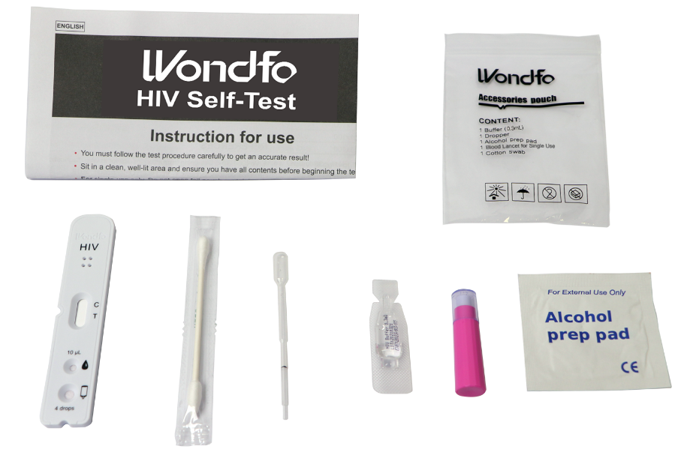
Wondfo HIV Self Test – Product Details
Product Description: The Wondfo HIV Self-Test is a single-use in vitro diagnostic self-test for fingerstick whole blood detection of HIV 1/2. It is intended to be used by people who believe they may have been exposed to HIV or may have been at risk within the last 3 months. It is intended to be used as a self-test and/or by medical professionals.
Test Procedure: The test is performed by pricking a finger and using the combination pipette-capillary tube to transfer blood to the sample well, then adding three drops of buffer. Two lines may appear after 15 minutes. The first is the control line “C” and confirms that the specimen migrated correctly. Test line “T” will only become visible if the applied sample contains antibodies to HIV.
Included in Test Kit:
Test device
Buffer
Alcohol pad
Lancet
WHO PQ’d: July 2022
Specimen Dropper
Cotton swab
IFU

Slide 15
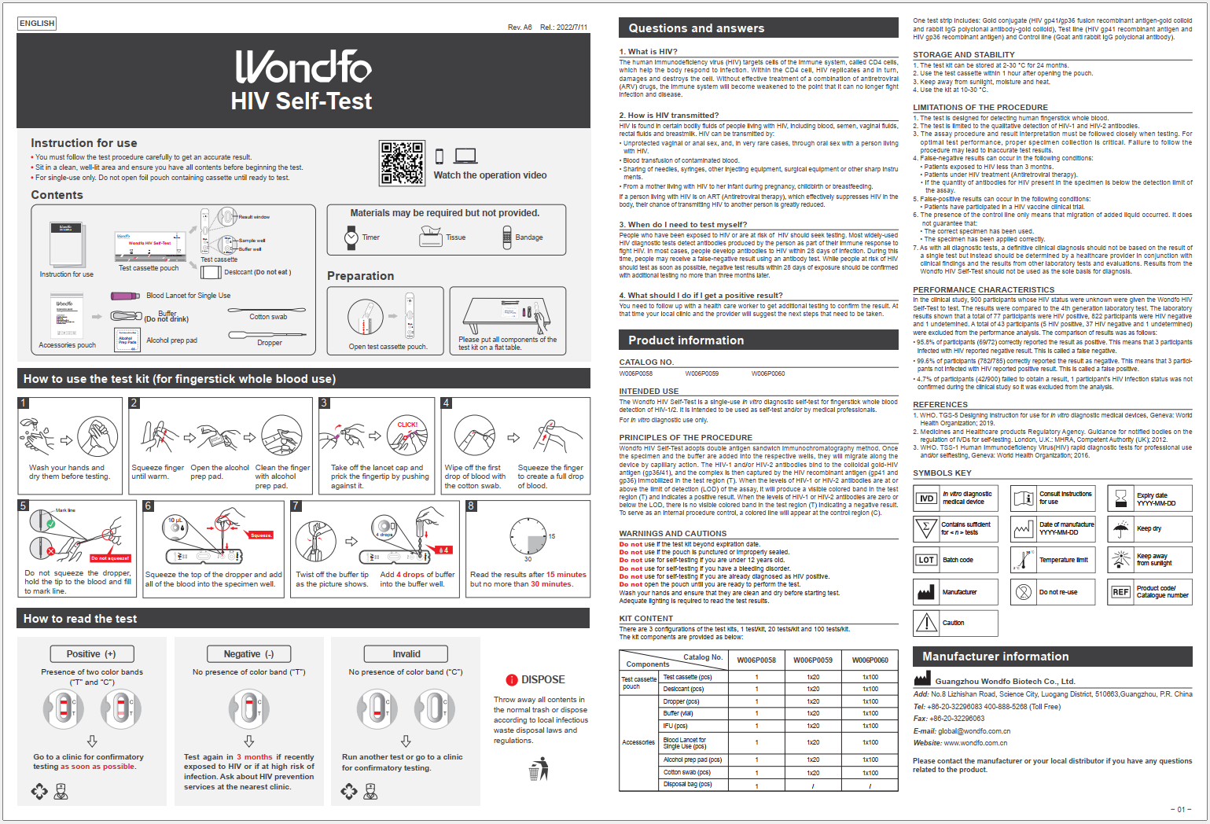
Wondfo HIV Self Test – Test Procedure

Slide 16
July 2022: CHAI and MedAccess announced a new partnership with Wondfo to introduce a WHO prequalified HIV self-test for $1.00 EXW
5-year volume guarantee between Wondfo and MedAccess
$1 EXW price applies for all public sector procurers across 140 LMIC
50% less than market leader OraQuick ($2)
>30% less than previous lowest price ($1.50, Abbott)
Evaluating mechanisms for extending price to private sector
While new to donor-funded market, Wondfo is already a large supplier of RDTs globally
>$400M in sales in 2020 and 80M RDTs sold in LMICs
Adapted prequalified conventional HIV RDT for use as HIVST
100% sensitive, 99.9% specific
Usability studies in South Africa, Senegal, and Cote d’Ivoire
95.8% sensitive, 99.6% specific
WHO PQ approved

Slide 17
HIVST Product Pipeline
HIVST Pipeline Products | Specimen | WHO PQ’d Estimated Market Entry Timing
Asante HIV-1/2 Oral Fluid Rapid Test (Sedia Biosciences Corp., USA) | Oral Fluid | WHO PQ submitted – likely Q2 2023
First Response® HIV 1-2.O Card Test* (Premier Medical Corp., India) | WB | WHO PQ submitted – likely late 2023
Exacto HIV Test (Biosynex, France) | WB | ERPD, WHO PQ submitted – timing TBD
Rapid Test for HIV-1 Antibodies in Urine (Beijing Wantai Biological Pharmacy Enterprise Co., Ltd) | Urine | WHO PQ submitted – timing TBD

Slide 18
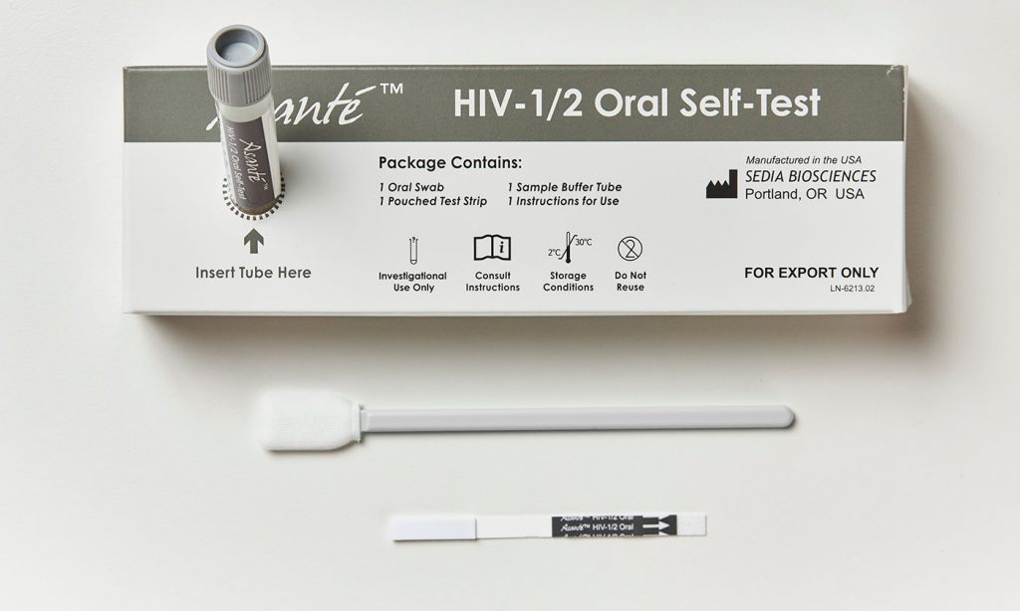
Asanté™ HIV-1/2 Oral Self-Test (Sedia) – Product Details
Product Description: A rapid, visually read, in vitro immunoassay for the qualitative detection of antibodies to HIV-1 and HIV-2 in oral fluid specimens. The Asanté™ HIV-1/2 Oral-Self Test will only be used with oral fluid specimens. Will be intended for use outside the United States.
Test Procedure: Swipe the included swab along the gums. The Oral Swab is inserted directly in the Sample Buffer Tube, and mixed by moving the Swab up and down at least 2 times. Once mixed, press the Swab against the Tube to expel excess fluid and discard the Swab with local, state, and federal regulations. Open test strip packaging and remove strip. Place test strip in tube with gray label and arrow pointing down. Wait at least 20 minutes (but no longer than 45 minutes) for the test to run. The “C” line is the Control Line which will indicate the test is functioning properly. The “T” line is the Test Line which is designed to indicate a positive result for HIV infection when present.
Included in Test Kit:
Test strip
Sample Buffer Tube
Oral Swab
WHO PQ: Submitted dossier in February 2022

Slide 19
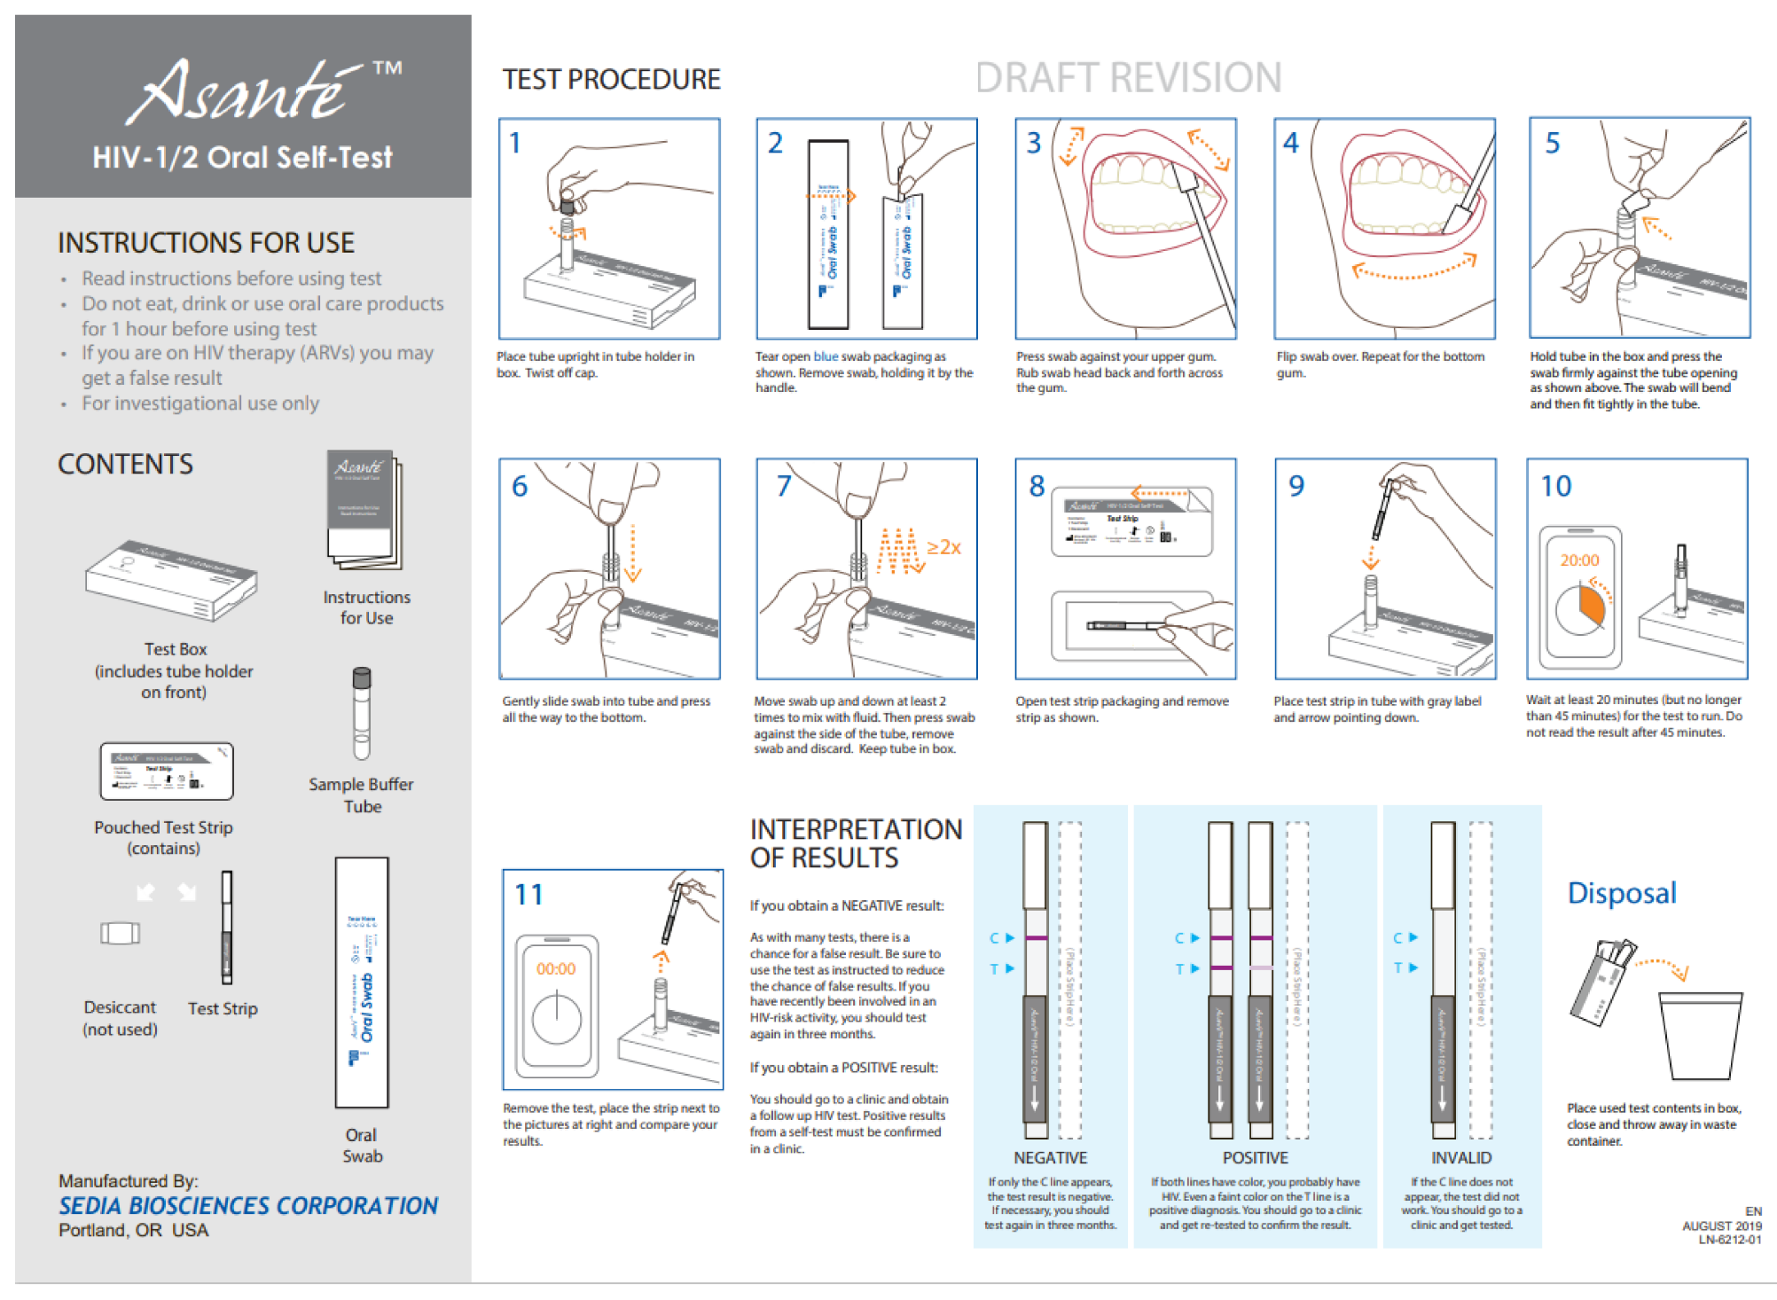
Asanté™ HIV-1/2 Oral Self-Test (Sedia) – Test Procedure

Slide 20
First Response HIVST (Premier) – Product Details
Product Description: First Response HIV 1-2 Card Test (Self Test) is an in vitro diagnostic medical device that is intended for self testing by untrained/lay user as an aid to detect antibodies specific to HIV-1 and HIV-2 in human whole blood. The test kit is not automated and does not require any additional instruments. The First Response HIV Self Test is manufactured by Premier Medical Corporation (PMC).
Test Procedure: The test is performed by collecting a small drop of blood, transferring it to a cassette and then adding two drops of diluent.
Included in Test Kit:
Cassette
Dropper Bottle
Inverted Cup
Lancet
WHO PQ: Submitted dossier in December 2022
Plaster
Alcohol Wipes
Disposal Bag

Slide 21
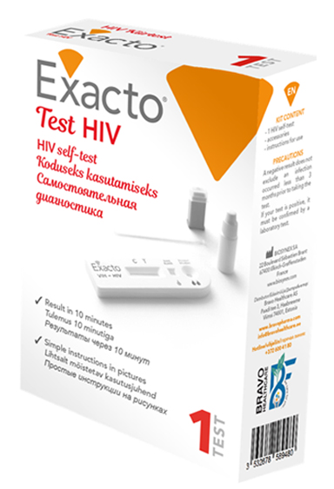
Exacto HIV Test (Biosynex) – Product Details
Product Description: The Exacto HIV Test is an immunochromatography test which requires a droplet of blood to be drawn from the fingertip. The test is designed to detect the presence of HIV-1 and HIV-2 antibodies and is comprised of a paper test strip inside a plastic cassette. The Exacto HIV Test is manufactured by Biosynex.
Test Procedure: The test is performed by collecting a small drop of blood, transferring it to a cassette and then adding two drops of diluent. There are two controls on the cassette test. The first is the square “blood,” which must be red before adding the diluent. The second is control line “C” confirms that the specimen migrated correctly. Test line “T” will only become visible if the applied sample contains antibodies to HIV.
Included in Test Kit:
Cassette
Dropper Bottle
Inverted Cup
Lancet
Global Fund ERPD Category 2 – January 2020
Plaster
Alcohol Wipe
Sterile pad

Slide 22
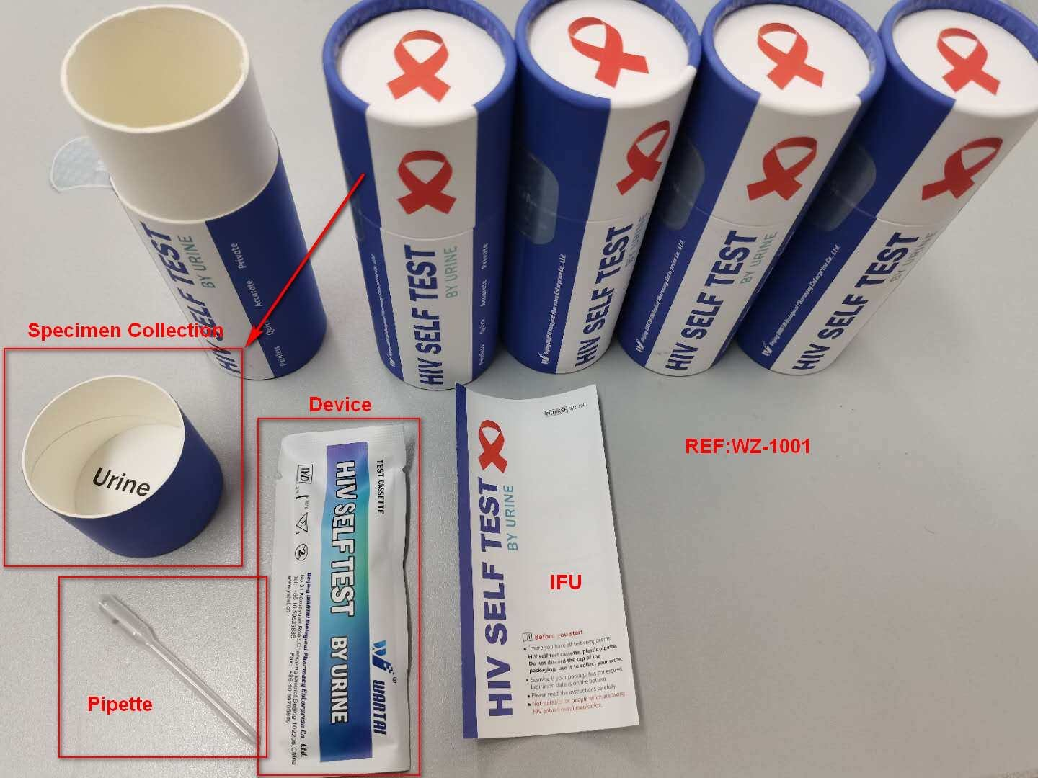
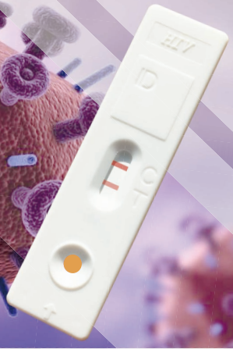
HIV Self Test by Urine (Beijing Wantai) – Product Details
Product Description: The HIV Self Test from Beijing Wantai is a urine-based rapid test to detect antibodies for HIV.
Test Procedure: The test is performed by collecting a small amount of urine in a sample collection cup that is integrated into the packaging tube. Then, using the provided pipette, three drops of urine are added to the test cassette. Results are available after 15 minutes.
Included in Test Kit:
Cassette
Pipette
Integrated cup
WHO PQ: Submitted in 2021

Slide 23
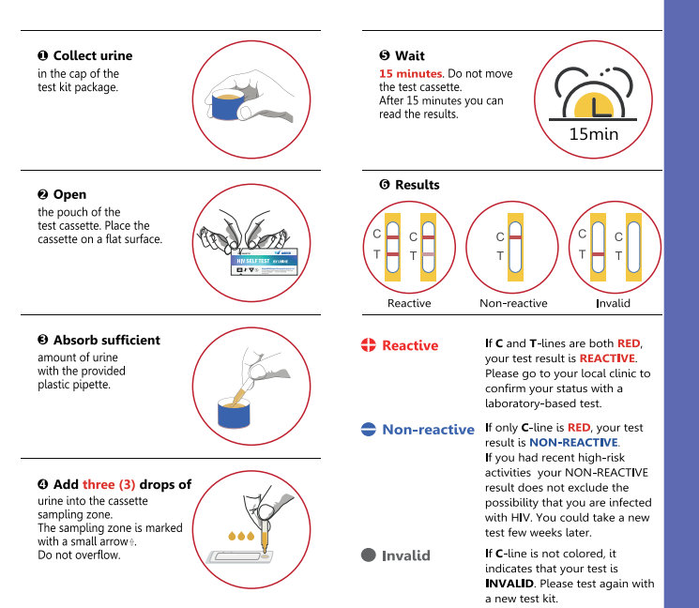
HIV Self Test by Urine (Beijing Wantai) – Test Procedure

