Slide 1
Value of Community Engagement in Improving Person Centered Services
CE CoP
Comprised of the CAN

Slide 2
Community Engagement
Pillars
Community Engagement
RoC Centered
Meaningful
Consistent
Transparent
Structured
Observes Equity
Is Supported and Practical
Observes Accountability
Is Sustainable
…a structured, supported, meaningful and accountable process that ensures that people living with HIV have a SEAT and a VOICE in decision-making, planning, implementation, monitoring and evaluation, in order to achieve access to quality HIV care for all.

Slide 3
Person Centered Services Pillars
Person Centered Services
By
With
For
RoCs
RoC Centered
Individualized
Diverse
Preferences & Choices
Flexible/Adaptable
Evidence Based
Informed Providers & ROCs
Rights Based
Pay Attention to CE Definition
Under Strong Health & Community Systems (HSS & CSS)
Accommodates Feedback
…entails the provision of Individualized care that is Holistic, Engaging, Responsive, and Respectful, with the Recipient of Care Actively Participating in Defining their care in Consultation with Policy Makers & Service Providers

Slide 4
Overview of Community Engagement
Why measure community engagement in DSD?
Hypothesis: When communities of people living with HIV are engaged in the design, implementation and evaluation of DSD models, those programs are of higher quality and better meet the needs of the recipients of care (RoC) they intend to serve
How we measure?
Through a set of indicators to monitor the level (or lack) of community engagement in policy-level, program-level, and implementation-levels, across three spheres of DSD design, DSD implementation and DSD monitoring and evaluation

Slide 5
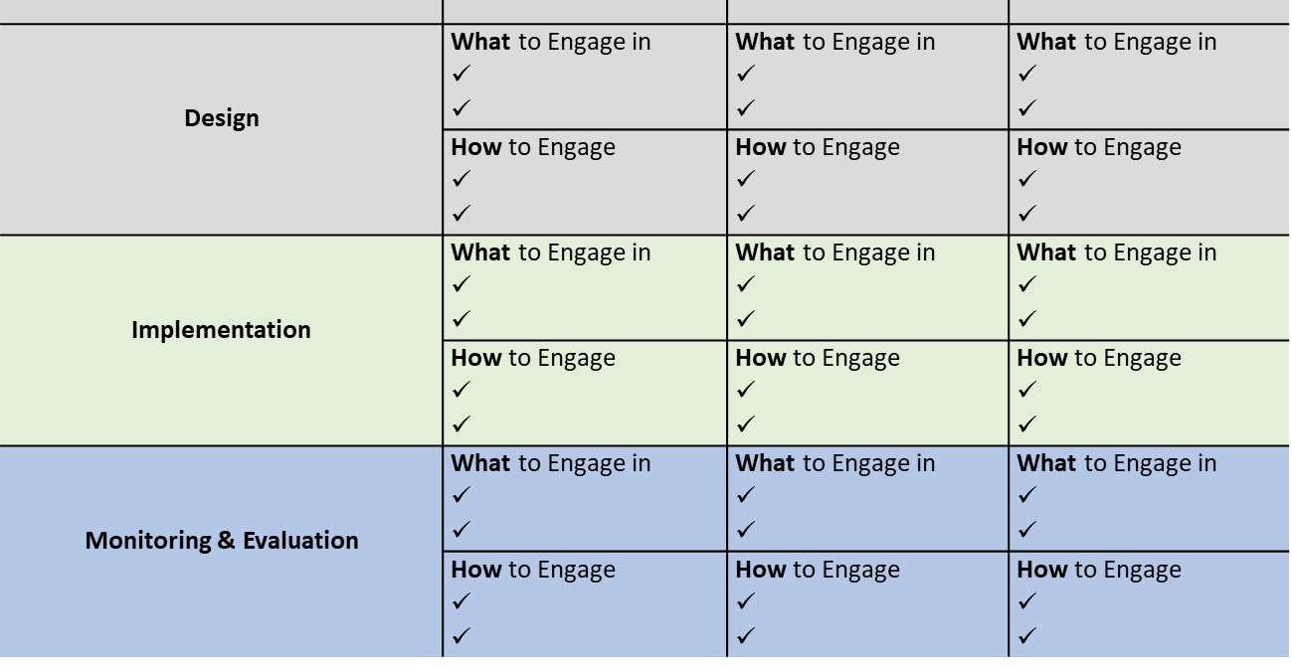
Community Engagement Framework
Notes:
Communities have measured engagement so that experiences will be shared by Liberia, DRC, and Kenya. The key elements of the CE framework is interrogating how communities should be involved at policy, program, and community level. Through the WHAT, WHERE and how questions to engagement across the design, implementation, and M&E we have to ensure that people are engaged through monitoring and accessing outcomes. We need to understand the link between the outcomes of data and show the impact of improving PCC.

