Slide 1
AHD Toolkit App
Ikechukwu Amamilo, Senior Technical Advisor
Williams Eigege, Regional Manager
Clinton Health Access Initiative

Slide 2
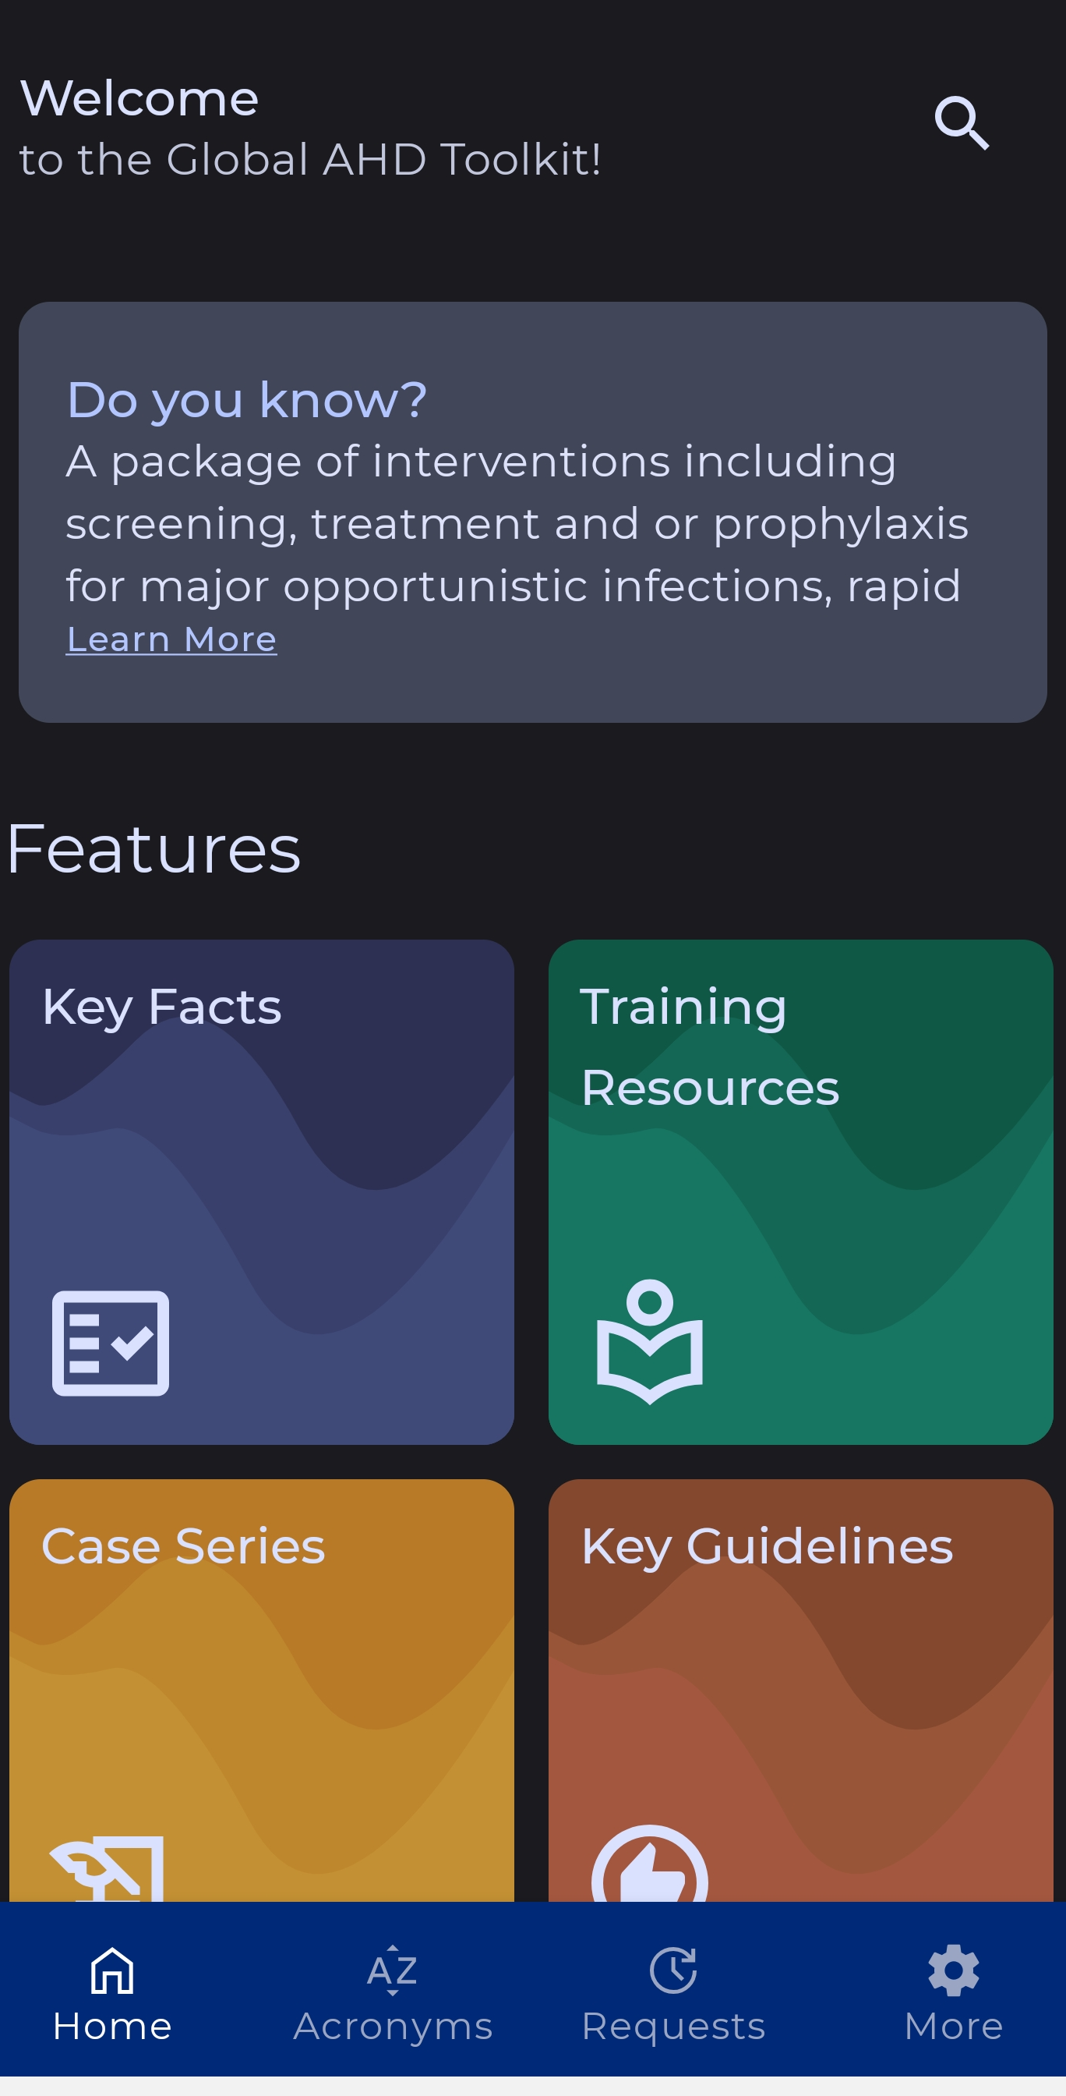
With support from Unitaid, CHAI and the Infectious Diseases Institute Uganda developed a mobile application linked to the Global Advanced HIV Disease Toolkit (GAHDT)
The AHD toolkit app:
Aims to provide versatile support to frontline HCWs managing AHD clients
Built to support online and offline access
Developed using feedback from a survey of HCWs and partners.
AHD
Toolkit App
 | Key Facts | Summarizing AHD epidemiology data
 | Quick Search | To easily navigate the application and find key information
 | Dosages & Medications | Information on regimens for major AHD-related OIs
 | Key Guidelines | Key recommendations for prevention, diagnosis, and treatment for major AHD-related OIs
 | Training Resources | Featuring training slides, job aids, and demonstration videos
 | Case Series | Clinical AHD case presentations to engage and inform on the appropriate management of conditions
 | FAQs | Commonly asked questions and answers for HCWs
 | Glossary | Key terms defined
Functionality and features include:

Slide 3
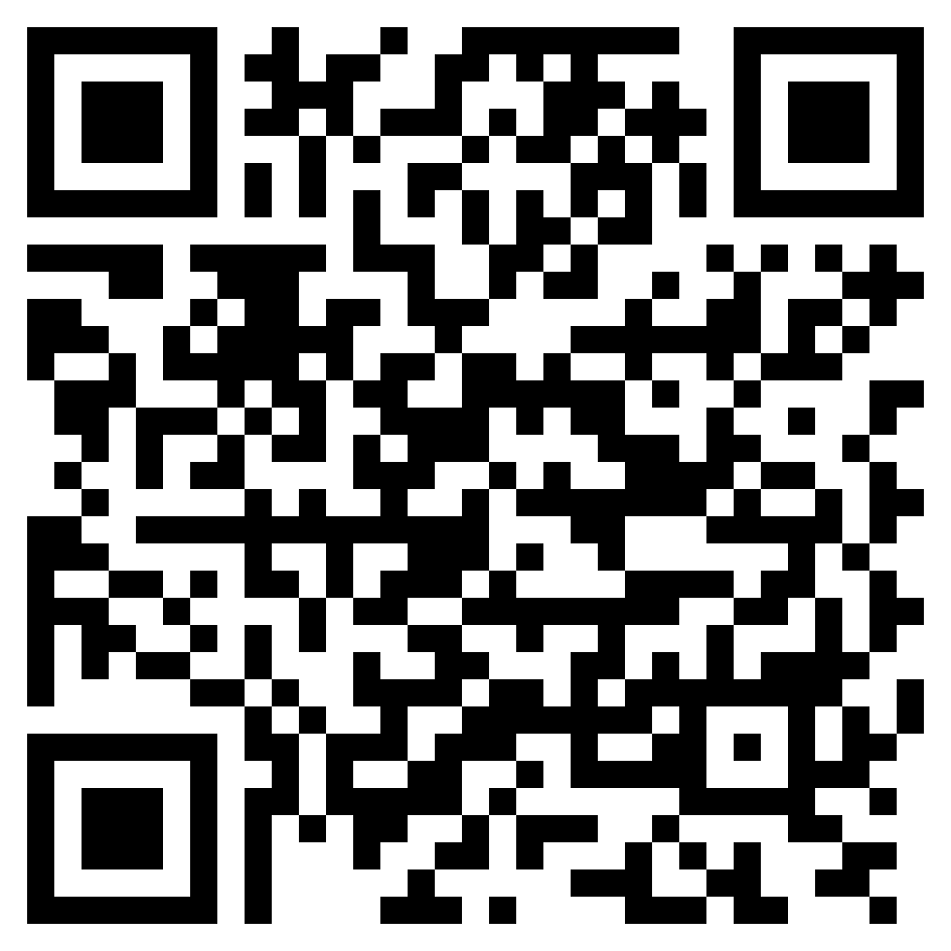
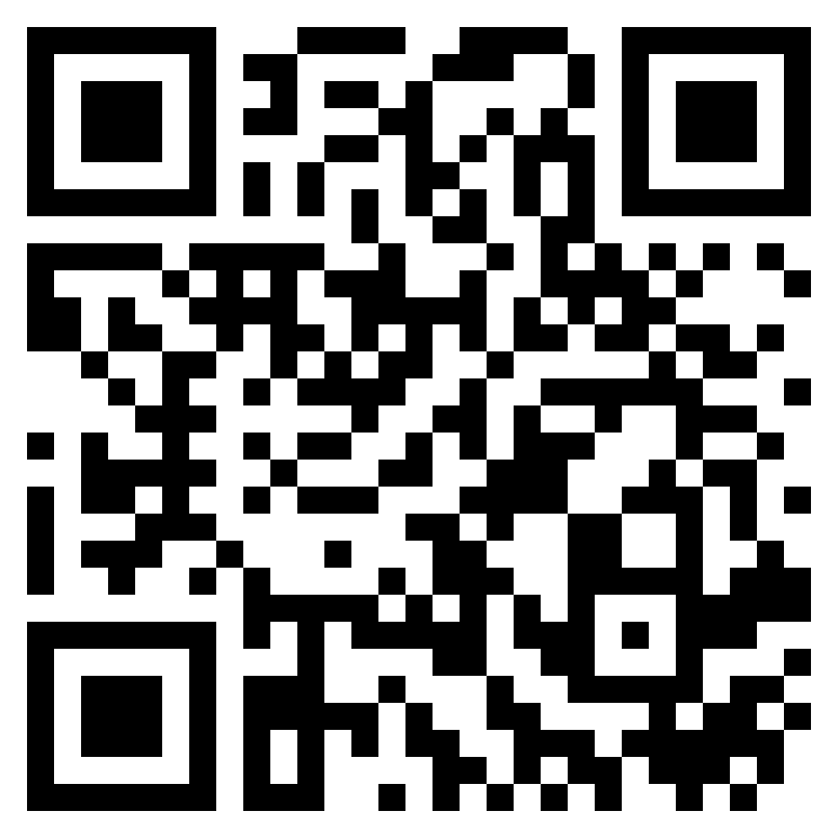
The AHD Toolkit app will be also be customizable to national contexts
Customization of the AHD app is possible where a MOH seeks to further contextualize the app to its setting
Only the customizing country will have access to the customized version
The following aspects of the app can be customized:
Logo
Added local content (e.g., guidelines)
Search AHD Toolkit app
in app stores
or ccan to download!
Google
Play
The ‘Requests’ tab can be used to log a request for customization
iOS
App store

Slide 4
LIVE DEMO!

