Slide 1
Advanced HIV Disease Instruments from Mozambique
Irénio Gaspar, Care and Treatment Lead
Orrin Tiberi, Monitoring and Evaluation Advisor

Slide 2
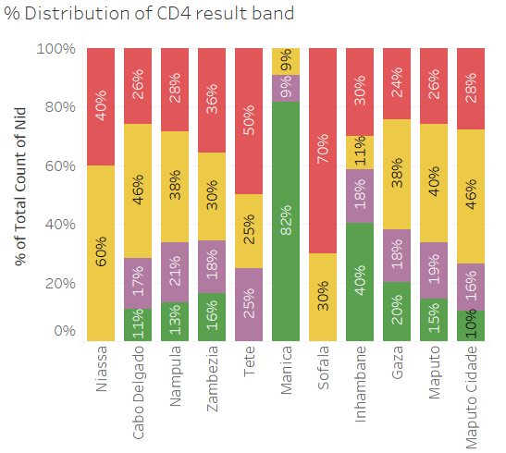
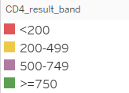
Content of the Presentation
2022 Results of CD4 testing
Background of AHD
Reporting Flow for AHD
Instruments of AHD
Patient Chart
Prevention of Cryptococcal Meningitis Card
Cryptococcal Meningitis Card
CD4 Request Card
Monthly Report
Conclusion

Slide 3
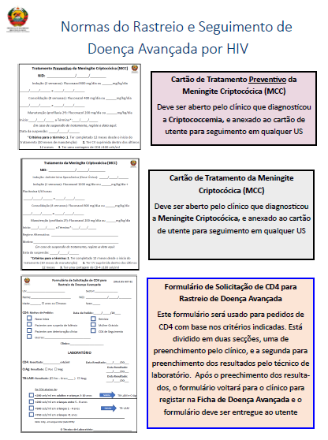
Background of AHD
The Guidance Document for Clinicians for AHD Supporting Material
AHD started implementation in 2021, however instruments were piloted and had a phased national expansion starting in 2022.
Estimated that approximately 25% of new initiates could be eligible for AHD inclusion
Continues challenges in supply chain and correct testing through-out the country

Slide 4
Reporting Flow
EPTS/SESP
AHD has information reported in the national Patient Chart as well as a AHD specific patient chart
These information are entered in the Monthly Report (RM) which is then submitted into SIS-MA, the national reporting system
The monthly report also recieves information from SESP/EPTS to complete more complex fields about different treatment regimes

Slide 5
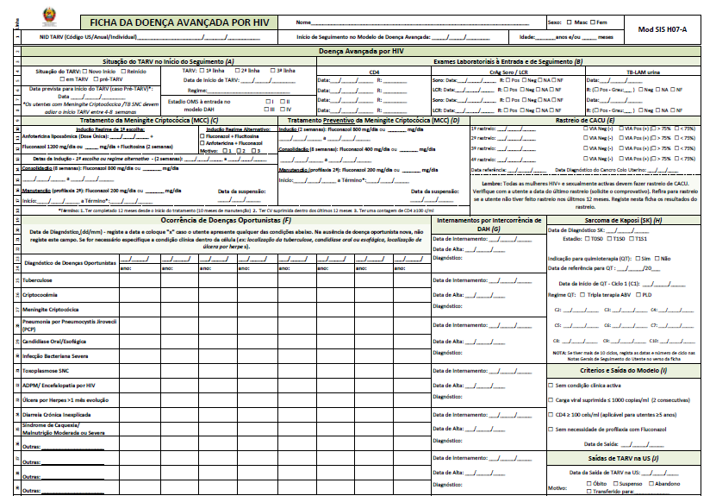
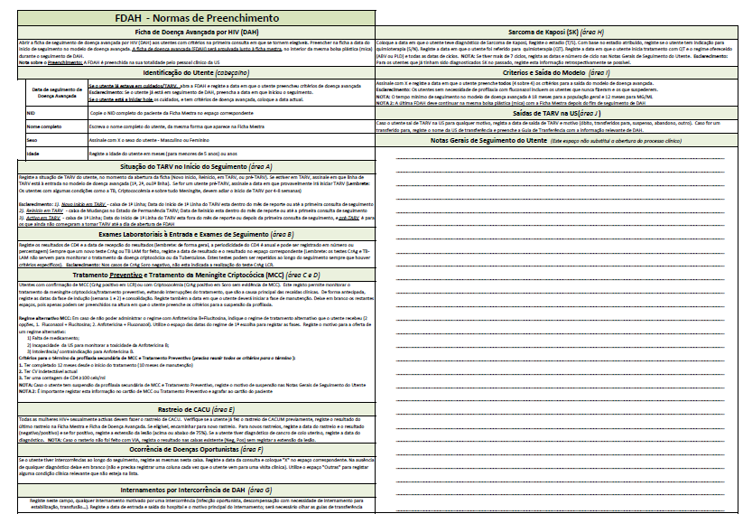
Patient Chart
New registration initiated at the time of diagnosis and initiating the AHD package of care
It is completed in parallel with the general ART patient chart, and as such the information is not duplicative between the two sources
It is used for follow-up until the beneficiary does not require AHD follow-up.
A new patient chart is opened if the beneficiary is included in the model at a future date, both old and new charts are kept with the Master Card

Slide 6
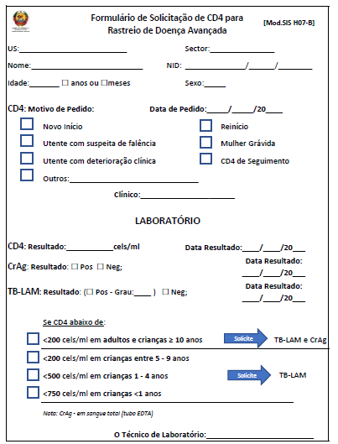
CD4 Request Form for AHD Screening
Used for communication between the laboratory and the clinician to ensure that the correct tests are done for low CD4 counts
The first section is completed by the clinician, then the laboratory technician completes the second section

Slide 7
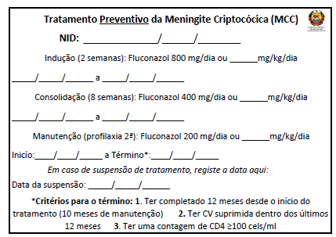
Cryptococcal Meningitis Pre-emptive Treatment Card
Used for beneficiaries that receiving pre-emptive treatment for Cryptococcal Meningitis
Should be stapled / attached to their patient card, which is kept with them allowing continuation of treatment even if visiting a different health facility

Slide 8
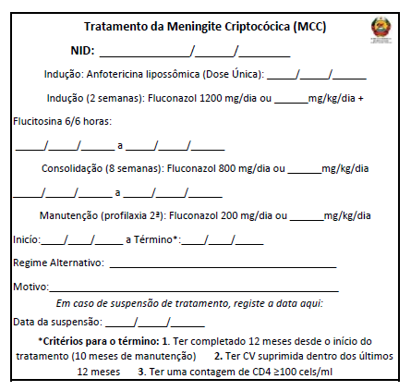
Cryptococcal Meningitis Treatment Card
Used for beneficiaries that are receiving treatment for Cryptococcal Meningitis
The card is opened after the induction phase with Liposomal Amp B
Should be stapled / attached to their patient card, which is kept with them, this allows a continuation of treatment even if visiting a different health facility

Slide 9
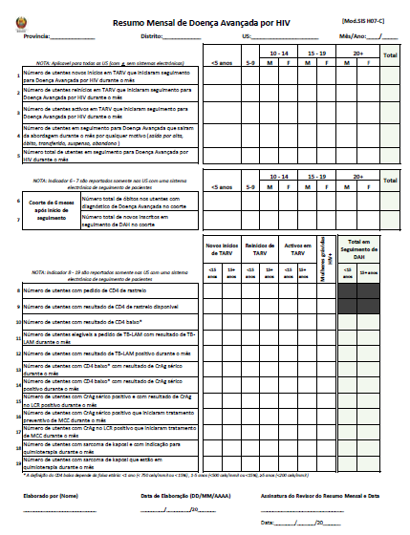
Monthly Report
The report has three sections:
First, the number of beneficiaries enrolled
A cohort of 6 months to monitor deaths in different age groups
Testing cascade with CD4, TB-LAM, CrAg, SK
Reported by all HF with AHD, and section 2 and 3 are reported using SESP/EPTS

Slide 10
Monthly Report Indicators
AHD Assessment for People at Risk for AHD
Number of users new to ART who began follow-up for Advanced HIV Disease during the month
Number of users restarting ART who started follow-up for Advanced HIV Disease during the month
Number of active users on ART who started follow-up for Advanced HIV Disease during the month
Number of users being followed up for Advanced Disease who left the approach during the month for any reason (discharge, death, transferred, suspended, abandonment)
Total number of users being followed up for Advanced HIV Disease during the month
Six Month Cohort
Total number of deaths among people diagnosed with Advanced HIV Disease in the cohort
Total number of new enrollees in AHD follow-up in the cohort

Slide 11
Monthly Report Indicators
Treatment Cascade
Number of users with a CD4 test request
Number of users with available CD4 screening results
Number of users with low CD4 results*
Number of users eligible for TB-LAM request with TB-LAM result during the month
Number of users with a positive TB-LAM result during the month
Number of users with low CD4* with serum CrAg results during the month
Number of users with low CD4* with positive serum CrAg results during the month
Number of users with positive serum CrAg and positive CSF CrAg results during the month
Number of users with positive serum CrAg who started pre-emptive treatment for CM during the month
Number of users with positive CSF CrAg who started CM treatment during the month
Number of users with Kaposi's sarcoma and indicated for chemotherapy during the month
Number of users with Kaposi's sarcoma who are undergoing chemotherapy during the month

Slide 12
Mozambique AHD Cascade

Slide 13
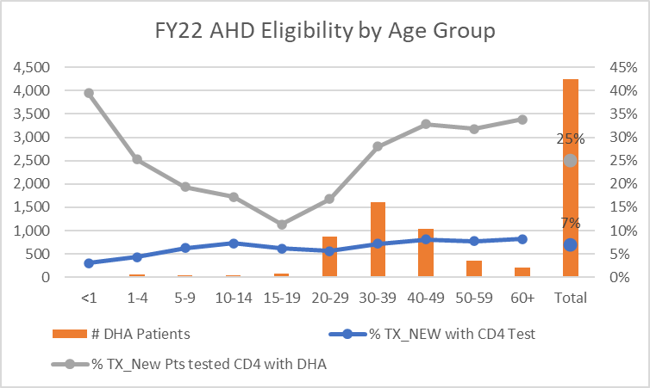
Conclusion
AHD package of care is still not available at all government supported health facilities, due to the limited access to the AHD laboratory and pharmaceutical commodities
The patient chart and monthly report are in the process of inclusion in the SESP/EPTS instance at PEPFAR supported HF, which will allow for improved follow-up of people with Advanced HIV disease

