Slide 1
Performance and evaluation tools for DSD in Mozambique
Irénio Gaspar, Care and Treatment Lead
Orrin Tiberi, Monitoring and Evaluation Advisor

Slide 2
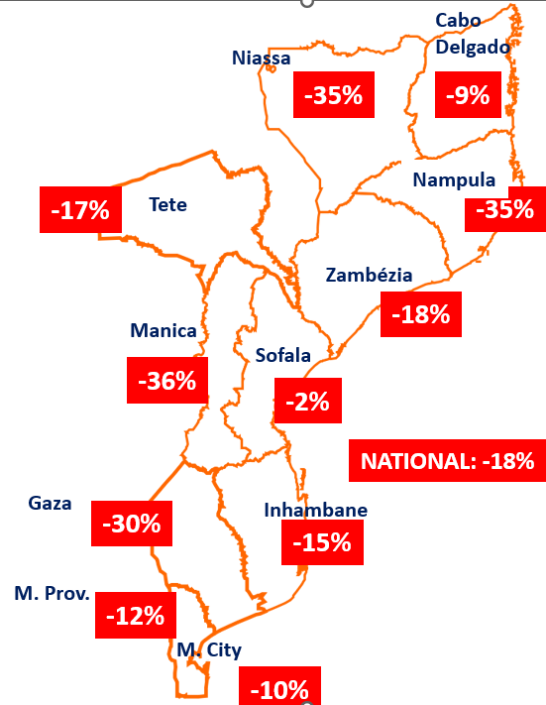
Content of the Presentation
2023 VL Results: Initial VS Follow Up VL result
Background of DSD
Implementation
Instruments of the DPR
Patient chart (master card)
Excel based form
Visualizations
Conclusion

Slide 3
Background of DSD
Despite the DSD guide being implemented since 2018 we are not able to record and report all information required at site level
The MOH health information systems and M&E tools do not allow the reporting of DSD data.
In order to better understand DSD implementation, the MOH has been conducting yearly data collection since 2021 from a sample of HF to monitor the implementation of DSD.

Slide 4
Implementation
2021 – 2023
What do we evaluate:
DSD coverage
ROC coverage in the DSD
Quality of the services offered to the ROC
DSD impact (Viral load suppression and retention in care)
ROC and providers views on DSD
How do we do it:
A nationally representative sample of HFs (6 per province)
Urban and rural HF
Decentralized (2023)
Quantitative component
Qualitative component

Slide 5
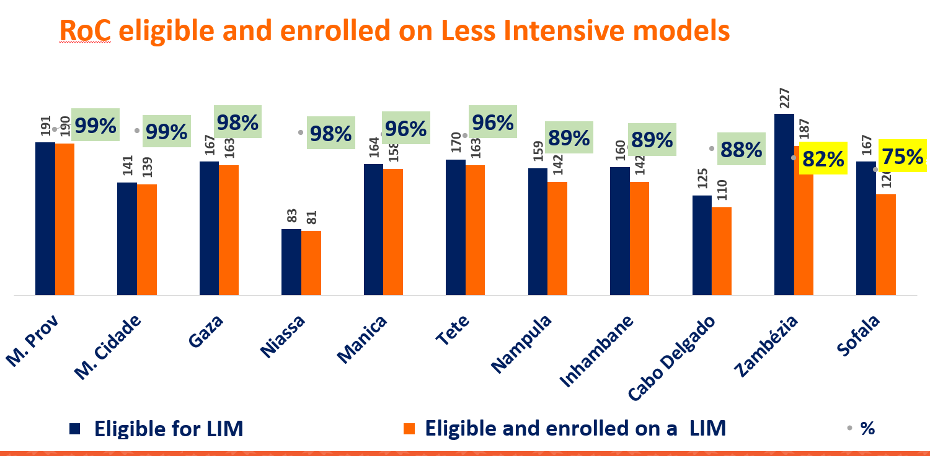
Quantitative component
Out of 1754 ROC eligible for LIM, 1601 (91%) were enrolled in LIM

Slide 6
Patient Chart (master card)
Opened at the moment of inclusion in the HIV care program
Should be used forever or until the ROC leaves follow-up.
A new chart is opened when this finishes
This is the primary tool we use to collect the DPR data

Slide 7
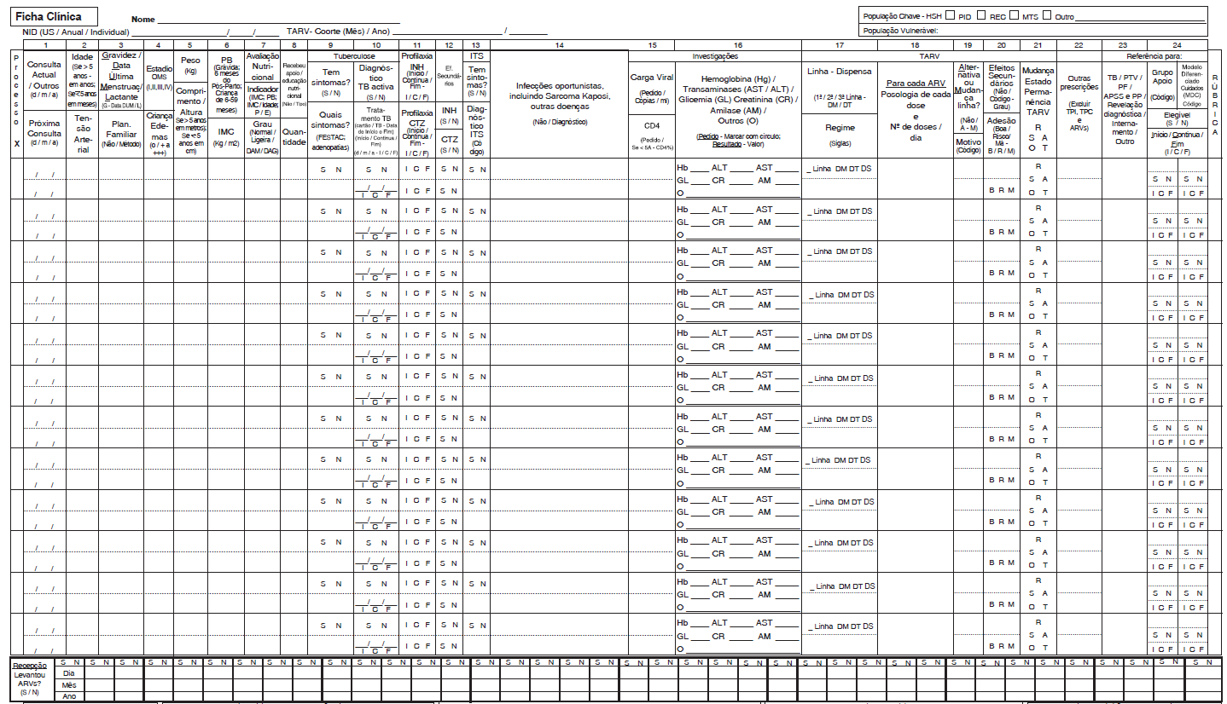
Notes:
On the mastercard we collect information from:
Collumn 1 – date of the current and next appointment (clinical and PSS)
Collumn 4 – WHO staging
Collumn 15 – CD4 and viral load
Collumn 24 – DSD that the ROC is enrolled
And many other variations of the questions related to the dates
This data is collected manually

Slide 8
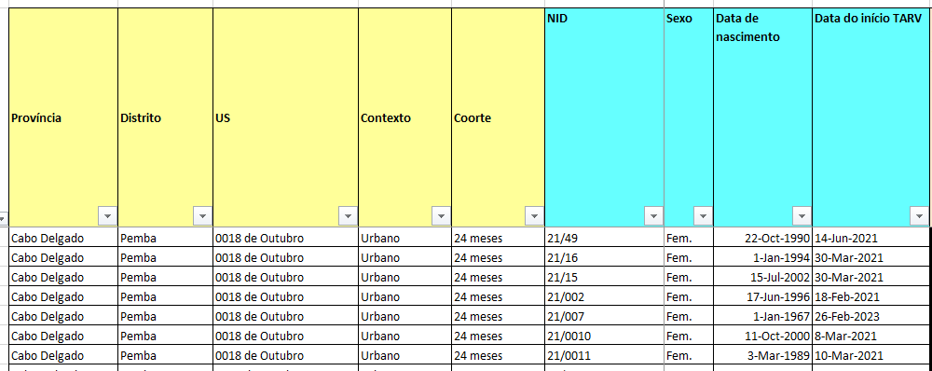
Data collection tool
Excel based form
Basic information:
Province
District
HF
Context
Cohort (12 and 24 months)
NID (patient identification number)
Sex
Birth date
ART starting date

Slide 9
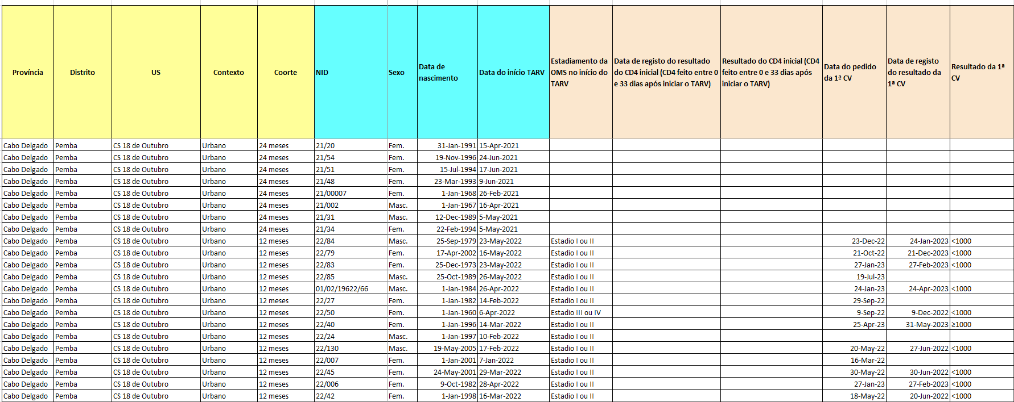

Slide 10
Cohorts (12 and 24 months)

Slide 11
Visualizations

Slide 12
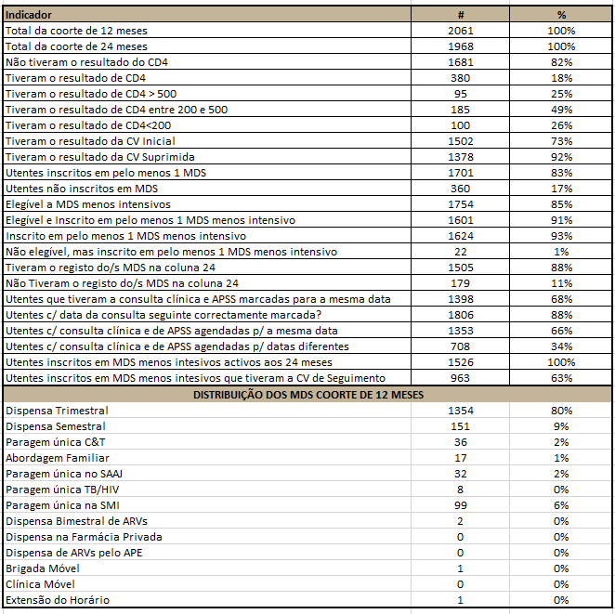
Visualizations
As the data is inserted, indicators are filled
Cohorts totals
ROC with CD4 and VL results
CD > 500 and CD4 < 200
VL < 1000
ROC with clinical and PSS schedules
ROC enrolled in at least 1 less intensive DSD
Distribution of the ROC among the DSD (12 months cohort)

Slide 13
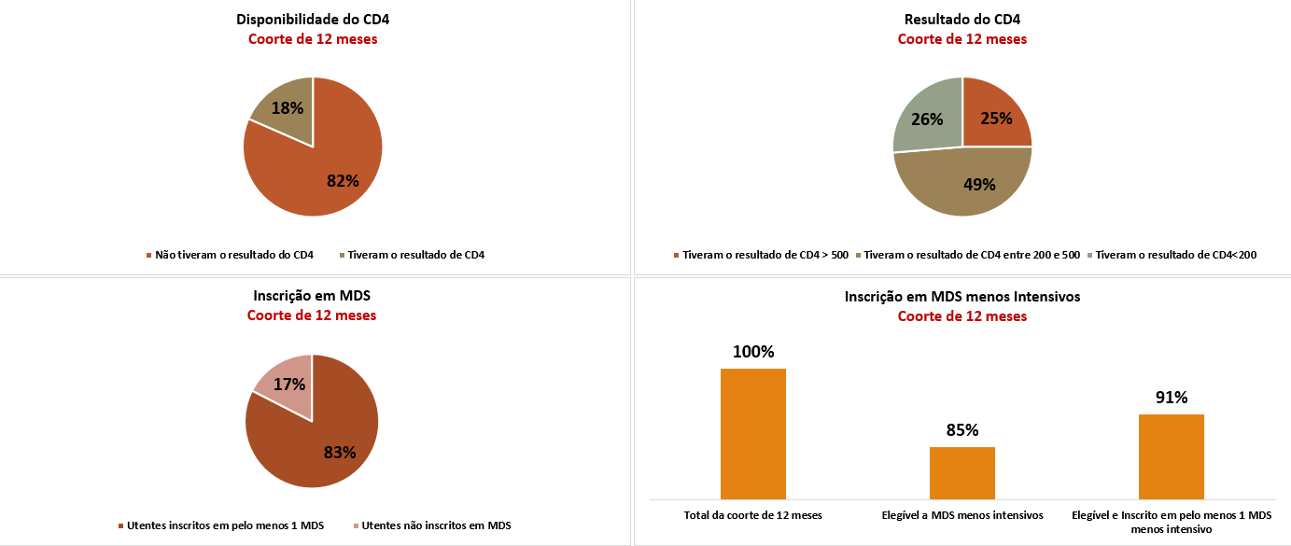
Results from the DPR
CD4 availability
12 months cohort$
CD4 request
12 months cohort$
Did not have CD4 result
Had CD4 result
Had CD4 result > 500
Had CD4 result between 200 and 500
Had CD4 result < 200
DSD enrollment
12 months cohort$
DSD enrollment in LIM
12 months cohort$
ROC enrolled at least in 1 DSD
ROC not enrolled at any DSD
12 months cohort total
ROC elegible to LIM
Elegible and enrolled in at least 1 LIM

Slide 14
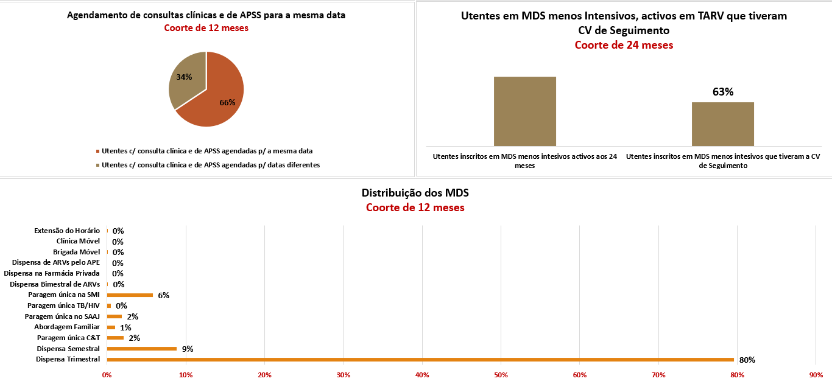
Results from the DPR
Same day clinical and PSS & PP schedule
12 months cohort$
ROC in LIM, active on ART, who had a VL follow up
24 months cohort$
ROC with cc and PSS & PP in the same day
ROC with cc and PSS & PP in different days
ROC enrolled in LIM and active at 24 months
ROC enrolled in LIM who had a follow up VL
DSD distribution (% of ROC enrolled)
12 months cohort$

Slide 15
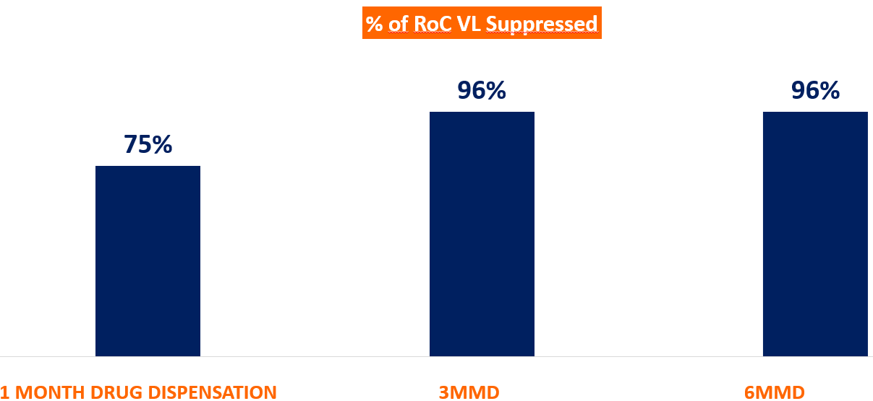
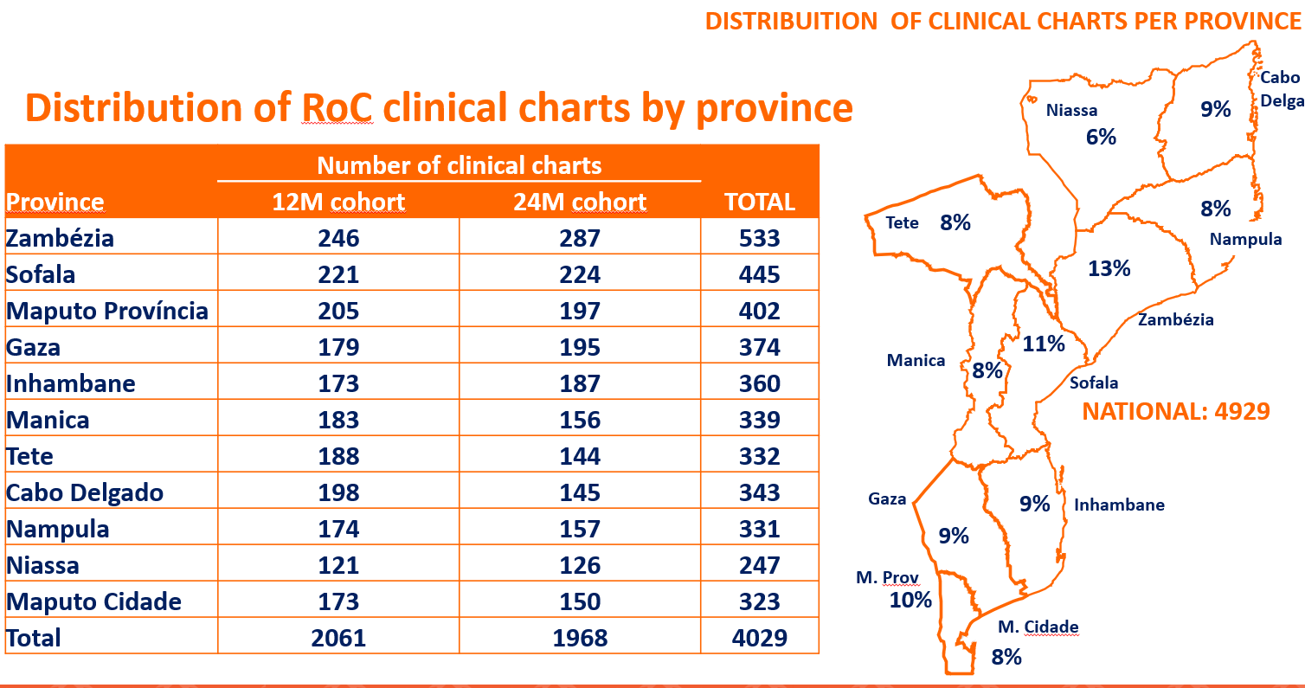
Conclusion
DPR Results
It is a simple and easy to use tool
The indicators can be adjusted based on the country needs
With the use of this tool, we concluded that it is possible to integrate the review into Mozambique EMR for future DPRs

