Slide 1
Enabling Telehealth and Self Care Through ORA / QuickRes
The Online Reservation and Case Management app (ORA)

Slide 2
About ORA
Online Reservation and Case Management App (ORA) is a web-app accessible via web browser
ORA has interfaces and functions for clients, providers, case managers, and program managers
Relevant for a wide range of health services; already tailored for HIV, STI, family planning, violence, mental health, COVID-19 services, post-natal care, and early childhood immunizations.
Client confidentiality and data security ensured through secure hosting and web-services, advanced security functions, and tailored implementation
Deployment options: 1) country specific ORA or 2) join multi-country ORA (QuickRes)
Notes:
[read slide contents] – additional unscripted notes below
About ORA
ORA is a webapp, which means it can be accessed on a web browser, like Chrome on a computer, tablet, or smartphone.
ORA can be deployed for a specific country/project or countries/projects can join an existing multi-country ORA deployment (available at quickres.org)
ORA has interfaces for clients, providers, case managers, and program managers. I will review some of these functions on the next slide
The general functions on ORA are relevant and adaptable for any health area and the system has already been tailored for HIV, STI, family planning, violence, mental health, and C19 services.
Client confidentiality and data security are ensured through secure hosting and other webservices like SLL encryption, some novel security functions built in to the app (like encryption of client identifying information), and we also through the tailored implementation of ORA, such as confidentiality training of back-end users, and limited collection of client identifying info, etc. We have added some notes on this slide that provides more details on the security features and would be happy to review these in more detail.
Value add:
Engages clients directly (self-care)
Facilitates virtual consultations (telehealth) and decentralized service distribution
Live data entry and use
Wrap-around and out-of-the box solution
Custom-built for easy operation for clients, providers, case managers
Client confidentially and data security
Hosting and web services: SSL encryption; secure high-capacity server hosting; offsite backup service with military grade encryption
Security functions: Password protected logins with access permissions tailored for each user; two-factor authenticated login for admin users; segmented front-end and back-end apps; sensitive client mobile numbers viewed individually as needed by client support staff but stored as encrypted code in raw database and in data export.
Tailored implementation: Back-end users trained to protect client confidentiality, limited collection of identifying or sensitive information (context-dependent), comprehensive client terms of use, explaining how data is collected, used, accessed, and secured

Slide 3
ORA functions across the client care continuum
Client-facing functions
Find nearby providers and services
Online appointment booking (for in-person, virtual, or delivered services)
Chat support
Client referral tool
Client satisfaction and complaint survey
SMS notifications when test results have been posted (for HIV and viral load)
SMS reminders to support retention (e.g., missed appointments; low ART and PrEP stock)
HIV/STI service assessment
COVID-19 risk and vaccination screening
Automated appointment reminders
Assess health needs
Book health services
Service delivery
Follow-up
Data use
Edit provider information, services, and availability
availability per provider
Provider appointment management
Backend appointment booking function
Report appt attendance
Report health services delivered to client
Initiate virtual consultation with client
Decentralized service referrals and tracking (DDD)
Case management and longitudinal ART, PrEP, and C19 cohort tracking
Autobook ART/PrEP refills
Offer and manage client referrals and feedback (including tracking resolution of client complaints)
Send SMS to client cohorts
Track results from online campaigns and outreach (using “tokens”)
Live data visualizations (cascade, timeline, compare, client referral, HIVST)
Data export of reservations, client referrals, and client feedback for custom analysis and reporting
Provider and program functions
Notes:
ORA was designed as a wrap-around and out-of-the-box solution to enable telehealth and self care. You can see the client facing functions on top, and provider or program functions below. While ORA has functions to support the entire client journey, programs need not use all these functions. They can simply select the functions that address important gaps in their program, and turn off the other functions they will not use on ORA.
[Additional unscripted remarks below]
Client facing functions:
Assess health needs: Clients can take an HIV/STI service needs assessment and a C19 risk and vaccination screening, which presents to clients recommended health services based on their responses in the assessment
Book health services: Clients can continue to find nearby health services and providers, book appointments with those providers, including by in-person, virtual, or delivery modalities. They can also open a chat within ORA with client support staff who can assist them to assess their health needs and book health services.
Service delivery: Clients receive automated appt reminders by SMS
Follow up: After clients book services, they are offered to complete a survey to provide their feedback on the services they received or anonymously refer other people for services, which can be used for promotional or contract tracing efforts. The system also sends automated SMS message that support retention in care, including missed appt notifications, and reminders for clients enrolled on ART or PrEP case management, that they are running low on their stock and should book their next refill.
Provider and program functions:
Book health services: Providers can edit their appt availability and the services and modalities they offer for public booking (in-person, virtual, or delivered). Providers and case managers can also book appts on behalf of clients on the backend.
Service delivery: Providers have a simple interface to view upcoming appts and see the service and modality requested by the client. They can report when the client attended their appt, and what services were provided to the client. Providers can also grant a second provider registered on ORA access to a client’s appt record to complete reporting of service delivery (DDD) or to report results of lab based diagnostic services (HST, VL).
Follow up: ORA assigns appts to case managers users who can view missed appointments and follow up with clients to reschedule. These CMs can also add clients to an ART, PrEP, or C19 cohort which allows a convenient way to track clients in long term care. Backend users can also use ORA to follow up with clients to offer them the option to refer others for services (e.g. contact tracing) and provide feedback on services. Case mangers have access to view service complaints reported by clients and report how such cases were resolved.
Data use: Backend users, such as program staff also have access to view data visualizations, including several different HIV cascades and ability to export data into Excel for custom analysis.

Slide 4
How does ORA support DSD along the cascade?
Expand outreach to online target audiences (granularly track online outreach and marketing efforts)
Empower clients to take greater control over their health (client-led health assessments, appt booking, SMS reminders, client feedback, client referral, and client self report of HIVST results)
Allow providers to track and manage their client’s access to DSD services (e.g., DDD, diagnostic /lab services)
Provide a simple interface for case managers to virtually support clients in long-term care (e.g., ART PrEP)
Facilitate service delivery to clients in three modalities (in-person, virtual, home delivery)
Notes:
Here I will explain how ORA can be used to support differentiated service delivery for HIV programs.
Virtual engagement in health services is considered differentiated because it allows clients to receive health information and services at a distance and from the convenience of their mobile device. Virtual engagement can also help clients avoid risks of stigma, discrimination, and violence associated with in-person modalities of service delivery.
ORA supports the entire HIV services cascade and several DSD models including:
Expand outreach to online target audiences (granularly track online outreach and marketing efforts)
Empower clients to take greater control over their health (client-led health assessments, appt booking, SMS reminders, client feedback, client referral, and client self report of HIVST results)
Allow providers to track and manage their client’s access to DSD services (e.g., DDD, diagnostic /lab services)
Provide a simple interface for case managers to virtually support clients in long-term care (e.g., ART PrEP)
Facilitate service delivery to clients in three modalities (in-person, virtual, home delivery)

Slide 5
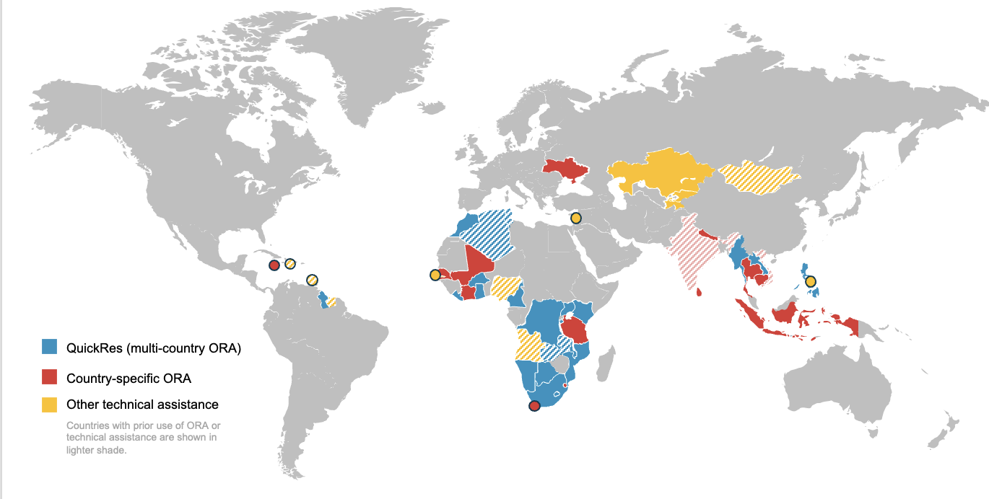
ORA global footprint and use cases
Impact across 45 countries
USAID/EpiC: Niche implementation for online KP audience booking and arrival
Jamaica/EpiC: Client management for private HIV service providers
Wits RHI SA: Scaled implementation for ART case management at 7 gov’t sites scaling to 40 (general population) – potentially expanding for PrEP navigation for AGYW (CAB-LA)
Morocco/EpiC: Broad health reservation and client management for specific CSOs
PARTNERS (ORA FUNDED BY):
Notes:
Our Going Online team has provided technical assistance to health programs in about 45 countries, and 32 of these are shown in blue or red include use of ORA .
There can be any number of use cases with ORA, because programs can choose which of ORA’s functions they want to use and to what scale. I want to highlight four common use cases that have emerged
EpiC’s KP HIV programs have typically implemented ORA alongside online outreach and marketing efforts with the aim of reaching niche online KP audiences and supporting them to book and access HIV services
ORA is also used by private health providers to support client management and service delivery reporting, including in Jamaica, Botswana, and India.
Some programs, mainly in Southern Africa are beginning to use ORA to facilitate case management of clients on ART and PrEP, including by a CDC-funded project implemented by Wits RHI
In Morocco, ORA supported LGBTI audiences to access mental health services, and the CSOs providing those services are now interested to scale ORA across all their health services, to offer their clients a online one-stop-shop
With most of these existing use cases being quite niche in terms of target audience, scope, or scale, we have not yet had an opportunity to scale use of ORA at the national level. But we know ORA has been tested enough in smaller use cases to know it is ready for scaled implementation.
Starting with initial investment from PEPFAR and USAID through the LINKAGES and EpiC projects, ORA is now also supported by funding from CDC, UNAIDS, Global Fund, WHO; and several individual ministries of health and regional partners like Wits RHI.

Slide 6
QuickRes tutorial videos
Client explainer video (3:08 minutes)
Case management video (2:04 minutes)
View video on YouTube: https://www.youtube.com/watch?v=YlIGn4bgzrU
View video on YouTube: https://www.youtube.com/watch?v=hiKhIst9_3g

Slide 7
Considerations
How can ORA serve the needs of clients, providers, or other program staff?
How would ORA integrate with existing HMIS tools and processes?
What financial and human resources must be deployed to rollout and use ORA effectively?
What level of expert technical assistance might the program require to use ORA?
Want help exploring these questions, email us at goingonline@fhi360.org
Notes:
You might be thinking, maybe ORA could help my program? Consider some of the questions here and if you need help exploring these, contact us by email.

Slide 8
Resources
Meta Accelerator Program Case Studies (2022): Cambodia; Ghana; Nepal; South Africa; Thailand
Policy brief: Virtual interventions in response to HIV… UNAIDS and WHO (2022)
Digital Health Landscape Report, PROMISE Project (2022)
Going Online: A Budgeting and Programming Aid for Virtual HIV Interventions (2022)
Local Partner Capacity Development for Going Online (2022)
Secure Use of Mobile Devices and Apps (2021)
LINK Technical Guide: An Electronic Client Feedback System for HIV Programs (2021)
QuickRes Technical Guide: A Global Online Reservation and Case Management App for HIV Programs (2021)
A Vision for Going Online to Accelerate the Impact of HIV Programs (2019)
Various technical briefs: Quick Online Surveys, Social Media Mapping, Social Influencer Outreach, and Social Network Outreach
Notes:
Find all resources at https://fhi360.org/goingonline

Slide 9
Thank you from the Going Online team!

