Slide 1
Development of the Zambia Differentiated Service Delivery Initiative for Men Toolkit
Dr Natalie Vlahakis - DSD SI lead
Mubiana Muhau - DSD Technical Advisor

Slide 2
Introduction
Gaps
Country achievements towards 95-95-95 UNAIDS target are 88.7%: 98%:96.3% (ZAMPHIA 2021)
DSD SI Strategies
Developed Policies and strategies to reach men 15-44yrs with HIV services
VL suppression for men aged 15-34 years is 70.1% (ZAMPHIA 2021).
88.7% adults living with HIV know their status (only 86.6% of men)
National scale-up of DSD models targeting men to improve delivery of the HIV services across the cascade.
Deveplment of Toolkits to support implementation

Slide 3
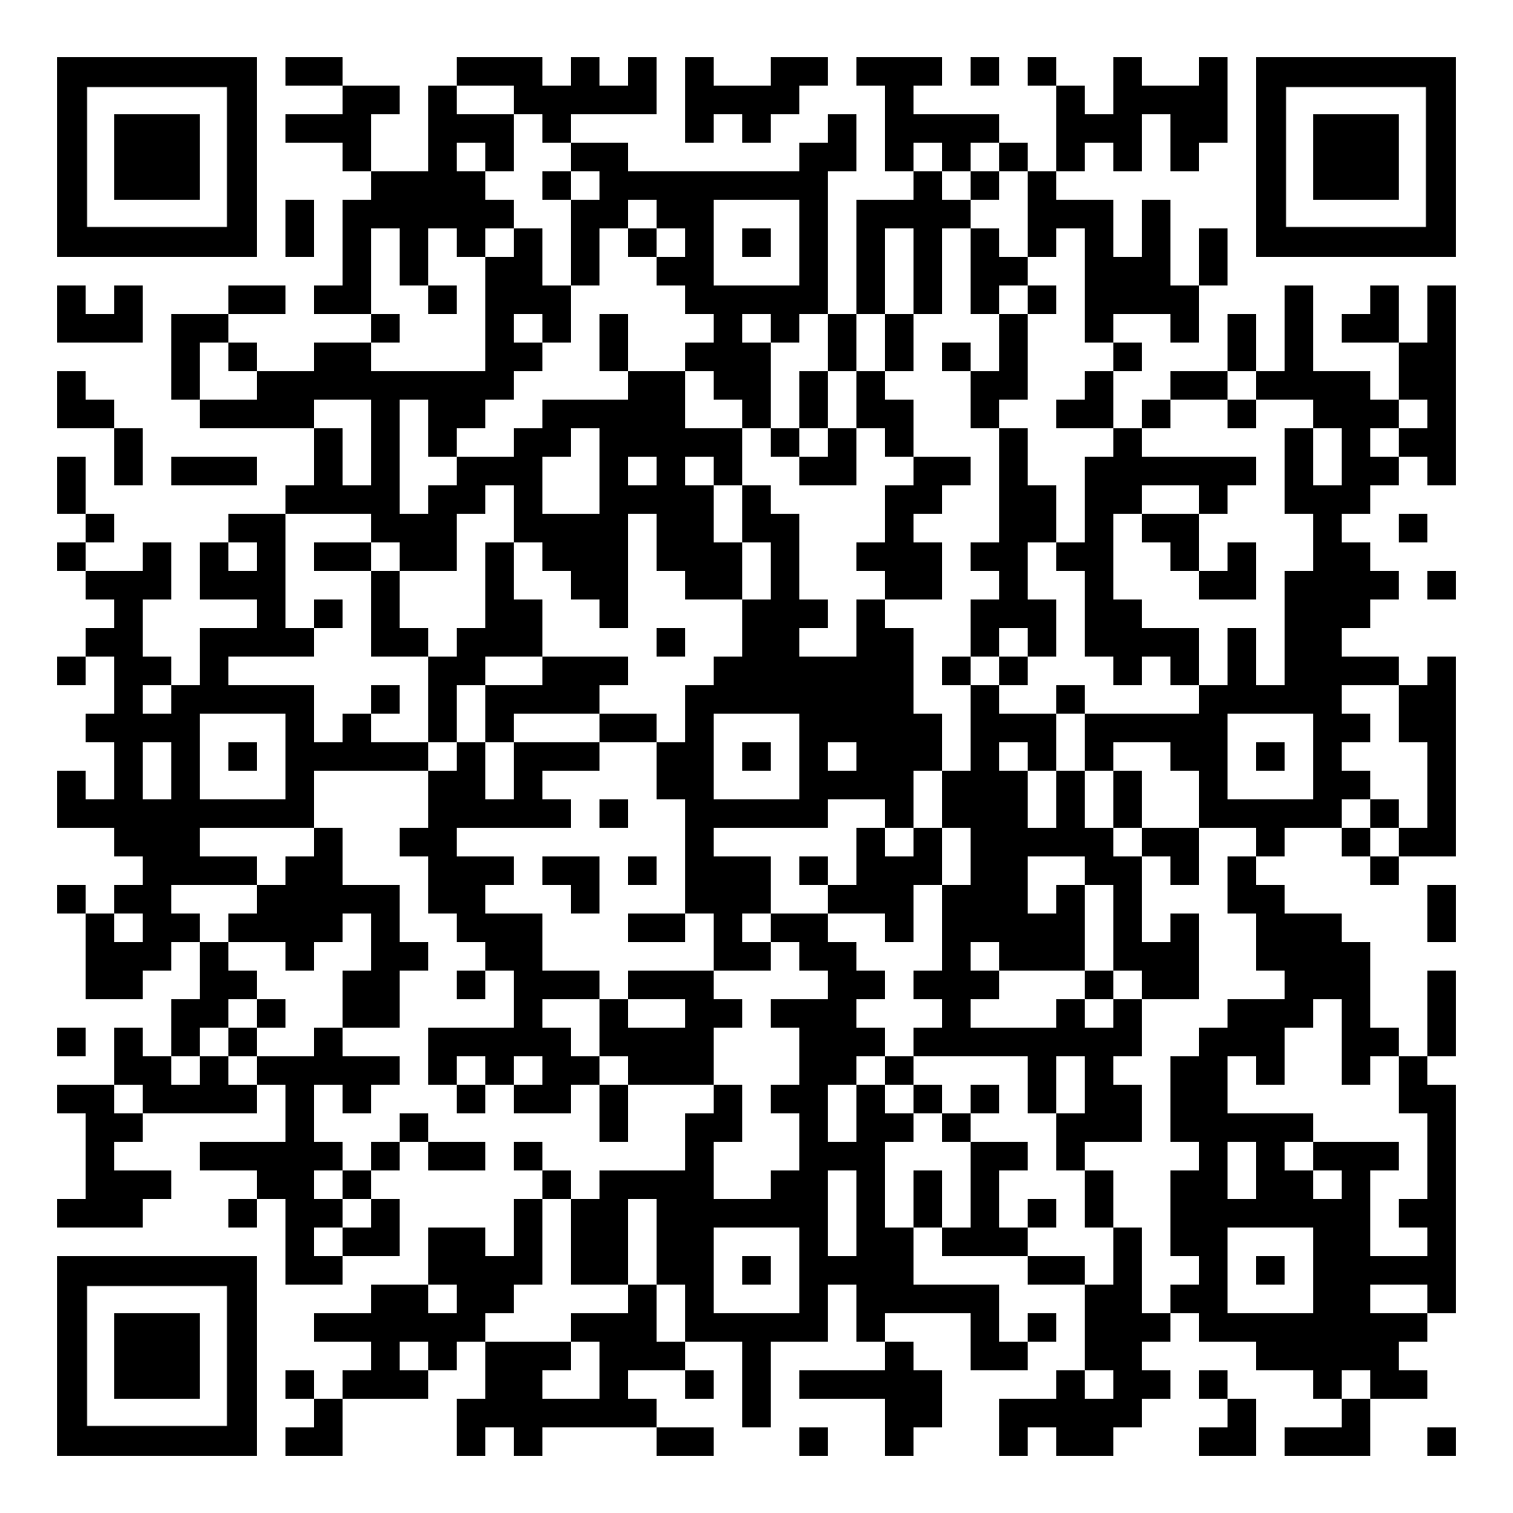
Development Process of the Toolkit
IP Mapping: to identify models
Sites visits to learn more and collection of supporting materials
Review of Materials and SOPs
Adaptation and adoption of identified model
Toolkit development
Presented during the Monthly DSD taskforce Meeting
Submitted to WHO for Input
Signing by MOH
Dissemination

Slide 4
Contents of the toolkit
Cost of set up (CPs and Men's Clinic)
SOPs for CPs and Men's Clinics models
Strategies for finding men
Training package
TORs of key players
M&E Framework
Digital platform guide
Coordination of IPs, CSOs and MOH
IECs Materials
 | Men’s Clinic | Community Post
WHEN | 3 months, 6months and as required | 3 months, 6months and as required
WHERE | Dedicated area within facility or community | Markets, Bus Stations, Taxi ranks, Church grounds, fishing camps
WHO | Preferably operated by a trained male HCW | Trusted local HCWs trained in customer care and in the core values of the model
WHAT | Male Sexual Reproductive Health, NCDs, STI, HTS, HIV prevention, ART | HTS, Linkage to treatment, Prevention service, referal to parent site

Slide 5
Conclusion
The DSD Initiative for Men Toolkit serves to standardize implementation of male friendly services
Helps demand creation for male specific services
Strong coordination and stakeholder engagement including male involvement is essential in the development process

