Slide 1
The CQUIN Advanced HIV Disease Quality Standards and Indicators Framework
Gillian Dougherty & Martin Msukwa
ICAP at Columbia University
13 November 2023
Notes:
Good afternoon, I am … from ICAP at Columbia University.
I will be taking you through the CQUIN Advanced HIV Disease Quality Standards and Indicators Framework.

Slide 2
Outline
1. What is the AHD Quality Standards and Indicators Framework?
2. How does it work?
3. How does it improve the quality of AHD services?
Notes:
I will explain what we mean by the ' Advanced HIV Disease Quality Standards and Indicators framework', then touch on how it works and lastly review how this framework will aid in improving the quality of AHD services.

Slide 3
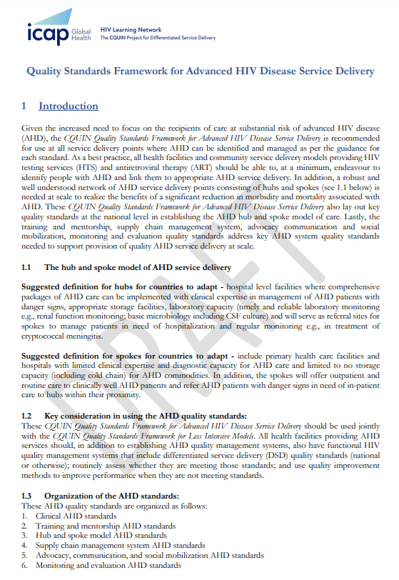
What is the AHD Quality Standards and Indicators Framework?
Link: https://cquin.icap.columbia.edu/wp-content/uploads/2023/08/AHD-Quality-Standards-and-Indicators_Pilot-Version_28-March-2023.pdf
QR Code:
The CQUIN Quality Standards Framework for Advanced HIV Disease Service Delivery are a set of quality standards and indicators recommended for use for periodic assessment at all service delivery points where AHD can be identified and managed to ensure the quality of AHD services is constantly improved and sustained.
These CQUIN Quality Standards Framework for Advanced HIV Disease Service Delivery should be used jointly with the CQUIN Quality Standards Framework for Less Intensive Models.
Notes:
On the figure on right you can see a screen shot of the first page of the AHD Quality Framework.
The link and the QR code are also provided for ease of access, and here with me I have a copy for this demonstration.
Read slide …
To Print / Carry
CQUIN LIM quality framework
CQUIN AHD quality framework

Slide 4
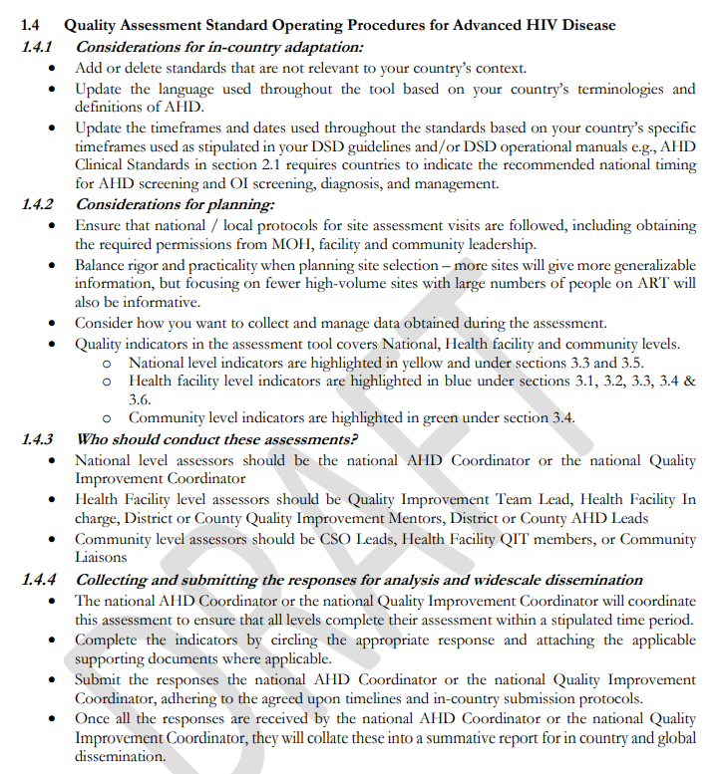
How does it work?
Stakeholder engagement
In-country adaptation
Quality assessment planning, implementation, data analysis
Dissemination of findings
Notes:
There are four steps to consider in adapting and using these standards and indicators by CQUIN member countries. These are also briefly outlined in the AHD quality framework:
Stakeholder engagement – ideally by the AHD TWG
In-country adaptation – particularly in line with national SOPs e.g. on 'prompt' assessment of people at risk of AHD – ensuring the standards on promptness are known
Quality assessment and quality improvement – PDSA; Learning sessions and Harvest meetings
Dissemination of key / proven quality interventions

Slide 5
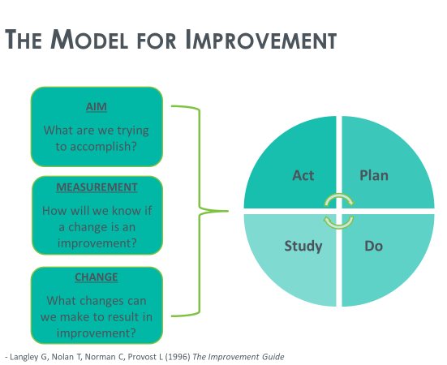
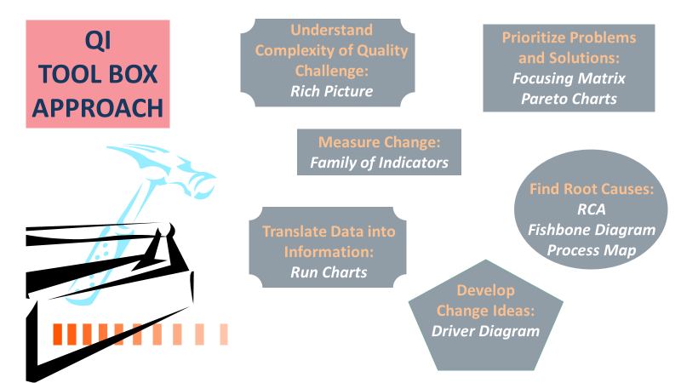
How does it improve the quality of AHD services?
Applying QI methods, tools and approaches to improve quality challenges identified during the assessment process
Notes:
It is critical in addressing the quality gaps identified during the quality assessment, to apply quality improvement methods, tools and approaches – drawing from the QI tool box depicted in the figure on the left here.

Slide 6
Findings from the AHD Quality Standards Pilot
Notes:
This figure shows the summary findings from the pilot of the AHD quality standards done in DRC, Eswatini, Mozambique, Uganda and Zambia.
To Print / Carry
Summary of AHD quality pilot

Slide 7
AHD Capability Maturity Model: The Quality Domain
Quality of AHD Services
 | 2021 | 2023
Cote d'Ivoire | 1 | 2
Eswatini | 1 | 3
Ethiopia | 1 | 1
Kenya | 1 | 2
Malawi | 1 | 5
Mozambique | 3 | 3
Nigeria | 2 | 3
Tanzania | 3 | 3
Uganda | 3 | 5
Zambia | 2 | 2
Zimbabwe | 2 | 2
Quality of AHD Services | Quality standards for AHD services have not been defined and are not currently in development | National quality standards for AHD services are in development or have been defined, but no evaluations of quality using national standards have been completed | At least one evaluation of AHD service quality has been conducted using the national quality standards, but the results do not indicate that standards have been met | At least one evaluation of AHD service quality has found that the program meets established national quality standards | Repeated evaluations of AHD service quality have found that the program meets established national quality standards
We will share experiences from Eswatini, Malawi and Uganda to understand what has contributed to their successes during upcoming CoP meetings – Please Attend!
 | BUR | CAM | CIV | DRC | ESW | ETH | GHN | KEN | LES | LIB | MAL | MOZ | NIG | RWA | SEN | SL | SA | TZ | UG | ZAM | ZIM
Quality of AHD Services | 1 | 2 | 2 |  | 3 | 1 | 2 | 2 | 1 | 1 | 5 | 3 | 3 | 1 | 1 | 2 | 2 | 3 | 5 | 2 | 2
Notes:
Looking at the Quality domain in the AHD CMM, 6 Countries show improved maturity of the quality domain.
Read text box ...

Slide 8
Key Takeaway Messages
There is an opportunity to improve the quality AHD services through the rapid adaptation and scale up of the use of the AHD quality standards and indicators
It is important to assess the quality of AHD service delivery at in-patient department settings separately
Overall, availability and adherence to SOPs as well as establishment of structured national referral systems remain critical gaps to ensuring prompt delivery of quality AHD services
Gaps persist in integrating AHD demand creation and service delivery into community programs (e.g., Community Led Monitoring Programs)
Notes:
Some key takeaway messages from the pilot of the AHD quality framework include … (Read slide)

Slide 9
Notes:
Thank you!
Any questions or clarifications?

