Slide 1

Monitoring and Evaluation of AHD: EGPAF Experience
Presented by:
Reuben Musarandega, Associate SI&E Director
Elizabeth Glaser Pediatric AIDS Foundation

Slide 2
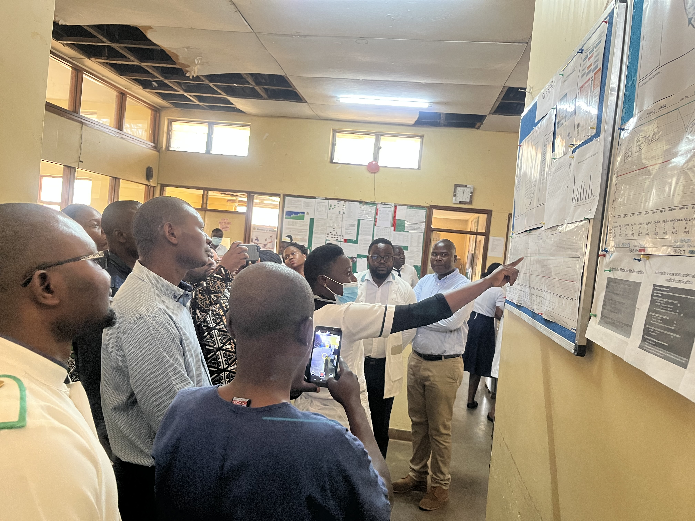
Outline
Background
AHD work in EGPAF
M&E Approach
Indicator framework
Data systems
Data use examples
Data quality assurance
Challenges

Slide 3
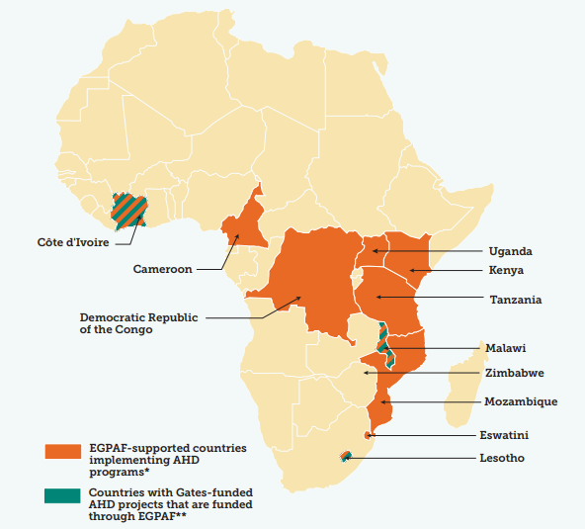
AHD Work in EGPAF
AHD support offered within U.S. President’s Emergency Plan for AIDS Relief (PEPFAR) funded HIV care and treatment programs through funding from the U.S. Centers for Disease Control and Prevention (CDC) and the U.S. Agency for International Development (USAID).
Côte d’Ivoire, Malawi, and Lesotho implementing AHD programs through Gates funds, embedded within PEPFAR care and treatment programs.
Figure: Map showing countries with EGPAF-supported AHD implementation

Slide 4
AHD Work in EGPAF
EGPAF Global Efforts
CDC Foundation AHD Funding
PEPFAR-Funded AHD work
Gates AHD Funding
  Advocacy
  EGPAF participates in key Global working groups & meetings on AHD – CryptoMAG, Global Steering Committee
  Implementation
  AHD Tools & Frameworks to support implementation,
  Patient Centered DSD Model,
  Hub & Spoke Model,
  Community of practice for AHD
  South-to-South learning & exchange
  Evidence Generation
  Evaluations and publications
  Dissemination at conferences
  Implemented in: Malawi,
  Zimbabwe,
  Tanzania
  Projects ended Dec 2022
  Implemented in:
  Lesotho, Eswatini, Mozambique, Malawi, Tanzania, Kenya, CDI, Cameroun, DRC, Uganda (TA)
  AHD implemented within existing HIV care & treatment programs
  Phase 1: Malawi
  Ended in March 2023,
  No Cost Extension
  Phase 2: Malawi, CDI, Lesotho, Kenya
  Start 1st Nov 2022
  End 31st Oct 2024

Slide 5
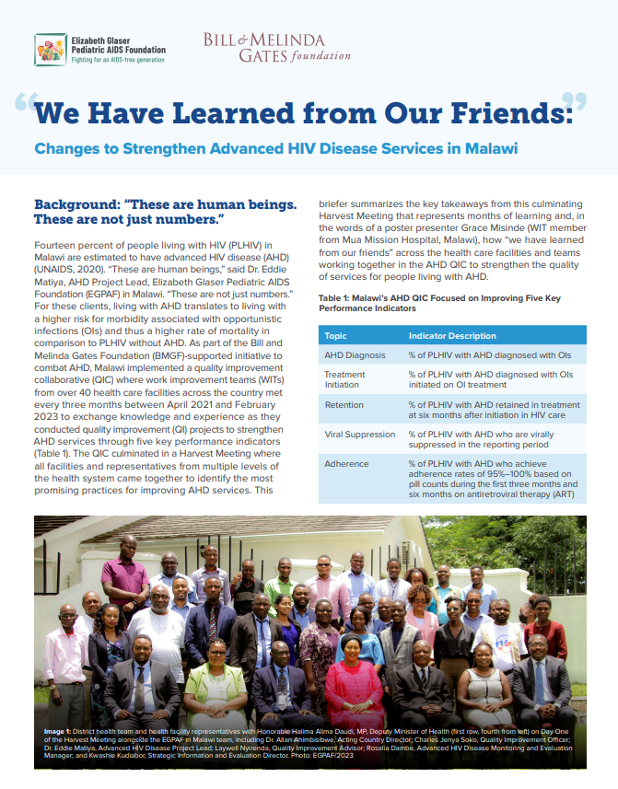
Scope of AHD Work
Technical assistance and support for established AHD programs
Adapting lessons learned from mature programs in supporting scale-up of AHD services to different epidemic settings and country contexts
Evaluating more mature and start-up AHD programs by different funders
Leverage program activities to create “common good” resources that can be used across various countries for AHD program implementation
Sustain and transition QI AHD Model in Malawi

Slide 6
M&E Approach in the Framework: R1
Minimum Requirements Approach
AHD Core M&E indicators
Based on Foundation AHD M&E framework
Disaggregated by patient type*, age, sex * New on ART, Returned to Care, Failing Treatment (HVL)
Primary data collection tools for core AHD indicators
  EMRs
  LIMS
  Paper registers: AHD register, lab register, lab forms, ART register
  Data aggregation tools: tally sheets, report forms
DHIS2 instance data repository of core AHD indicators
Power BI analytics dashboards for core AHD indicators
Additional indicators
  Indicators for QI-based approach
  Process indicators for funded AHD projects
  Site readiness assessment indicators
Data collection tools for additional indicators
  Patient data tools (digital and/or paper-based)
  QI tools: DHIS2-based Ez-QI tool
  DHIS2 data repository for additional indicators
  DHIS2 instance for site readiness assessment tool
  Power BI analytics for additional indicators

Slide 7
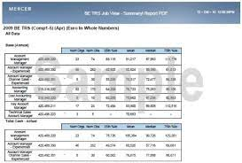
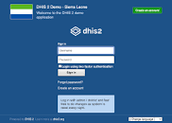
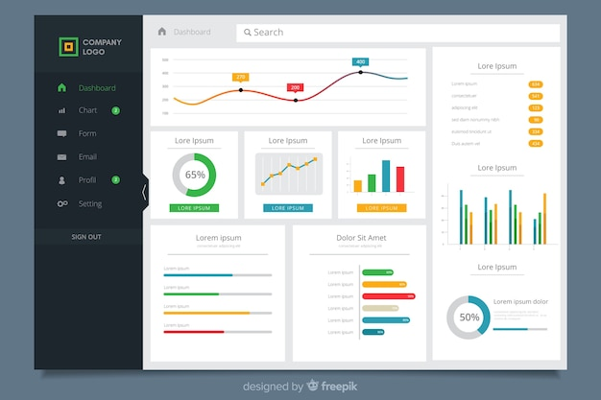
Recommended Data Flow, Data Management, Data Analytics: R2
Data to be pulled from various sources into an AHD summary report in MS Excel which is imported into the DHIS2 instance, from which data are visualized on Power BI dashboard
Enabling data management & data flow from health facilities for data analysis & use at national and global levels; building on existing national data systems; upgrading as needed
EMR
LIMS
Inpatient register
Manual lab forms
Manual AHD register
Patient files / cards
AHD Summary report form
DHIS2 Instance for AHD data management
Power BI Dashboards

Slide 8
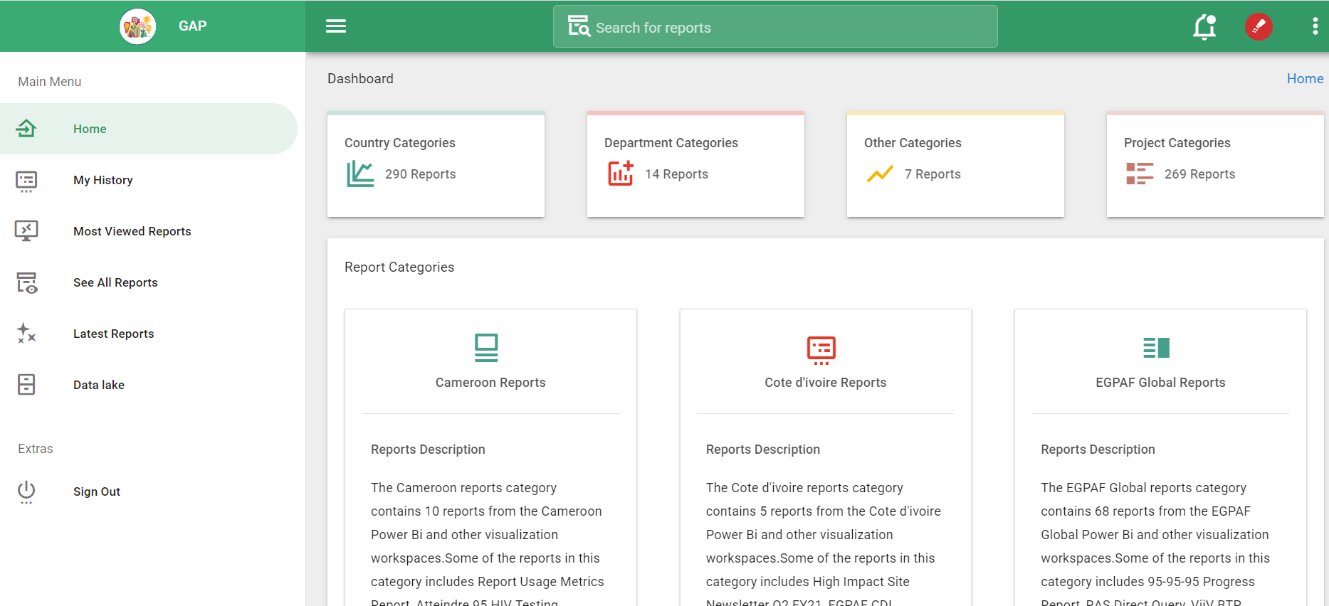
Global Data Access: R3
Through the Glaser Analytics Platform, all EGPAF data reports, global and country program reports are accessible to all staff. AHD data are also accessible through the GAP
Example: Glaser Analytic Platform

Slide 9
EGPAF AHD Indicators: R4
AHD Screening: CD4 Testing and WHO Staging
PLHIV eligible for AHD screening (Newly diagnosed HIV+ patients, HVL patients, RTT patients, Other per your guidelines),
PLHIV screened for AHD by CD4 count (includes those who are screened by both CD4 and WHO staging),
PLHIV screened by WHO staging only (No CD4),
PLHIV diagnosed with AHD by CD4 (<200) (includes those who are screened by both CD4 and WHO staging),
PLHIV diagnosed with AHD by WHO Staging only (Stage 3/4),
PLHIV considered AHD clients without CD4 count or WHO staging,
Total PLHIV diagnosed with AHD (sum of last 3 groups),
Cryptococcal Meningitis Diagnosis and Treatment
Total PLHIV diagnosed with AHD,
PLHIV tested with Serum CrAg,
PLHIV tested positive to Serum CrAg,
PLHIV tested with CSF CrAg,
PLHIV tested positive to CSF CrAg
PLHIV started CM treatment,
CM treatment outcomes (Induction phase, consolidation phase)
4. Diagnosis and Treatment of Other OIs
Total PLHIV diagnosed with AHD,
PLHIV screened for other OIs by type of OI (Severe bacterial infections, Pneumonias, Capos Sarcoma, malnutrition, other),
PLHIV started treatment for the respective OIs diagnosed,
2. Tuberculosis Diagnosis, Treatment and Outcomes
Total PLHIV diagnosed with AHD,
PLHIV diagnosed for TB (by type of test – TB Lam, GeneXpert, Chest Xray, other),
PLHIV diagnosed with TB,
PLHIV started TB treatment,
TB treatment outcomes (cohort data where patients with each outcome are counted at 9 -12 months after start of treatment per country TB treatment regimens),
5. AHD Follow-Up Outcomes
AHD clients with a follow-up VL test and received results after AHD diagnosis,
AHD care outcomes at 6 (Alive and in care, Died, Discharged from AHD care, Lost to follow-up)
AHD care outcomes at 12 months (Alive and in care, Died, Discharged from AHD care, Lost to follow-up)

Slide 10
EGPAF AHD Reporting, Sept 2023
Data categorized by:
Patient category
Gender
Age group – finer ages aligned with global recommendations
Age disaggregation allows monitoring AHD in children

Slide 11
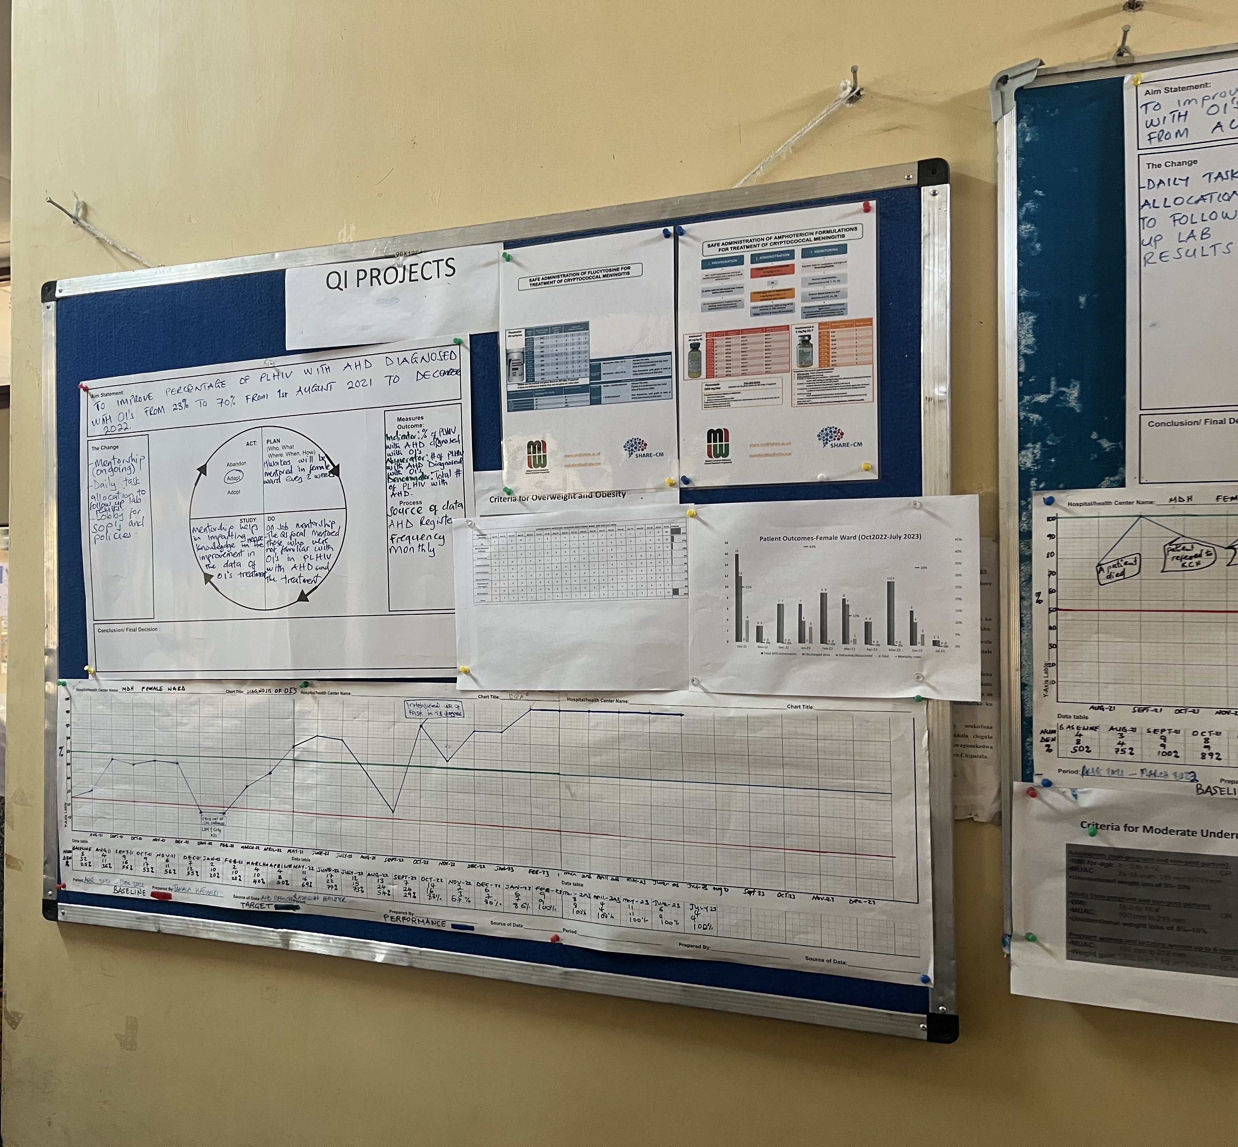
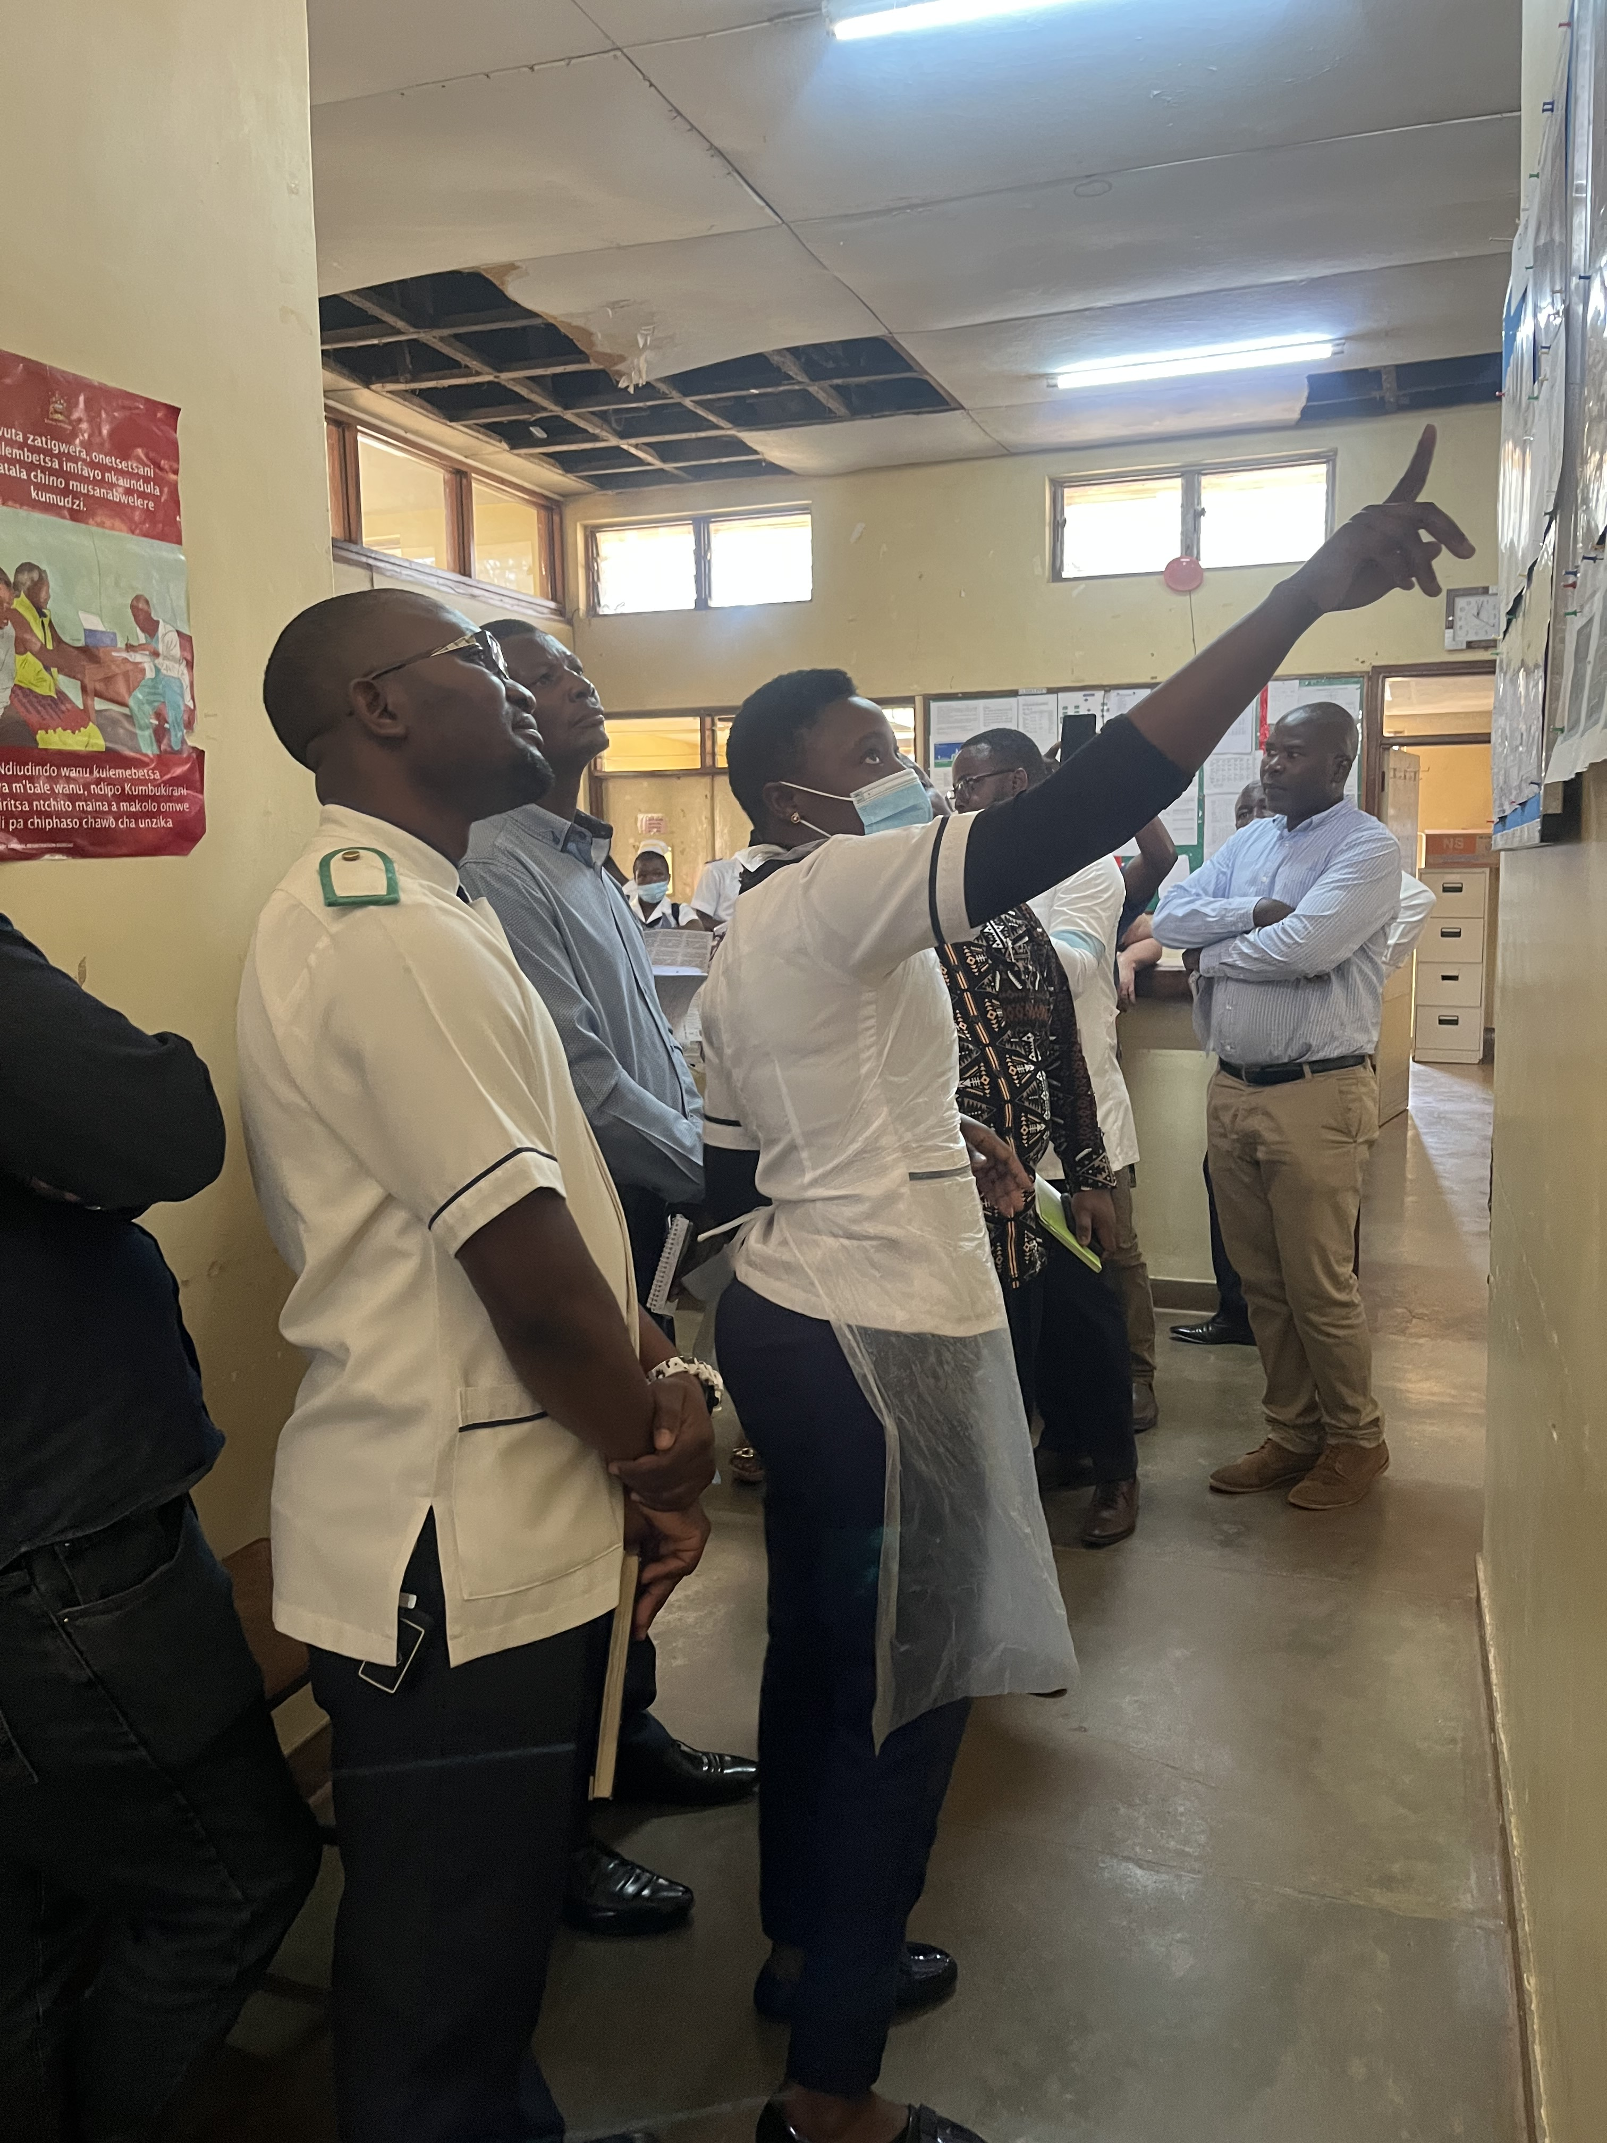
AHD Data Use: Malawi Example
Daily HCWs use the data to manage patients through EMRs and registers.
Weekly & monthly, they plot run charts for key indicators to monitor progress made by project interventions – using a QI approach
Data displays for AHD QI projects in Malawi, August 2023
Nurses explaining AHD QI results to EGPAF learning visit team, Aug 2023

Slide 12
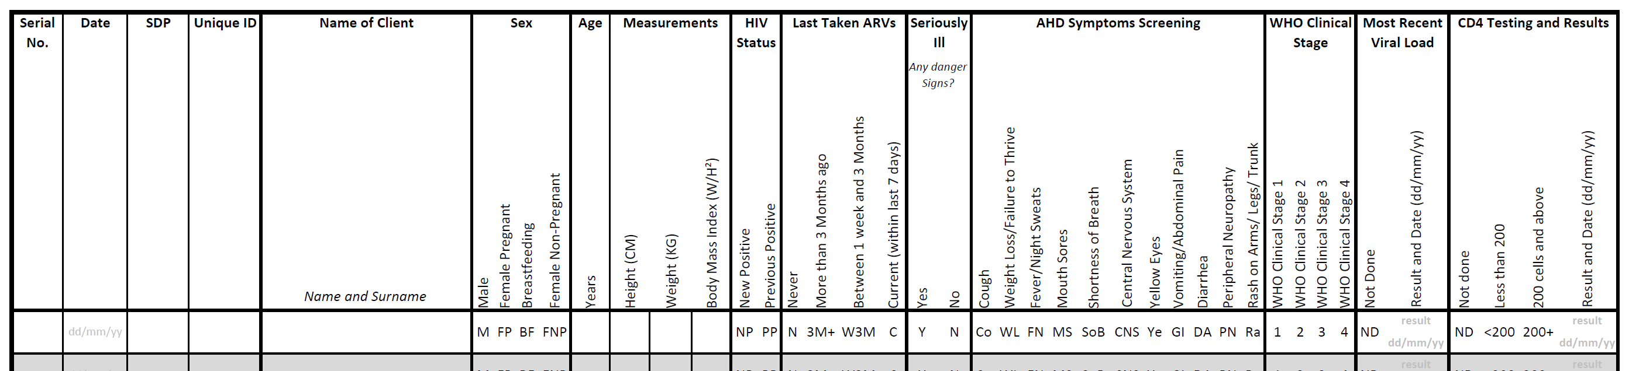
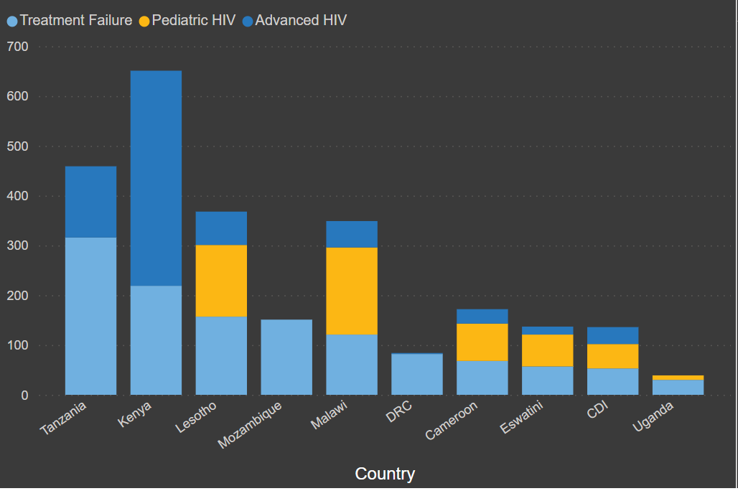
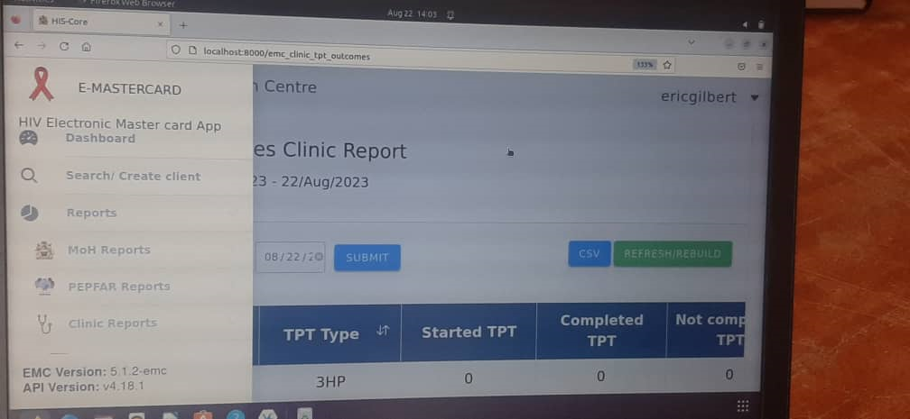
Challenges
Using multiple data sources vs AHD-specific tools
Aligning multi-country indicators
Enforcing data submissions
Frequency of data submission
Adding AHD module to EMRs
AHD Register: MOH Approved for national use
AHD data submission on EGPAF Global Analytics Platform
Absence of AHD from EMRs and cost of adding it

