Slide 1
TPT Completion Tracking Worksheet
Horacio Caliche, MD

Slide 2
Summary:
1- Context
2- Main objectives of TPT completion tool
2- Steps for TPT Triangulation MC
3- Steps for TPT eligible for completion
3- Demonstration of TPT triangulation tracking tool
4- Results of TPT Triangulation tracking tool

Slide 3
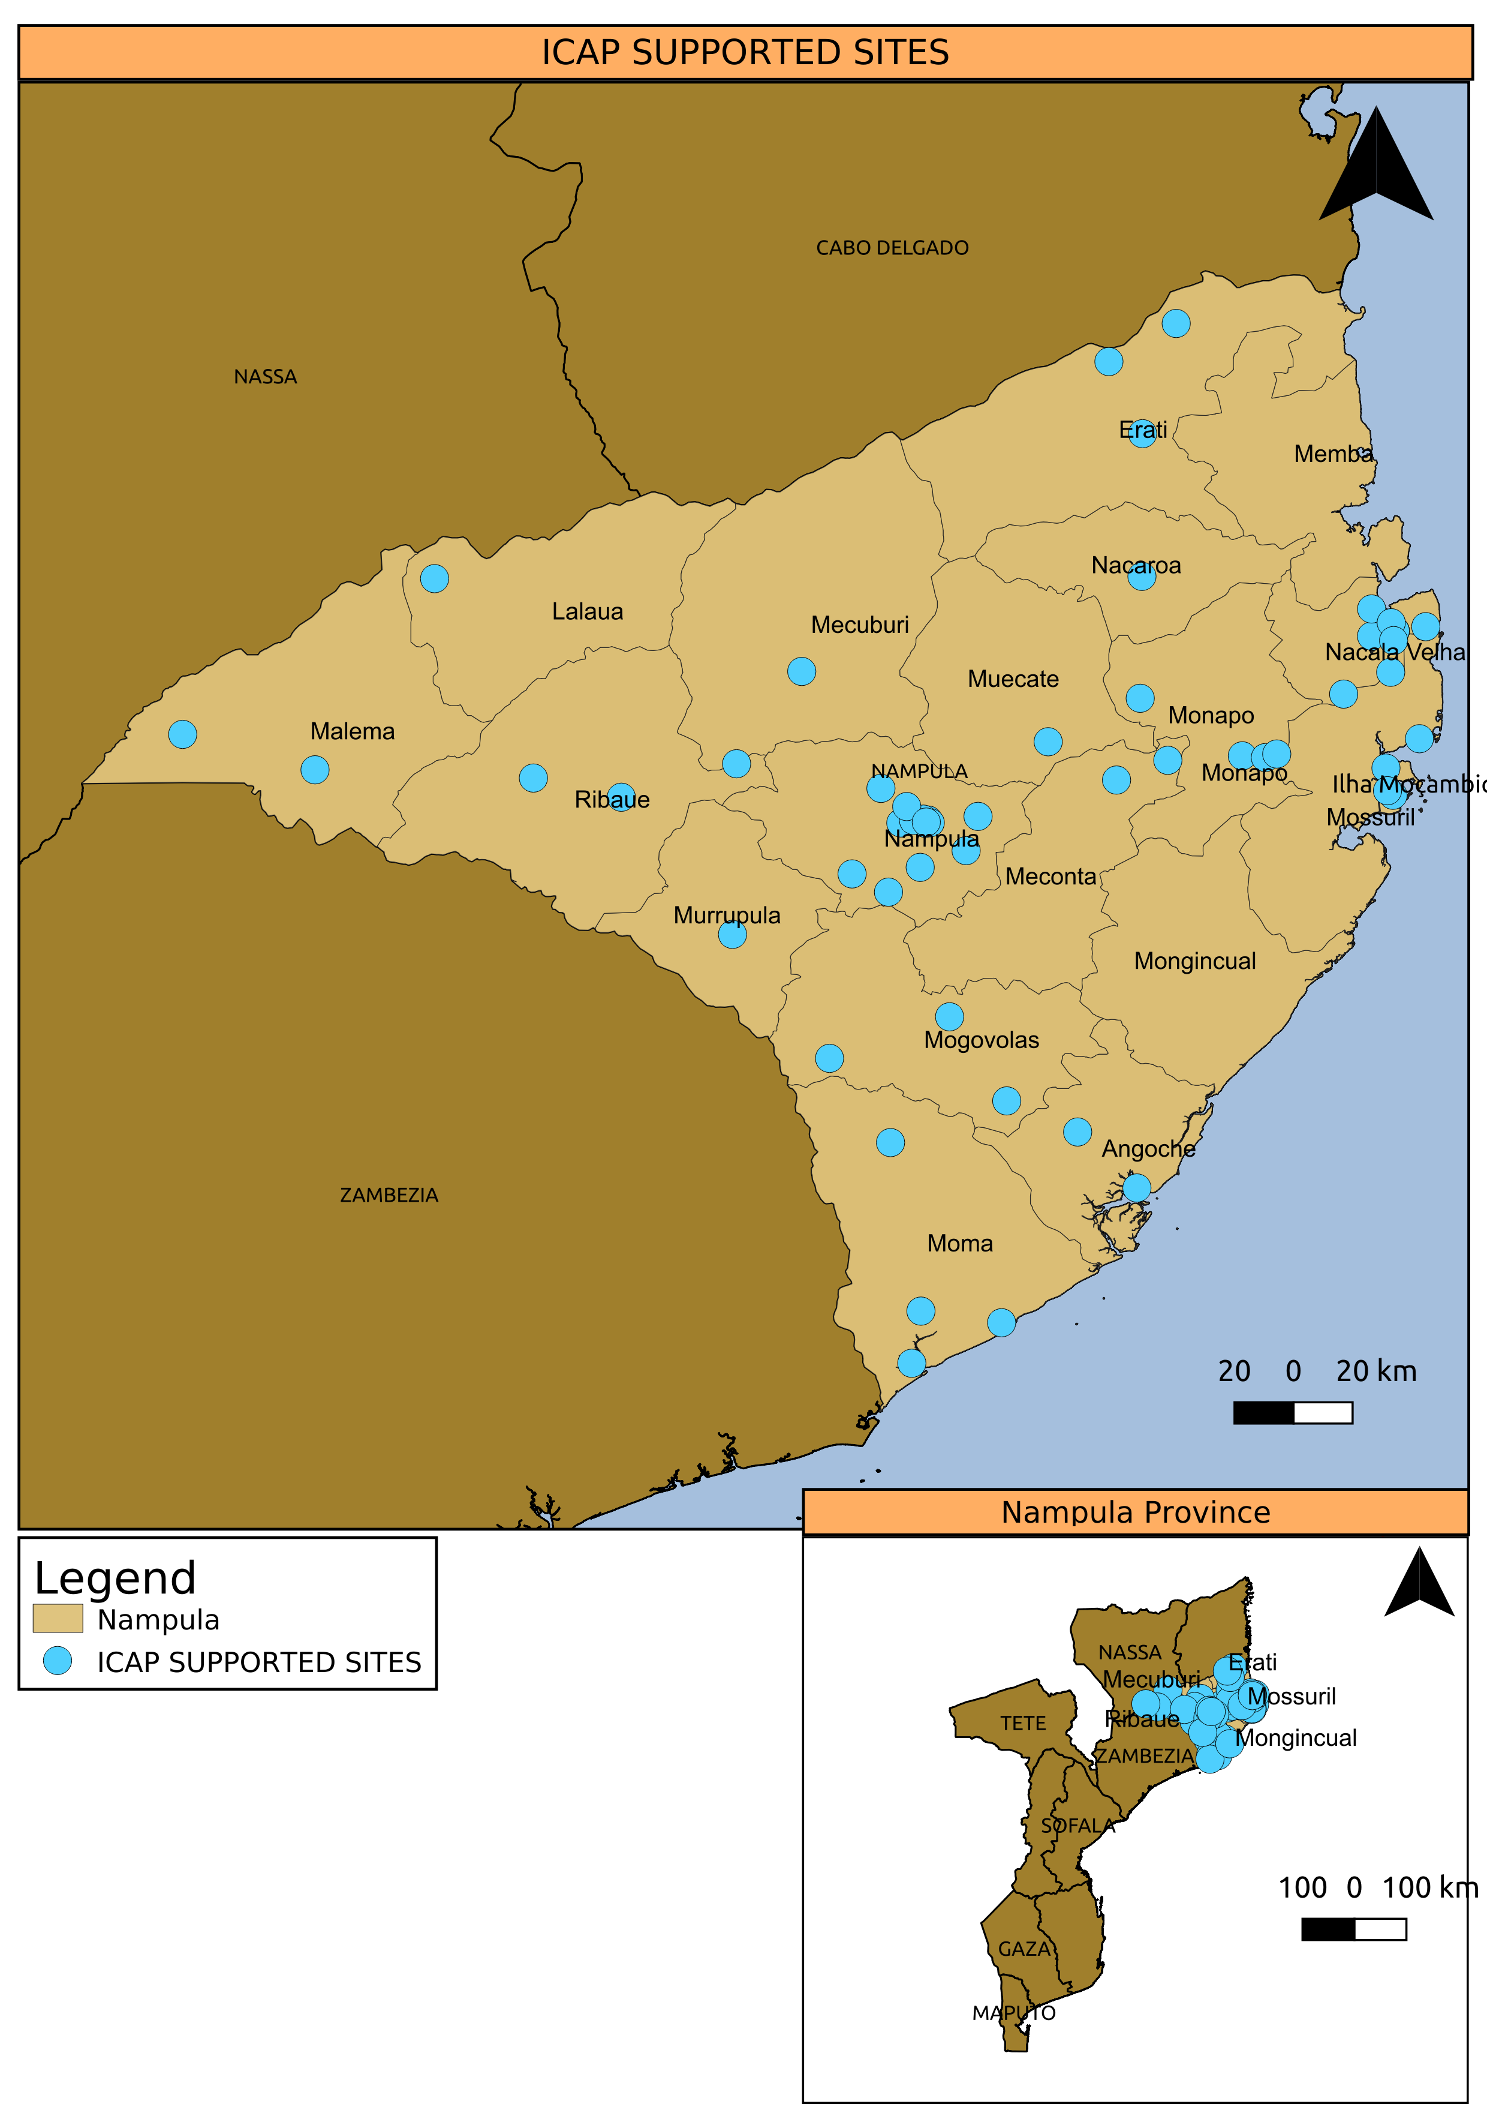
Context
Mozambique
Estimated HIV prevalence in Mozambique: 12.5% (INSIDA 2021)
PLHV in Mozambique estimated: 2.465.000 (MoH Semi-Annual Report) Spectrum 6.29
Nampula Province
23 districts and 246 health units (HF)
ICAP supports comprehensive HIV/TB prevention, care and treatment (C&T) services in 60HF and NCH in 19 districts through CDC/PEPFAR funds.
Estimated HIV prevalence: 10.0% (INSIDA 2021)
208,092 Currently on ART, 80% (21447/26868) TPT completion (PEPFAR, FY23)

Slide 4
WHY TPT TRIANGULATION TOOL?
Overall Objective:
Define procedures to improve registration of variables for the TB_PREV indicator
Implement the MoH standards for the end of the TPI cycle during the reporting period,
SPECIFIC objectives:
Guide the ME staff on generation of the list of recipients of care who started IPT
Guide clinical and lay staff to use the lists produced by M&E staff
Guide M&E staff and clinical staff in filling in the TPT worksheet, outreach the patients for TPT completion, fill in the MC and update EMR (OpenMRS)
Improve the TPT completion from 32% to 80% within two years.

Slide 5
STEPS OF USE OF THE TPT TERMINATION TRIANGULATION WORKSHEET
 | Intervention | Responsible
a | Generating the "lists of recipients of care who have started IPT” 6 months ago | Data Assistant / Regional M&E Officer
b | Filling in the variables in the tracking worksheet | Data Assistant / Regional M&E Officer
c | Locate the Master Cards (availability) | Receptionist
d | Cross-checking the information on the list without an end of TPT date with the Master Card information | Clinical officer at the HF
e | Cross-Checking the list of patients with an IPT end date less than 6 months | Clinical officer at the HF
f | Filling in the variables on the spreadsheet tracking tool | Clinical officer at the HF
g | Presentation and discussion of the information filled in on the spreadsheet to the HF staff | Clinical officer at the HF
h | Updating information on OpenMRS Database at the HF | Data Assistant / Regional M&E Officer
i | Re-verification of information | Data Assistant / Regional M&E Officer
j | Filling in the missing variables in the online spreadsheet | Data Assistant / Regional M&E Officer
NOTE: Interventions above takes place fortnightly

Slide 6
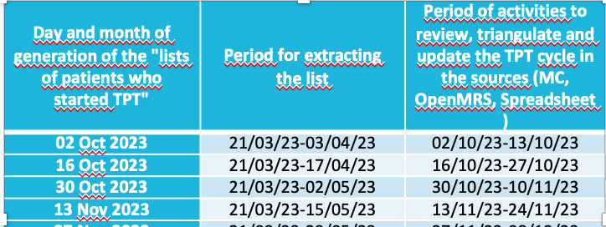
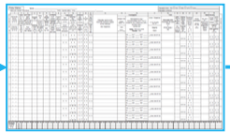
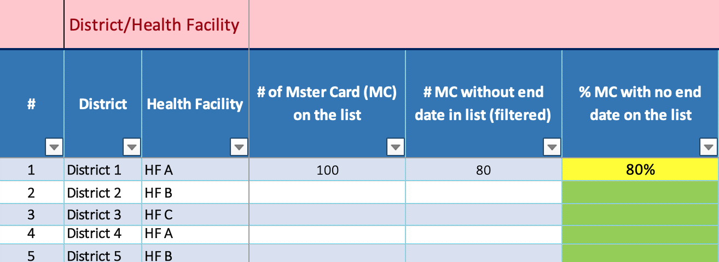
“Tools” for TPT Triangulation
OpenMRS database,
INH prescriptions,
List of eligible patients
TPT report
Master Card

Slide 7
Generating a list of RoC who have started IPT
Who: Data Assistant /Regional M&E Officer
Consults the schedule for generating the "list of patients who have started IPT" to identify the day on which the list will be generated.
Opens OpenMRS
Day and month of generation of the "lists of patients who started TPT" | Period for extracting the list | Period of activities to review, triangulate and update the TPT cycle in the sources (MC, OpenMRS, Spreadsheet )
02 Oct 2023 | 21/03/23-03/04/23 | 02/10/23-13/10/23
16 Oct 2023 | 21/03/23-17/04/23 | 16/10/23-27/10/23
30 Oct 2023 | 21/03/23-02/05/23 | 30/10/23-10/11/23
13 Nov 2023 | 21/03/23-15/05/23 | 13/11/23-24/11/23
27 Nov 2023 | 21/03/23-29/05/23 | 27/11/23-08/12/23
11 Dec 2023 | 21/03/23-12/06/23 | 11/12/23-22/12/23
26 Dec 2023 | 21/03/23-27/05/23 | 26/12/23-05/01/24
08 Jan 2024 | 21/03/23-10/07/23 | 08/01/24-19/01/24
22 Jan 2024 | 21/03/23-24/07/23 | 22/01/24-02/02/24
05 Feb 2024 | 21/03/23-07/08/23 | 05/02/24-16/02/24
19 Feb 2024 | 21/03/23-21/08/23 | 19/02/24-01/03/24
04 Mar 2024 | 21/03/23-04/09/23 | 04/03/24-15/03/24
18 Mar 2024 | 21/03/23-18/09/23 | 18/03/24-22/03/24
25 Mar 2024 | 21/03/23-26/09/23 | 25/03/23-29/03/24

Slide 8
TPT Triangulation Worksheet Tracking Tool
Notes:
Aqui vou explicar como funciona e vou demonstrar com própria planilha “excel”

Slide 9
TPT COMPLETION- TB Prev Quarterly Trend Q2Fy19 to Q4FY23
Notes:
Aqui é para colocar dois gráficos de tendência que mostram pacientes que iniciaram e Finalizaram TPT antes e depois da criação de planilha de triangulação de TPT, colega de M&A está a gerar os gráficos e vai mandar ainda hoje

Slide 10
Challenges:
Involves more than two people to complete the triangulation exercise
Availability of MC of the eligibe patients
Spreadsheet relatively lengthy
Incomplete update of the Open-MRS Database
Reduced # of HF reporting the information regarding to TPT tiangulation
Delay on sending the report of triangulation for analysis and feedback

Slide 11
TPT TRIANGULATION WORKSHEET TRACKING TOOL
Q&A?

