Slide 1
Differentiated Services for Children and Adolescents Living with HIV (CALHIV)
Tanya Medrano, Technical Advisor Vulnerable Children and Youth, FHI 360/HQ
Christine Magezi, Acting Country Representative, FHI 360/South Africa
Nonsikelelo Nyoni, OVC Specialist, FHI 360/South Africa

Slide 2
Package of Services and Interventions for Children and Adolescents Living with HIV (CALHIV). Technical Guidance for Orphans and Vulnerable Children (
Package of Services and Interventions for Children and Adolescents Living with HIV (CALHIV)
Technical Guidance for Orphans and Vulnerable Children (OVC) Programs
or Orphans and Vulnerable Children (OVC) Programs

Slide 3
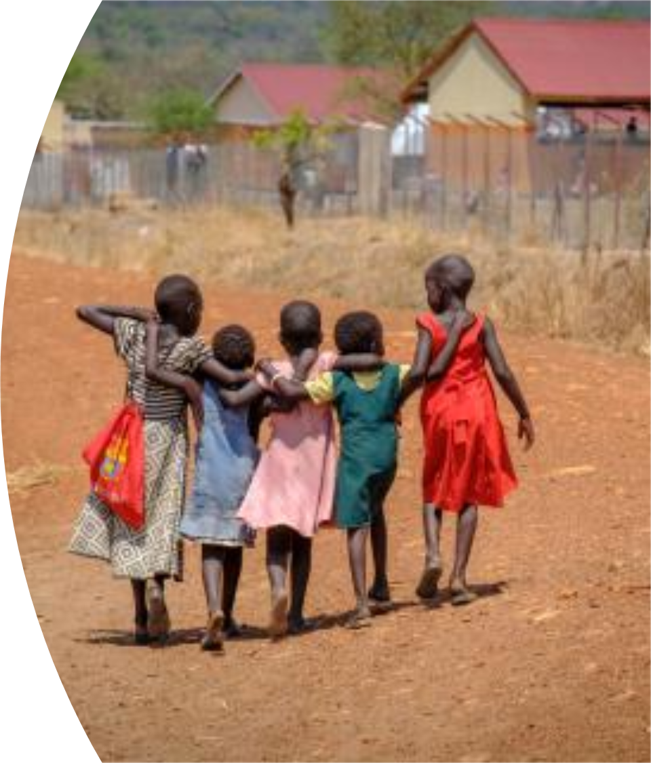
Why Did FHI 360 Develop this Guidance Document?
To ensure OVC programs have comprehensive and updated evidence-based guidance on the services and interventions that help improve HIV treatment outcomes and well-being among CALHIV.
To ensure differentiated high-quality care for CALHIV.
To contribute to reduce the pediatric and adolescent treatment gap.

Slide 4
Overview of the CALHIV Service Package Document

Slide 5
Guiding Principles for Service Delivery to CALHIV
Provide person-centered care
Provide family-centered care
Deliver comprehensive and age-appropriate services
Use an HIV-sensitive case management approach
Engage community case workers that are PLHIV
Provide appropriate training and support supervision to community case workers

Slide 6
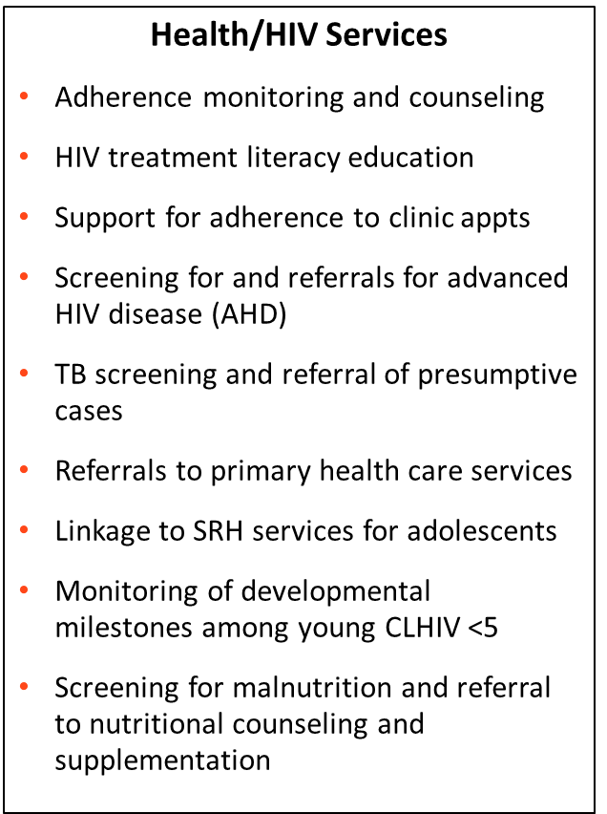
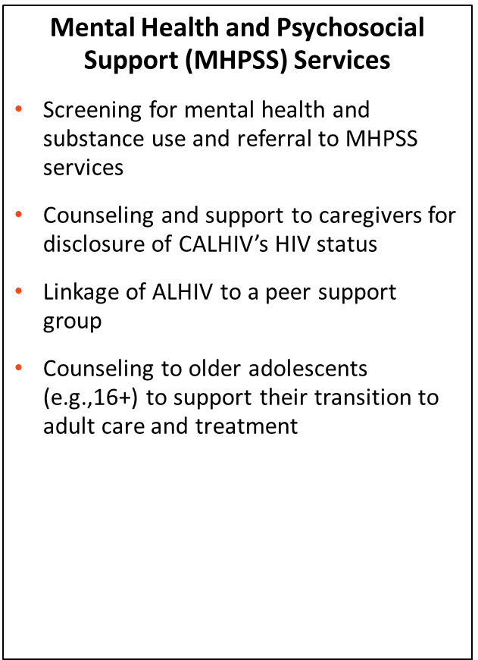
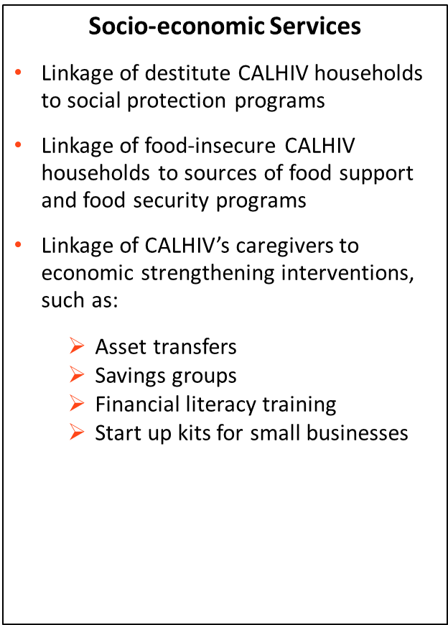
Package of Services to Support VL Suppression among CALHIV
CALHIV

Slide 7
OVC Project-Level Activities to Support CALHIV
Establish MoUs with HIV treatment partners to facilitate shared confidentiality, joint case conferencing, data triangulation, and joint planning and progress review of efforts to improve pediatric and adolescent HIV treatment outcomes.
Track treatment information for each CALHIV to ensure that those who are eligible are:
On optimized treatment regimens
Benefitting from multi-month dispensing (MMD) of ARVs
Accessing ARV refills in the community, where this is feasible
Advocate with clinical partners for the implementation of family-centered HIV care and treatment models.
Support care and treatment partners to conduct VL sample collection at the community level for children unable to go to the HF.

Slide 8
Links to Useful Resources

Slide 9
This Guidance Document Can Be Useful for:
Planning and budgeting for services for CALHIV in new programs.
Optimizing existing service packages for CALHIV in on-going programs.
Orienting or training OVC program staff on differentiated services for CALHIV.
Improving the supervision of service delivery activities for CALHIV.

Slide 10
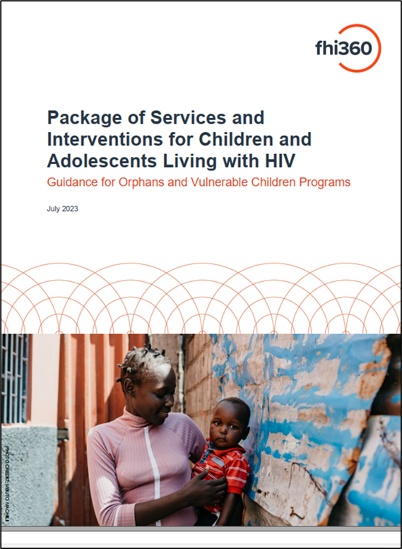
If you have questions or need more information on this new tool, please ask the FHI 360 team presenting this tool. You can also reach out to Tanya Medrano at tmedrano@fhi360.org

