Slide 1
Materials for Integration of Mental Health Screening and Management into HIV Care
MoH, Ethiopia
HIV/AIDS Prevention and Control LEO
Presenter: TBD

Slide 2
Goal
To Enhance routine screening and management of common mental illness (MH) among recipients of care

Slide 3
Strategies
Need assessment was conducted in 5 regions to inform mental health integration (MHI) approach into HIV care
Based on the needs assessment findings, necessary materials were developed:
MHI training curriculum
Screening checklist and referral form
Client education materials in local language
Provider support tools and standard operation procedures for MH services
Case managers logbook and monthly reporting form.

Slide 4
MHI Workflow
Adherence Case Mangers (ACM) or Adherence Supporters provide health education on MH in client waiting areas.
Eligible clients identified and linked to ACM, who screen them using the MHI screening tool and attach it to the client chart.
ACM escort clients who screen positive to the ART clinic/psychiatric clinic at the HF and serve as an ongoing link between the psychiatric and ART clinics, facilitating communication, documentation and follow-up.
Clinicians at ART/ psychiatric clinic will review ACM assessment, re-assess the client and manage accordingly.
Clinicians will complete a feedback form and revert back to ACMs for documentation and record keeping.

Slide 5
Eligibility for MHI Screening
I. MHI priority clients – RoC on ART
1. Newly initiated on ART
2. Unsuppressed viral load
3. Re-starting ART
4. Adherence challenges
5. Challenges with disclosure
6. Suspected to have a MH condition
II. MHI priority clients – RoC not on ART
1. Declined ART with out identifiable reasons
2. Adherence preparation > 2 weeks
3. Advanced disease management
4. Suspected to have a MHI condition

Slide 6
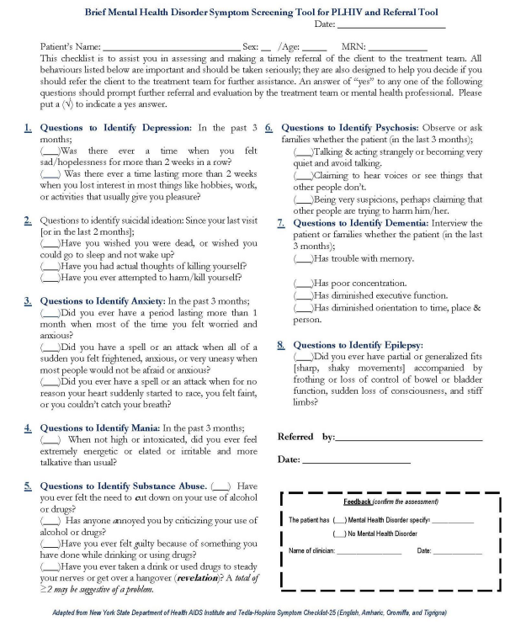
MH DSD Framework and Screening Materials
Mental Health DSD Framework
Who:
Peer support/ACM
ART providers
Psychiatrist by referral
What:
Screening for common mental illness
Link to psychiatrist
Where:
ART clinic, PMTCT clinic, KP clinic, community service delivery points, DIC
When:
At each client visit as per national guidelines (1M, 3M, 6M), including unscheduled visits
Amharic / English

Slide 7
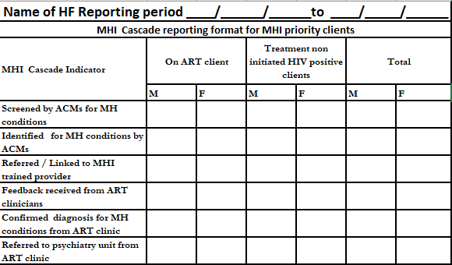
MH Recording and Reporting Tools
Mental Health Data Flow
ACM monthly →ART clinic monthly → HF management monthly → Regional Health Bureau → MoH quarterly
Mental Health Key Indicators:
Screened by ACM for MH disorder
Identified MH disorder by ACM
Linked to MHI trained provider
Feedback received from ART clinicians
Confirmed diagnosis for MH conditions from ART clinic
Referred to psychiatry unit from ART clinic

