Slide 1
Community Engagement (CE) Monitoring Tool 2.0
Pragashnee Murugan, International Treatment Preparedness Coalition (ITPC), Program Officer

Slide 2
Monitoring Community Engagement: Amplifying the Voice of Communities
Objective: promote community engagement across various levels (policy, programmatic, community) and areas (design, implementation, M&E)
A community engagement tracking tool was developed for communities, by communities. It covered multi-level assessment areas of policy, programs and community
Application of CLM model: indicator development >data collection > data analysis > advocacy and engagement for redress
Move from communities not being involved and no plans for involvement (red) to meaningful engagement in implementation, evaluation and oversight (green)
Community engagement is…
“…a structured, supported, meaningful and accountable process that ensures that people living with HIV have a SEAT and a VOICE in decision-making, planning, implementation, monitoring and evaluation, in order to achieve access to quality HIV care for all.”
Notes:
The scale-up of high-quality differentiated service delivery (DSD) holds promise for improving the quality and efficiency of HIV services for recipients of care and people living with HIV
CAN members contribute to amplifying the community voice and ensuring that people living with HIV, including recipients of care and their advocates, participate in the design, implementation, and evaluation of DSD initiatives at country and regional levels.
To identify existing gaps and to co-create solutions for meaningful engagement of people living with HIV and communities in DSD initiatives, the CAN developed a community engagement tracking tool—which is currently being rolled out in their contexts.

Slide 3
Objectives of the CE Framework
Ensure people living with HIV’s views are understood and considered when developing DSD guidelines, strategies, policies and during DSD implementation.
Ensure the people living with HIV and their advocates have the opportunity to participate in the development of DSD models through inclusive and equitable engagement practices
Strengthen community forums by creating opportunities for people living with HIV and their advocates to get involved with, and have their say on DSD implementation
Improve the relationship and level of trust between the people living with HIV and ministries of health and other stakeholders by ensuring that people living with HIV and their advocates are informed about and involved in DSD program activities.
Enhance the coordination, planning, and promotion of community engagement activities.
Strengthen feedback and communication from the ministry of health and other stakeholders so that recipients of care and their advocates know when and how their input has been considered to inform decisions.

Slide 4
CE MONITORING TOOL IMPROVEMENT FROM 1.0 to 3.0
Streamline indicators by removing sub-disaggregation in the indicators % of DSD M&E activities where RoC participated and # of communication materials produced by RoC to educate communities about policies, results of evaluations/assessments
Separate the policy, program, and community level
Include an example completed sheet
Explain each indicator and provide example for each indicator
Predefine the scope of the data (national, sub-national, health facility level) to guide data collectors
Remove the numeric indicators
Improve the color-scoring methodology by differentiating between activities that have no CE, activities that have not yet started in a country, and indicators where data is not available to better understand the nuances between low levels of engagement.
Integrate the grey option to the scoring system (activity not started or information unavailable) in the tracking tool to facilitate areas for future data collection and analysis
Integrate an option in the tool where countries can clearly specify if the activity is currently being implemented in a country was already implemented before the reporting period
Develop a manual to complement version 2.0

Slide 5
List of Indicators
 | POLICY LEVEL (6) | PROGRAM LEVEL (7) | COMMUNITY LEVEL (6)
DESIGN | % of technical working group (TWG) and task team (TT) meetings on DSD where RoC/community members participated during the reporting period % of policy validation exercises where RoC/community members participated % of online DSD TWG and TT platforms that include RoC/community members | % of meetings focused on DSD program design where RoC/community members participated % of DSD planning meetings where RoC/community members provided recommendations on prioritization of DSD models | % of thematic working group meetings where RoC/community members presented
IMPLEMENTATION | % of government-developed DSD policy communication materials that acknowledged input from national networks of PLHIV | % of DSD health facility trainings that include RoC/community members as planners, facilitators and participants | % of DSD sensitization/demand creation activities led by or actively involving RoC/community members % of health facilities with DSD where RoC work as service providers % of peer educators who attended health education learning sessions % of RoC/community members who attended health education learning sessions
MONITORING & EVALUATION | % of DSD-related M&E meetings that include RoC/community members % of DSD impact assessment/evaluations where RoC/community members participated | % of DSD M&E tools development meetings where RoC/community members participated % of DSD supportive supervision visits that include RoC/community members % of CQUIN Capability Maturity Model self-assessments conducted by MoH where RoC/community members participated and led on community engagement domain | % of health facilities offering DSD services where community scorecards and/or RoC satisfaction surveys are implemented
2019: 19–indicator Community Engagement (CE) tracking tool finalized and piloted in the DRC and Kenya, generating insightful results and interest in community engagement
2022: Roll out by 19 members of the Community Advocacy Network (CAN) in their respective countries. Information retroactively collected for the period of 1 June 2021 – 31 May 2022. Data collection between July-November 2022.
2023: Revamped the CE tool and rolled out in 22 countries (June 2023), based on country feedback about the 2022 exercise
A supplement to the ICAP CQUIN DART CMM dashboard, completed by ministries, program implementers, and communities.
Notes:
countries cannot achieve dark green on the CQUIN DART CMM unless they have matured in the majority of the CE toolkit indicators even in your talking points

Slide 6
Community Engagement Tracking Tool
Scoring Levels & Definitions
Color score
CE scoring descriptions (DSD Dashboard 3.0) | Representatives from the community of people living with HIV (PLHIV) and civil society organizations (CSO) are not involved in any activities related to DSD and there are currently no plans to engage these groups* * use this color score if activity not developed / planned and therefore no CE or plans to engage communities | PLHIV and CSO are not currently engaged in DSD activities, but engagement is planned or meetings and discussions are ongoing | PLHIV and CSO are meaningfully engaged in DSD implementation | PLHIV and CSO are meaningfully engaged in implementation and evaluation of DSDM | PLHIV and CSO are meaningfully engaged in implementation and evaluation of DSD, as well as oversight of DSD policy (e.g., through inclusion in DSD task force or other group)
% definition | If % is between 0-20% | If % is between 21-40% | If % is between 41-60% | If % is between 61-80% | If % is between 81-100%
Score points | 0 | 1 | 2 | 3 | 4

Slide 7
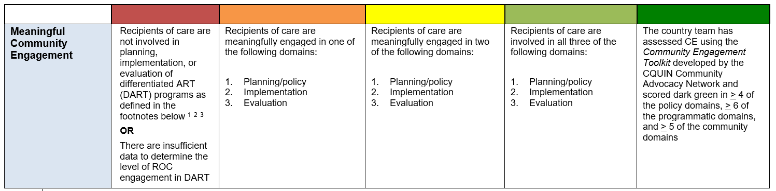
Community Engagement Tracking Tool
2023 UPDATED CQUIN DART CCM SCORING STAGES FOR THE COMMUNITY ENGAGEMENT DOMAIN
Notes:
Although CE is a core domain in the main CQUIN dashboard, the scoring matrix below is used in the CAN CE tracking tool and complements the general CQUIN dashboard that countries use to assess the maturity of their national DSD programs. This slide shows the updated CQUIN DART CMM scoring stages for the Community Engagement Domain just in case you may want to reference it

Slide 8
Community Engagement Tracking Tool
Although CE is a core domain in the main CQUIN dashboard, the scoring matrix below is used in the CAN CE tracking tool and complements the general CQUIN dashboard that countries use to assess the maturity of their national DSD programs
Representatives from the community of people living with HIV (PLHIV) and civil society organizations (CSO) are not involved in any activities related to DSD and there are currently no plans to engage these groups | PLHIV and CSO are not currently engaged in DSD activities, but engagement is planned, or meetings and discussions are ongoing | PLHIV and CSO are meaningfully engaged in DSD implementation | PLHIV and CSO are meaningfully engaged in implementation and evaluation of DSDM | PLHIV and CSO are meaningfully engaged in implementation and evaluation of DSD, as well as oversight of DSD policy (e.g., through inclusion in DSD task force or other group)

Slide 9
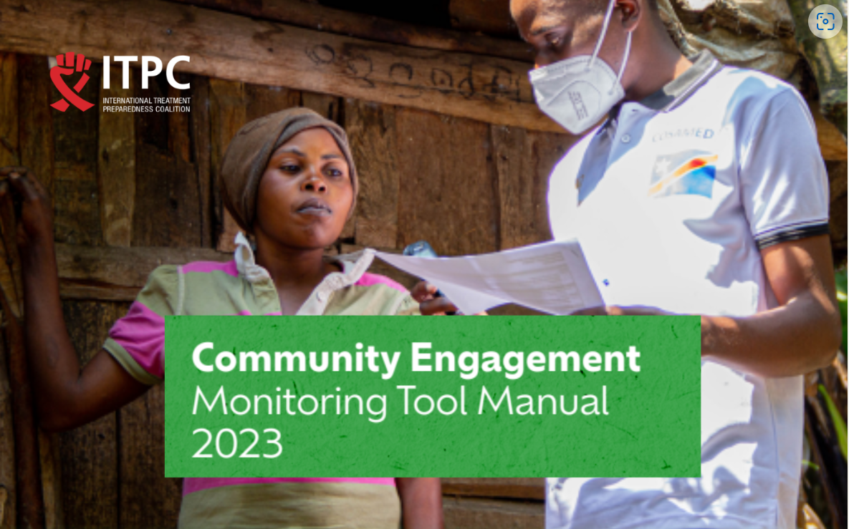
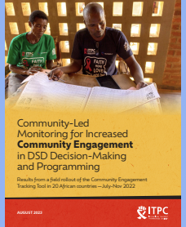
How does it Work?
Data Collection
Step-Down Trainings with country data teams
Data sources, challenges, best practices
Data Analysis, Reporting
Rigorous process of data cleaning with country teams
Community does analysis and reporting
Advocacy
Community develops advocacy plans to improve CE in DSD, armed with data
Notes:
Excel Format across all levels and areas of engagement
-Retrospective Reporting Period

Slide 10
CE Webpage: https://itpcglobal.org/activism/community-engagement/

