Slide 1
Tools Lab Session: Leveraging on Electronic Medical Records (EMR) Systems for HIV/FP M&E: The Kenya Case Study
Dr. Lazarus Momanyi – DSD Coordinator
Dr. Liilly Nyagah - SI Section Manager
Kenya MoH NASCOP

Slide 2
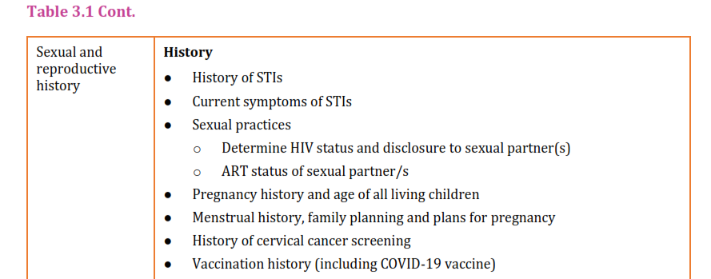
Background
The Kenya HIV Treatment Guidelines 2022 provide for pregnancy and intention assessment, counselling and provision of choice-based family planning for WLHIV

Slide 3
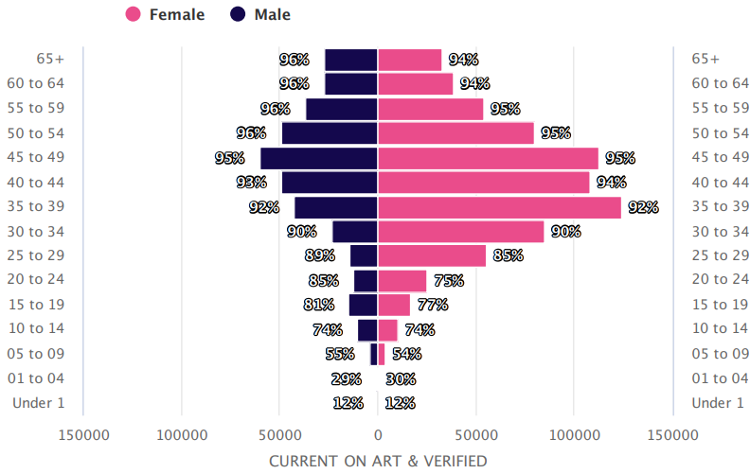
47% of PLHIV Current on are WLHIV of Childbearing Age
1.3 Million: Total PLHIV Current on ART: 1.3 Million
66% ; Female, 34%; Male
47%; Women Living with HIV of Reproductive Age (WRA) on ART (15 - 49 years)
Source: Kenya NDWH Data

Slide 4
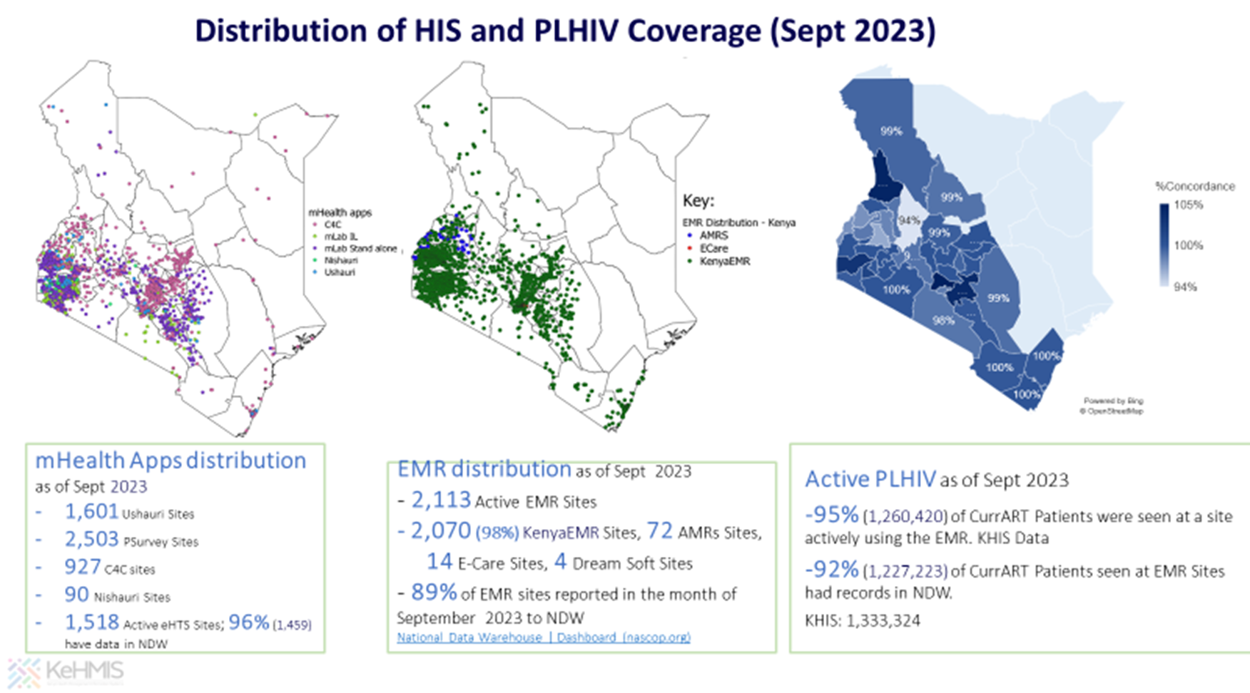
Why leverage on EMR in Kenya for FP Data Amongst WLHIV?
92% (1,227,223) of PLHIV current on ART seen at EMR Sites had their records in the Kenya National Data Warehouse (NDWH)
Data at NDWH is individual/patient level
Reports from FP paper registers is not disaggregated for WLHIV

Slide 5
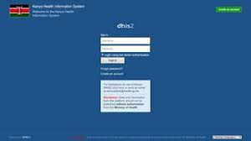
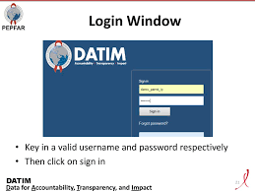
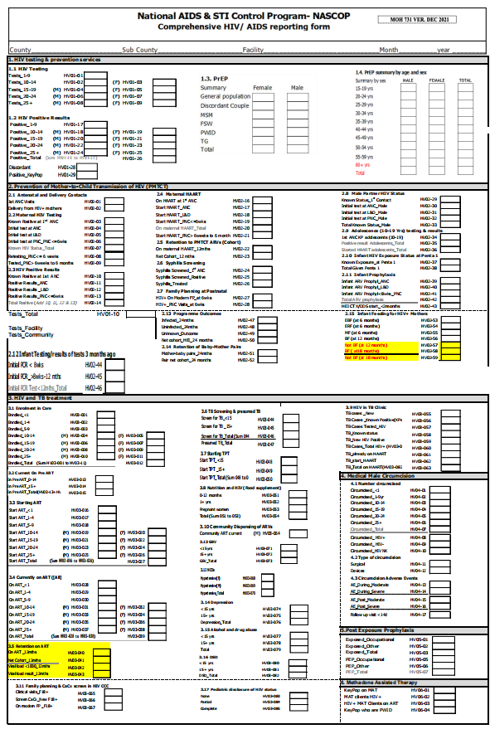
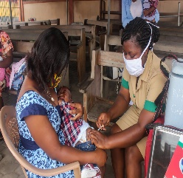
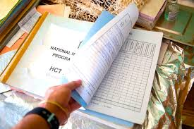
HIV Reporting & Data Flow
Individual Level Data Repository
Aggregate Data Repositories
Data Use
1. Estimates inputs
2. Global Reporting
3. Planning
4. Monitoring
5. Resources
6. Surveillance
7. Public health action
Commodity summary
NDWH
KHIS
DATIM
EID/VL
Database
MoH 731 report
DWAPI DWH
Extract
KenyaEMR Lab Manifest
PEPFAR Reports
Web ADT
EMR records
Paper Registers
Paper Encounter

Slide 6
https://prod.kenyahmis.org:8500/openmrs/kenyaemr/enterForm.page?appId=kenyaemr.medicalEncounter&visitId=54202&patientId=1982&formUuid=22c68f86-bbf0-49ba-b2d1-23fa7ccf0259&returnUrl=%2Fopenmrs%2Fkenyaemr%2Fclinician%2FclinicianViewPatient.page%3FpatientId%3D1982%26&

Slide 7
BEGINNING of Back Up Slides (To be only used if Live Demo from Kenya HMIS Encounters Challenges)

Slide 8
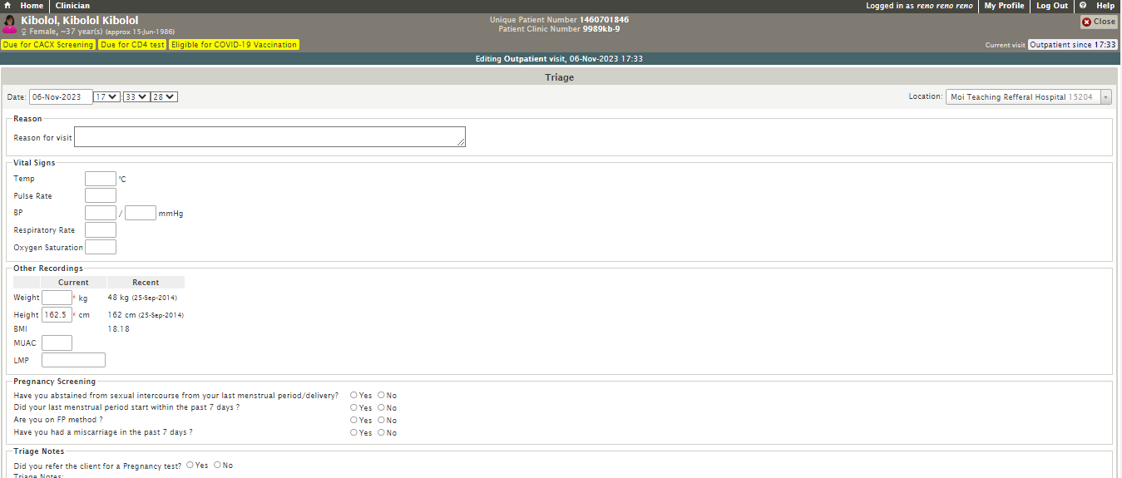
EMR Clinician Module : Triage
1
Triage: Conducted by nurse or other support staff : Vitals and other recordings
Triage: Includes Pregnancy Screening

Slide 9
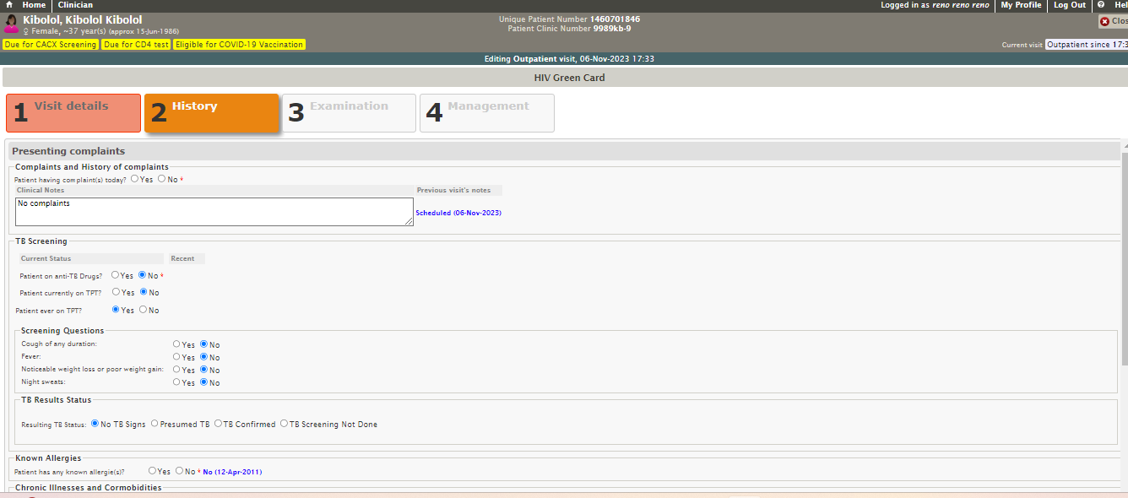
Clinical Encounter Form (Green Card) : History - 1
2
History Part 1: Includes TB Screening, Any adverse drug reactions etc

Slide 10
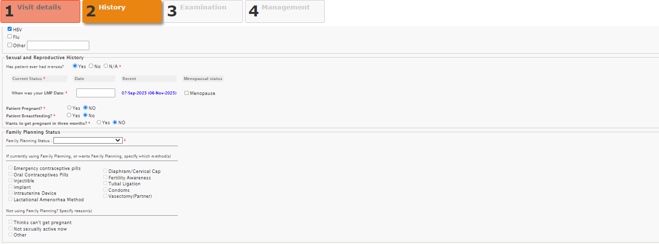
Clinical Encounter Form (Green Card) : History - 2
3
History Part 2: Includes Sexual Reproductive History
(a) Menses, LMP, If Pregnant, If Breastfeeding
(b) Pregnancy Intention Assessment: Wants to get pregnant in next 3 months?

Slide 11
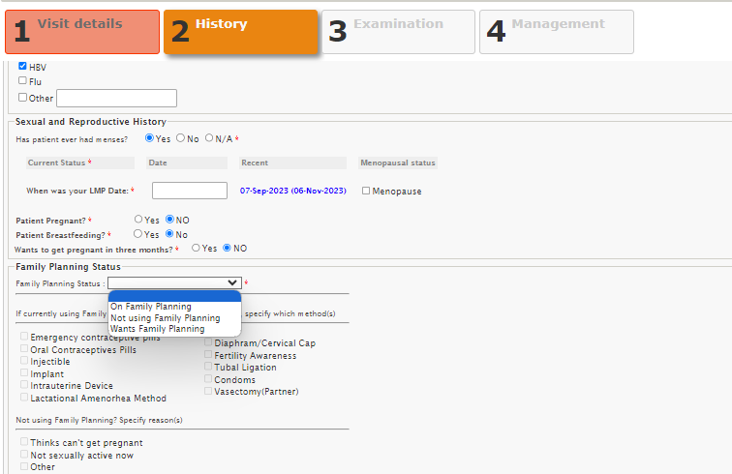
Kenya EMR: Clinical Encounter Form (Green Card): History - 3
4
Family planning Status Documented
If not using family planning, reason entered

Slide 12
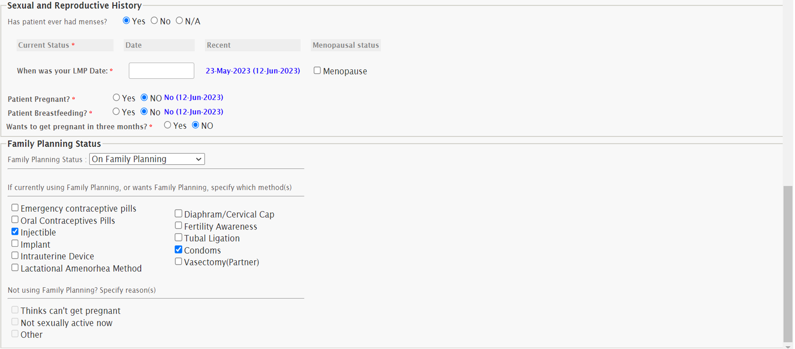
Clinical Encounter Form (Green Card) : History - 4
5
If woman is On FP OR Wants FP:
FP method already on or method chosen after by woman counselling (in newly initiating method) entered

Slide 13
END of Back Up Slides (To be only used if Live Demo from Kenya HMIS Encounters Challenges)

Slide 14
Example of NDWH Data Outputs (FP Among WLHIV on ART)
Implant (75%) and IUD (10%) 2 most preferred methods (n=7,886)
Source: Kenya NDWH

Slide 15
Gaps & Opportunities : Leveraging on EMR for FP/HIV M&E
Opportunities
Sensitization of HCWs on utility of form; to promote accuracy and completeness of reporting (quality of data)
Create dashboards at NDWH that can integrate with data on DSD models for WLHIV to compute uptake
Promote data use by including data analysis in review meetings
Challenges
Incomplete documentation of the SRH/FP data

Slide 16
Acknowledgement

