Slide 1
Linkage to Combination Prevention Services in Tanzania: Tools, and Process
Dr. Zeye Nkomela
National HIV Testing Services Lead
Ministry of Health, Tanzania

Slide 2
Linkage from testing to combination prevention services is part of the dHTS Continuum
Create Demand for HIV testing Services
Link to HIV testing
Screening for Eligibility for HIV testing
Deliver
pre-test information
Perform HIV testing using national algorithm
Deliver Post test Counseling
Refer and Link
HIV Positive: Immediately for ART Care and Support services
HIV Negative:
Prevention and Support Services
Linking from HIV testing to combination Prevention Services:
Where: At the HTS clinic, or co-located services within the same facility
At referral sites, away from the testing facility/testing point
When: At the time of confirming risk, after testing HIV negative
Who: HTS provider, who can be a professional or lay tester, including counsellors
What: Risk Profiling, pre-testing information giving, post testing counselling, linkage and referral
Notes:
This slide shows the HTS continuum in Tanzania highlighting linkage from testing to combination prevention services.

Slide 3
dHTS Tools and Reporting system in Tanzania
dHTS Tools
HTS Screening for eligibility
HTS register
Risk profiling tool
KVP categorization tool
Monthly report tools (HTS & KVP)
Reporting System
Electronic HTS module
Micro 3 data base
DHIS2

Slide 4
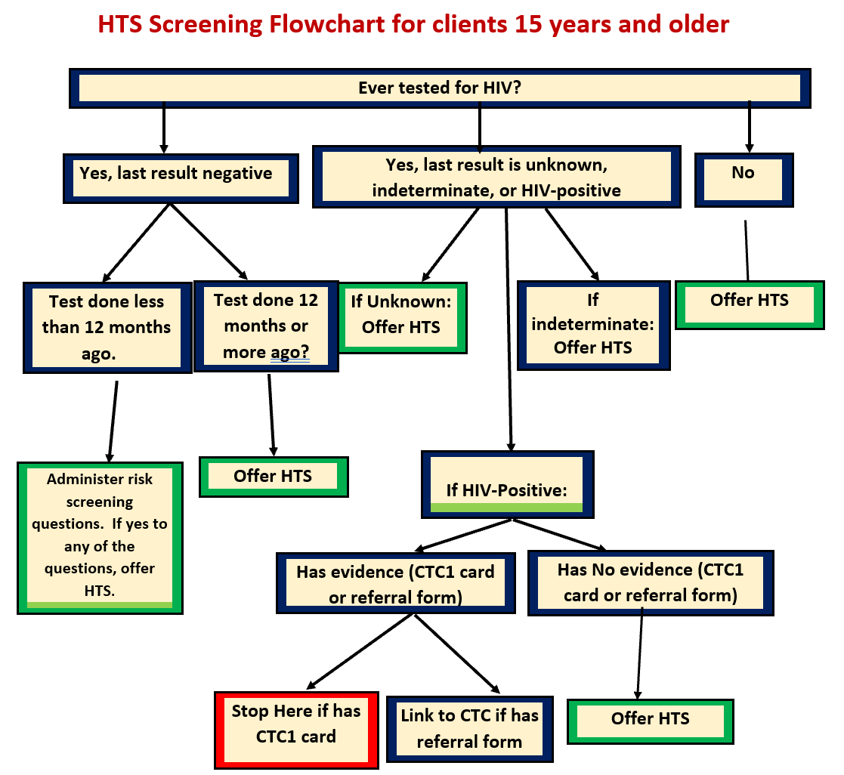
Step1. Clients are screened using an HTS Screening for eligibility
.
When: During first encounter with a Tester
Where: At facility or Community Testing points
Who: Testers, counsellors
What: Screening for testing eligibility
Clients who do not meet the eligibility criteria but insist on HIV testing are not denied of HTS.
HIV Exposure Assessment

Slide 5
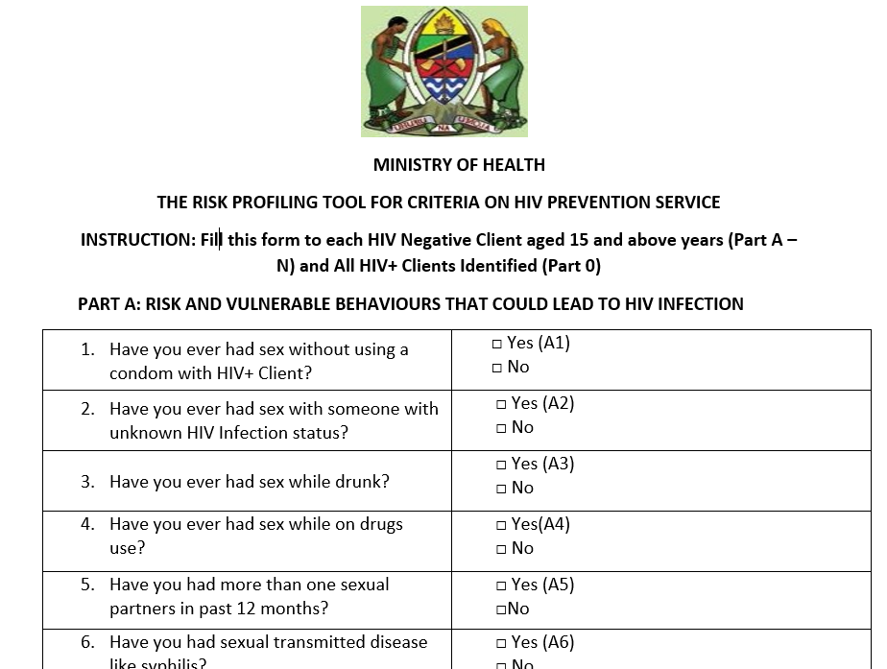
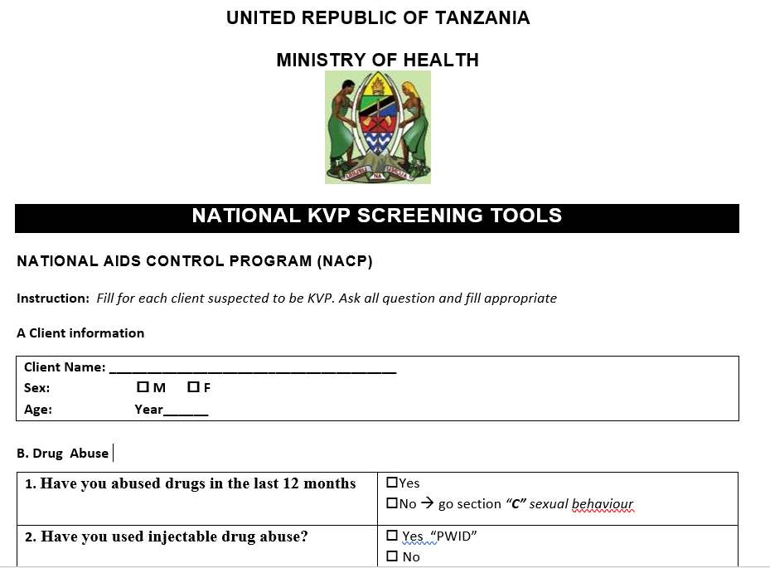
Step 2 Clients who test HIV negative are risk profiled using a general, or Key and Vulnerable population risk profiling tools
.
The National KVP screening tool in KVP type categorization
Risk profiling guides the HCWs on the types of HIV prevention services to offer

Slide 6
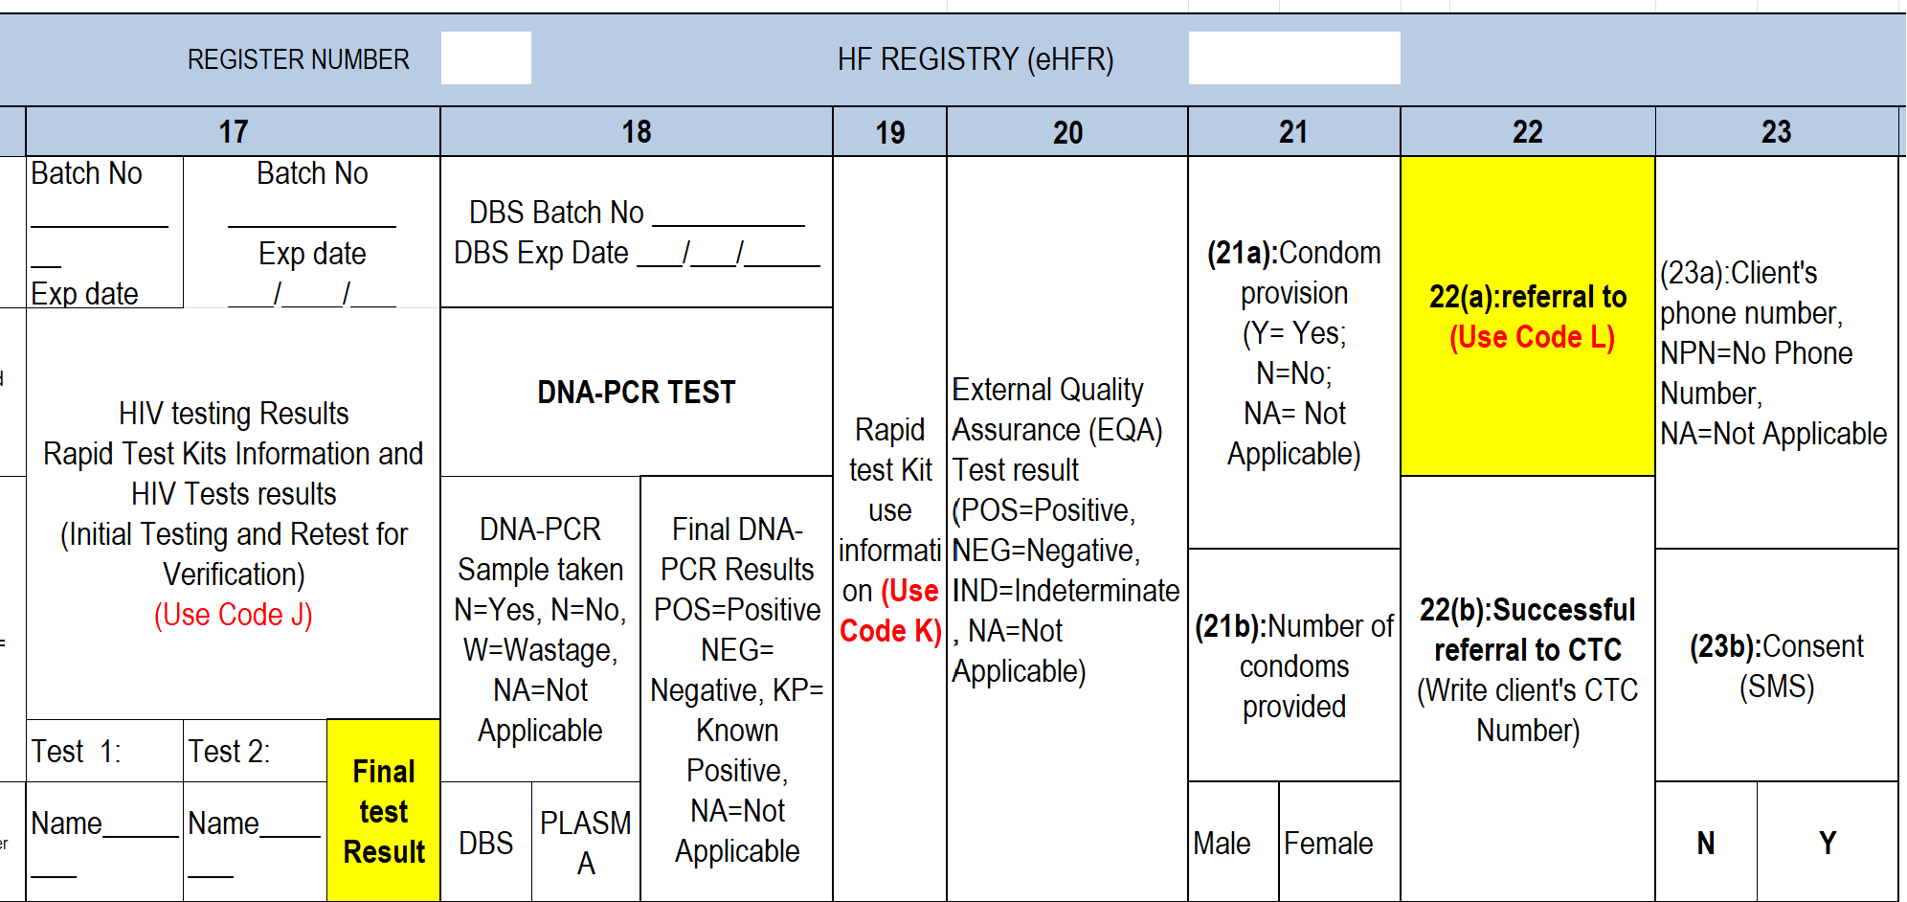
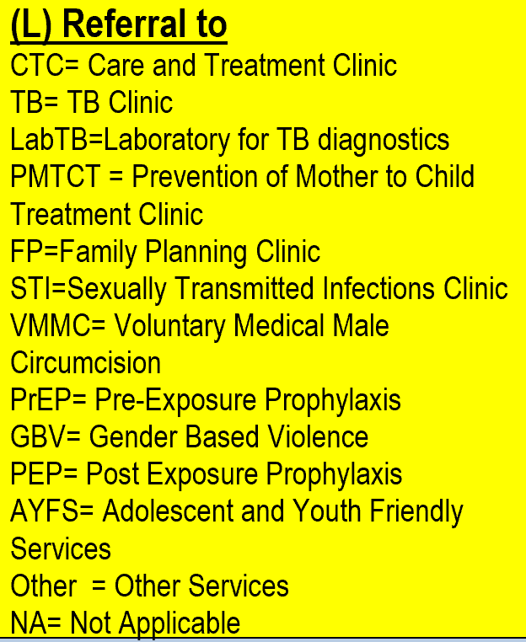
Step 3. Risk profile results are used to select and record a prevention service/s in the National HTS register
Notes:
The HTS register capture the client data information.
Based on the final results of the clients under column 17, the risk profiling tools is used to determine the appropriate Prevention services to be offered and the KVP screening tool assist the HCWs to categorize the KVP type.

Slide 7
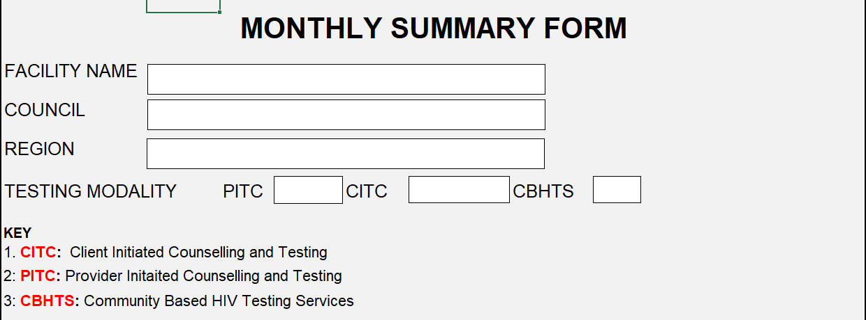
Sept 4. Linkage to combination prevention granular data is reported in DHIS2 using Monthly report forms (HTS & KVP)
.
Notes:
Number of new client registered during the reporting period
Number of KVP clients received minimum prevention package (minimum standards) during the reporting period
The minimum package is accounted for at least five Prevention services

