Slide 1
TPT Mentorship Checklist
Brian Kwizera
MOH, Rwanda Biomedical Centre

Slide 2
TPT Mentorship checklist

Slide 3
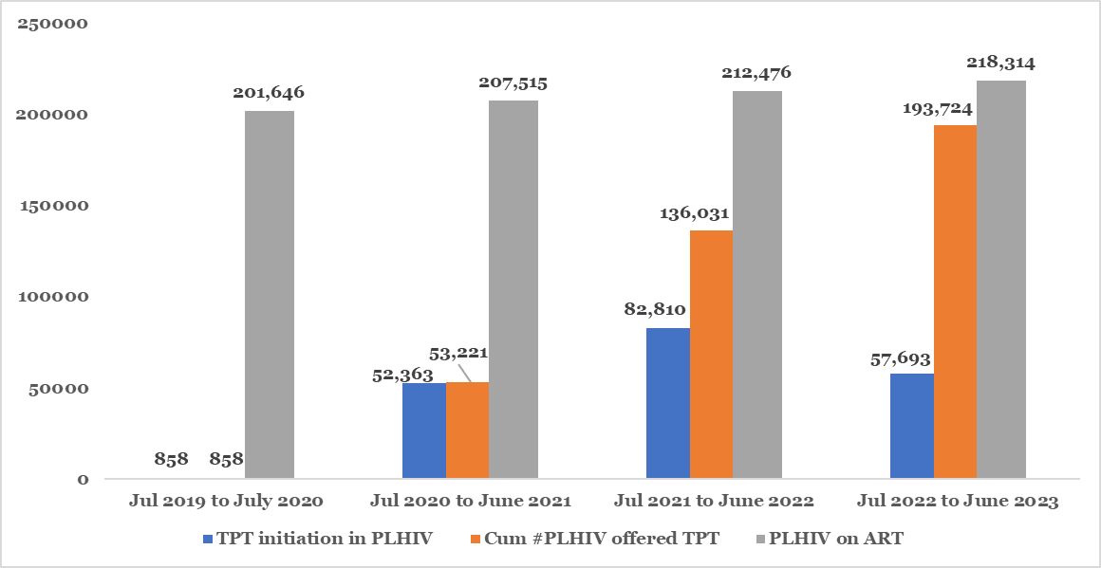
Introduction
TPT was initiated in 2019 for newly diagnosed HIV+ due to the limited infrastructure needed to diagnose active TB.
In July 2020, the TWG concluded that TPT was scalable even with limited infrastructure e.g. X-ray.
Rwanda embarked on a country-wide TPT scale-up starting with high HIV and TB prevalent areas and TPT availability.
30/30 districts have been trained and provided with the necessary skills and commodities to integrate TPT into HIV service delivery in a one-stop shop model.
As of June 2023, 88.7% (193,724) of PLHIV have been initiated on TPT, with significantly high completion rates of 95%.

Slide 4
TPT mentorship checklist
To sustain HIV/TB program gains and provide high-quality integrated HIV/TPT services, the program has developed a TPT mentorship checklist to assess whether the standards and quality of TPT services are being met.
The TPT mentorship checklist assess four implementation areas:
Knowledge
implementation processes
Drug management and
Monitoring and Evaluation

Slide 5
Knowledge of TPT Delivery
TPT implementation process
Observation: Randomly check 10-20 client files for:
Where are TPT services provided?
Is IEC around TPT provided to all PLHIV?
Did all receive TB screening-5 questions?
Is Diagnostic follow-up for presumptive TB done?
Patient Follow-up: Review TPT register and patient file for:
% of PLHIV respect of appointment?
% PLHIV screened for TB at every clinical visit?
Rate Adherence?
Is TPT/HIV One-stop shop functional?
Proportion of trained ART and TB staff,?
Any Onsite training conducted?
Availability of guidelines and algorithms?
Probe questions to assess:
Knowledge on TPT initiation criteria?
Describe TPT algorithm?
Evaluated period/ month | # Of Screened using symptoms (5 Questions) |  |  | # Xpert performed among screened positive |  |  |  | # CRX performed among screened positive with Gxp negative result |  |  | Observations (if CXR is not performed to all eligible cases provide reasons)
 | Pos | Neg | Not done | Pos | Neg | Not done | Pos | Abnormal | Normal | Not done

Slide 6
Drug Management
Monitoring and Evaluation
Obeservtion: Assess for adequate supply and stockout of TPT;
Stock card available and completed?
Calculation of minimum stock?
Has there been a stockout? If yes, how long? Why?
Adverse events on TPT at each clinical visit?
Use of grading scale for classification of side effects?
Probe questions to assess knowledge on criteria for TPT interruption and restart?
Proportion of clients with side effects? Neuropathy or Hepatotoxicity Grades?
Observation: Are recommendations from central/hospital level implemented?
Availability of TPT tools-TPT charts, register, guidelines, algorithms? And completeness?
HMIS monthly report status? Documentation, discrepancies, Assess for timely submission of TPT reports?

Slide 7
Feedback-Action
Specifics challenges | Strategies proposed to address challenges observed | Timeline | Responsible

