Slide 1
USAID DISCOVER-Health Health Hub: Men on the Move
Adamson NDHLOVU
Deputy Project Director Technical Services

Slide 2
USAID DISCOVER-Health: A Brief Overview
Aligning with the Ministry of Health vision of ensuring a healthy and productive nation, the USAID District Coverage of Health Services (DISCOVER-Health) Project was designed to expand the reach of the health system to underserved areas and populations, through a direct service delivery and outreach model, at the lowest level of the health system (health post) to provide an integrated package of primary health services.

Slide 3
USAID DISCOVER-Health: A Brief Overview
The project:
Set up new prefabricated clinics, partnering with churches, in high-density informal settlements and with the Ministry of Health (MOH) to expand the range of services provided in existing health posts; and deliver services using tents where need is high and there is no infrastructure.

Slide 4
USAID DISCOVER-Health: A Brief Overview
Directly employed key technical staff including ART providers and RMNCH providers, who work alongside MOH staff in supported sites to provide a package of integrated HIV, FP/RH, MCH, and general OPD clinic services.
The project intends to bring services even closer to migrant populations including truck drivers with an innovative strategy using digital health solutions and integrated outreach service modality within the preference of truck drivers through the Health Hub: men on the move.

Slide 5
Objectives – Health Hub: Men on the Move
Overall Objective: “To provide personalized and accessible integrated primary health care services including HIV Prevention and Treatment for truck drivers, promote universal access to health records, and ultimately improve the health outcomes and well-being of the truck drivers”

Slide 6
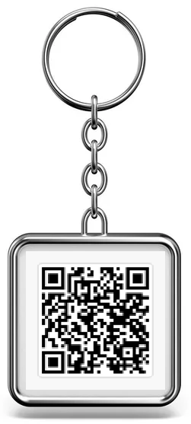
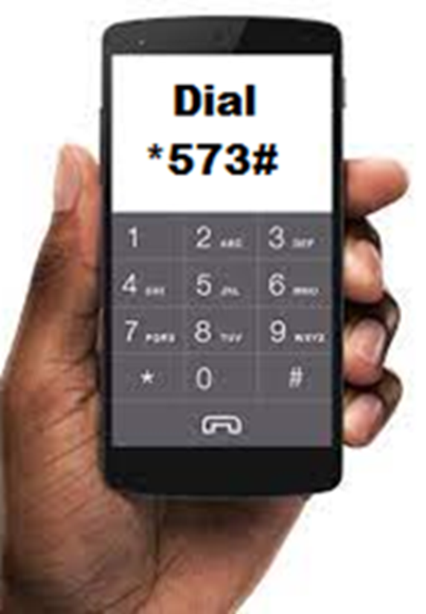
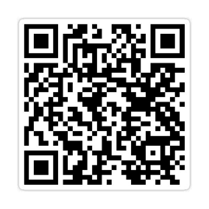
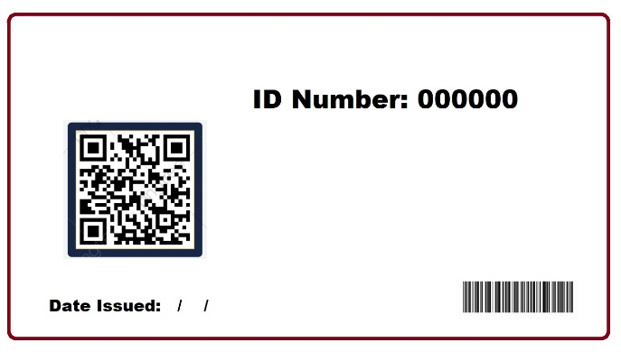
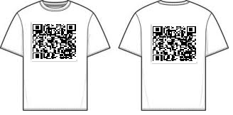
Access to the Health Hub: Men on the Move
How will it be done?
QR Code/USSD Code (*573#) and website link will be designed and carried in different formats which will be placed in strategic places for easy access by the clients
Key holders
ID Cards
Car Sticker
USSD Code
Pamphlets
T-Shirts

Slide 7
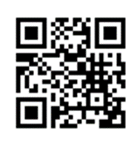
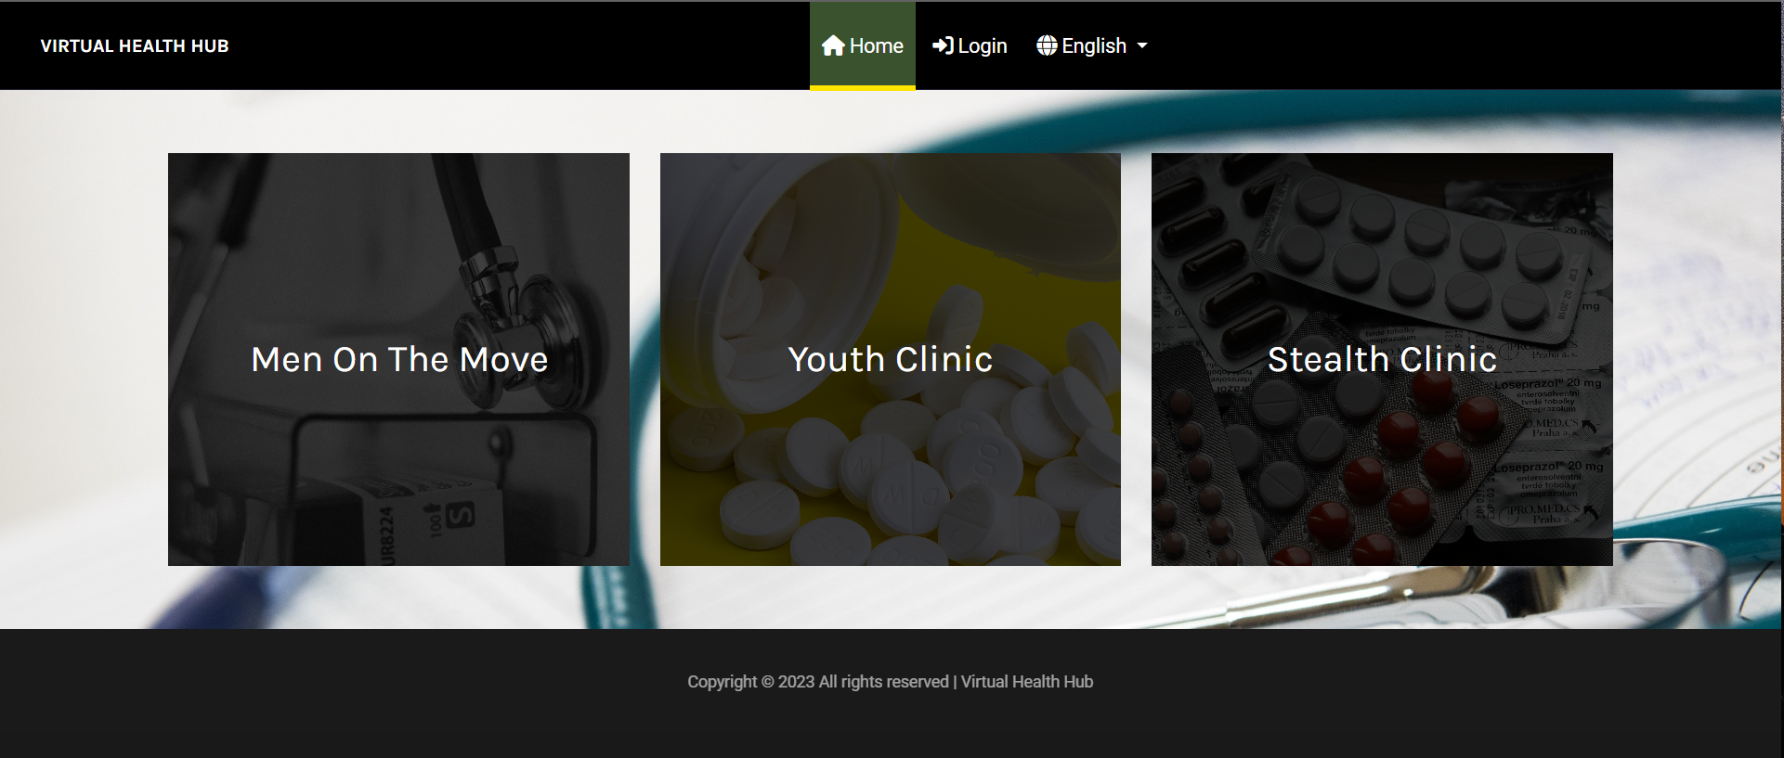
Registration
Step 1. Scan the QR Code
Step 2. The Health Hub opens in a browser, then click on the box “Men On The Move”.

Slide 8
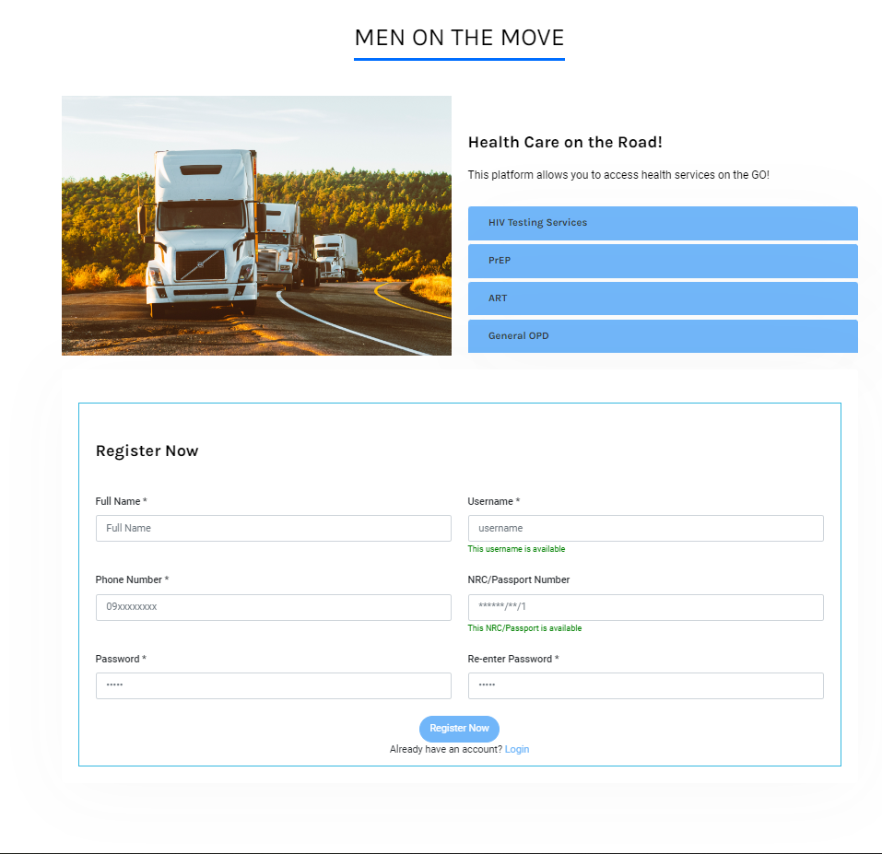
Registration Cont’d
Step 3. Scan the QR Code

Slide 9
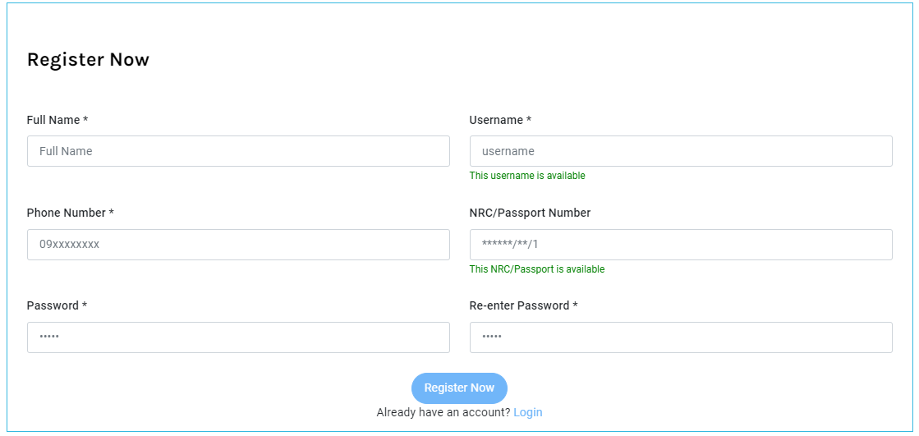
Registration Cont’d
Step 4. Fill in this form and click “Register Now”.

Slide 10
Registration Cont’d
Step 5. When this message appears, it shows that you have registered successfully.
Step 6. Click the “OK” button

Slide 11
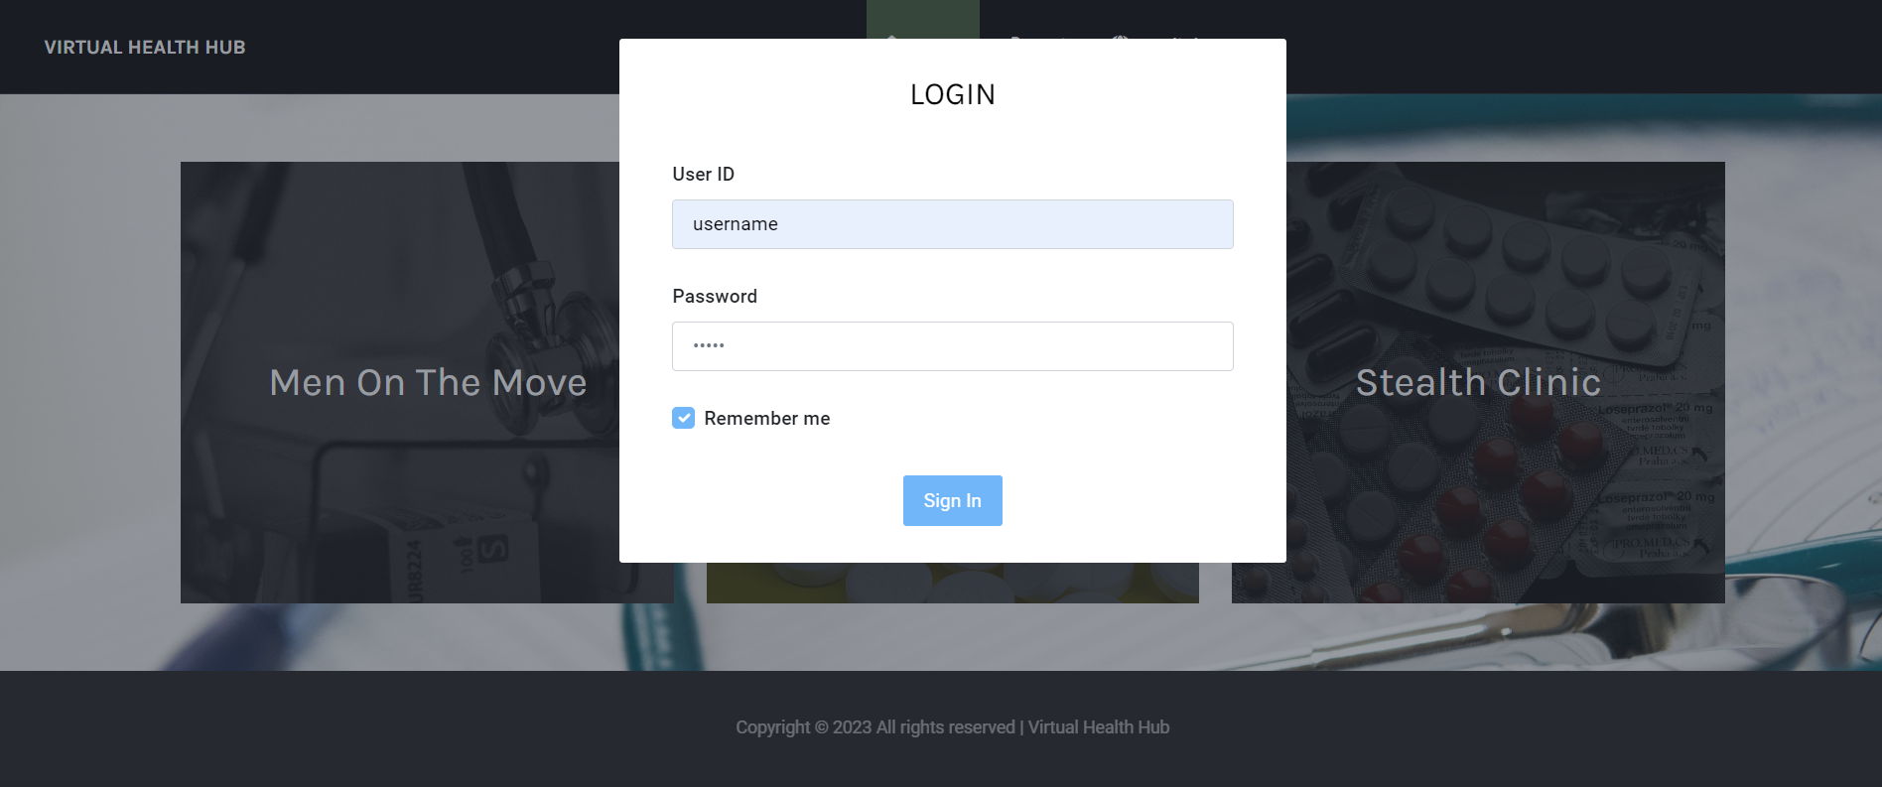
Login
Step 7. The Login Form appears, enter your username and password you created and click Sign In

Slide 12
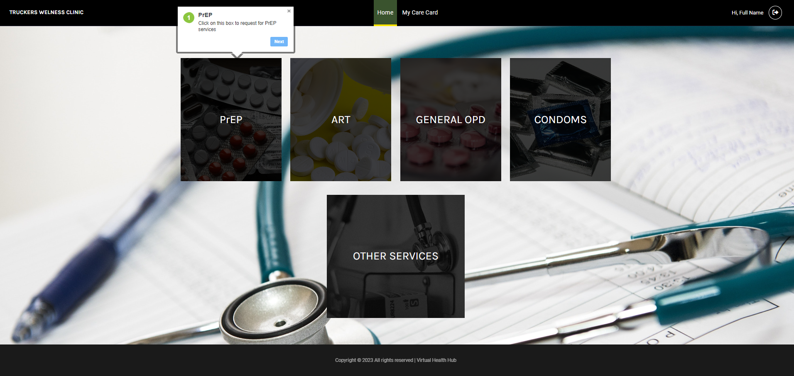
Requesting for a service
Step 8. When you login successfully, this page appears, click on a desired service to book an appointment

Slide 13
Requesting for a service
Step 9. Enter the location of where you are and when you would like to be seen by our service providers.

Slide 14
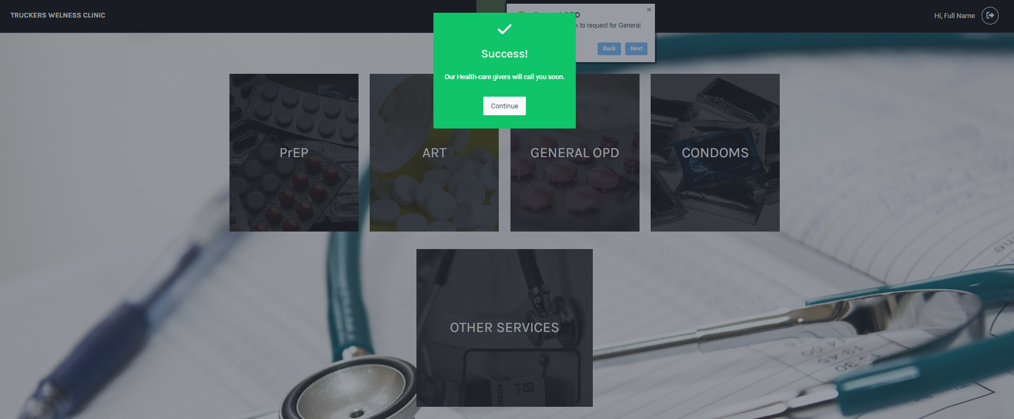
Requesting for a service
Step 9. A success pop-up will appear indicating that the appointment has been booked successfully

Slide 15
Final Step. Our service providers will get in touch with the client and follow them to their stated location on the date specified
Health provision will be done in our mobile clinics and client’s health records will be update on the system

