Slide 1
Differentiated HIV Testing Services Optimization Tool
Marvin Lubega.
Program Manager, Access to diagnostics.
Clinton Health Access Initiative, Uganda.

Slide 2
As countries near their 1st 95 goals, finding the remaining PLHIV only gets harder and requires a systematic approach to optimizing HTS.
Prioritize and set targets
Situational analysis
Design testing mix
Assess data including 1st and 2nd 95 gaps across geographies and population groups
Assess the current HIV testing service delivery models
Clearly define gaps
Define target populations, geographies, and operational bottlenecks
Adapt or design testing modalities aligned with gaps in meeting population needs
Determine optimal mix and scale-up of test modalities
Prioritize based on cost effectiveness, operational feasibility, and national policies
Define national targets and draft operational plan

Slide 3
An optimized testing strategy must consider a range of criteria, including yield, population, and cost
Yield high number of identifications
Prioritize delivery channels with high testing yields
Focus should be on absolute identifications
Determine the combination of channels that collectively reach ART scale-up targets with the lowest number of tests
1
Target priority populations
Delivery channels need to be designed to meet the needs of different populations
Certain populations will require new ways of approaching testing
Without this approach, risk continuing to reach certain populations, leaving others behind
2
Low cost per patient linked to treatment
Focus beyond cost per test but cost per person linked to ART
Cost varies by population (e.g. ANC is a very low cost channel but limited to pregnant women; strategies that target men may be a higher cost)
Need to consider operational realities
3

Slide 4
Optimization model supports target setting by delivery channel, linked to overall treatment scale-up targets
Situational analysis
Design testing mix
Prioritize and set targets
Optimization Model: Target setting model to determine the volumes and mix of testing strategies needed to reach ART scale-up targets, prioritized based on yield, cost, and operational feasibility
1
2
3
# of ART initiations
=
Yield
*
# Tests
*
Linkage to care rate
Reachable Pop.
*
Testing Coverage
Goal is to have the sum of ART initiations at each entry point equal the total # initiations needed to reach treatment targets in a given year.
This needs to be evaluated across each entry point
This will very by entry point and reflects the potential population an entry point can reach.
This is where the target setting takes place. We can adjust these in the model to see how they change total initiations and costs, and how to best reach initiation targets
This can also differ by entry point

Slide 5
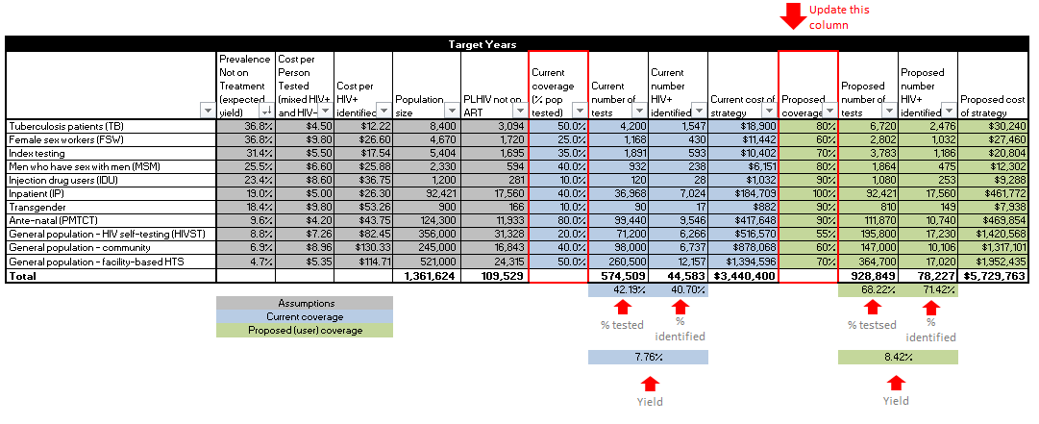
Updating the ‘proposed coverage’ allows for design of your testing strategy

Slide 6
Overview of the outputs
Total tests, number HIV+ identified, and testing yield

Slide 7
Overview of the outputs
Total cost for HIV testing strategy and cost per HIV+ identified
$65.50
Per HIV+ identified
$56.30
Per HIV+ identified

Slide 8
Relation to status neutral testing
The tool allows countries to conduct HTS Optimization analyses and set evidence-based and entry point testing targets.
Can be used in setting linkage to prevention targets and to determine testing needs for the prevention program.
By estimating testing targets for targeted HTS approaches such as Index, and social network testing services, the model provides novel estimates for high-risk individuals who will need to be linked to prevention, hence addressing status Neutral Testing Approach.

