Slide 1
Quality of Care assessment tool Assessing the quality of differentiated service delivery in healthcare facilities in Nigeria
Dr. Chinyere Eleen Ekanem
DSD Coordinator-TA NASCP
FMOH, Nigeria.

Slide 2
Outline
What is a Quality of Care (QoC) assessment tool?
How does the QoC assessment tool work?
How does QoC assessment improve DART services?

Slide 3
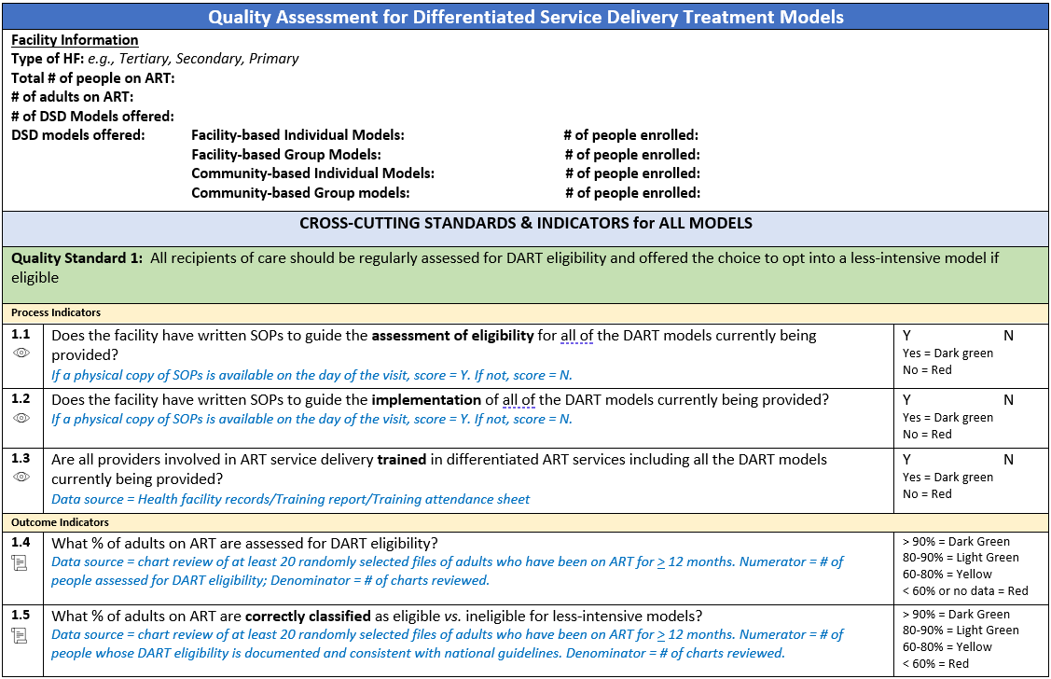
What is a Quality of Care (QoC) assessment tool?
Quality of Care assessment tool is a structured instrument or set of criteria used to evaluate and measure the quality of DSD ART services and the care provided to Recipients of Care.
It includes standards, indicators, and guidelines that assess various quality aspects of healthcare, such as effectiveness, safety, patient-centeredness, timeliness, efficiency, and equity.
The tool can be used to identify strengths and weaknesses in healthcare delivery in this case in differentiated treatment models (DART); to guide improvements, and ultimately enhance the overall quality of care for patients in healthcare settings.

Slide 4
What is a Quality of Care (QoC) assessment tool?
This Quality Standards Toolkit, developed and piloted by the Quality and QI Community of Practice, is intended to serve as a complementary resource for stakeholders to assess and improve DART quality.
It is envisioned to be a living document and feedback and suggested edits or additions can be made/contextualized periodically to fit the countries unmet needs.
Countries should feel free to adapt the tool to their local context and DART models.

Slide 5
How does the QoC assessment tool work?
The QoC assessment tool consists of predetermined criteria, standards, or indicators that are designed to measure various aspects of healthcare quality. These include factors like patient safety, effectiveness of treatment, patient-centered care, timeliness of services, efficiency in care delivery, and equity in access.
Assessors use the tool to collect data during on-site visits or through the review of medical records, surveys, or interviews with healthcare providers and patients. The assessment tool guides the data collection process, ensuring that relevant information is gathered.
The collected data is then scored or evaluated against a predefined criteria and indicators within the QoC assessment tool. This step helps assessors quantify the quality of care based on the established benchmarks.

Slide 6
How does the QoC assessment tool work?
After scoring and evaluation, the assessment team analyzes the results. They identify areas where the healthcare service meets or exceeds the desired quality standards and areas where improvement is needed. Immediate feedback is provided to healthcare providers and organizations based on the assessment findings.
Based on the assessment results and feedback, action plans are developed to address areas of improvement. These plans include specific steps and strategies for enhancing the quality of care.
The QoC assessment tool can be used as part of a continuous improvement program. Regular assessments can track progress over time and guide ongoing quality improvement efforts.
The results of the QoC assessments are often documented and communicated to relevant stakeholders, including healthcare providers, administrators, and policymakers. Transparent reporting helps ensure accountability and supports informed decision-making.

Slide 7
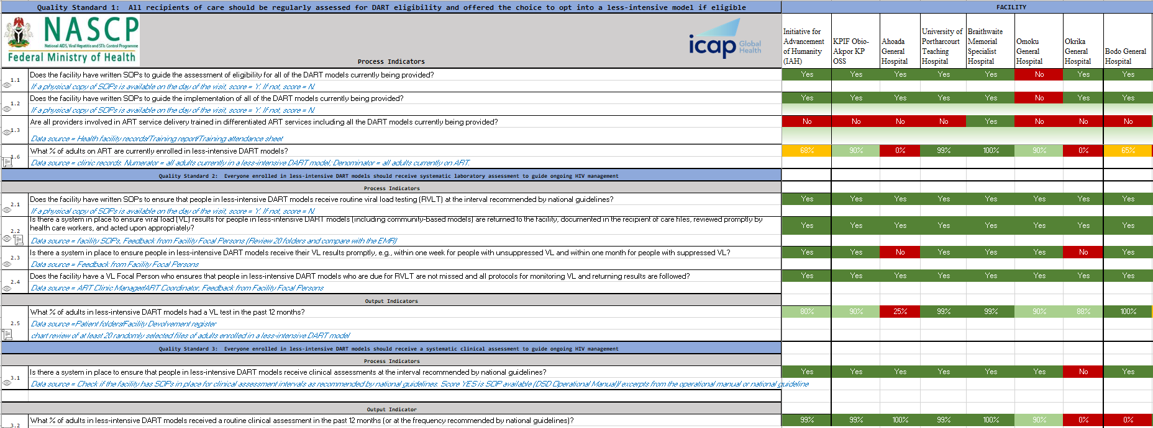
How does QoC assessment improve DART services?
By assessing the level of adherence of healthcare facilities implementing the DSD programs in comparison with the global DSD Quality standards.
Helps Identify gaps in service delivery for persons devolved to a less intensive DSD models across the designate health facilities.
It promotes evidence-based decision-making, identifies areas for enhancement, and supports the delivery of higher-quality care to patients.
Helps strengthen the quality of DSD program implementation in the country.

