Slide 1


RESULTS OF PILOT, ACCEPTABILITY AND USABILITY STUDY
FOR THE WONDFO BLOOD-BASED HIV - SELF-TESTING KIT IN LILONGWE AND DOWA DISTRICTS OF MALAWI
Malawi October 2024

Slide 2
Outline
Overview of Wondfo Blood-Based HIVST Pilot and Field Evaluation
Results from the Wondfo HIVST Pilot (n = 2,918)
Results from the Usability and Acceptability Survey (n = 585)
Challenges and Limitations
Final Recommendations

Slide 3
In September 2022, the NHRL in Malawi conducted a laboratory evaluation of the blood-based Wondfo HIVST kit and concluded that the “Wondfo HIVST could be used in Malawi as an ideal blood self test kit”
Findings:
Clinical Performance:
Wondfo HIV Self-Test had sensitivity of 100% and specificity 100%, as performed by lay users.
Usability:
The results showed that in all facilities, most participants managed to analyze and read the results successfully with a usability score of 80.6%*
Conclusion:
“The clinical performance of the test kit was good with no discordant results with national algorithm and reference testing. In all the participating study sites there were few challenges however with the little assistance from the study staff struggling participants managed to complete the test analyses. Wondfo HIV Self-Test kit could be used in Malawi as an ideal blood self test kit.” - NHRL
*This evaluation was conducted using kits with IFU in English only. Since then, Wondfo have now developed IFUs in Chewa and Tonga
Notes:
Districts were Salima- Khombedza Health centre, Thyolo, Machinga, Chikwawa-Ngabu and Ntcheu

Slide 4

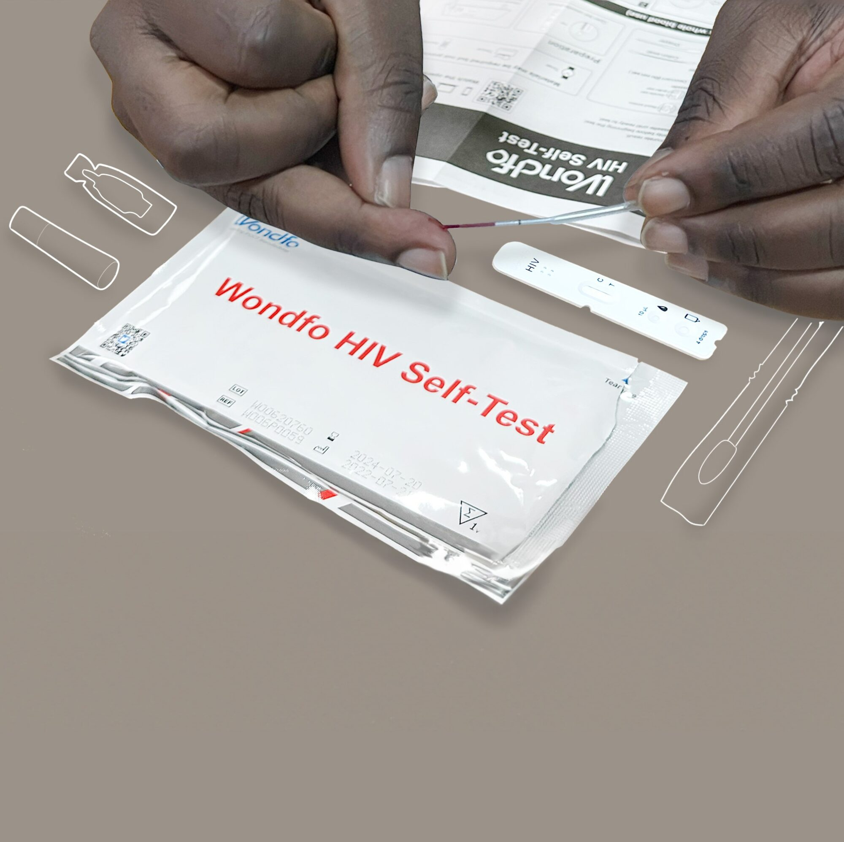
The next step in the approval for use process for the Wondfo blood-based HIVST is a field evaluation to evaluate the acceptability and usability under routine testing conditions in facilities in Malawi.
Laboratory Validation
(NHRL)
Field Evaluation/Pilot
MOH endorsement
Regulatory Approval (PMRA)
Regulatory Filing Submission (PMRA)
Approval for Use Process:
Status of Wondfo HIVST:
Pending
Progress towards approval for use can be summarized as follows:
Regulatory filing with PMRA: submitted by Wondfo on 12 November 2022
Lab validation (NHRL) – evaluation of clinical performance and usability complete with report recommending use of test
Field evaluation/pilot- to assess the usability and acceptability of the Wondfo HIVST by lay users in facilities is complete with very positive findings for usability and acceptability of the blood-based Wondfo HIVST by lay users and health care providers.
Wondfo received PRMA approval November 2024
Next Steps
Presentation of findings of field evaluation/pilot for DHA endorsement via TWG and formal adoption

Slide 5
MOH requested for an additional pilot and field evaluation of the Wondfo Blood-Based HIVST Kits to Assess the Usability and Acceptability of the Kits by Lay Users at Facility Level in Malawi.
There were two components to the field evaluation. The first was a pilot by the MOH to inform evidence-based policy recommendations for the scale up of blood-based HIVST in Malawi. The second, was an adjacent study that aimed to add to the lab-based evaluation of the kits by assessing the usability and acceptability of blood-based HIVST kits by lay users as they form a part of routine HIVST at facilities in Malawi.
Field Evaluation of Blood-Based HIVST
Pilot
Usability and Acceptability Study
Clients who present to facilities for HIV testing were offered the option of participating in the piloting of the blood-based HIVST kit
Clients who used the blood-based HIVST kit in the pilot and agreed to voluntarily take part in the usability and acceptability survey
WHO:
In accordance with the national HIVST guidelines and SOPs. Training of the HDS serviced providers on the blood-based HIVST kits was conducted by the MOH.
A research assistant (provided by CHAI) was stationed in a private room. They consented the participants and administered a short usability and acceptability survey.
HOW:

Slide 6



Purpose and Objective of the Field Evaluation: As part of standard practice for new product introduction in Malawi, the field evaluation sought to assess the usability and acceptability from lay users
ASSESSING THE ACCEPTABILITY AND USABILITY FOR THE WONDFO BLOOD-BASED HIV - SELF-TESTING KIT IN Lilongwe AND Dowa DISTRICTS OF MALAWI
Purpose:
The study aimed at contributing evidence on the acceptability and usability of blood-based HIVST in facilities towards evidence-based policy recommendations for the scale-up of blood-based HIVST in Malawi.
Primary Objectives:
To determine the acceptability of Wondfo Blood-based HIV self-testing kit among clients seeking HIV testing at health facilities in Malawi.
To determine usability of Wondfo blood-based HIV self-testing kit among clients seeking HIV testing at health facilities in Malawi.
To assess health care workers' experience with the kit and the willingness to recommend the kit to clients.
Secondary Objective:
To assess the uptake and profile of clients selecting the Wondfo blood-based HIVST kit as a secondary analysis of routine data recorded in the HDS registers at health facilities in Malawi

Slide 7
Study Methodology: The study was a cross-sectional mixed-methods study in 5 facilities across 2 districts. The study obtained approvals from Lilongwe and Dowa DHMTs and an ethical approval from Malawi IRB, NHSRC
The usability and acceptability study was a cross-sectional observational mixed-methods study that was carried out in 5 sites in 2 districts. The study protocol was approved by the Malawi IRB,NHRSC, The Lilongwe and Dowa DHMTS and their corresponding district Research committees.
During the course of the Pilot and Study, the target was to distribute 3,000 HIVST kits and to conduct a minimum of 500 usability and acceptability surveys on a sub-sample of the 3,000 Wondfo kit users.
The Wondfo HIVST kit was used in primary distribution at all HDS delivery points i.e., in OPD, HTS room, and others following the approved HIV self-testing standard operating procedures.
The service providers and Research assistants were trained on use of wondfo BBHIVST. Job aides/SOP’s were used
The sites were purposively selected by DHA and implementing partners PIH and Lighthouse, to satisfy the following criteria:
  high HIV prevalence,
  high testing levels,
  availability of HDS providers
  sufficient space for clients to privately test
  both urban and rural population
Sites | Partner
Lilongwe
Bwaila MPC | Lighthouse Trust
Kawale Health Centre | Lighthouse Trust
Area 25 HC | Partners in Hope (PIH)
Nthondo HC | Partners in Hope (PIH)
Dowa
Mponela Rural Hospital | Partners in Hope (PIH)

Slide 8





Study Methodology: Pilot Study Population, Inclusion and exclusion Criteria.
Target population: adults aged 13 and over who present to the selected facilities in need of HIV testing and had consented and took part in the pilot of the Wondfo blood-based HIV self-testing kit.
Inclusion criteria for clients participating in the usability and acceptability survey
Clients aged 13 and over
Clients who used the Wondfo blood-based HIVST kit from a trained HDS provider at the study sites during the study period and provide informed consent to participate in the survey
Exclusion criteria for clients participating in the usability and acceptability survey
Clients using other types of HIV test at the study sites
Clients who were not clinically eligible for using the Wondfo blood-based HIVST
Clients under 13

Slide 9
Study Methodology: In addition to end user feedback, this study sought to evaluate feedback from the HDS Service Providers
To gain some insight into what the HDS service providers think about the Wondfo Blood-Based Kit, we asked them to complete a survey at the end of the study about their willingness to recommend the test to clients, perceived ease of use, challenges and recommendations.
The target population: HIV testing providers and/or HIV self-testing distributors trained on Wondfo blood based HIVST kit distribution participating in study implementation.
Inclusion criteria for HDS provider feedback questionnaire:
Trained HDS providers (HDS counsellors, HIV Diagnostic Assistants) and HIVST distributors, trained on Wondfo blood based HIVST distribution who consent to participate in study implementation.
Exclusion criteria for HDS provider feedback questionnaire:
Non HDS providers and/or HDS providers not trained in Wondfo Blood-based HIVST distribution and those who did not consent to participate in the study implementation.
The consenting procedure for the HDS provider survey took place during their training, with the survey being answered upon completion of the study.

Slide 10
Outline
Introduction: Situation Analysis, Background, Approach, Overview of Pilot and Field Evaluation
Overview of Wondfo Blood-Based HIVST
Results from the Wondfo HIVST Pilot (n = 2,918)
Results from the Usability and Acceptability Survey (n =585 )
Challenges and Limitations
Final Recommendations

Slide 11
Scope | Over 6 weeks, nearly 3000 Wondfo blood based HIVST were distributed at facilities , 585 clients and 40 service providers provided insights into the feasibility, acceptability and usability of the kits.
 | Pilot Distribution |  |  | Client Usability & Acceptability Survey |  |  | Service Provider Survey
 | Total Target | Actual at end of study | % of target | Target Survey/ site | Actual at end of study | % of target | Target Survey/site | Actual at end of study | % of target
Total | 2920 | 2918 | 99.9% | 570 | 585 | 103% | 65 | 40 | 62%
Study was conducted in 2 districts and 5 facilities: Nthondo, Kawale, Area 25, and Bwaila in Lilongwe and Mponela in Dowa districts.
Over the course of 5 weeks, 2,918 Wondfo HIVST were distributed with 585 (~20%) clients enrolling in the usability and acceptability study, which was more than the target sample size
62 % (n = 65) of service providers provided valuable insights into their experience in distributing the Wondfo blood based HIVST
All the facilities distributed about 100% of the targeted number of Wondfo HIVST kits allocated. The targets were set dependent on previous HIVST utilization and the donated Wondfo HIVST kits available for study.
4 out of the 3000 (0.13%) donated kits had factory faults noted after distribution as such they were not used.
The service providers interviewed were less than the target sample size because some of the trained providers were not active in Wondfo kit distribution because of their duty station.

Slide 12
Results of HIVST distributed in June (n =3,368 ) |. A total of 3,368 HIVST were under primary distribution in June with an average of about 54% clients opting for Wondfo blood-based kit. However, Nthondo HC emerged as an outlier registering 100% with clients only requesting for blood-based HIV self tests.
This includes facility primary distribution data for Oraquick at OPD and VCT service delivery points where Wondfo was also distributed.
  Excluded were Community, ANC and maternity service delivery points due to exclusion criteria of study.
The study was conducted from 20th May to 7th July, 2024 with June being the only full month covered.
And 1,659(57%) of the wondfo kits were distributed in this month.

Slide 13
Results of Pilot (n =2,918 ) | More than half of pilot participants were female, nearly 80% had primary or secondary level or education, and ~62% were from Urban Settlements.
54% of pilot participants were female, which aligns with overall trends in HIV testing services by sex.
~81% of pilot participants have either secondary (47%) or primary (34%) as highest-level education
62% of participants were urban settlers
The mean age of pilot participants was 30 years, with the majority (67%) younger than 35 years.

Slide 14
Results of Pilot (n =2,918 ) | 68% of the pilot participants were unassisted, nearly 100% interpreted the results correctly, 1.5% of participants had a reactive result and 93% were confirmed positive
Type of HIVST (n = 2918) |  | Frequency | % (n = 2918) | % Total (n=2918)
 | Directly Assisted | 947 | 32.5% | 32.5%
 | Unassisted | 1969 | 67.5% | 67.5%
 | No data | 2 | 0.07 | 0.07
Results of Wondfo HIVST as interpreted and reported by Participant (n = 2918) |  | Frequency | % (n = 2918) | % (n = 2918)
 | Reactive | 45 | 1.5 | 1.5
 | Non-reactive | 2870 | 98.4 | 98.4
 | Inconclusive | 1 | 0.0 | 0.0
 | No data | 2 | 0.07 | 0.07
Results of Wondfo HIVST as interpreted and reported by Service Provider (n = 2918) |  | Frequency | % (n = 2918) | % (n = 2918)
 | Reactive | 45 | 1.5 | 1.5
 | Non-reactive | 2871 | 98.5 | 98.5
 | Inconclusive | 0 | 0.0 | 0.0
 | No data | 2 | 0.07 | 0.07
Results of HIV Test as confirmed by 3 Test Algorithm. Only Reactive HIV Self test results were referred for confirmatory Test (n=45) |  | Frequency | % (n = 45) | % (n = 2918)
 | Reactive | 42 | 93.3 | 1.4
 | Non-reactive | 0 | 0 | 0
 | Inconclusive | 0 | 0 | 0
 | Not done | 3 | 6.7 | 0.1
~68% of clients using the kit took the test independently (1,969/2,918)
Nearly 100% of clients correctly interpreted the results correctly, as confirmed by the health care provider (2,915/2,918) – interpretation on findings differed only on 1 test with participant reporting inconclusive and provider as negative.
1.5% of clients had a reactive result (45/2,918)
93.3% of reactive clients were confirmed positive with national 3-test algorithm (42/45), the remaining 3 were not tested immediately but later follow-up confirmed that the 3 were tested and initiated on ART, resulting in a 100% confirmed positive overall.

Slide 15
Results of Pilot (n =2,918 ) |. The Chi-square tests results indicate there are significant differences in choice to conduct the HIVST assisted or unassisted according to residence type, highest level of education and age of client (P= 0.05).
The Chi-square test P Values for Residence type, Highest Level of Education and Age of client were all less than 0.05 (significant at P= 0 .05) meaning the differences in these categories affects the choice of HIVST delivery type with age of client having the most influence, then client education level and lastly residence type.
Pearson chi2 = 50.1210 Pr = .000
Pearson chi2 = 23.7024 Pr = .000
Pearson chi2 = 5.8471 Pr = .016
Clients with primary, secondary or tertiary level as highest education are more inclined towards unassisted testing.
Those with no education or ‘other’ show no strong preference
Unassisted testing is the preferred model in both rural and urban areas, with a stronger preference in urban areas
Younger clients prefer unassisted testing compared to 45+ who prefer assisted testing for HIVST

Slide 16
Outline
Introduction: Situation Analysis, Background, Approach, Overview of Pilot and Field Evaluation
Overview of Wondfo Blood-Based HIVST
Results from the Wondfo HIVST Pilot (n = 2,918)
Results from the Usability and Acceptability Survey (n =585 )
Challenges and Limitations
Final Recommendations

Slide 17
Usability and Acceptability Study (n = 585 )| More than half of study participants were female, 88% had primary or secondary level of education, and 70% were under the age of 35 years
Separated, 0.3%
Other,1, 0.2%
54% of study participants were female, which aligns with overall trends in HIV testing services by sex.
49% of study participants were married, followed by 39% who were single
Half of the study participants have at least secondary education and 27% with primary as highest level of education
The mean age of participants was 30.6 years, with the majority (70%) younger than 35 years old

Slide 18
Usability and Acceptability Study (n = 585)| Nearly all clients found the kit easy to use and would recommend it to others
User preference between Oral and Blood based(n = 302). Only those who ever tested with an oral based HIVST were qualified to answer this question. |  | Count | %(n=302)
 | 1. Oral based | 6 | 2.0
 | 2. Blood based 3. No data | 295 1 | 97.7 0.3
Are the Instructions Clear |  | Count | %(n=585)
 | 1. Yes | 584 | 99.8
 | 2. No | 1 | 0.2
Ease of Use as reported by Client |  | Frequency | % (n = 585)
 | 1. Very Difficult | 1 | 0.2
 | 2. Difficult | 10 | 1.7
 | 3. Easy | 394 | 67.4
 | 4. Very easy | 180 | 30.8
Recommend to Others( Participants) |  | Count | %(n=585)
 | 1. Yes | 582 | 99.5
 | 2. No | 3 | 0.5
Strong user preference for blood-based kits: 97.7% of participants who had previously used oral HIVST (n = 302) stated that they prefer blood-based HIVST.
High useability: Nearly all clients reported the Wondfo HIVST was “easy” or “very easy” to use (67.4% and 30.8%, respectively) and found the instructions clear (99.8%).
High acceptability: 99.5% of participants willing to recommend the product to their peers

Slide 19
Usability and Acceptability Study (n = 585)| Age group is the only factor with categories that have significant differences affecting clients’ perception of usability of the Wondfo HIVST. However, no other factor is significantly associated with clients’ willingness to recommend the Wondfo HIVST.
Factor | Usability | Willingness to Recommend
Residence type | Pearson chi2= 5.8471 Pr = .056 | Pearson chi2(1) = 5.8471 Pr = 0.103
Highest level of education | Pearson chi2 = 14.5319 Pr = .268 | Pearson chi2(4) = 7.0860 Pr = 0.131
Age group* | Pearson chi2 = 56.4057 Pr = .000032 | Pearson chi2(7) = 9.7093 Pr = 0.206
Sex | Pearson chi2 = 3.0089 Pr = .390 | Pearson chi2(1) = 0.5324 Pr = 0.466
Age group was the only statistically significant factor in the assessment of usability (Pr=0.000 less than P=0.05), with more older clients 50+ finding the tool difficult to use.
P Values for Residence type, Highest Level of Education and Sex evaluated on the ease of use were all > 0.05 (not significant at Pr=.05) meaning the differences in these categories does not affect clients’ perception of usability of the Wondfo HIVST.
On the other hand, the P Values for all the above factors explored on willingness to recommend were not significant at Pr = .05 and therefore differences in these categories does not affect clients’ willingness to recommend others to use the Wondfo HIVST.
The analysis was done using Chi-square test and multinomial logistic regression

Slide 20
Participants Insights | Willingness/Recommendation to use again or not
38% of clients sited ease of use as a reason to recommend the test to peers.
Other popular factors mentioned for use recommendation were privacy, confidence in the test result, quick result, self prick not being as sore as anticipated, and trustworthy because it uses blood sample.

Slide 21
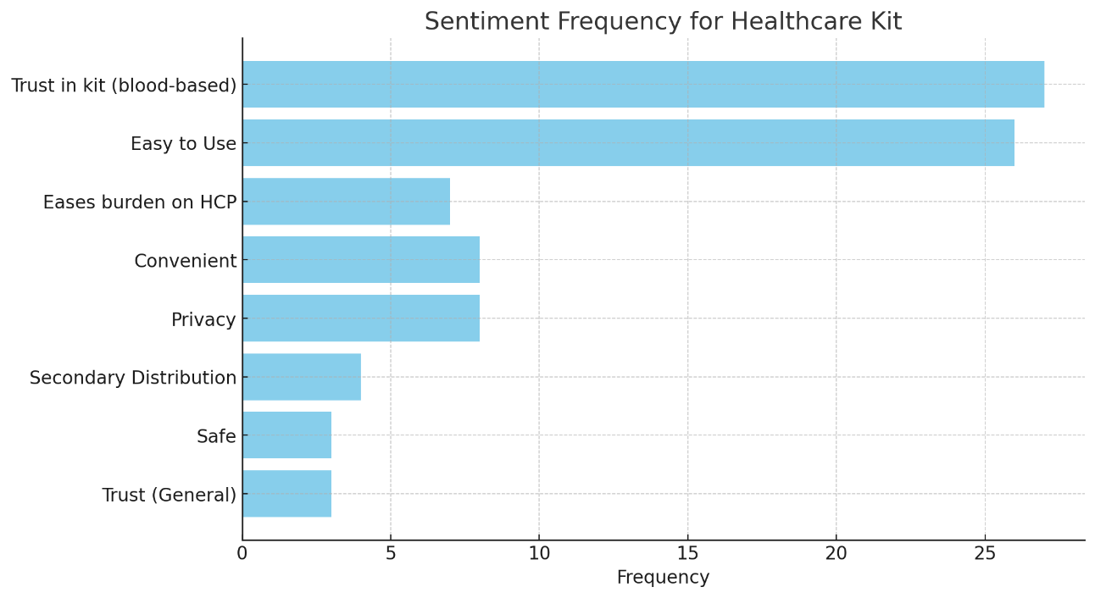
Service Provider Insights | Results of Service Provider Perceptions of Wondfo HIVST were overwhelmingly positive with 100% willing to recommend the kit to clients.
Feedback from service providers when asked to provide reasons for why they would recommend the Wondfo HIVST to clients:
Ease of Use as reported by Service Provider On a scale of 1 to 5, with 1 being very challenging and 5 being very easy, how would you assess the ease of using the Wondfo Blood-based HIV Self-Test kit for clients? | Count | % (n=40)
1 Very Challenging | 0 | 0.0%
2 Challenging | 1 | 5.0%
3 Neutral | 13 | 32.5%
4 Easy | 23 | 57.5%
5 Very Easy | 3 | 7.5%
Frequency of Sentiment on Willingness to Recommend
64.5% (40 of 62) of service providers involved in the pilot of the Wondfo HIVST provided insights on their experience and perceptions of client experience with the Wondfo HIVST.
65% (26 of 40) of service providers reported it as easy or very easy to use and 37.5% (13) reported it as neutral.
“Based from the experience that I have had, clients had doubts using the oral based self-test. They would ask why we test saliva yet HIV is found in blood. There is no ample time to explain to them that we actually test for antibodies and not saliva. With this blood based self-test, clients easily understand and accept to use the kit because of the same belief that HIV resides in blood.”
“From my observation on clients using this blood based HIVST, clients found this test kit easy to use and reliable (because of the blood sample). Clients, found this kit reliable unlike the oral based HIVST because of the sample issue.”
“If they are willing to, I would encourage them. I saw that it was easy for people to use.”
“Most clients were able to understand on how to do the test regardless of their background.”
Willingness to Recommend to Clients | Count | % (n=40)
Yes | 40 | 100%
No | 0 | 0%
100% of the service providers are willing to recommend the Wondfo blood-based HIVST to clients

Slide 22
Outline
Introduction: Situation Analysis, Background, Approach, Overview of Pilot and Field Evaluation
Overview of Wondfo Blood-Based HIVST
Results from the Wondfo HIVST Pilot (n = 2,918)
Results from the Usability and Acceptability Survey (n =585 )
Challenges and Limitations
Final Recommendations

Slide 23
Challenges and Limitations
Challenges
4 out of the 3000 (0.13%) donated kits had factory faults noted after distribution as such they were not used. These were due to missing test and control lines (2), no buffer solution in package (1) and no pricker in package (1).
20 HIVST kits were missing and could not be traced.
Study implementation delayed by 2 days due to a HCW sit in, which affected client visits to the facility, this was resolved after government addressed the HCW concerns.
Limitations
Some register entries were incomplete and/or others appeared to have incorrect values that couldn't be traced/corrected
In line with the National Health Science Research Ethics Committee requirement, participants received $10 compensation for their lost time during participation in the Accessibility and Usability study. As such, willingness to participate in the study scan not be emphasized.
The study only looked at facility and primary distribution due to issues of reporting surrounding community feedback and secondary distribution

Slide 24
Lessons learnt
Delays in the study approval process
  Delays by MoH to review the study protocol and give approvals
  Delays by ethics board to review the protocol
Training of Health workers and Research Assistants took more time and resources
CHAI had to develop SOPs, Blood based HIVST messages and other tools (Data collection tools, translate instructions leaflet to vernacular) to align with the current HIVST protocols
Missing testing kits at facility
Lack of adequate space to conduct the study procedures within the facilities

Slide 25
Recommendation
The team recommends adoption of the Wondfo HIVST kit given its strong performance in laboratory validation, field evaluation, positive user feedback, positive service provider feedback, and cost-effectiveness.
Suggestions to strengthen the Wondfo HIVST process even further include
Consideration to include instructions leaflet in vernacular language Chichewa or Tumbuka and Yao dependent on parts of Malawi.
Consider providing IEC materials for Health Education in various local languages using different media platforms.

Slide 26
Acknowledgement
The team acknowledges the effort and support of the following institutions that made the study a success
LightHouse Trust and Partiners in Hope
Dowa and Lilongwe DHMT
The Management and staff of Bwaila Hospital, Mponela Rural Hospital, Kawale HC, Area25 HC and Nthondo HC
DHA
PEPFAR
NHSRC
Management and staff of CHAI
HTS Sub TWG

Slide 27
ddd
Securing Affordable and Sustainable Increased Access to Blood-Based HIVST: The Volume-Based Guarantee (VBG) between MedAccess and Wondfo explained
What is a volume-based guarantee (VBG)?
  A VBG is a financing agreement where MedAccess (a social finance company) has committed to a specific purchase volume from Wondfo to secure a low, stable price.
  Through this agreement, Wondfo is guaranteed minimum demand, enabling it to offer the blood-based HIVST at the historic low price of $1 (EXW)
What does this mean for National Testing Programs?
Stable, affordable pricing: Wondfo have committed to a ceiling of $1 (EXW) fixed price until mid-2028 to over 130 LMICs, safeguarding against fluctuations in demand or market changes.
No direct country commitment to volumes: individual countries are not responsible for volume commitments – MedAccess assumes all the risk, and MOH are free to make procurement decisions independently and freely.
Increased access to testing: Affordable pricing of HIVST unlocks the scale up of HIVST, thereby enhancing accessibility to clients.
Over time, the VBG will foster a competitive market environment where additional suppliers and lower prices become the norm. In five years, we anticipate that Wondfo will maintain or even further reduce its pricing of the blood-based HIVST to stay competitive, as the market for affordable HIV self-testing strengthens across LMICs.

Slide 28
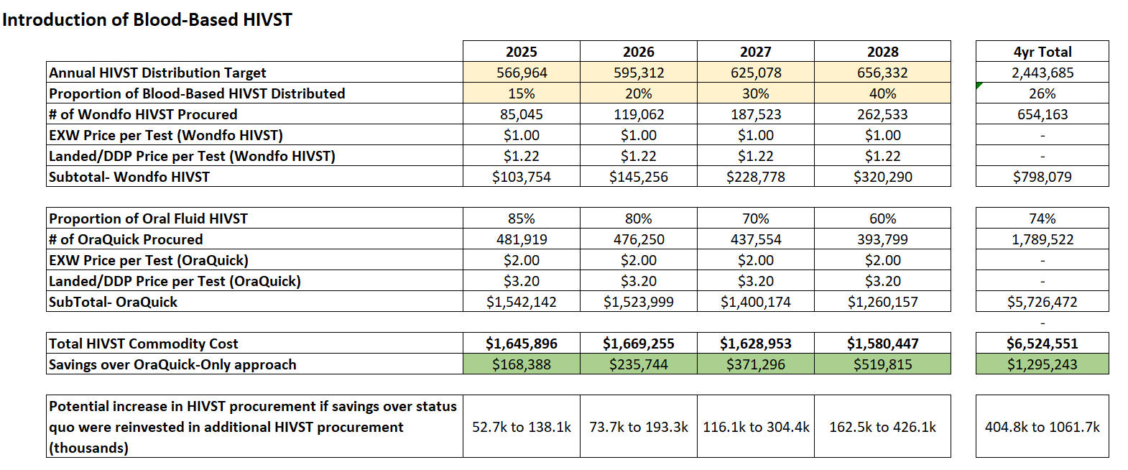
Compared to only using OraQuick, introducing a lower-price blood-based HIVST could save DHA >$1.2M over the next four years. If reinvested in procurement, this could allow for 0.4 - 1M additional HIVST (oral or BB) to be procured
Assumption: Low HIVST YOY Growth Volumes of 5%
Notes:
-CHAI developed a costing tool to calculate the potential savings from introducing a low-cost blood-based HIVST
-Compared to the status quo of procuring ~550,000 OraQuick HIVST each year, shifting 15% of procurement volume to a blood-based HIVST then steadily increasing that to 40% in four years, could save DHA $1.2 million over that time
-If DHA were to use those savings to procure additional HIVST, this would result in between 400k and 1M more HIVST (of either blood or oral) procured over four years compared to the status quo, depending on which HIVST is procured with those cost savings (low end estimate assumes purchasing more OraQuick, high end estimate assumes purchasing more Wondfo)

Slide 29
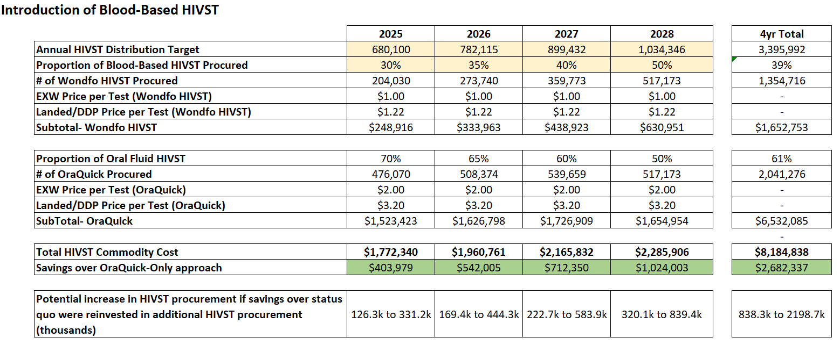
More aggressive scale up would net savings >$2.6M over four years and allow for an additional 0.8 to 2.2M HIVST to be procured without increasing the budget ceiling over the status quo OraQuick-only procurement
Assumption: High HIVST YOY Growth Volumes of 15%
Notes:
-With a more aggressive scale up, starting with 30% of procurement volume shifting to Wondfo and increasing to 50% in year four, DHA could increase savings to over $2.6 million
-If DHA were to use those savings to procure additional HIVST, this would result in between 840k and 2.2M more HIVST procured over four years compared to the status quo, depending on which HIVST is procured with those cost savings (low end estimate assumes purchasing more OraQuick, high end estimate assumes purchasing more Wondfo)
-CHAI will share the costing tool and DHA can input different scenarios

Slide 30
THANK YOU

